Slide 1
EPR Timeline in India
Food Safety and Standards Authority of India (FSSAI) guidelines for Bottle-to-Bottle Recycling
2016
2017
2018
2019
2020
2021
2022
CPCB imposes penalties to few big brands for incomplete compliance
Plastic Waste Management (PWM) Rules 2016 introduce EPR
CPCB empanels PRO's
CPCB issues SOP for EPR Compliance
Brands begin compliance of EPR
CPCB withdraws need for registration of PRO's
Draft Notification on EPR
PWM (Amendment) Rules 2022 - Guidelines on EPR for Plastic Packaging

Slide 2
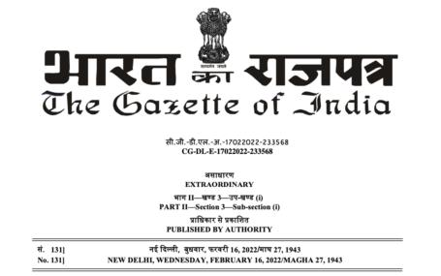
PWM (Amendment) Rules, 2022
Guidelines on EPR for Plastic Packaging
Provides framework for the implementation of Extended Producers Responsibility (EPR) in India.
Provide the roles and responsibilities of Producers, Importers, Brand Owners (PIBOs), Central Pollution Control Board (CPCB), State Pollution Control Board (SPCBs) or Pollution Control Committees, recyclers and waste processors.
Provides framework to strengthen circular economy of plastic packaging waste, promote development of new alternatives to plastics and provide further next steps for moving towards sustainable plastic packaging by businesses.

Slide 3
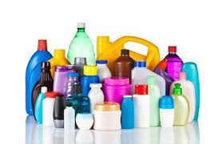
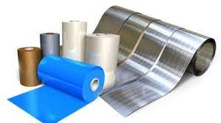
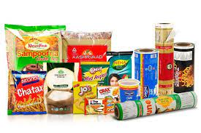
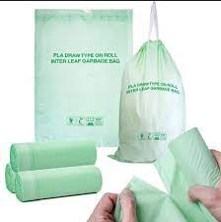
EPR for plastic packaging in India
Types of plastics covered under EPR for plastic packaging.
Category I Rigid plastic packaging
Category II Flexible plastic packaging of single layer or multilayer (more than one layer with different types of plastic)
Category III Multi-layered plastic packaging (at least one layer of plastic and at least one layer of other material)
Category IV Plastic sheet or like used for packaging as well as carry bags made of compostable plastics

