Slide 1
Form Changes from Module 1 to Module 1A

Slide 2

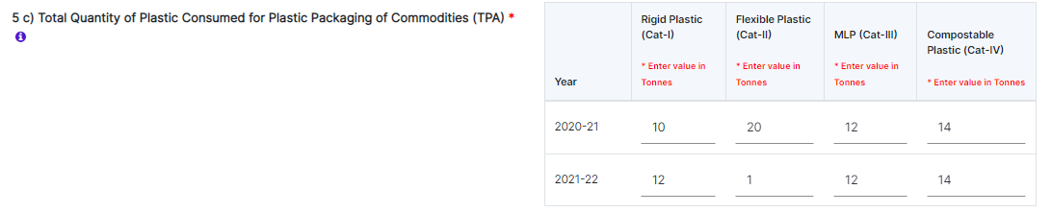
Changes in Section 5c
Module 1
Module 1A

Slide 3
Section 5c
Example table with key classification of plastic waste consumption
Section 5c is planned to be in a dynamic mode in which we shall be taking category wise plastic consumption figures for last two years.
For the first two years it is to be filled in subsequently, annual figures category wise need to be entered
Plastic consumed (Qty & Category) (5c) should match with state wise sales & preconsumer details in Section 7 (Alerts will be generated when there is a variation)
Year | Rigid Plastic (Cat-I) | Flexible Plastic (Cat-II) | MLP (Cat-III) | Compostable Plastic (Cat-IV)
2020-21 | 16.66 | 0 | 0 | 0
2021-22 | 16.66 | 0 | 0 | 0
2020-21 | 3.85 | 0 | 0 | 0
2021-22 | 3.99 | 0 | 0 | 0

Slide 4
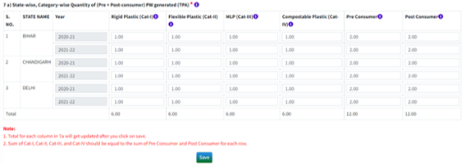
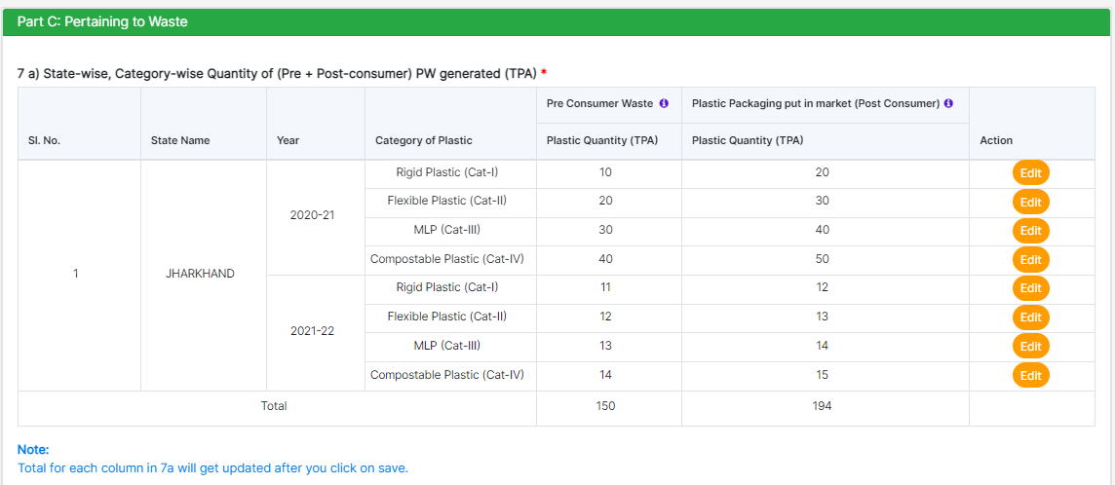
Section 7
Module 1
Module 1A

Slide 5
Section 7
Producers and Brand Owners
Details in section 7 are to be filled (annually) at the time of application / filing of annual returns / renewal
State wise Pre/Post consumer (Cat I /Cat II/Cat III/Cat IV) and percentage of recycled plastic in each category is to be provided
Points to Remember:
Percentage of recycled plastic used should be between 0 to 100.
If virgin plastic is used, percentage of recycled plastic will be zero.
Producer can sell to unregistered entities also and only that will be included in EPR target calculation.
For Cat 4 – Percentage of recycled content will always be taken as 0
7 a) State-wise, Category-wise Quantity of Plastic Packaging Used (TPA)
STATE NAME | Year | Category of Plastic | Pre Consumer Waste |  | Plastic Packaging put in market (Post Consumer)
 |  |  | Plastic Quantity (TPA) | Recycled Plastic % | Plastic Quantity (TPA) | Recycled Plastic %
Importers
7 a) State-wise, Category-wise Quantity of Plastic Packaging Used (TPA)
STATE NAME | Year | Category of Plastic | Pre Consumer Waste | Plastic Packaging put in market (Post Consumer)
 |  |  | Plastic Quantity (TPA) | Plastic Quantity (TPA)

Slide 6
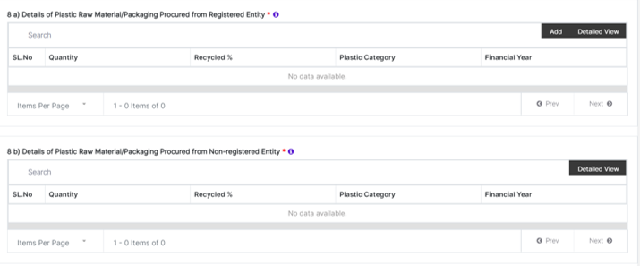
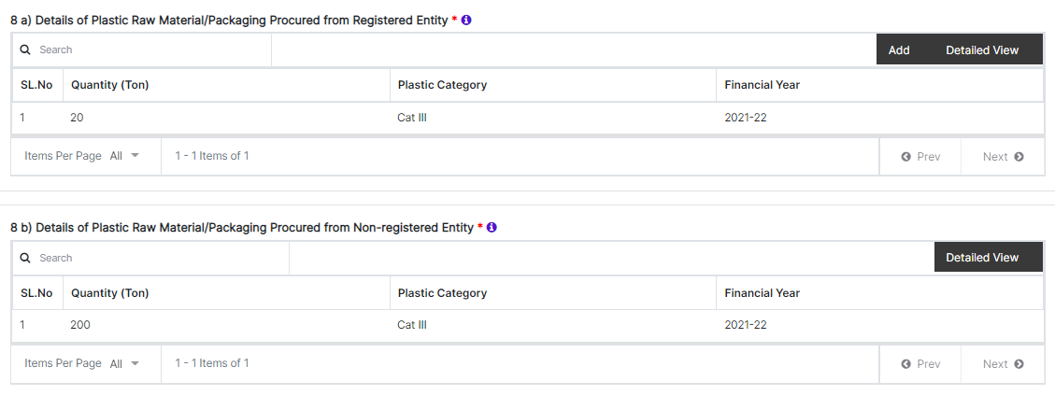
Section 8
Module 1
Module 1A

Slide 7
Section 8 (Brand Owners)
Plastic material type is to be entered by the brand owners in section 8(a) & 8(b) with the corresponding category of plastic
Points to Remember:
Validation of transactions will be done between registration entities through EPR invoice number
Plastic procured (Qty & Category) should match with state wise sales & pre-consumer details (Alerts will be generated when there is a variation)
Provision for uploading data in excel sheet is provided in Section 8
Total amount(quantity) will be reflected in each subsection of Section 8
8 a) Details of plastic raw material procured from registered entity
Name of Entity | State | Address | Mobile Number | Plastic Material Type | Category of Plastic | Year | Quantity (TPA) | Recycled Plastic %
Will be automatically fetched by the system |  |  |  | HDPE/PP/LDPE/LLDPE/PET/PVC/PLA-PBAT-Compostable to plastic/Others | CAT 1 CAT II CAT III CAT IV
8 b) Details of plastic raw material procured from non-registered entity

Slide 8
Section 8 (Producers)
Plastic material type is to be entered by the brand owners in section 8(a) & 8(b) with the corresponding category of plastic
Points to Remember:
Validation of transactions will be done between registration entities through EPR invoice number.
Total amount(quantity) will be reflected in each subsection of Section 8
8 a) Details of plastic raw material procured from registered entity
Name of Entity | State | Address | Mobile Number | Plastic Material Type | Category of Plastic | Year | Quantity (TPA) | Recycled Plastic %
Will be automatically fetched by the system |  |  |  | HDPE/PP/LDPE/LLDPE/PET/PVC/PLA-PBAT-Compostable to plastic/Others | CAT 1 CAT II CAT III CAT IV
8 b) Details of plastic raw material procured from non-registered entity
8 c) Details of Plastic Raw material sold to registered PIBOs
8 d) Details of Plastic Raw material sold to non-registered PIBOs

Slide 9
Section 8 (Importers)
Plastic material type is to be entered by the brand owners in section 8(a) & 8(b) with the corresponding category of plastic
Points to Remember:
Validation of transactions will be done between registration entities through EPR invoice number
Total amount(quantity) will be reflected in each subsection of Section 8
8 a) Details of plastic raw material procured from registered entity
Name of Entity | State | Address | Mobile Number | Plastic Material Type | Category of Plastic | Year | Quantity (TPA) | Recycled Plastic %
Will be automatically fetched by the system |  |  |  | HDPE/PP/LDPE/LLDPE/PET/PVC/PLA-PBAT-Compostable to plastic/Others | CAT 1 CAT II CAT III CAT IV
8 b) Details of plastic raw material procured from non-registered entity
8 c) Details of Plastic Raw material sold to registered PIBOs
8 d) Details of Plastic Raw material sold to non-registered PIBOs

Slide 10
Section 8 – Key Points to remember
Percentage of recycled plastic used should be between 0 to 100.
For Entity type as PWP – Percentage of recycled content will always be greater than zero.
For Entity type as Manufacturer – Percentage of recycled content will always be equal to zero.
For Category of plastic as CAT 4 – Percentage of recycled content will always be equal to zero.

Slide 11

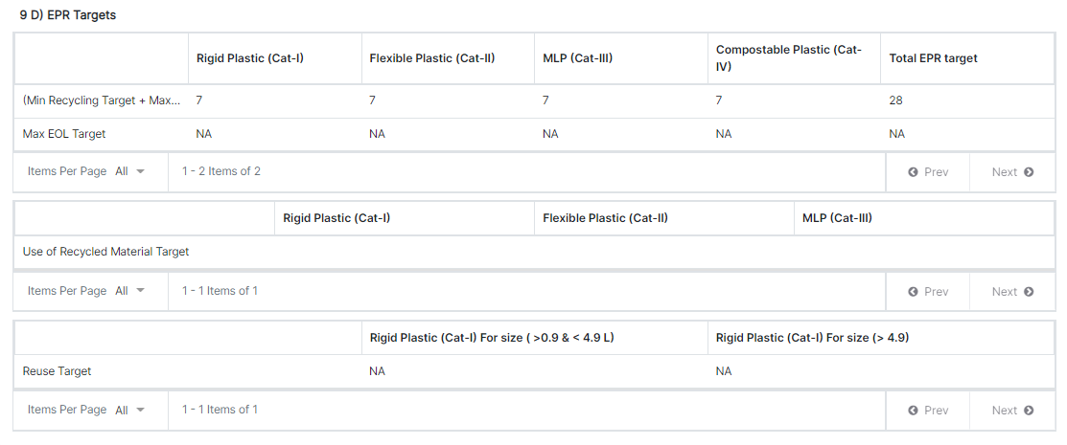
EPR TARGETS: Section 9 – for Brand Owners and Importers; Section 10 for Producers
Module 1
Module 1A

