Slide 1
Recycler unit operations

Slide 2

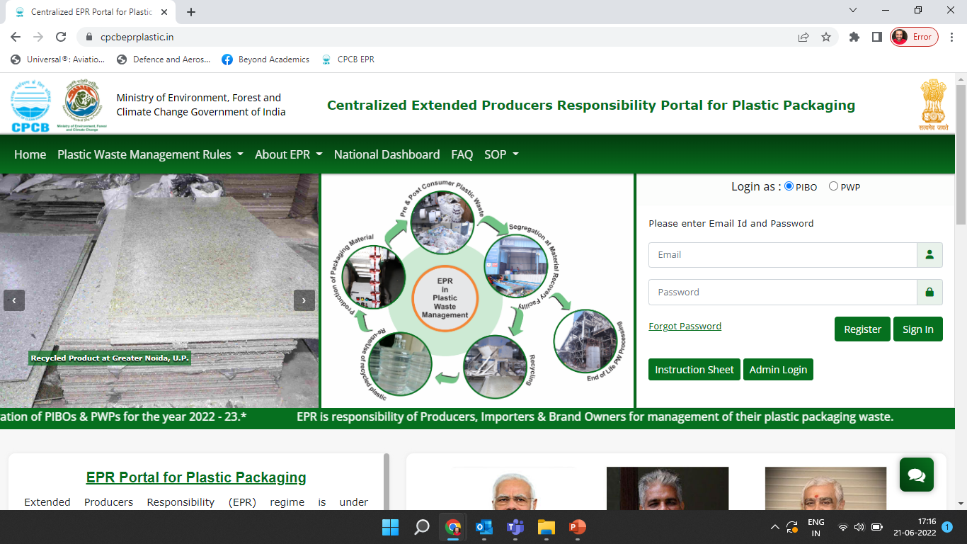

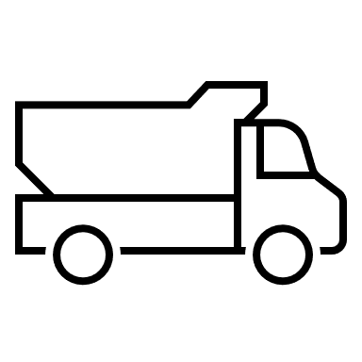


Reporting operations of the facility to generate EPR Certificates
CPCB EPR Portal
Production details
Sales details
Generation of certificates
Procurement details
Category wise Plastic Waste
Procurement
Production at the Recycling unit
Sales

Slide 3
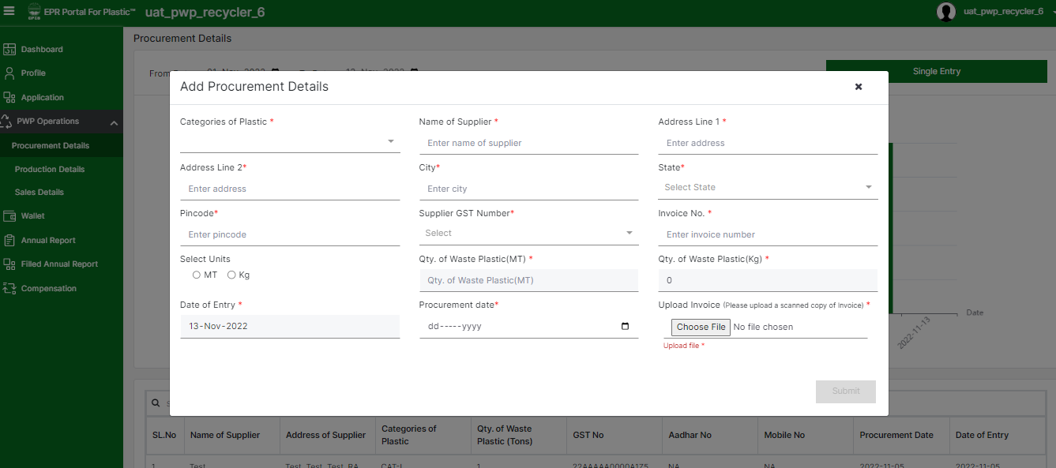
Recycler Unit Operation: Procurement details
Daily/Weekly/Monthly category wise plastic waste procurement details have to be provided by the recycler units

Slide 4
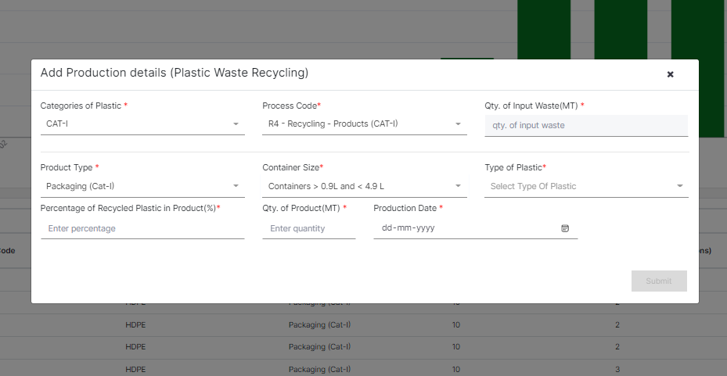
Recycler Unit Operation: Production details
In the production details section, click on the single entry button to add a production entry
Categories of plastic, process code used, type of product, type of plastic and percentage of recycled plastic to be provided in the production details
Container size have to be provided for Cat-I(Process Code as R4 – Recycling – Products & Product type as Packaging Cat-I)
The quantity of plastic waste processing will be auto-calculated based on conversion factors confirmed during physical verification by RO.
The cumulative procurement should be more than or equal to the cumulative plastic waste processed (category-wise)

Slide 5
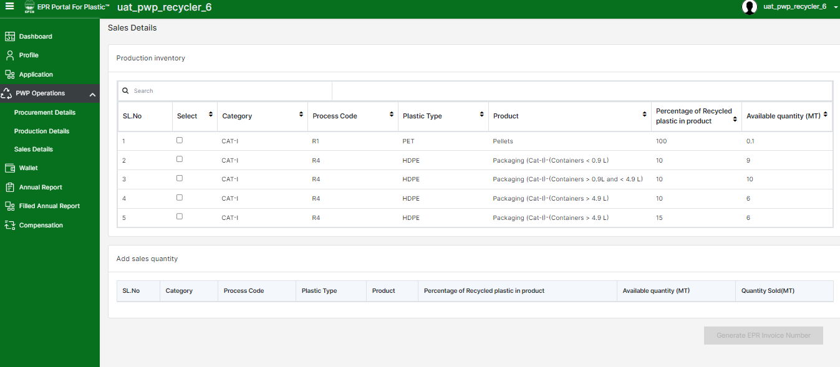
Recycler Unit Operation: Sales details
Products from the inventory must be selected and the corresponding quantities sold to be provided
User needs to confirm the sales details before generating invoice number
Corresponding potential for EPR Certificate Generation shall be reflected in the Wallet

Slide 6
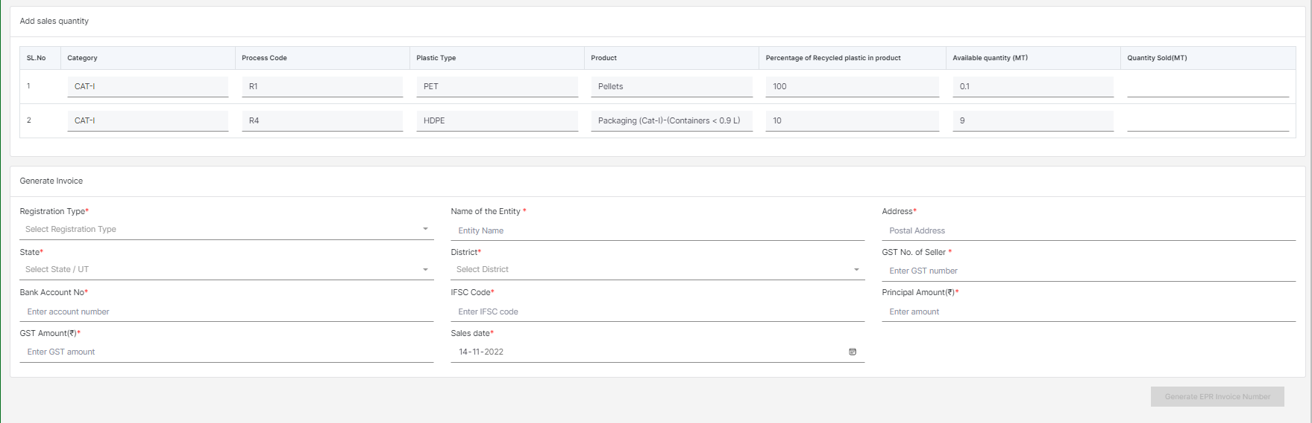
Recycler Unit Operation: Sales details (contd.)
The recyclers need to provide the details of the unit to whom the products are sold and finally generate EPR invoice for the same
Products selected from the production inventory are available for sales.
Recyclers need to provide the quantity to be sold
To generate the invoice, entity details and invoice details to be provided
User needs to confirm the sales details before generating invoice number
Corresponding potential for EPR Certificate Generation shall be reflected in the Wallet

Slide 7
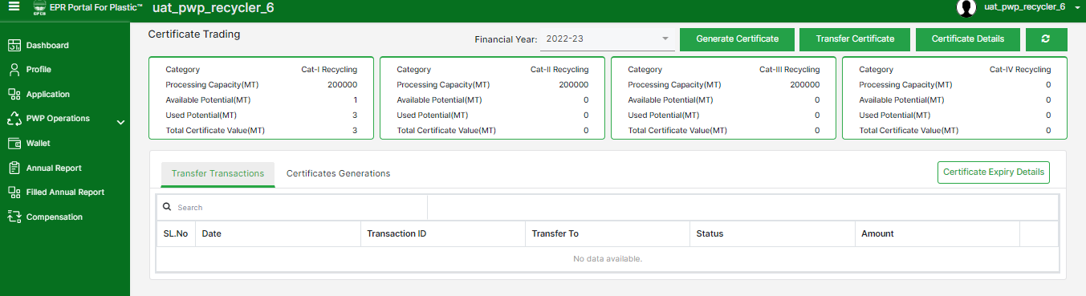
Recycler - Wallet
The wallet of the PWP displays Category Wise details of the Certificate Potential.
Processing Capacity is the maximum amount of plastics that can be processed by a PWP in an F.Y.
Total Potential is the quantity of plastic processed by a PWP in an F.Y.
Available Potential is the maximum value of certificates that can be generated.
Used Potential is the maximum value of certificates that can be generated.
Certificate Value is the value of generated certificates that are available for transfer.

Slide 8
Recycler Unit operation under EPR
Recycler Unit can generate their potential EPR certificates by filling following details
1 | Category wise quantity of plastic waste collected
2 | Quantity of plastic waste processed: 1/10/50/100/500/ 1000 Tonnes
3 | GST details and invoice of transaction
4 | Duration of the processing (From Date - To Date)
5 | Details of entity to whom the product is sold
6 | Date of transaction
7 | GST details and invoice of transaction for outputs

