Slide 1
Cement Co-processing units

Slide 2

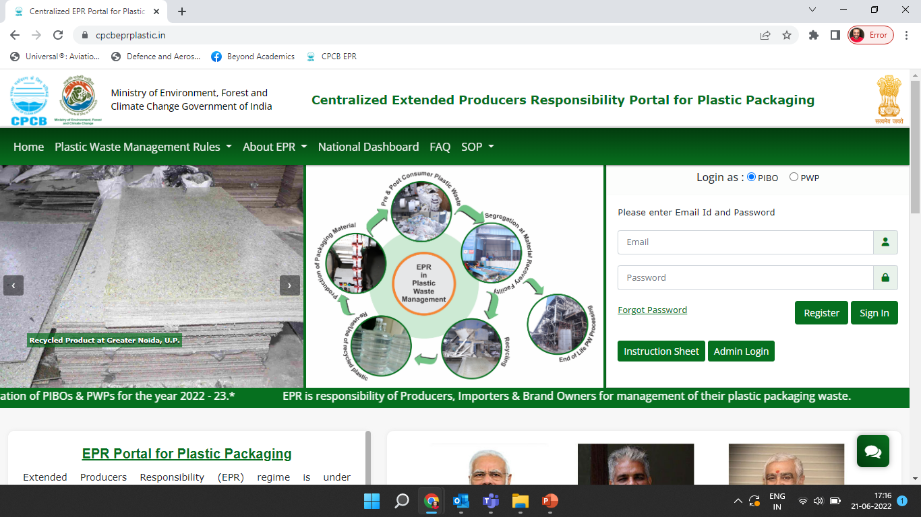





Reporting operations of the facility to generate End of life EPR Certificates
CPCB EPR Portal
Production details
Sales details
Generation of certificates
Procurement details
Test Report
Waste Feed
Procurement
Cement Coprocessing
Sales

Slide 3
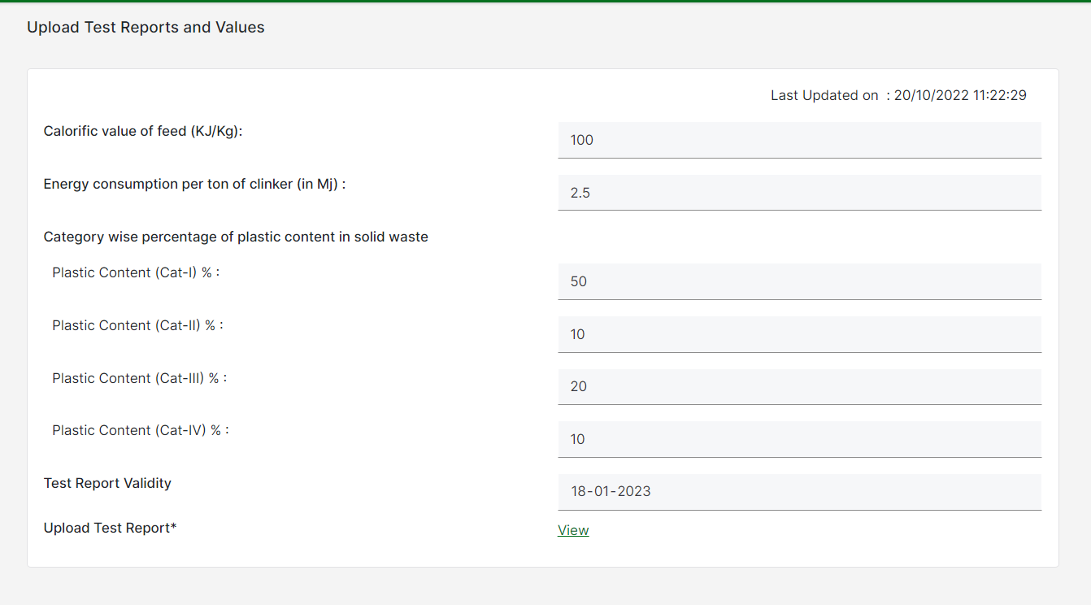
Upload Test reports
Add details in the Test Report form
Co-processing units have to update these test reports every three months
Test reports should include calorific value of feed to boiler and the plastic waste categorization to be provided
Energy Consumption per Ton of Clinker is from the Physical Verification of the PWP

Slide 4
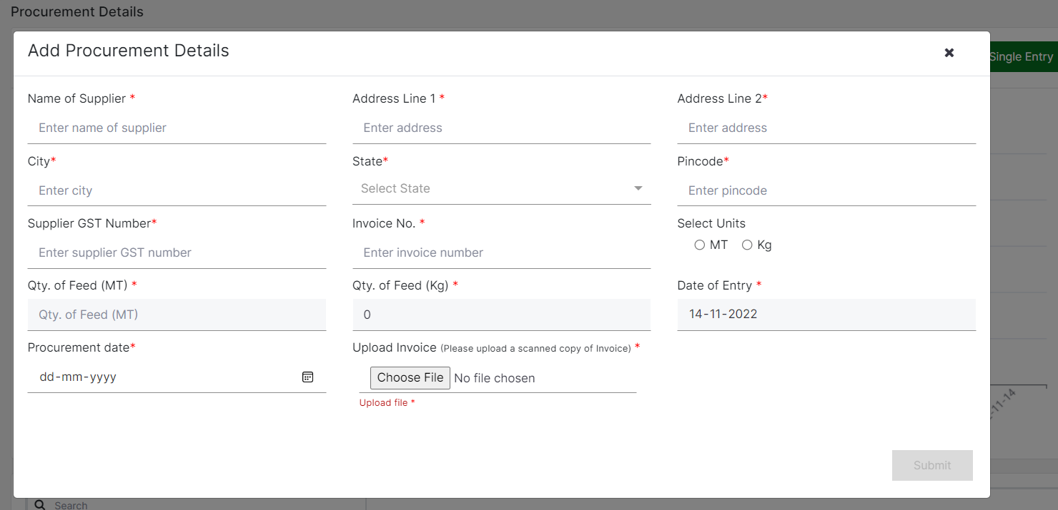
Procurement details
Daily/Weekly/Monthly plastic waste(feed) procurement details have to be provided by the co-processing units
Supplier GST number is mandatory to be entered during adding procurement details

Slide 5
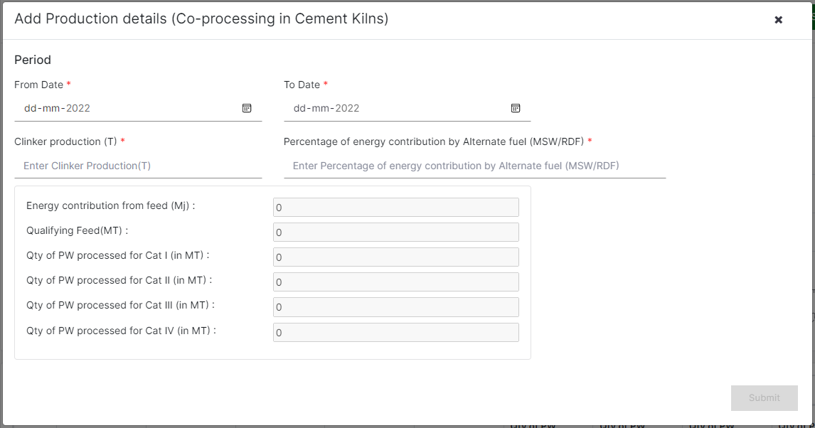
Production details
Quantity of clinker produced should be provided in the production details. Dates of production (start date and end date) to be provided
Percentage of energy contribution by alternate fuel (MSW/RDF) to be provided
Category wise quantity of plastic processed shall be calculated based on the Test Report and the Clinker Production & AFR

Slide 6
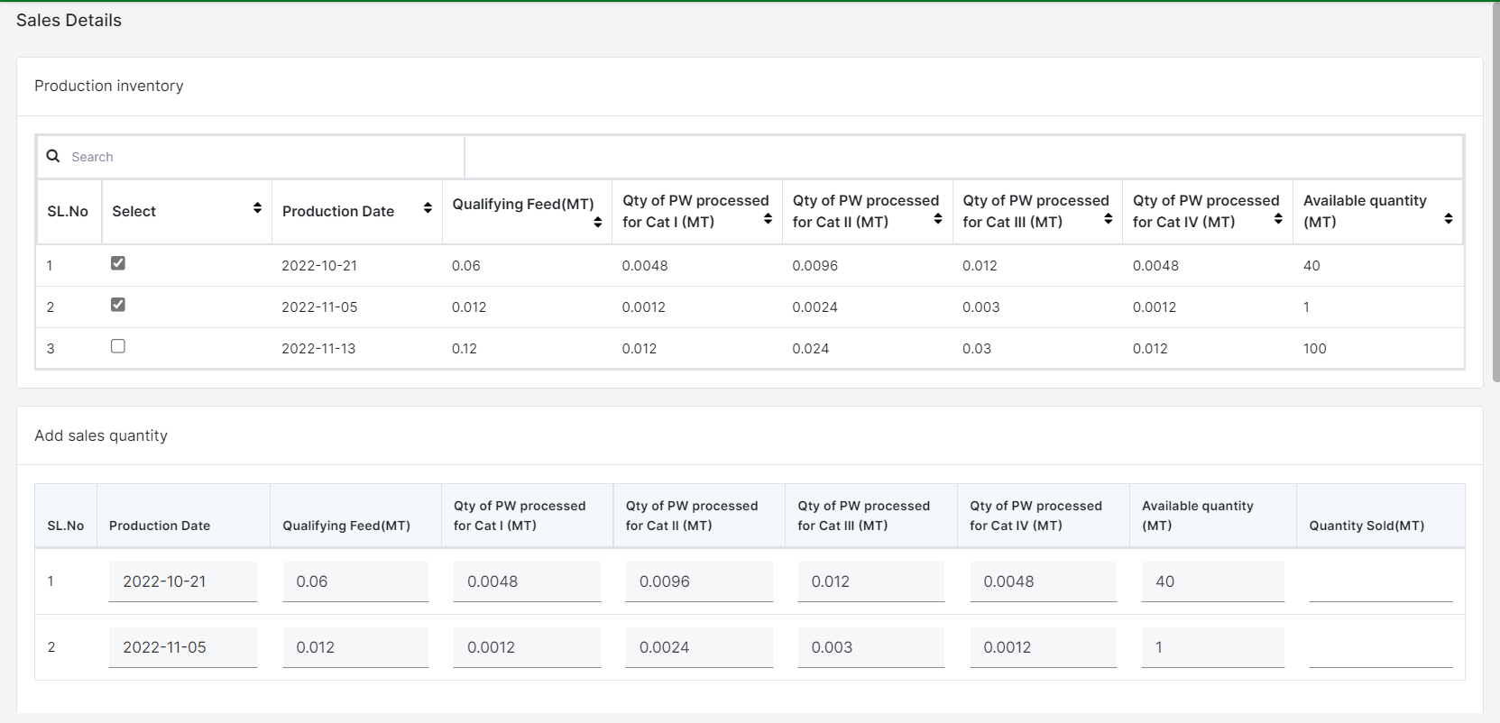
Sales details
Products from the inventory must be selected and the corresponding quantities sold to be provided

Slide 7
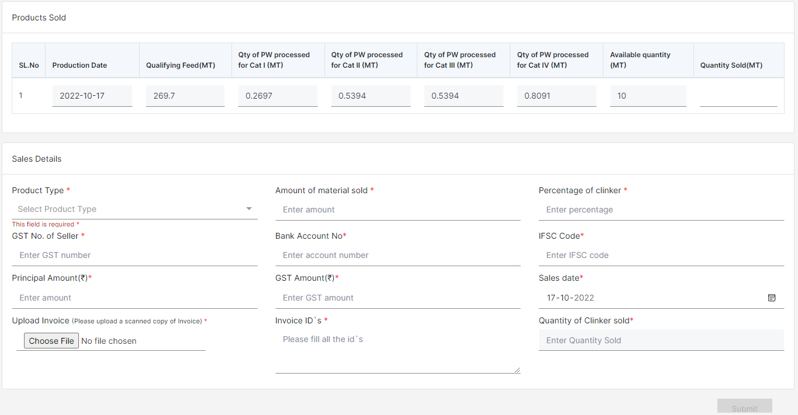
Sales details (contd.)
If the product to be sold is clinker, then the percentage of clinker will be auto-populated to 100 %.
If the product sold is cement, then the co-processing unit needs to provide the percentage of clinker used in the quantity of cement sold
The co-processing units need to provide the details of the unit to whom the products are sold and finally generate EPR invoice for the same
User needs to confirm the sales details before generating invoice number
Corresponding potential for EPR Certificate Generation shall be reflected in the Wallet

Slide 8
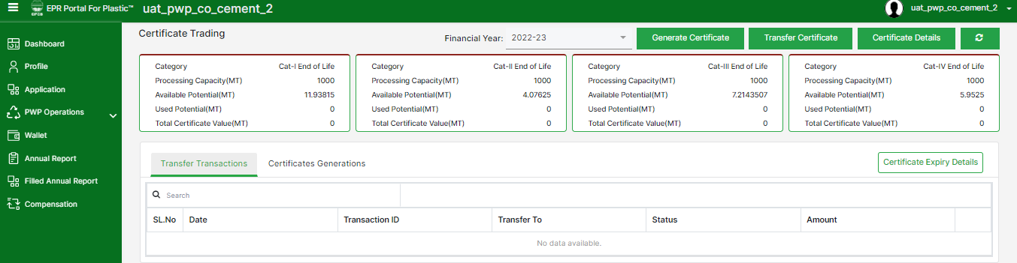
CEMENT co-processing - Wallet
The wallet of the PWP displays Category Wise details of the Certificate Potential.
Processing Capacity is the maximum amount of plastics that can be processed by a PWP in an F.Y.
Total Potential is the quantity of plastic processed by a PWP in an F.Y.
Available Potential is the maximum value of certificates that can be generated.
Used Potential is the maximum value of certificates that can be generated.
Certificate Value is the value of generated certificates that are available for transfer.
Certifcates can be generated & Transferred in this section

