Slide 1
Waste to energy units

Slide 2

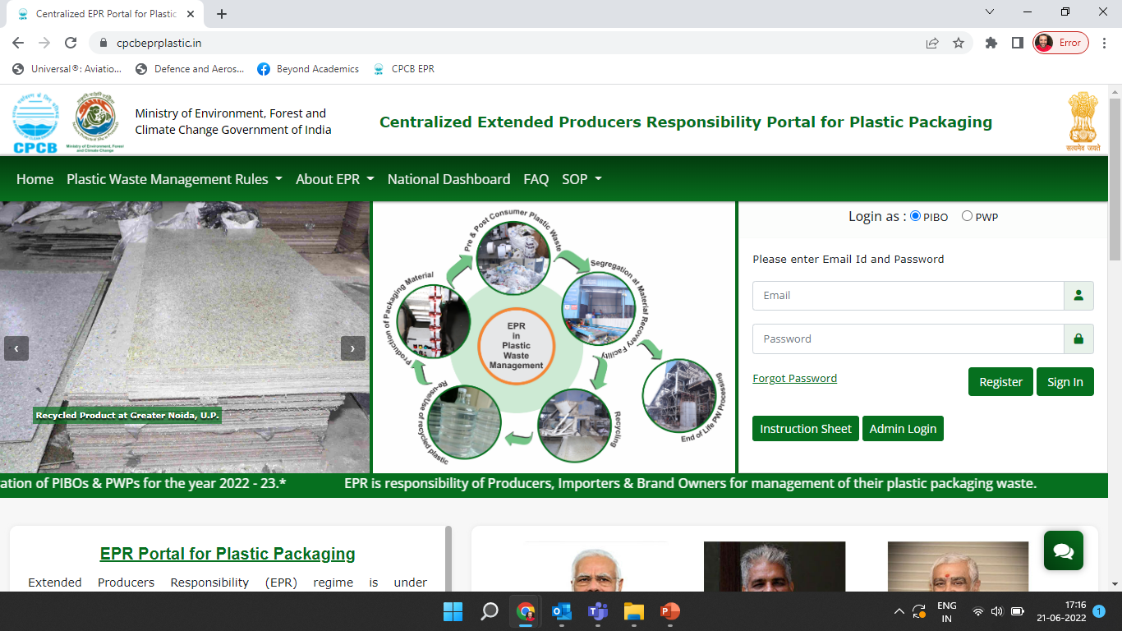




Reporting operations of the facility to generate EPR Certificates
CPCB EPR Portal
Production details
Generation of certificates
Procurement details
Test Report
Waste Feed
Procurement
Waste to Energy

Slide 3
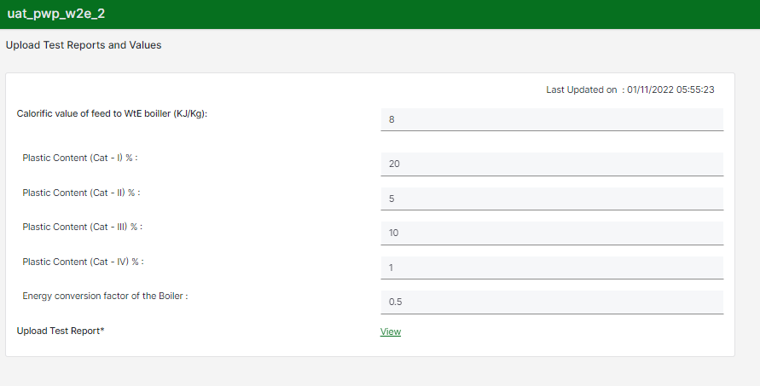
test report
Add details in the Test Report form
WtE units have to update these test reports every three months
Test reports should include calorific value of feed to boiler and the plastic waste categorization to be provided
Energy consumption factor of the Boiler is as per the Physical verification of the unit conducted by SPCB

Slide 4
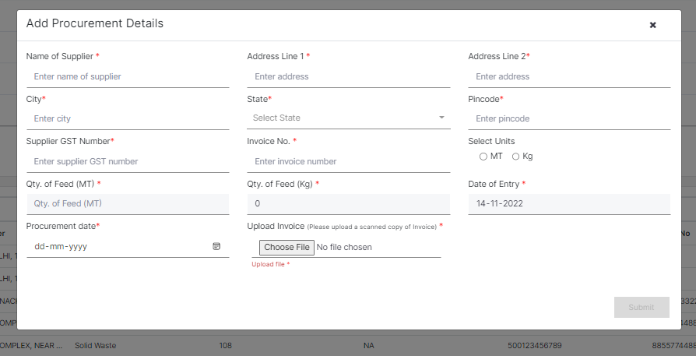
Procurement details
Daily/Weekly/Monthly plastic waste(feed) procurement details have to be provided by the WtE units
Supplier GST number is mandatory to be entered during adding procurement details

Slide 5
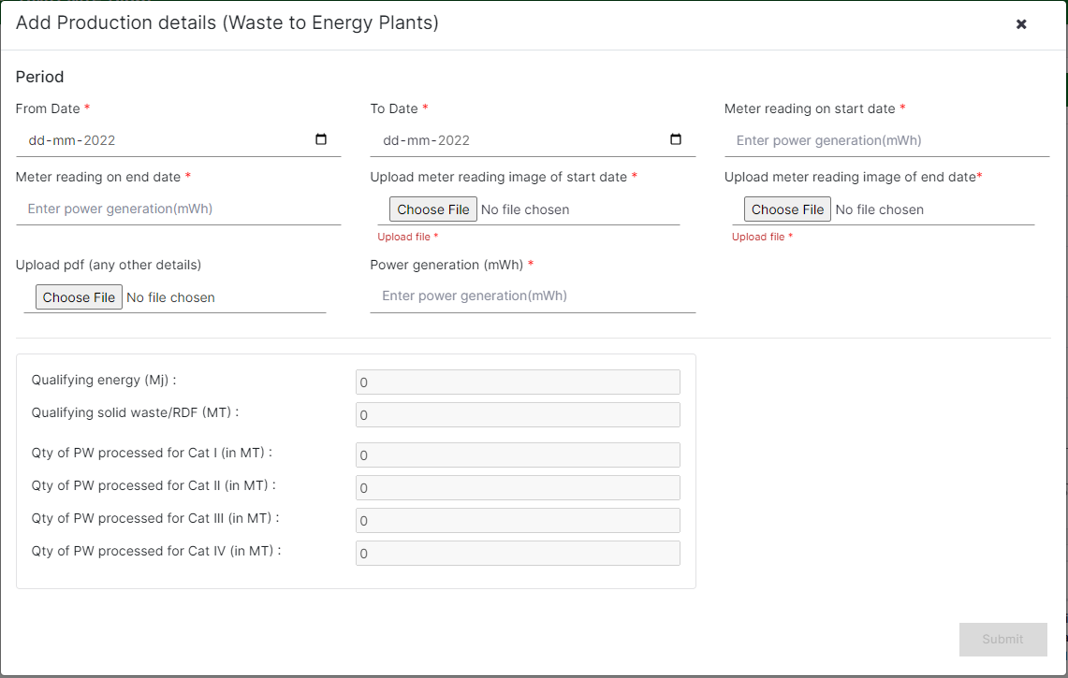
Production details
Meter readings and the picture of meter readings along with the power generation should be provided in the production details
Overlap in start date and end date is not allowed
Categorywise quanity processed shall be calculated based on the Test Report and the Power Generation
Corresponding potential for EPR Certificate Generation shall be reflected in the Wallet

Slide 6
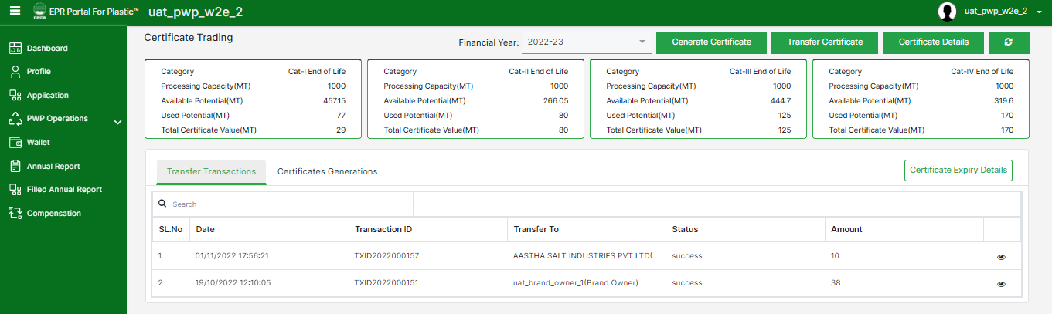
WtE - Wallet
The wallet of the PWP displays Category Wise details of the Certificate Potential.
Processing Capacity is the maximum amount of plastics that can be processed by a PWP in an F.Y.
Total Potential is the quantity of plastic processed by a PWP in an F.Y.
Available Potential is the maximum value of certificates that can be generated.
Used Potential is the maximum value of certificates that can be generated.
Certificate Value is the value of generated certificates that are available for transfer.
Certificates can be generated & transferred in this section

