Slide 1
Waste to oil units

Slide 2

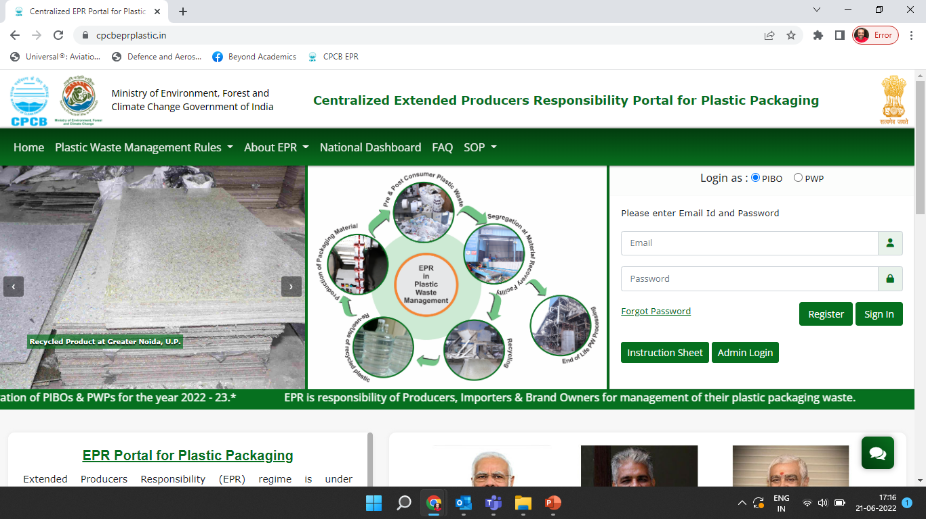





Reporting operations of the facility to generate EPR Certificates
CPCB EPR Portal
Production details
Sales details
Generation of certificates
Procurement details
Test Report
Waste
Procurement
Waste to Oil Facility
Sales

Slide 3
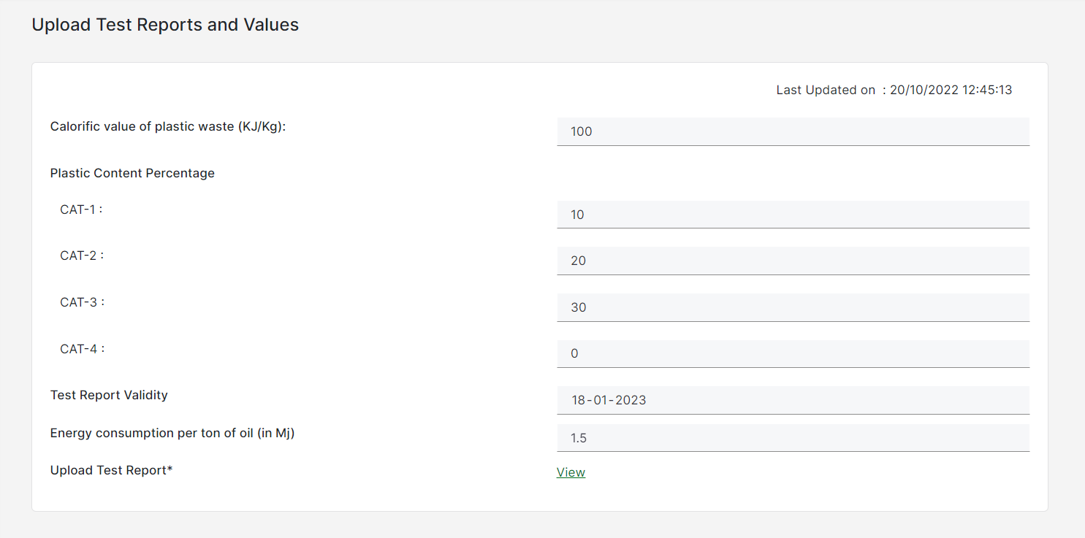
test report
Add details in the Test Report form
WtO units must update these test reports every three months
Test reports should include calorific value of feed to boiler and the plastic waste categorization to be provided
Energy Consumption per Ton of Oil is fixed and is as per the Physical verification of PWP by SPCB/PCC

Slide 4
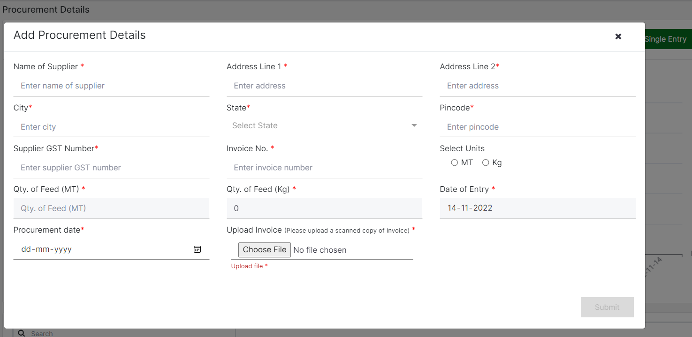
Procurement
Daily/Weekly/Monthly plastic waste(feed) procurement details have to be provided by the WtO units
Supplier GST number is mandatory to be entered during adding procurement details

Slide 5
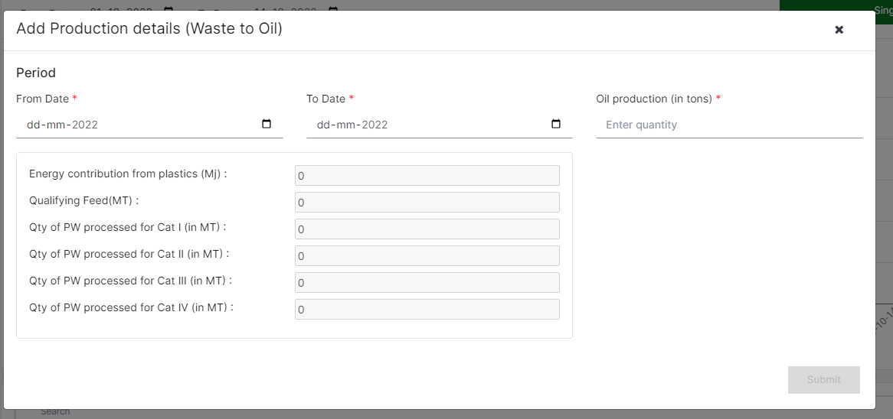
Production details
Quantity of oil produced should be provided in the production details
Overlap in start date and end date is not allowed
Categorywise Plastic Waste processed is calculated based on the oil produced and the test report

Slide 6
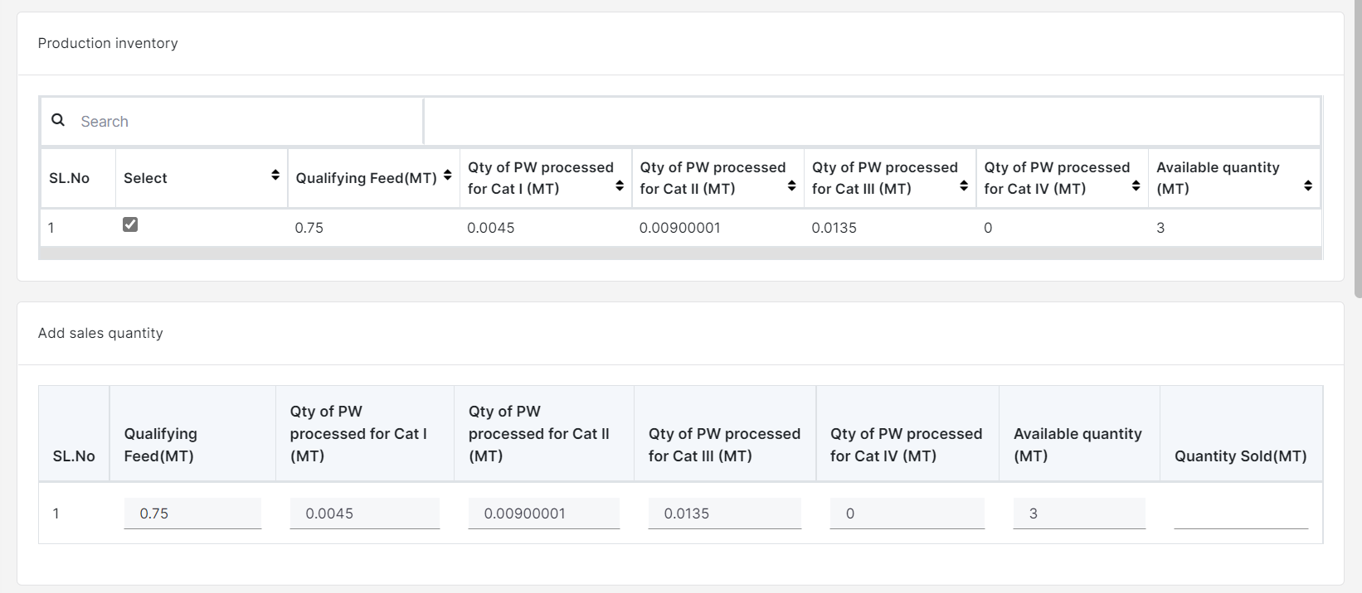
Sales details
Products from the inventory must be selected and the corresponding quantities sold to be provided
User needs to confirm the sales details before generating invoice number
Corresponding potential for EPR Certificate Generation shall be reflected in the Wallet

Slide 7
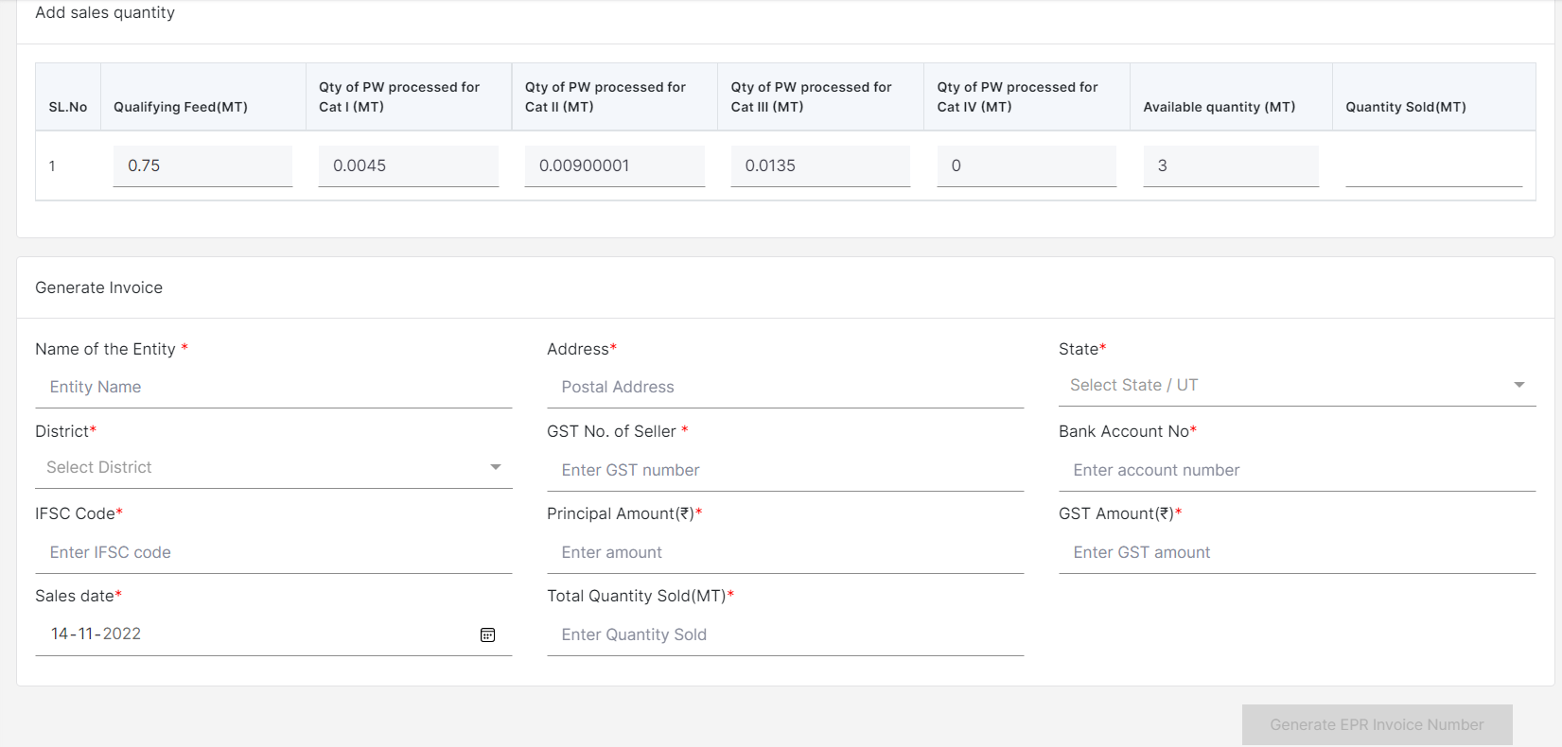
Sales details (CONTD.)
The WtO units need to provide the details of the unit to whom the products are sold and finally generate EPR invoice for the same
Products selected from the production inventory are available for sales.
WtO units need to provide the quantity to be sold
To generate the invoice, entity details and invoice details to be provided

Slide 8
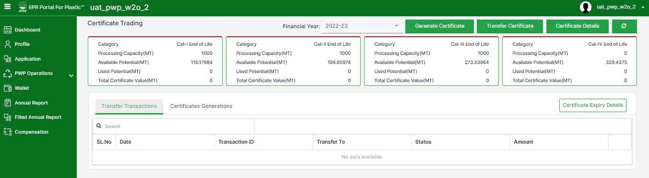
WtO - Wallet
The wallet of the PWP displays Category Wise details of the Certificate Potential.
Processing Capacity is the maximum amount of plastics that can be processed by a PWP in an F.Y.
Total Potential is the quantity of plastic processed by a PWP in an F.Y.
Available Potential is the maximum value of certificates that can be generated.
Used Potential is the maximum value of certificates that can be generated.
Certificate Value is the value of generated certificates that are available for transfer.

