Slide 1
Certificate potential
The generation of EPR certificates is done using the CP (Certificate Potential).
Total Potential is the measure of the quantum of plastic processed by a PWP in an F.Y.
The Certificate Potential details is available in the Wallet of the PWP.
The Certificate Potential is generated Category Wise and is limited to the Category Wise Processing Capacity of the PWP as declared in the registration application.
At any point in time, the maximum value of the certificates that can be generated is given by the Available Potential.
If the Available Potential is 0, the PWP will be unable to generate certificates.

Slide 2
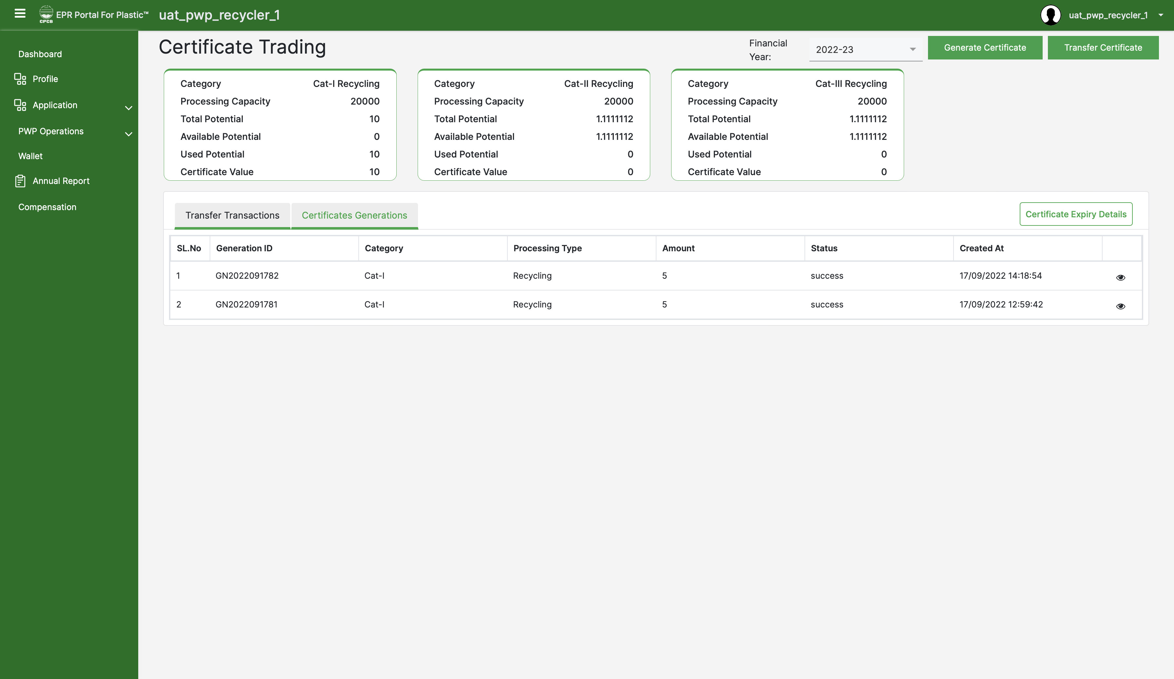
PWP WALLET
The wallet of the PWP displays Category Wise details of the Certificate Potential.
Processing Capacity is the maximum amount of plastics that can be processed by a PWP in an F.Y.
Total Potential is the quantity of plastic processed by a PWP in an F.Y.
Available Potential is the maximum value of certificates that can be generated.
Used Potential is the maximum value of certificates that can be generated.
Certificate Value is the value of generated certificates that are available for transfer.

