Slide 1

Important Definitions
“Biodegradable Plastics” means that plastics, other than compostable plastics, which undergoes complete degradation by biological processes under ambient environment (terrestrial or in water) conditions, in specified time periods, without leaving any micro plastics, or visible, distinguishable or toxic residue, which have adverse environment impacts, adhering to laid down standards of Bureau of Indian Standards and certified by Central Pollution Control Board.
“End of Life disposal” means using plastic waste for generation of energy and includes co-processing (e.g., in cement kilns) or waste to oil or for road construction as per Indian Road Congress guidelines, etc.

Slide 2
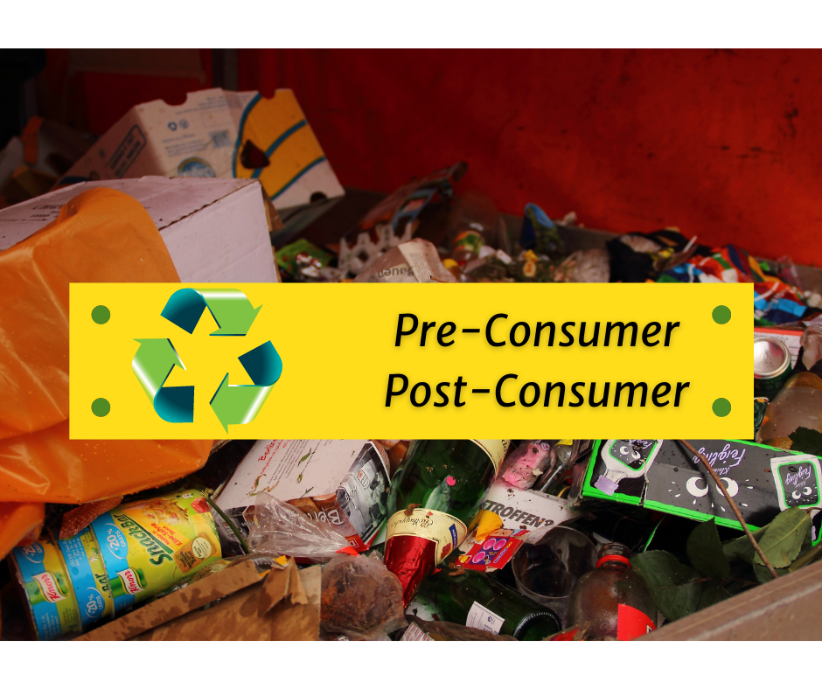
Important Definitions
“Pre-consumer plastic packaging waste” means plastic packaging waste generated in the form of reject or discard at the stage of manufacturing of plastic packaging and plastic packaging waste generated during the packaging of product including reject, discard, before the plastic packaging reaches the end-use consumer of the product.
“Post-consumer plastic packaging waste” means plastic packaging waste generated by the end-use consumer after the intended use of packaging is completed and is no longer being used for its intended purpose.

Slide 3
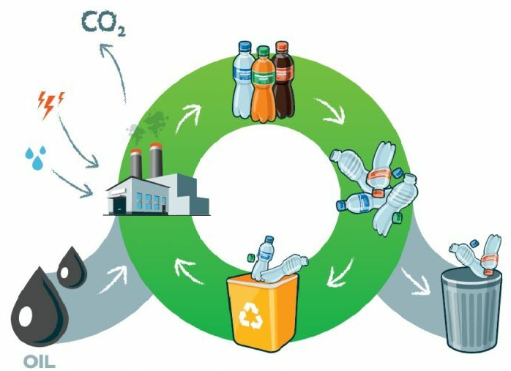
Important Definitions
“Recycling” means the process of transforming segregated plastic waste into a new product or raw material for producing new products.
“Reuse” means using an object or resource material again for either the same purpose or another purpose without changing the object's structure.
“Use of recycled plastic” means recycled plastic, instead of virgin plastic, is used as raw material in the manufacturing process;
“Waste to Energy” means using plastic waste for generation of energy and includes co-processing (e.g. in cement kilns).

Slide 4

PIBOs and PWPs
Producers (P) of plastic packaging
Importers (I) of all imported plastic packaging and or plastic packaging of imported products
Brand Owners (BO) including online platforms/marketplaces and supermarkets/retail chains other than those, which are micro and small enterprises as per the criteria of Ministry of Micro, Small and Medium Enterprises, Government of India.
Plastic Waste Processors (PWPs) means recyclers and entities engaged in using plastic waste for energy (waste to energy), and converting it to oil (waste to oil), industrial composting.
*As per the Ministry of MSME, this includes any company with a turnover of Rs 50 Cr+.
Notes:
Any brand (PIBO) that has a turnover of <50 Cr is exempt from compliance.

