Slide 1
APPLICATION FORM FORMAT
Part A: General Details
Part B: Effluent & Emissions
Part C: Procurement/ Sales/ Waste Generation
Part D: EPR Action Plan

Slide 2
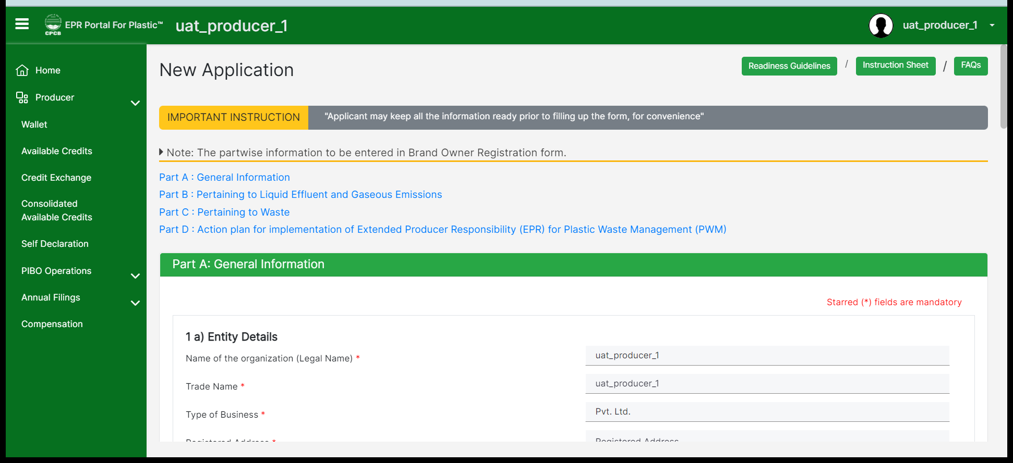
Producer
Requested Information is required to be entered in each section.
Part A: General Information for Producer.
Note: All mandatory fields marked in red asterisk are to be filled in so that you can move forward. Make sure to save the section at each stage so that you do not lose any data.

Slide 3
Part A: General Details – 1A
Legal Name, Trade name, Type of business: As appearing on GST Certificate
PAN: To be issued in Legal name of Entity
CIN: To be provided by Pvt/Public/ LPP firms registered in Company Act
GST: Combined GST of all States /UTs in which the Entity is operational
IEC: To be provided for importer
Category Document: Micro/Small Brand owners not to apply for Registration

Slide 4
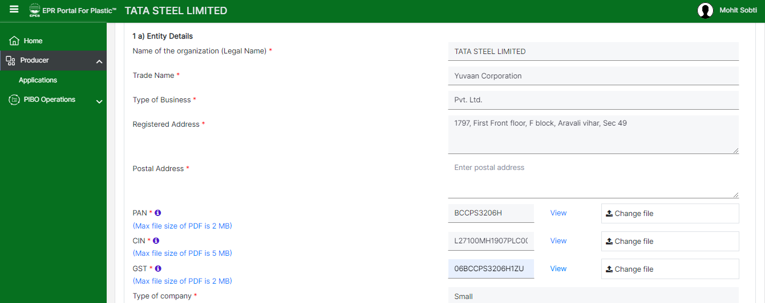
producer
Part A: General Information for Producer.
The following data need to be provided:
Postal Address pdf file
PAN card pdf file
CIN pdf file
GST pdf file
The rest of the fields marked in grey get auto-populated from the signup form.
Note: All mandatory fields marked in red asterisk are to be filled in so that you can move forward. Make sure to save the section at each stage so that you do not lose any data.

Slide 5
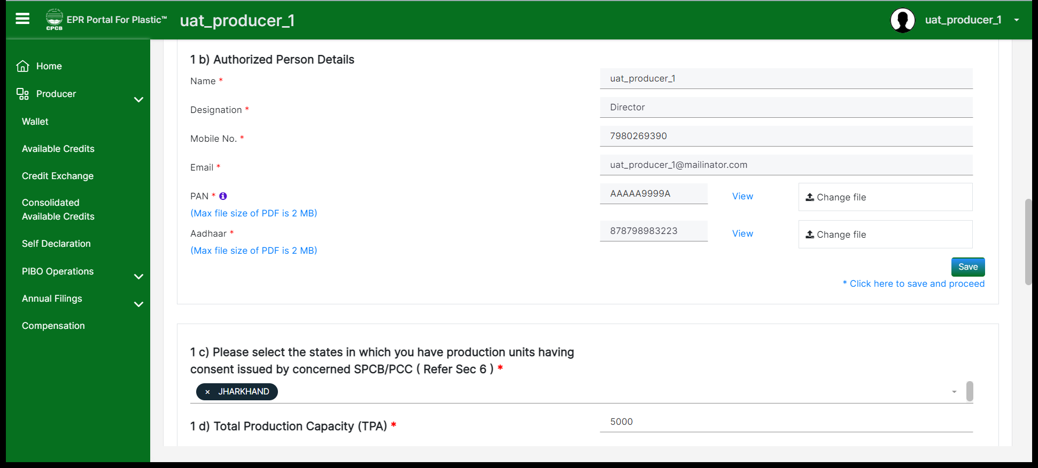
producer
Part A - 1(c): Please note that ​if you are operating (having manufacturing/production units) in one state. Only one state/UT to be selected. If you are operating in two states, it is required to apply for the second state separately.
In case of multiple units( one state or multi state) separate application for each unit to be submitted.

Slide 6
General Details:1(c) No. of States/UT in which the entity is operational
BO/Importer: Select states in which marketing products
Producer: States in which it is having production units
One State: Application is forwarded to the concerned State/UT
Two State: Application for first State /UT to be filed
Application for 2nd State/UT to be filed separately (no fees required for 2nd Application )
Application will get forwarded to the concerned States operating in 1 or 2 States
For more than two States – Application shall be forwarded to CPCB

Slide 7
Part A: POINTS TO REMEMBER
Registration Status: Fresh /Renewal to be correctly filled in
Date of issue, validity date, registration no. & Certificate to be provided
Cases due for renewal should not file application as fresh
DIC Certificate to be submitted by entities having Production facility
Plastic consumption / Waste Generation >Zero, if year of commencement is < 1 year
Consumption of Plastic in packaging only to be included (5c)
Plastic consumed in manufacture of commodities not to be included (5c)
Raw material /Product /process steps to be clearly indicated in PFD (Producers)
5d. Confirmation that SUP products/Carry bags (>75 micron )/ Sheets (> 50 micron); Nonwoven bags > 60 GSM are not being manufactured/Sold
5e: Process flow Diagram(PFD) (for producers only)

Slide 8
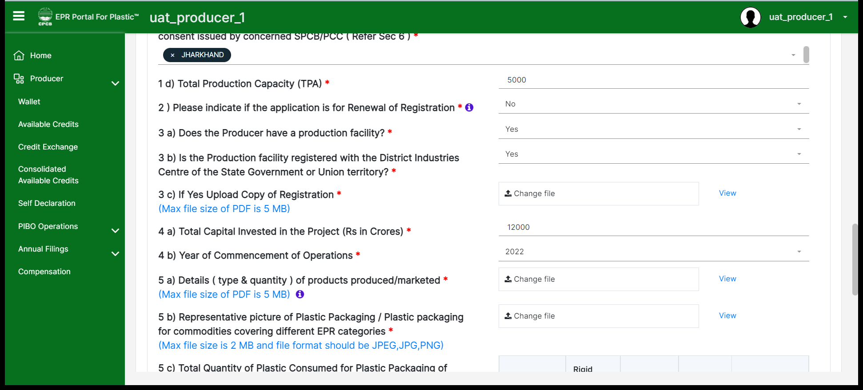
producer
Details about production capacity, facility and type & quantity of products produced/marketed to be provided.
Representative picture can be provided in 5(b) highlighting few of the products.

Slide 9
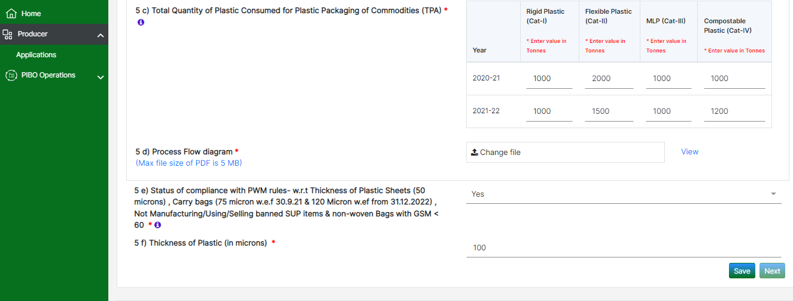
producer
Total plastic consumed (used for production) year wise should be provided based on its categories in the last two financial years.
Process flow diagram clearly specifying raw material, product and Operations of the unit should be uploaded.
Single Use Plastic (SUP) compliance should be ensured and stated in 5(e) as per the directions by CPCB for SUP. In section 5(f), thickness of the plastic should be specified.

Slide 10
Part b: Emissions and effluent related details
Consent details of production facility - Validity date & CTO (Air/Water) document to be uploaded
Consent to be valid on the date of application
Applicable for entities having production units
Optional for Brand owners (without production units) / Importers
Mandatory for Producers

Slide 11
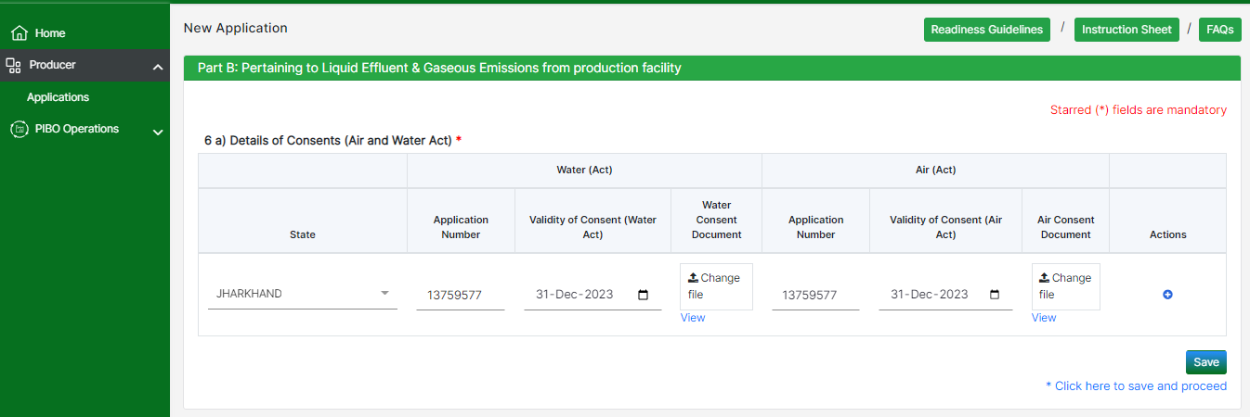
producer
Part B: State wise Details (Application Number) of consents to Operate and PDF document for the same where the producer has its operating units should be provided.

Slide 12
Part c: Procurement/ Sales/ Waste Generation
PIBOs to indicate plastic waste generation details equivalent to plastic packaging qty placed in market
Irrespective of the fact that commodity with plastic packaging directly / indirectly sold to end-users
Plastic waste category should match with the commodity with plastic packaging marketed
Plastic waste quantity should match with the plastic consumed in plastic packaging
Entity category ( P/I/BO/Recycler) & Contact details
Quantity, type of plastic, category of plastic to be reported
Details of Registered/Unregistered entities to be provided separately
Sales figures to be reported by Producers/ Importers
EPR target to be reduced by target sold to registered entities ( Producers/ Brand owners)
Cross validation included between sales to PIBOs

Slide 13
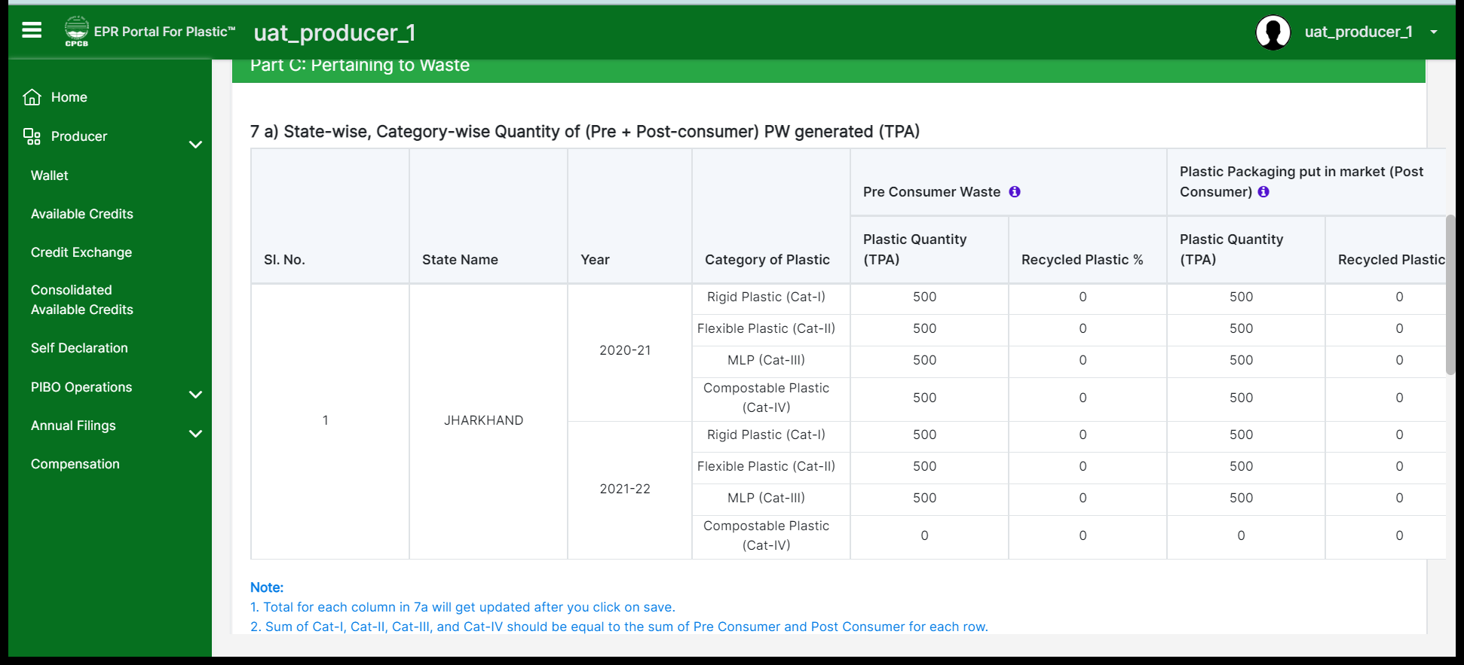
producer
Part C: Producer should provide the state wise and category wise generation of plastic waste (both pre-consumer and post-consumer)
Percent of recycled plastic* should be provided for these categories. If virgin plastic is used, percentage of recycled plastic will be zero.
The category-wise and year-wise sum of pre-consumer and post-consumer PW should be less than or equal to the corresponding value entered in 5c
* “Use of recycled plastic” means recycled plastic, instead of virgin plastic, is used as raw material in the manufacturing process

Slide 14
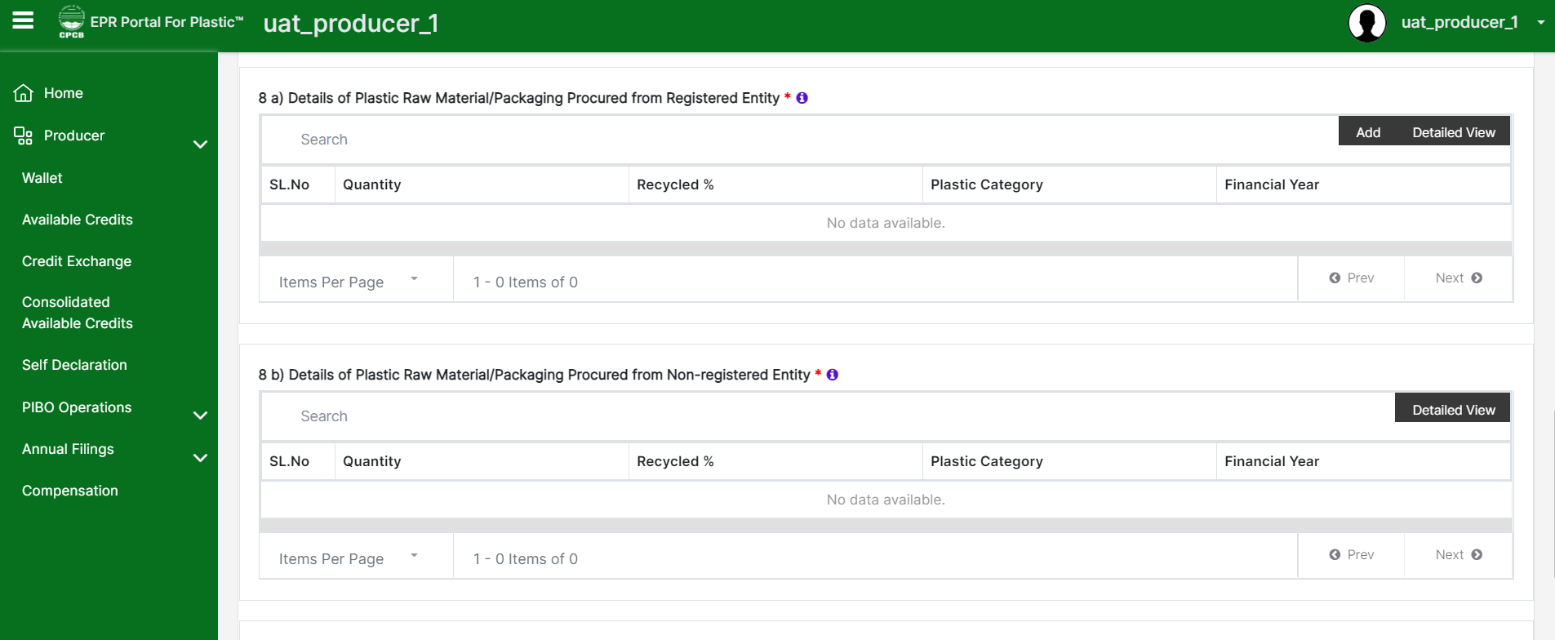
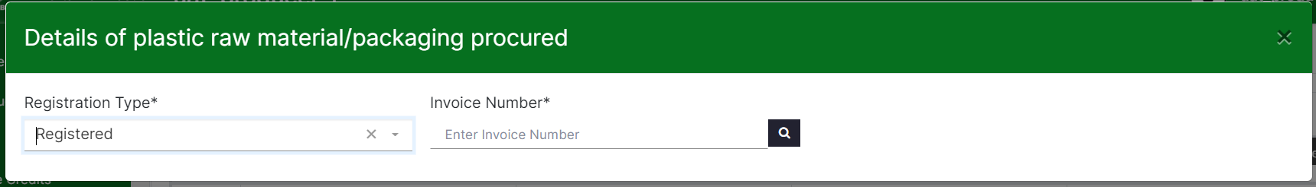
PIBO – 8(a)
8(a): Details of raw materials procured from registered entities – Producers to input the procurement details.
System generated EPR invoice ID should be entered, and the system would fetch all the procurement details from the registered seller.

Slide 15
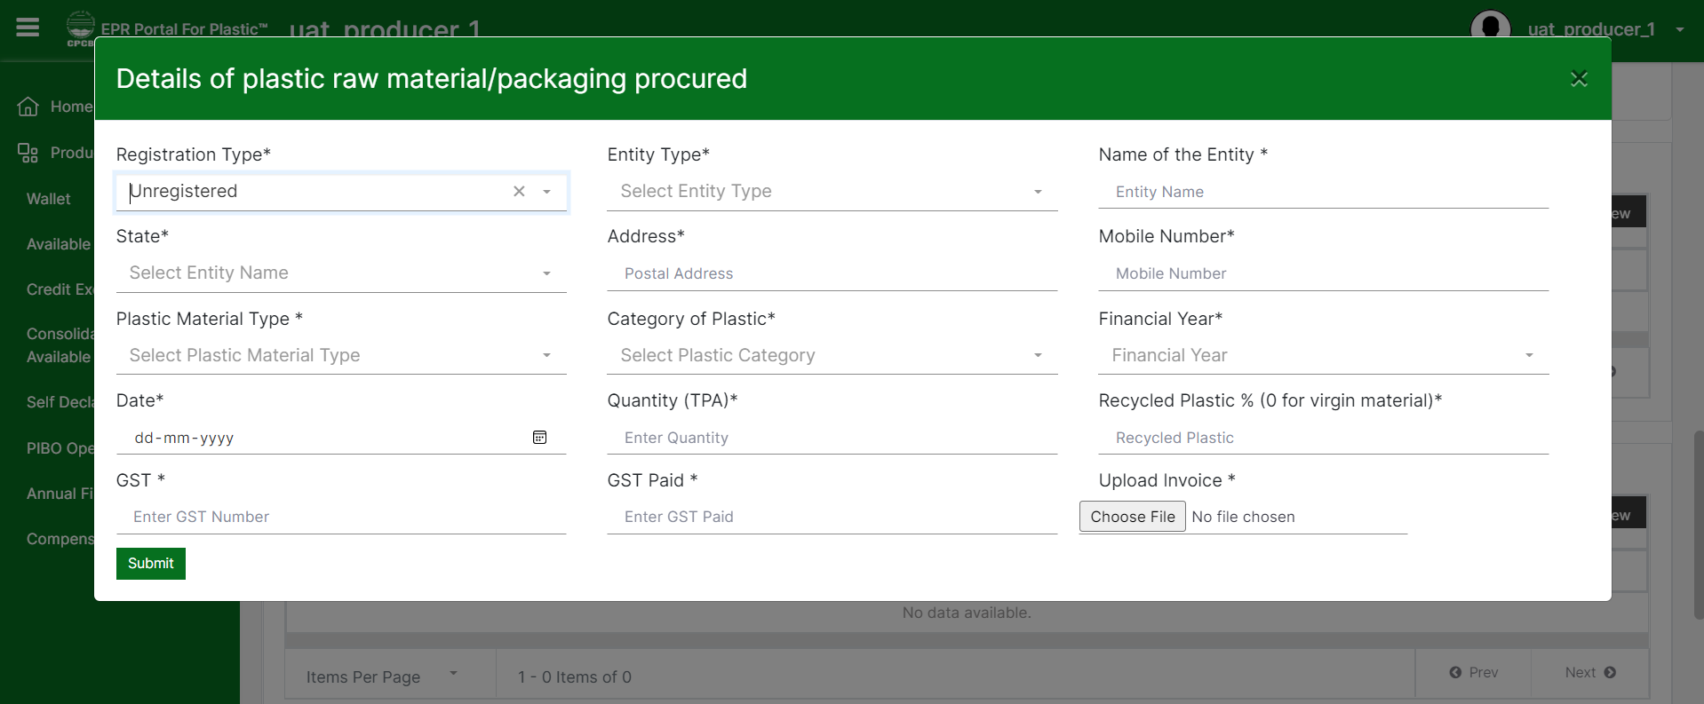
PIBO 8B
8(b): For details of raw materials procured from unregistered entities – Producers to input all the procurement details along with original invoice number.
If virgin plastic is used, percentage of recycled plastic will be zero.

Slide 16
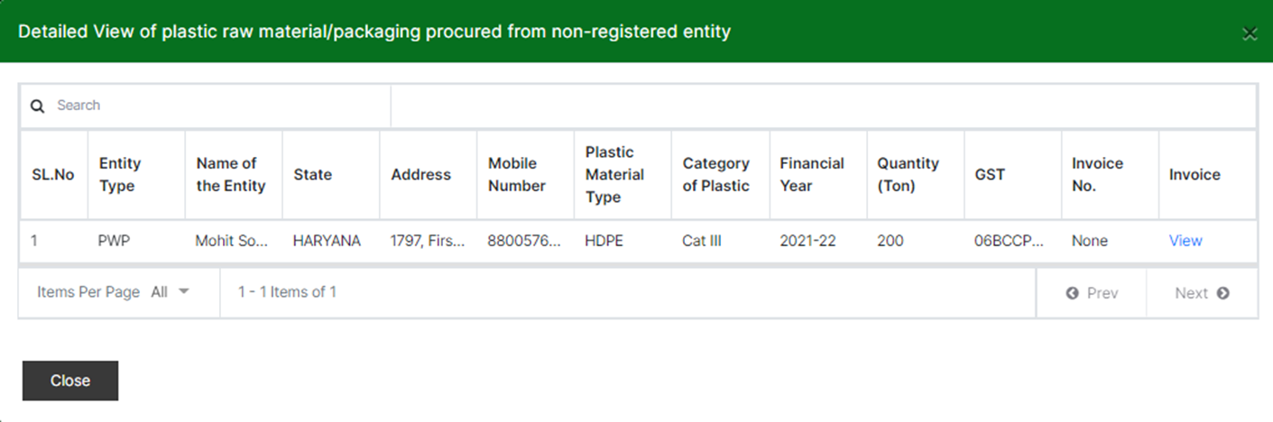
PIBO - 8B
Details of raw materials procured from unregistered PIBOs will get displayed here. Details will not be editable after submission.

Slide 17
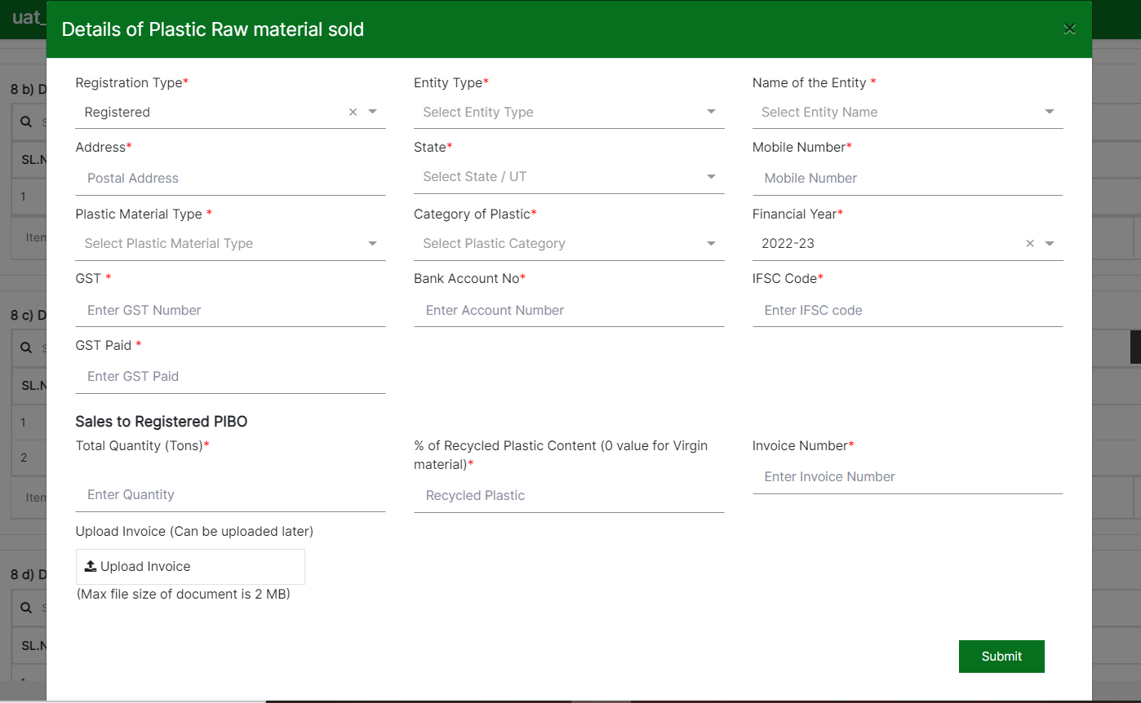
Producer & Importer - 8 C
8(c): Details of raw materials sold to registered and unregistered PIBOs.
Details of raw materials sold to registered PIBOs will get displayed here.
If virgin plastic is used, the percentage of recycled plastic will be zero.
Category-wise and the year-wise sum of post-consumer PW in 7a should be equal to the sum of corresponding entries in 8C and 8D

Slide 18
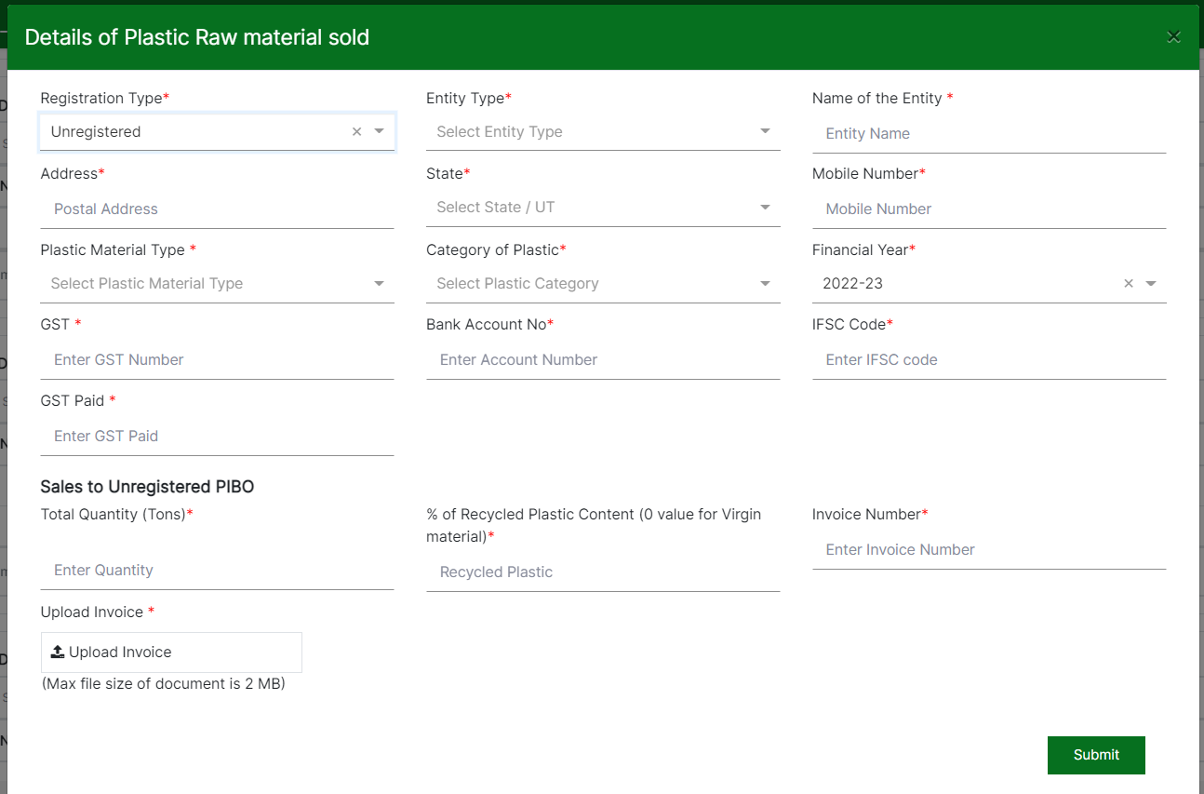
Producer & Importer - 8D
8(d): Details of raw materials sold to unregistered PIBOs will get displayed here.
If virgin plastic is used, the percentage of recycled plastic will be zero.
Category-wise and the year-wise sum of post-consumer PW in 7a should be equal to the sum of corresponding entries in 8C and 8D

Slide 19
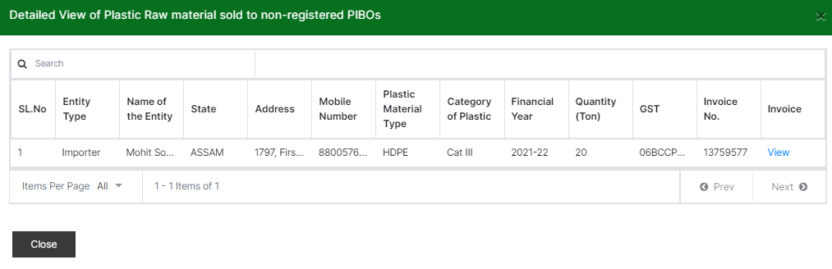
PIBO – 8D
Details of raw materials sold to unregistered PIBOs will get displayed here. Details will not be editable after submission.

Slide 20
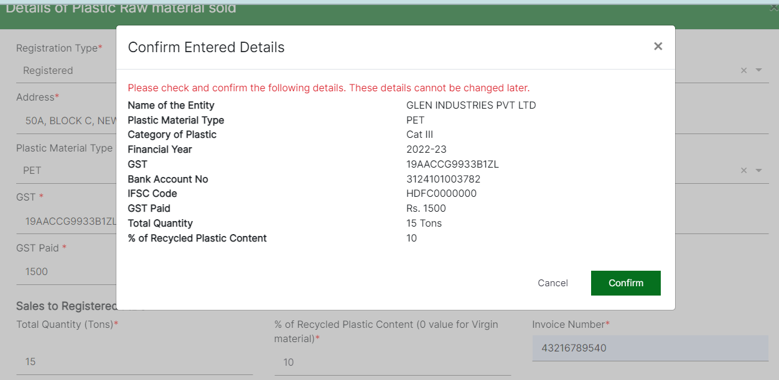
Confirm sales details
PIBO needs to confirm the sales details before it can be submitted. The following details need to be confirmed:
Name of the entity
Plastic material type
Category of plastic
Financial year
GST Number
Bank account details
GST paid
Total quantity sold
% of recycled plastic content

Slide 21
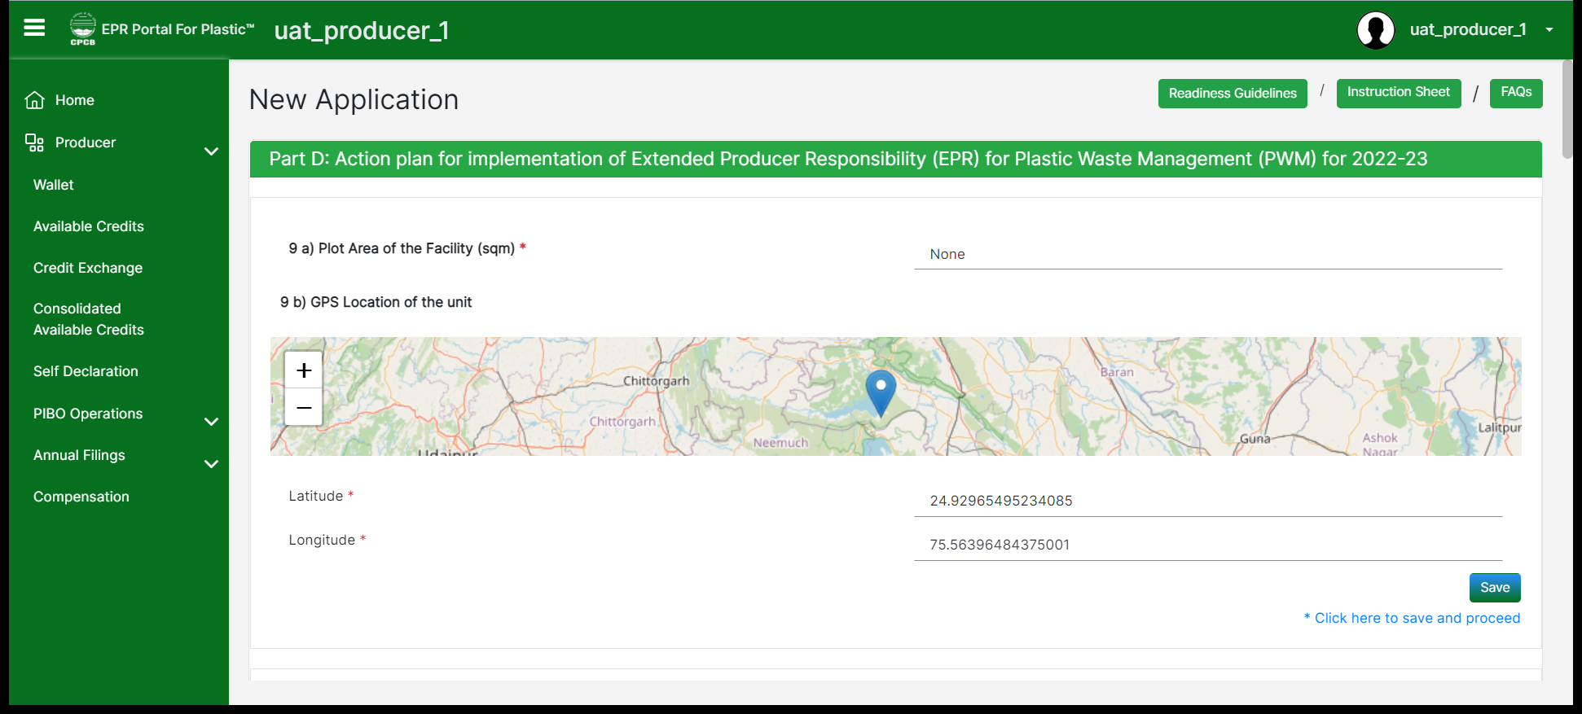
producer
Part D: Area and location of the production facility should be entered by the producer.
Note: Details of 9(a) to 9(g) containing production facility details are not to be provided in case of importers

Slide 22
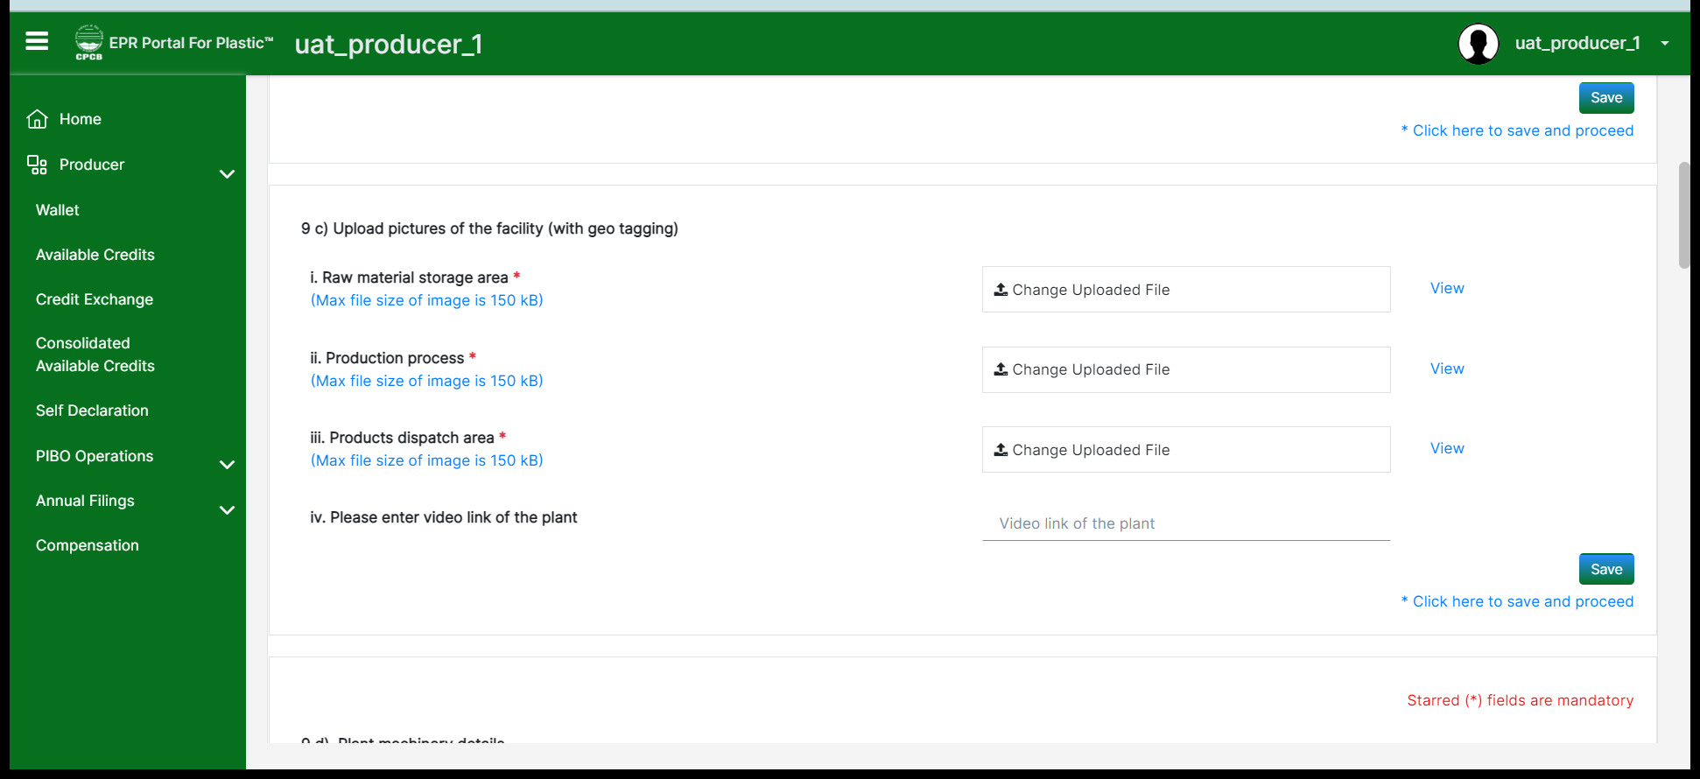
producer
9(c): Pictures of the facility and video of the plant operations should be uploaded.
Note: Details of 9(a) to 9(g) containing production facility details are not to be provided in case of importers

Slide 23
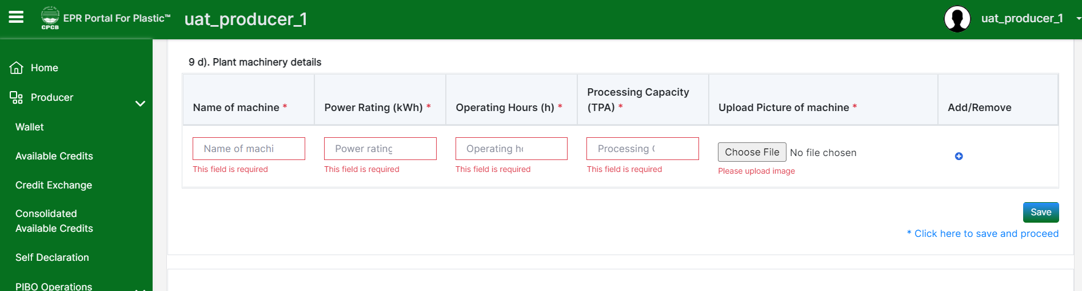
producer
9(d): Plant machinery details including the power rating, operations, processing capacity with picture of machinery should be provided. Please provide the details carefully with respect to the units mentioned.
Note: Details of 9(a) to 9(g) containing production facility details are not to be provided in case of importers

Slide 24
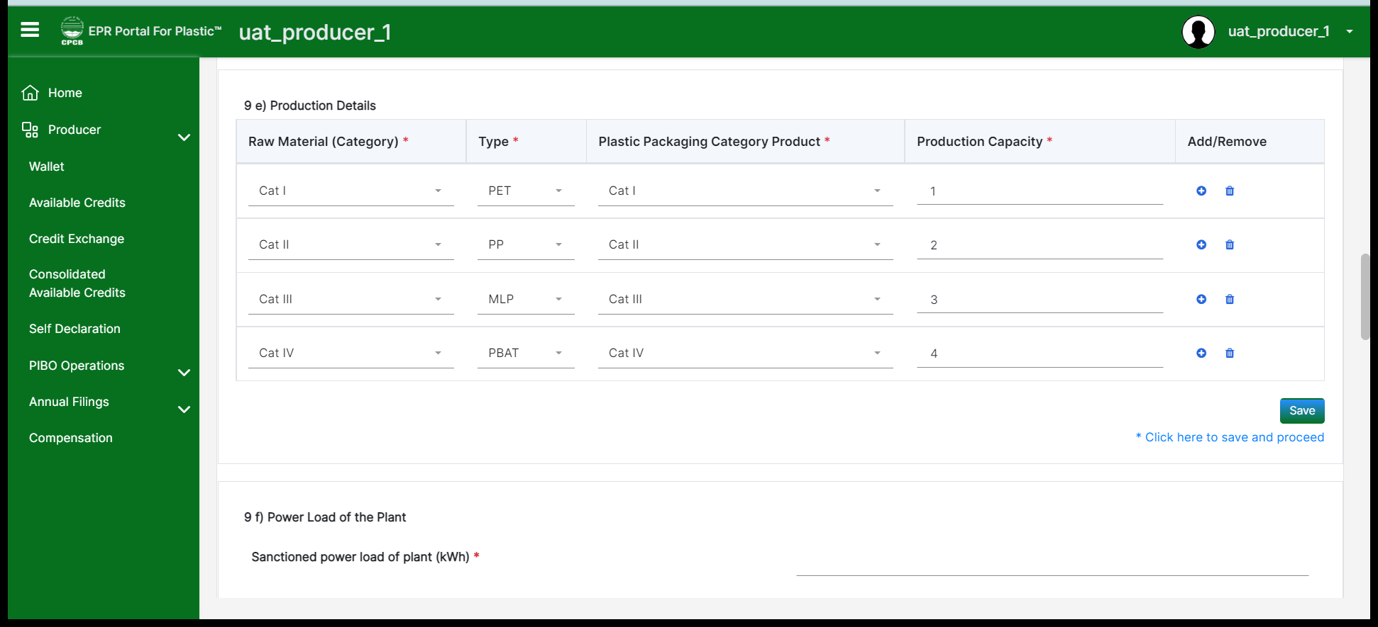
producer
9(e): Please provide the production details for raw material used category wise and type of plastic. Correspondingly plastic packaging category should also be entered and completed with the relevant production capacities.
Note: Details of 9(a) to 9(g) containing production facility details are not to be provided in case of importers

Slide 25
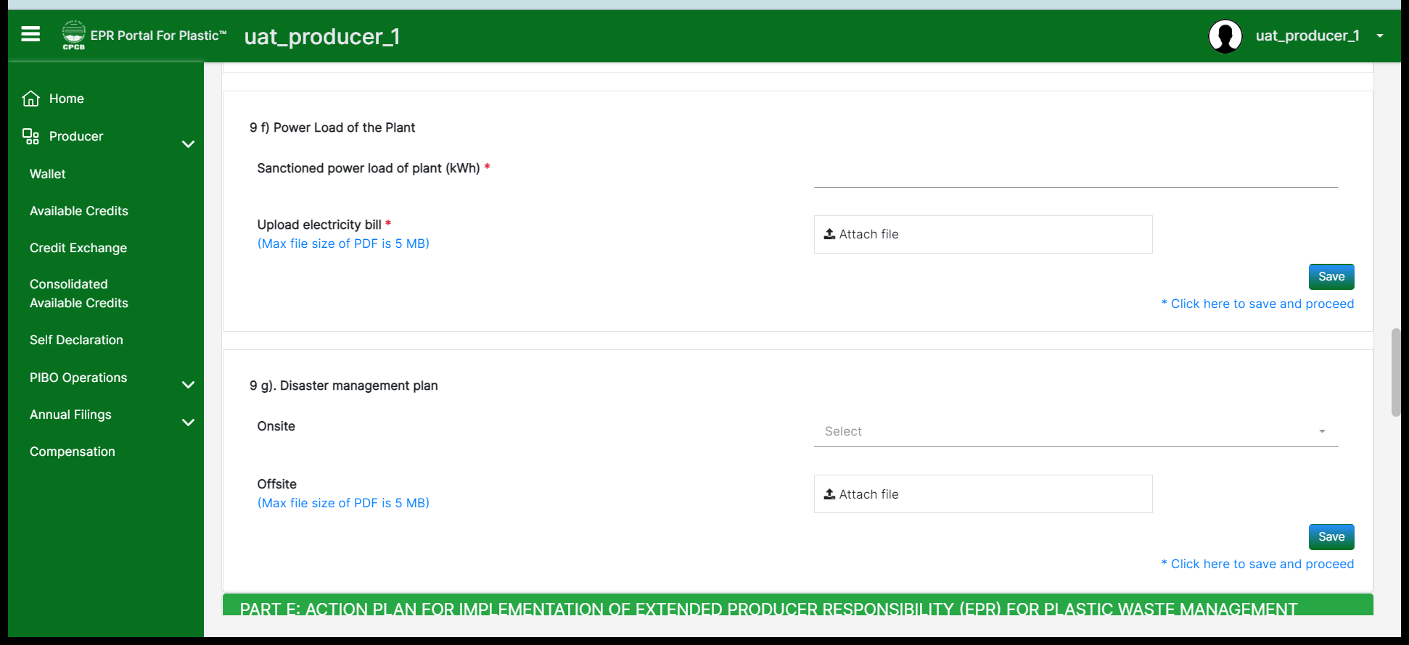
producer
9(f) and 9(g): Sanctioned power load of the plant and recent electricity bill document should be uploaded for the same.
9(g): Disaster management plan for onsite and offsite should be provided.
Note: Details of 9(a) to 9(g) containing production facility details are not to be provided in case of importers

Slide 26
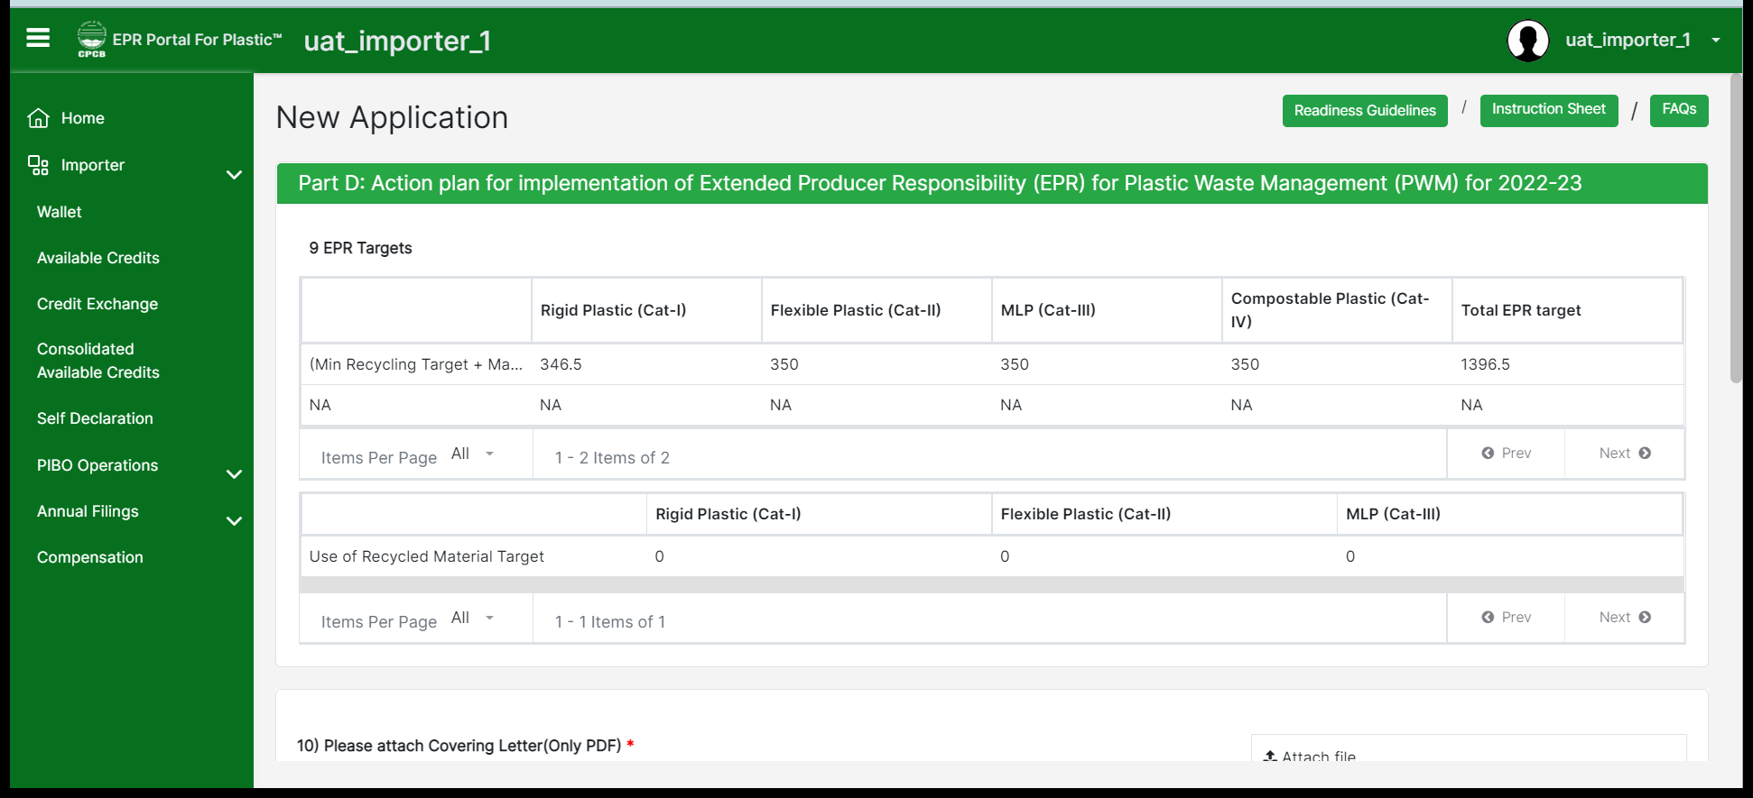
importers
Details containing production facility details are not to be provided in case of importers. EPR targets will be auto calculated in section 9 for importers.

Slide 27
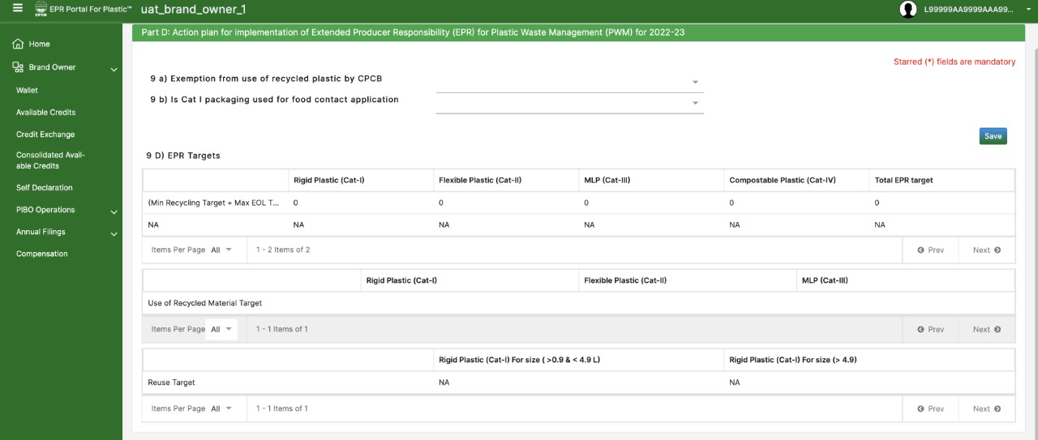
Brand owners
9(a): Exemption from use of recycled plastic by CPCB to be mentioned by the brand owners
9(b): Cat-I packaging use for food contact application should be mentioned by the brand owners

Slide 28
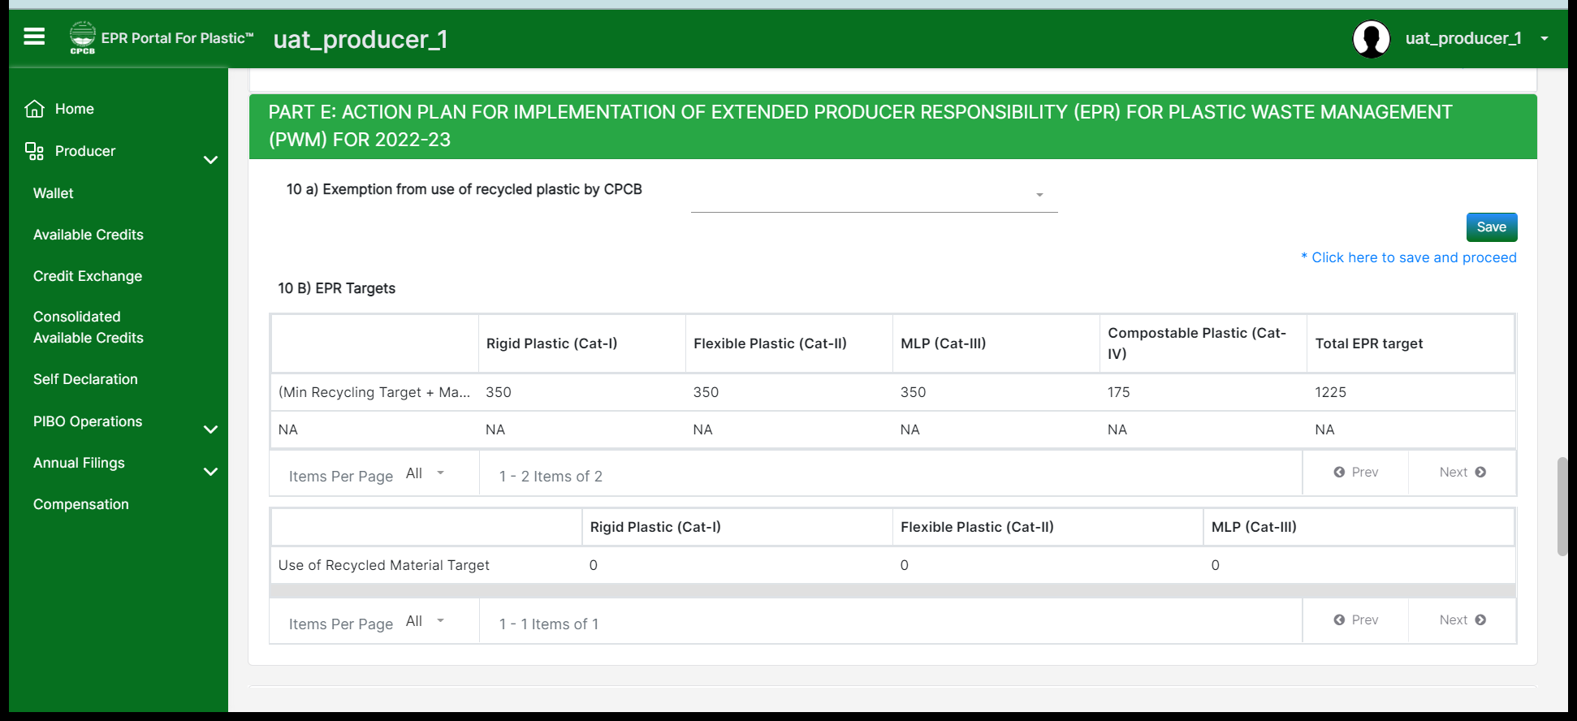
producer
10(a): Exemption from use of recycled plastic by CPCB is available, then the producers can procure/buy certificates for use of recycled plastic from other PIBOs to meet the EPR obligations.
10(b): EPR targets will be auto calculated based on the input details that have been provided.

Slide 29
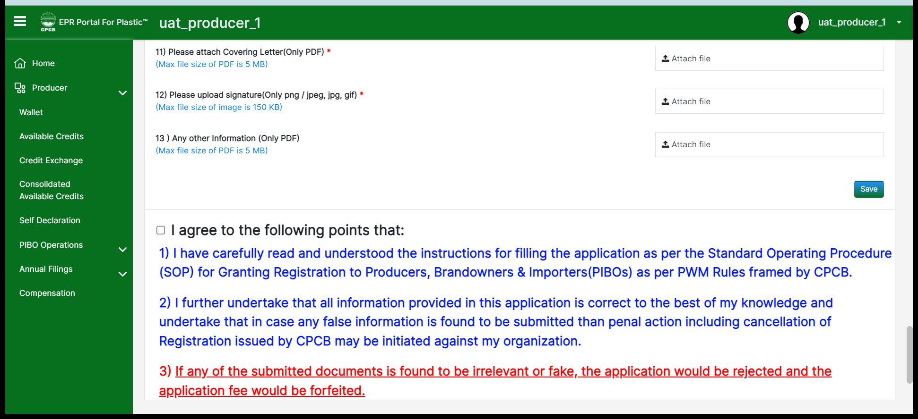
producer
Covering letter with signature should be uploaded in the relevant formats. Keep saving the details of the relevant sections and verify before submitting the application.

Slide 30
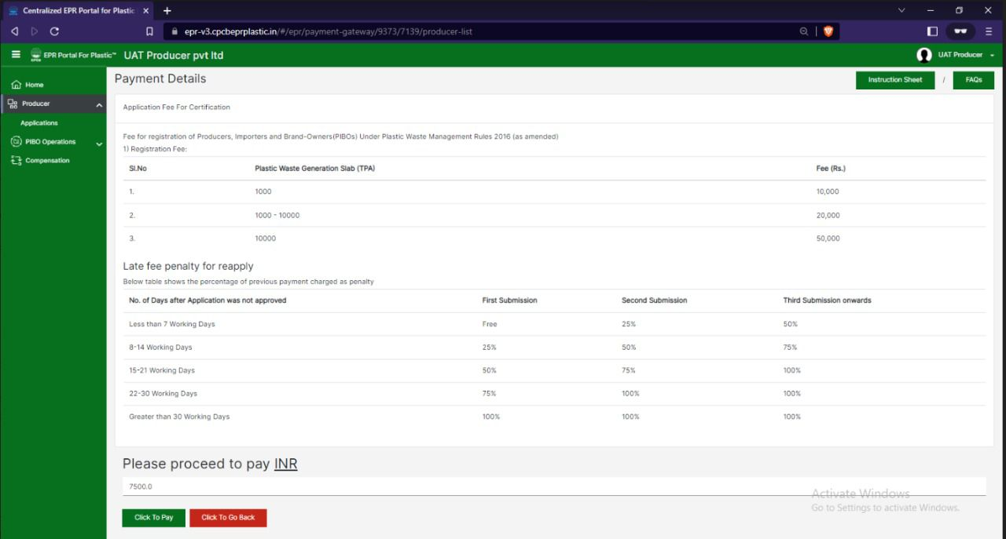
Application Fees & Annual Processing Charges

Slide 31
Application Fees & Annual Processing Charges

