Slide 1
PIBO Operations
( After REGISTRATION ON THE EPR PORTAL)

Slide 2
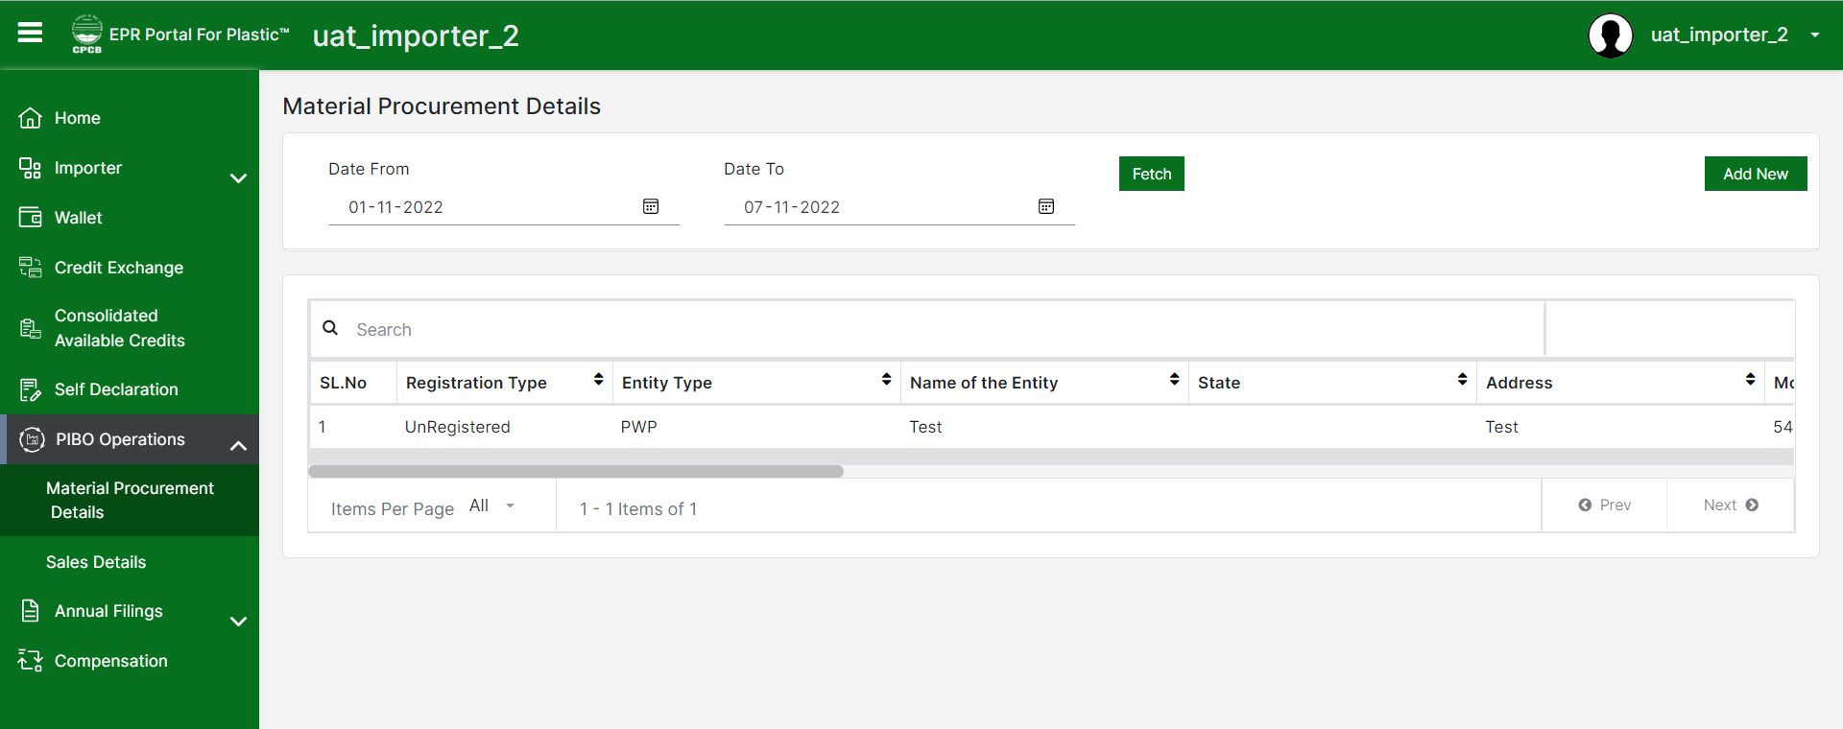
PIBO Operations
PIBO Operations – All procurement and sales details to be entered by PIBO in this section

Slide 3
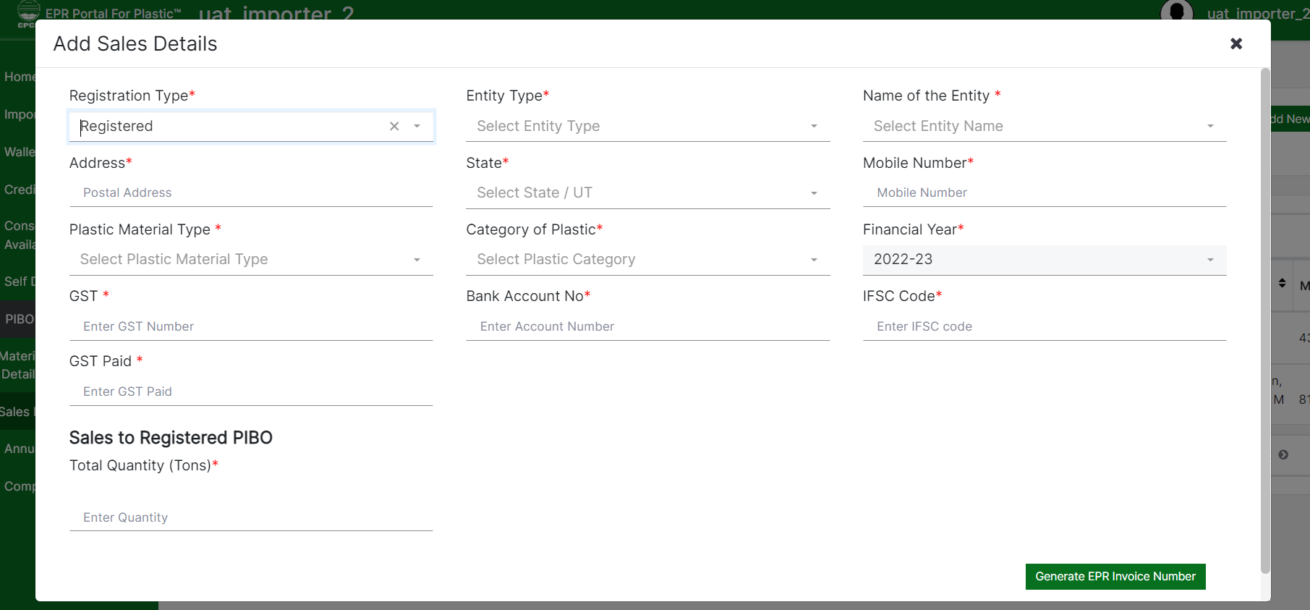
Sales to registered entities
If the sales is done to a registered entity, then the PIBO has to select the type and name of entity. PIBOs need to fill up the other details as shown in the screenshot
PIBO needs to confirm before adding the sales details
After confirming, the system will generate the EPR invoice number against the invoice details

Slide 4
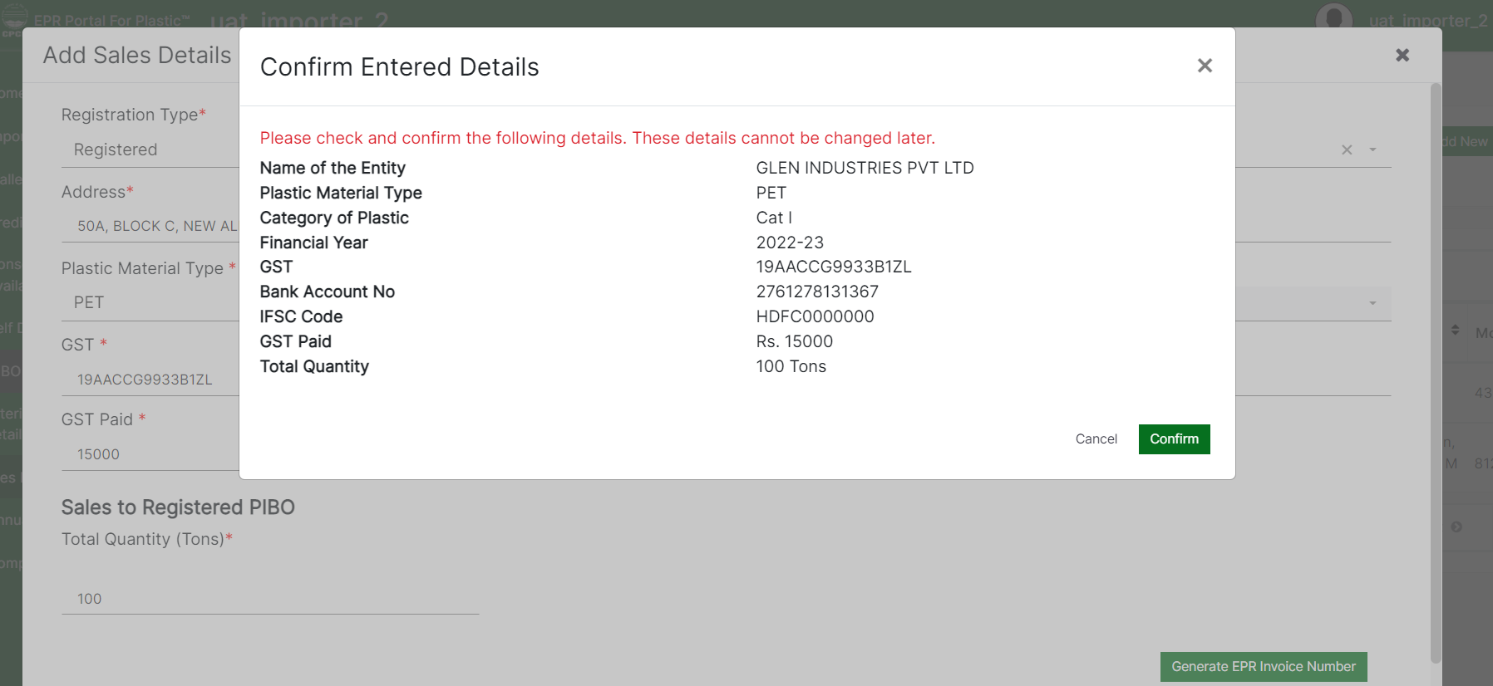
Confirm sales details
Confirmation is required before adding the sales details

Slide 5
Auto-population of invoice
If the sales transaction is between two registered entities, after the invoice is generated, the details gets auto-populated in the procurement section of the PIBOs to whom the sales is done
The EPR invoice number can only be used or auto populated if the invoice is uploaded by the entity creating the sales transaction
If the sales transaction is done to an unregistered entity, the invoice details will not get auto-populated on the procurement section. The unregistered entity needs to manually enter the EPR invoice number to populate the invoice details in the procurement section during registration at EPR Portal.

Slide 6
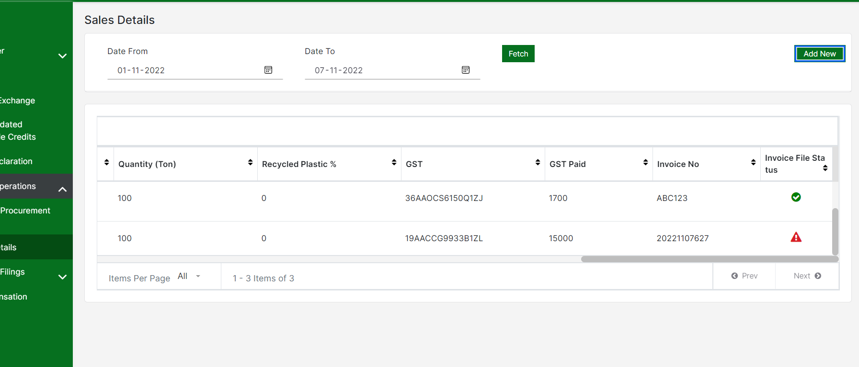
Auto-population of invoice (contd.)
Green tick in the last column indicates the invoice is uploaded. A warning sign will be shown if the invoice is not uploaded.

Slide 7
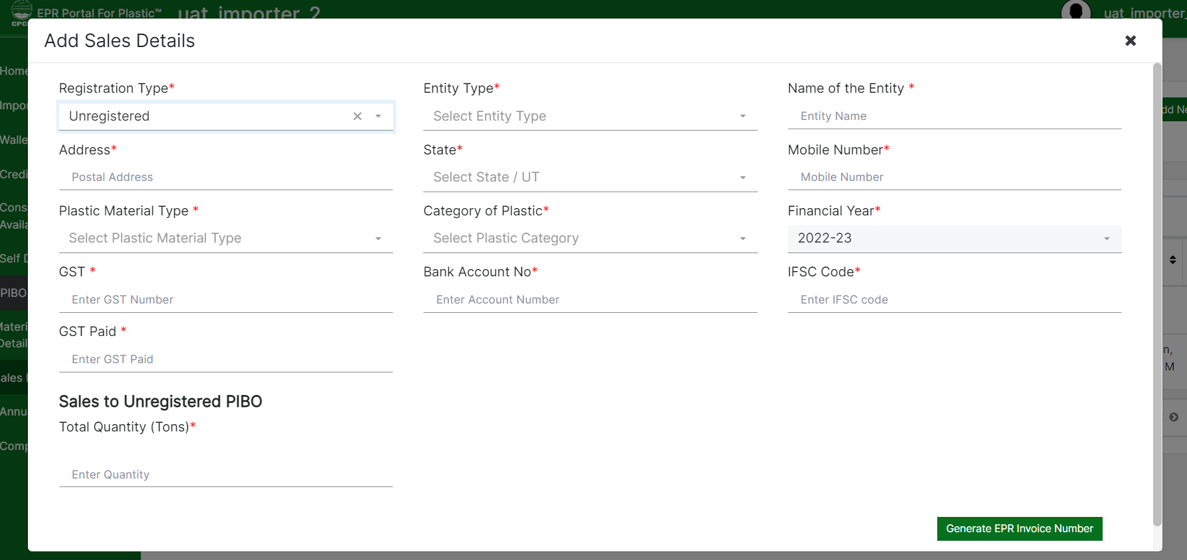
Sales to unregistered entities
If the sales is done to an unregistered entity, then the PIBO has to manually enter the type and name of entity. PIBOs need to fill up the other details as shown in the screenshot.
PIBO needs to confirm before adding the sales details
After confirming, the system will generate the EPR invoice number against the invoice details.
The EPR Invoice No. has to be quoted on the EPR invoice.
The EPR No. can be quoted during filing of application by unregistered entities . It will auto-populate the details

Slide 8
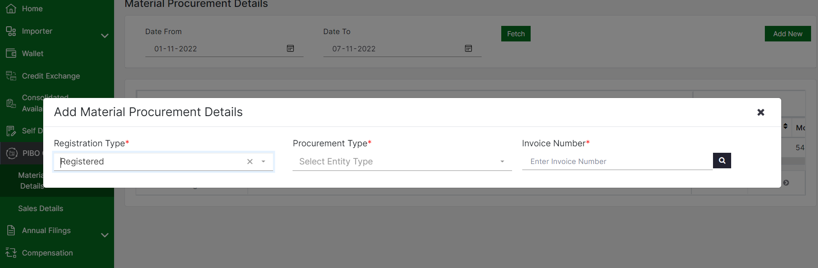
Material procurement from registered entities
If material procurement is done form registered entity, then the PIBO has to enter the EPR invoice number available on the invoice.
The system will auto-populate all the details from the invoice.
The PIBO needs to confirm before adding the procurement details
Note: Once invoice is generated and invoice copy is uploaded, the details get auto-populated in the procurement section of the PIBOs to whom the sales is done

Slide 9
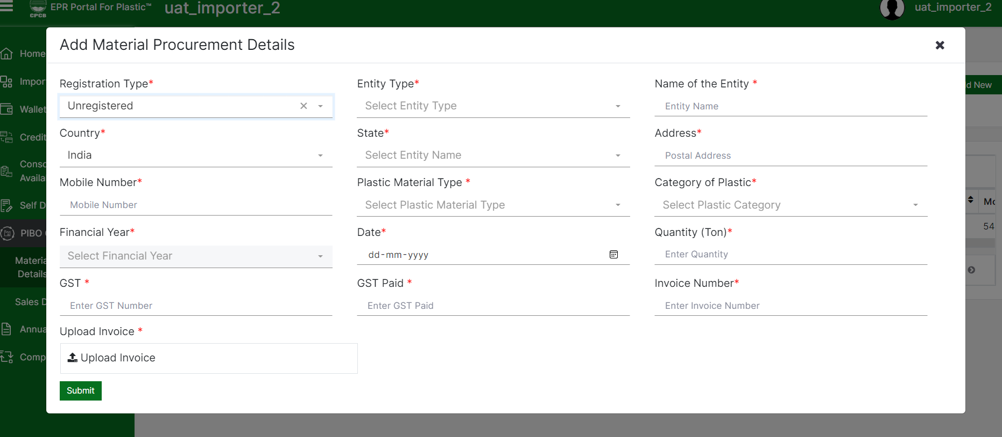
Material procurement from unregistered entities
If material procurement is done from an unregistered entity, then the PIBO must enter all the details available on the invoice manually.
The PIBO needs to confirm before adding the procurement details

