Slide 1
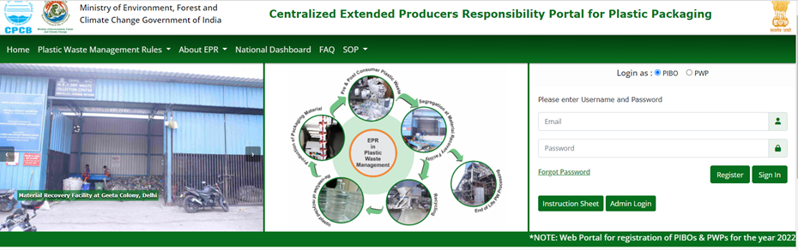
REGISTERING FOR SIGNUP – PIBO
Go to Centralized EPR Portal for Plastic Packaging (https://eprplastic.cpcb.gov.in/) webpage for registration and then signup using the 'Register' option by filling your email and password.

Slide 2
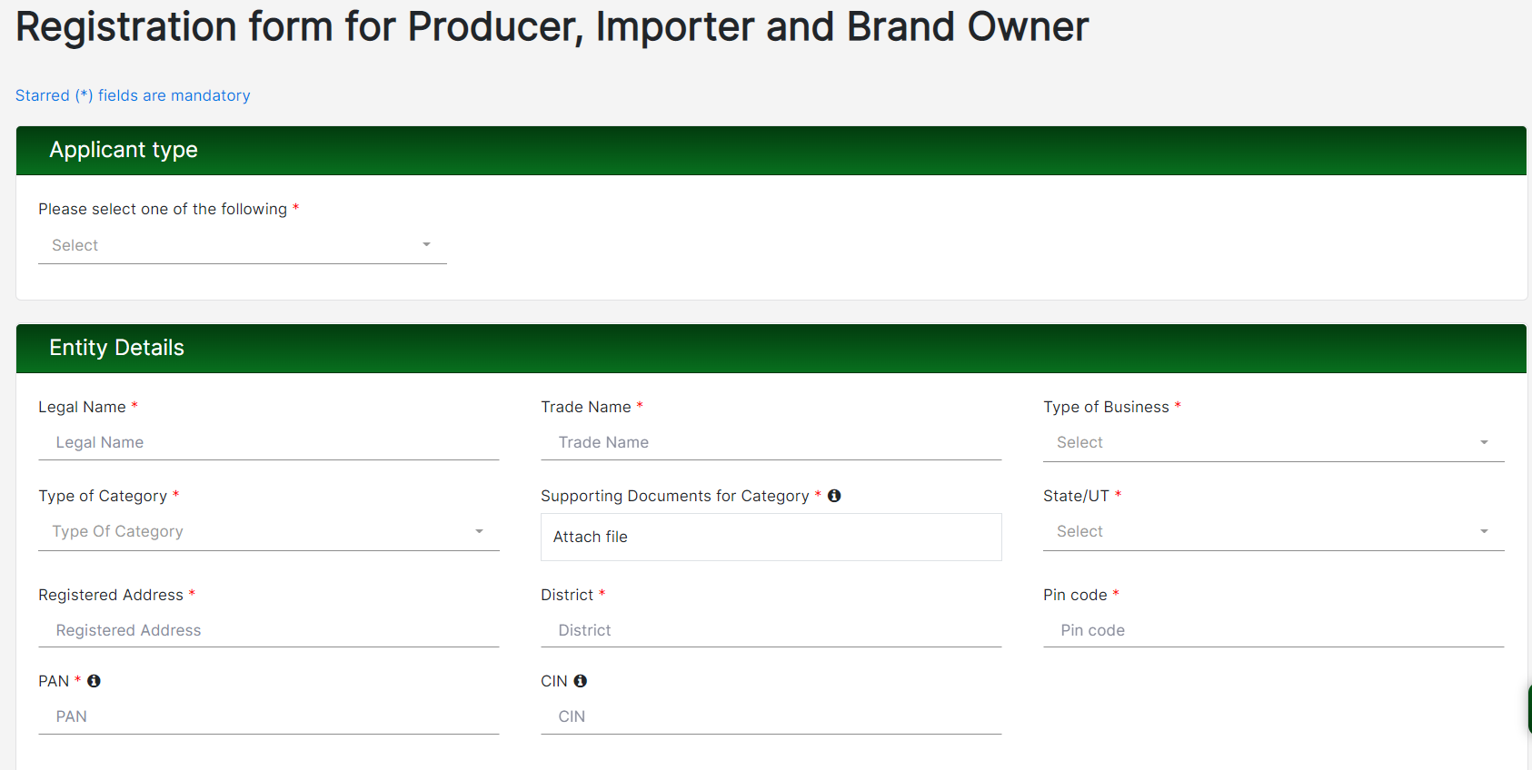
PIBO – REGISTRATION PAGE
Signup form for new registration opens up. Information about the applicant type, Company details, authorized person and login details are to be provided.

Slide 3
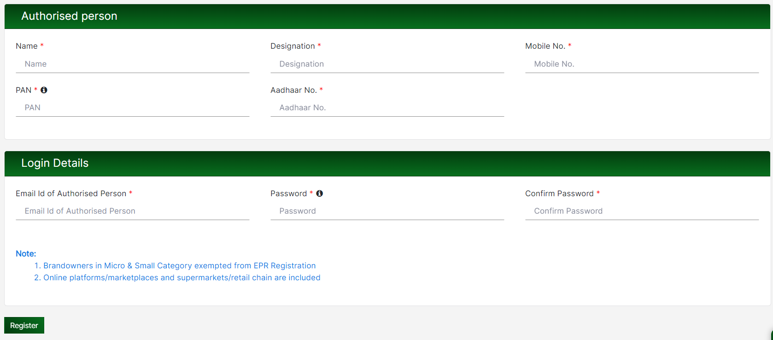
PIBO – REGISTRATION PAGE
Signup form for new registration opens. Information about the applicant type, Company details, authorized person and login details are to be provided.

Slide 4
READINESS CHECKLIST - PIBO
Prior to filling up Application form, it shall be ensured that Applicant is readily available with the following documents
in pdf/jpg/png file.
Additional documents for Producer registration
Scanned copy of Process flow diagram
Combined copy of Consent (Air & Water Act) in PDF Format issued by SPCB/ PCC
Additional documents for Importer registration
IEC of the Company
Additional documents for Brand Owner registration
Consents issued by SPCB/ PCC (if unit has a production facility)
Required Documents for PIBOs
PAN, GST, CIN of the Company
Aadhar, PAN of Authorized person (Scanned Copies)
DIC Registration in PDF format (if unit registered with DIC)
Scanned copy containing details of products (type and quantity) produced/marketed.
Representative Picture of packaging overing different plastic categories under EPR
Covering letter in PDF format
Scanned copy of signatures of authorized persons in png, jpeg, jpg.
Document regarding any other information which the unit wishes to provide.

