Slide 1
APPLICATION FORM FORMAT
Part A: General Details
Part B: Effluent & Emissions
Part C: Procurement/ Sales/ Waste Generation
Part D: EPR Action Plan

Slide 2
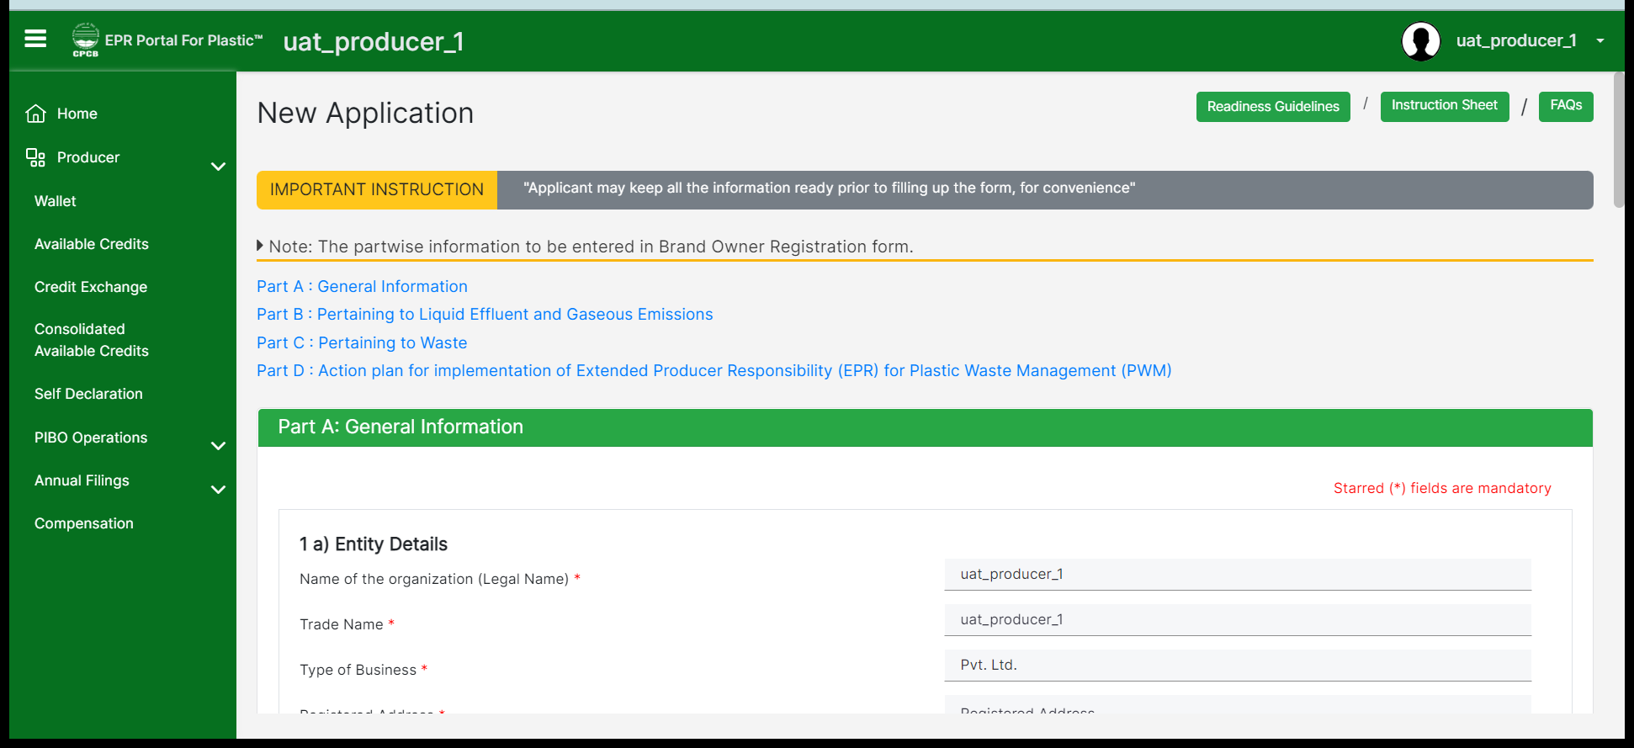
PRODUCER
Part wise information is required to be entered.
Part A: General Information for Producer.
Note: All mandatory fields marked in red asterisk are to be filled in so that you can move forward. Make sure to save the section at each stage so that you do not lose any data.

Slide 3
PART A: GENERAL DETAILS – 1A
Legal Name , Trade name, Type of business: As appearing on GST Certificate
PAN : To be issued in Legal name of Entity
CIN : To be provided by Pvt/Public/ LPP firms registered in Company Act
GST : Combined GST of all States /UTs in which the Entity is operational
IEC: To be provided for importer
Category Document: Micro/Small Brand owners not to apply for Registration

Slide 4
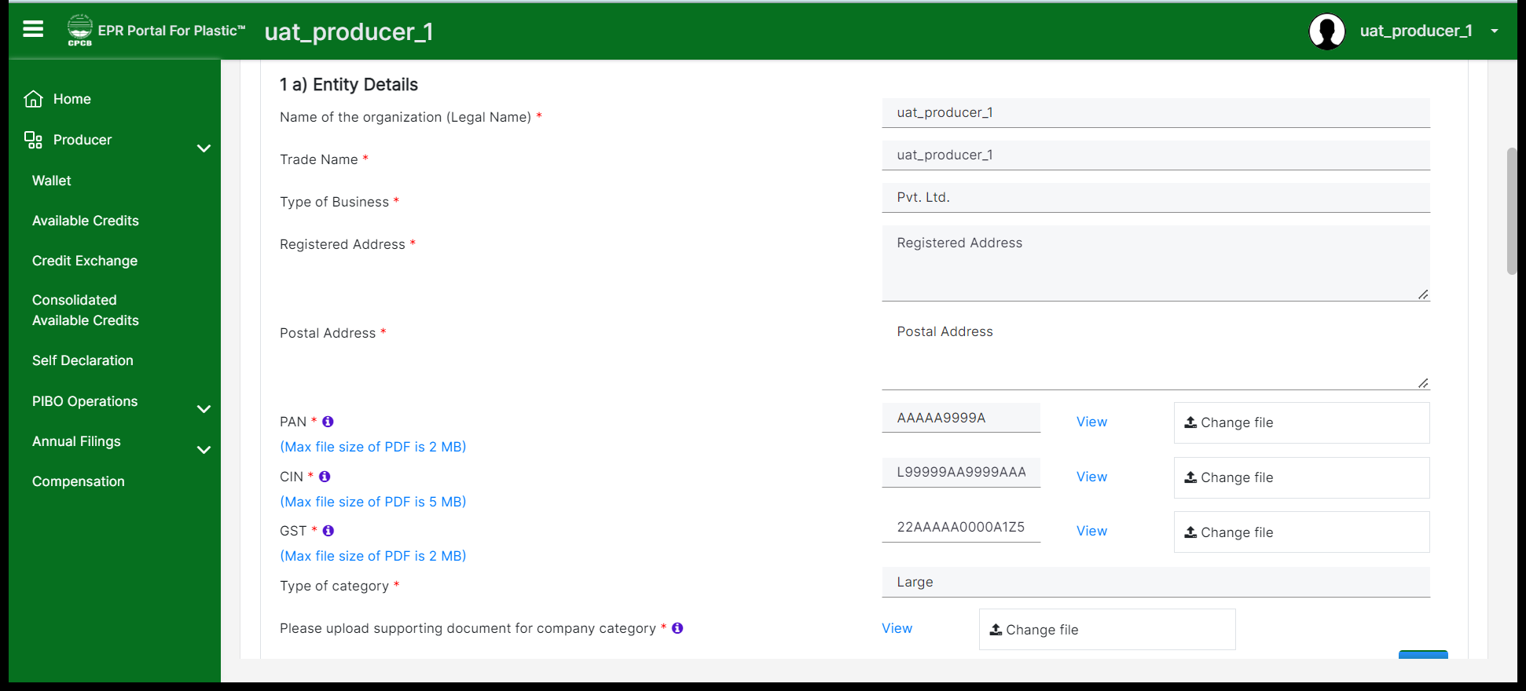
PRODUCER
Part A: General Information for Producer.
Note: All mandatory fields marked in red asterisk are to be filled in so that you can move forward. Make sure to save the section at each stage so that you do not lose any data.
Notes:
Specific Field level

Slide 5
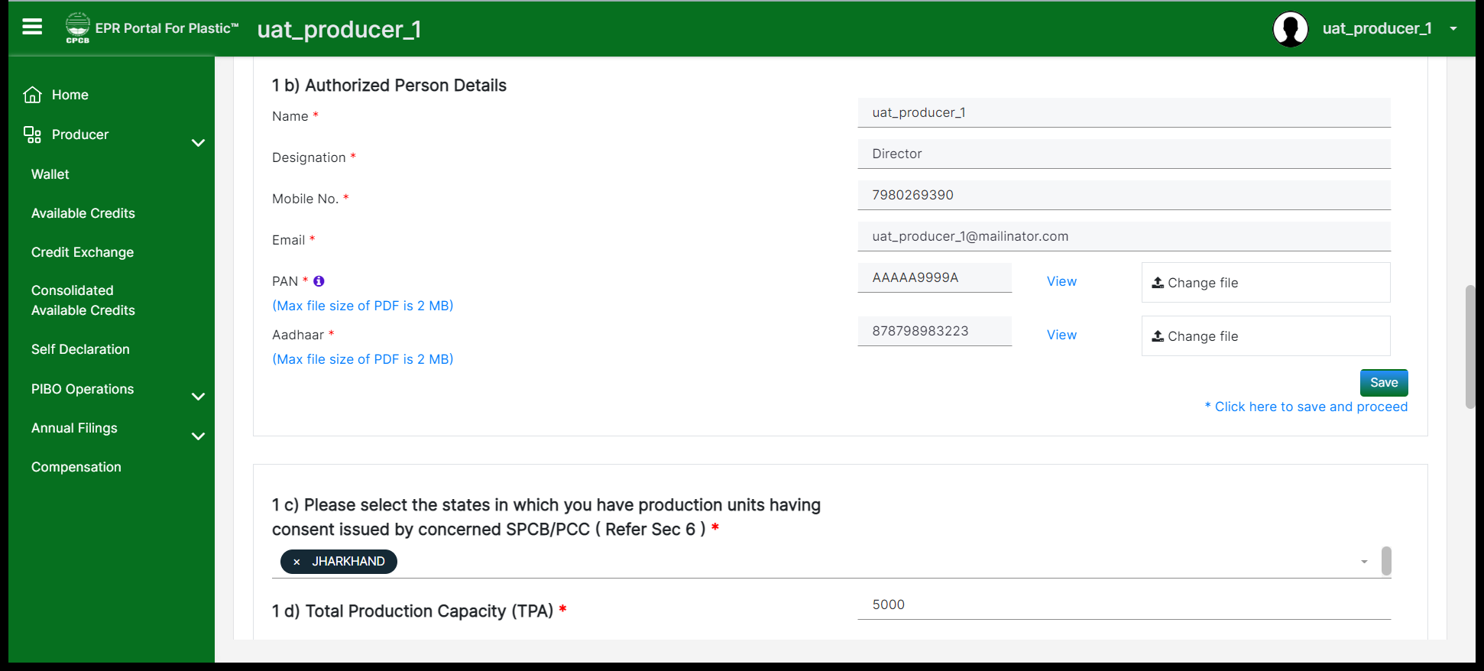
PRODUCER
Part A - 1(c): Please note that ​if you are operating (having manufacturing/production units) in one state application will be processed by the respective SPCBs. If you are operating in 2 states, it is restricted and should apply for the second state separately. If you are operating in 3 or more states in the country, then the application will be processed by the CPCB.

Slide 6
GENERAL DETAILS:1(C) NO. OF STATES/UT IN WHICH THE ENTITY IS OPERATIONAL
BO/Importer: Select states in which marketing products
Producer : States in which it is having production units
One State : Application is forwarded to the concerned State/UT
Two State: Application for first State /UT to be filed
Application for 2nd State/UT To be filed separately ( no fees required for 2nd Application )
Application will get forwarded to the concerned States for1/2 States
For more than two States – Application shall be processed with CPCB

Slide 7
PART A: GENERAL DETAILS
Registration Status: Fresh /Renewal to be correctly filled in
Date of issue, validity date, registration no. & Certificate to be provided
Cases due for renewal should not file application as fresh
DIC Certificate to be submitted by entities having Production facility
Plastic consumption / Waste Generation >Zero , if year of commencement is < 1 year
Consumption of Plastic in packaging only to be included (5c)
Plastic consumed in manufacture of commodities not to be included (5c)
Raw material /Product / process steps to be clearly indicated in PFD( Producers)
5d. Confirmation that SUP products/Carry bags ( >75 micron )/ Sheets( > 50 micron); Nonwoven bags > 60 GSM are not being manufactured/Sold
5e: Process flow Diagram (for producers only)

Slide 8
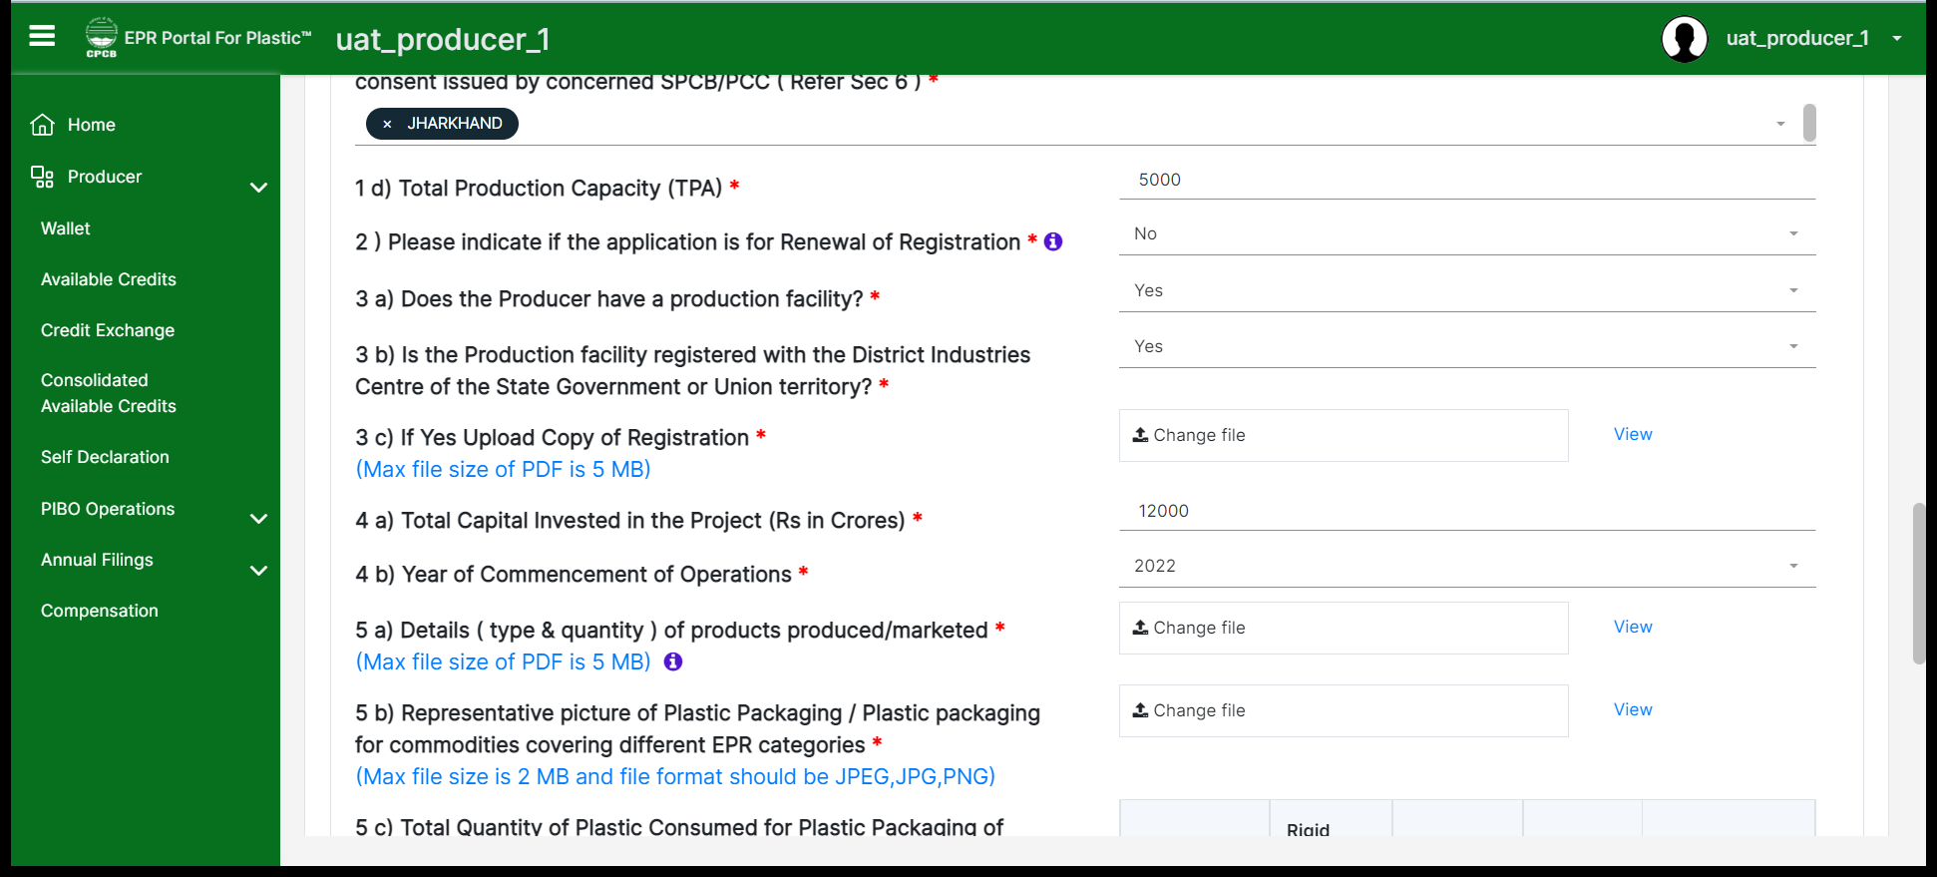
PRODUCER
Details about production capacity, facility and type & quantity of products produced/marketed to be provided.
Representative picture can be provided in 5(b) highlighting few of the products.

Slide 9
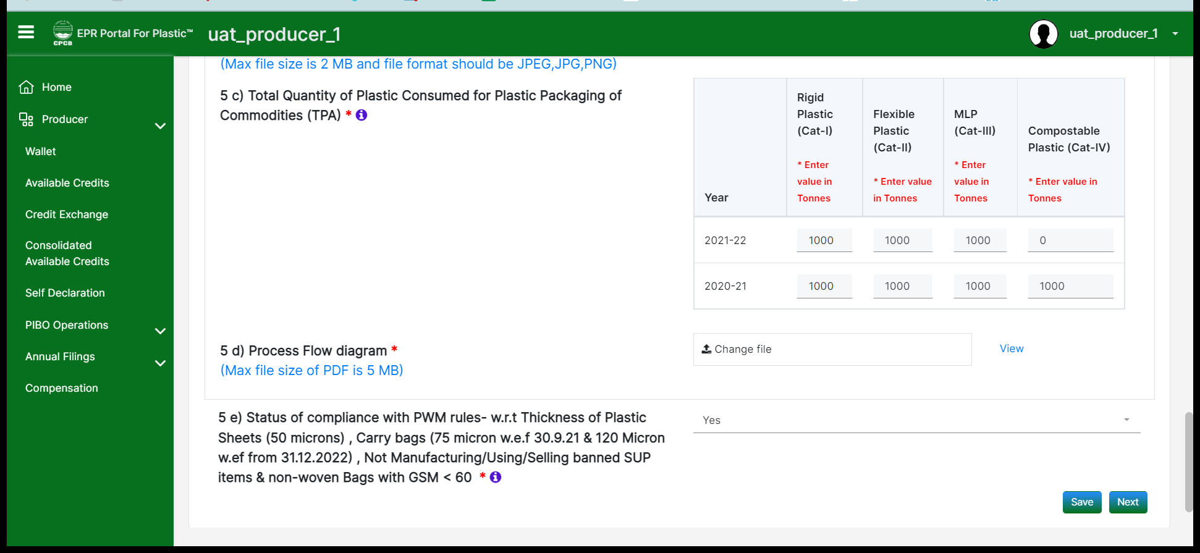
PRODUCER
Total plastic consumed (used for production) year wise should be provided based on its categories in the last two financial years.
Process flow diagram involving the components and operations at the unit should be uploaded.
Single Use Plastic (SUP) compliance should be ensured and stated in 5(e)
Notes:
Directions by CPCB for SUPs

Slide 10
PART B: EMISSIONS AND EFFLUENT RELATED DETAILS
6: Consent details of production facility - Validity date & CTO (Air/Water) document to be uploaded
Consent to be valid on the date of application
Applicable for entities having production units
Optional for Brandowners/ Importers
Mandatory for Producers

Slide 11
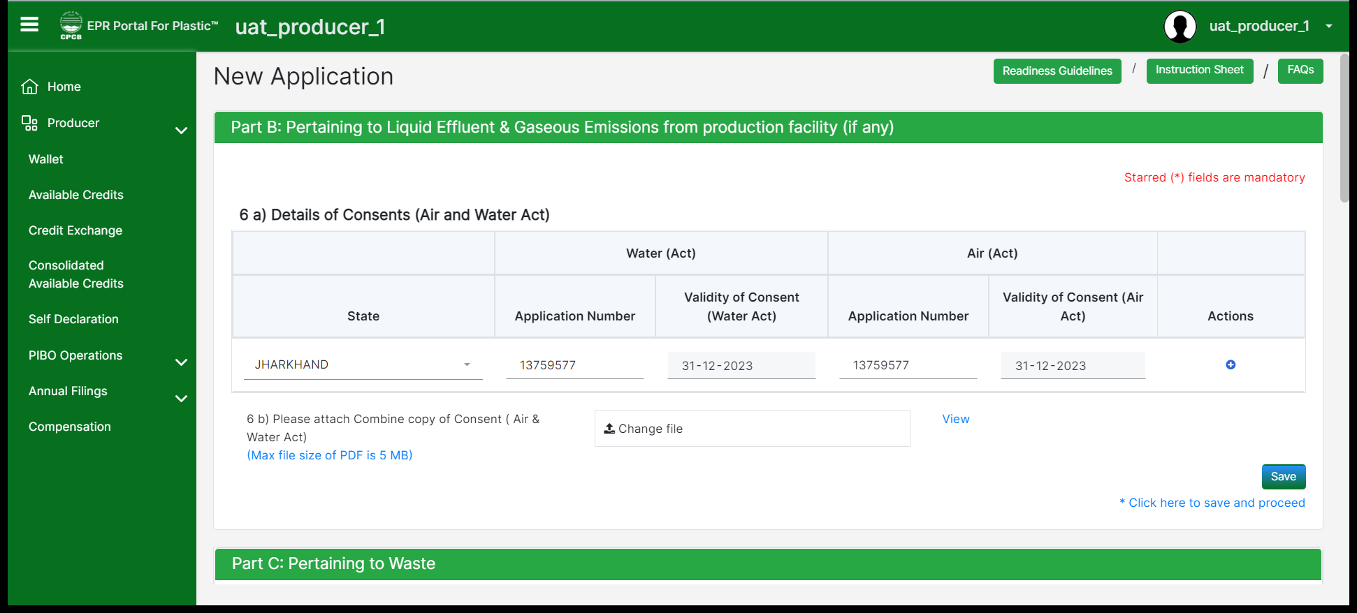
PRODUCER
Part B: Details of state wise consents(consent to operate (CTO) document provided by SPCB for liquid effluent and gaseous emissions) where the producer has its operating units should be provided.
Also combined consent copies pertaining to air and water acts should be uploaded.

Slide 12
PART C: PROCUREMENT/ SALES/ WASTE GENERATION
PIBOs to indicate plastic waste generation details equivalent to plastic packaging qty placed in market
Irrespective of the fact that commodity with plastic packaging / plastic packaging is directly / indirectly sold to end-users
Plastic Waste category should match with the commodity with plastic packaging / plastic packaging marketed
Plastic waste quantity should match with the plastic consumed in plastic packaging
Entity category ( P/I/BO/Recycler) & Contact details
Quantity , type of plastic, category of plastic to be reported
Details of Registered/Unregistered entities to be provided separately
Sales figures to be reported by Producers/ Importers
EPR target to be reduced by target sold to registered entities ( Producers/ Brandowners)
Cross validation included between sales to PIBOs

Slide 13
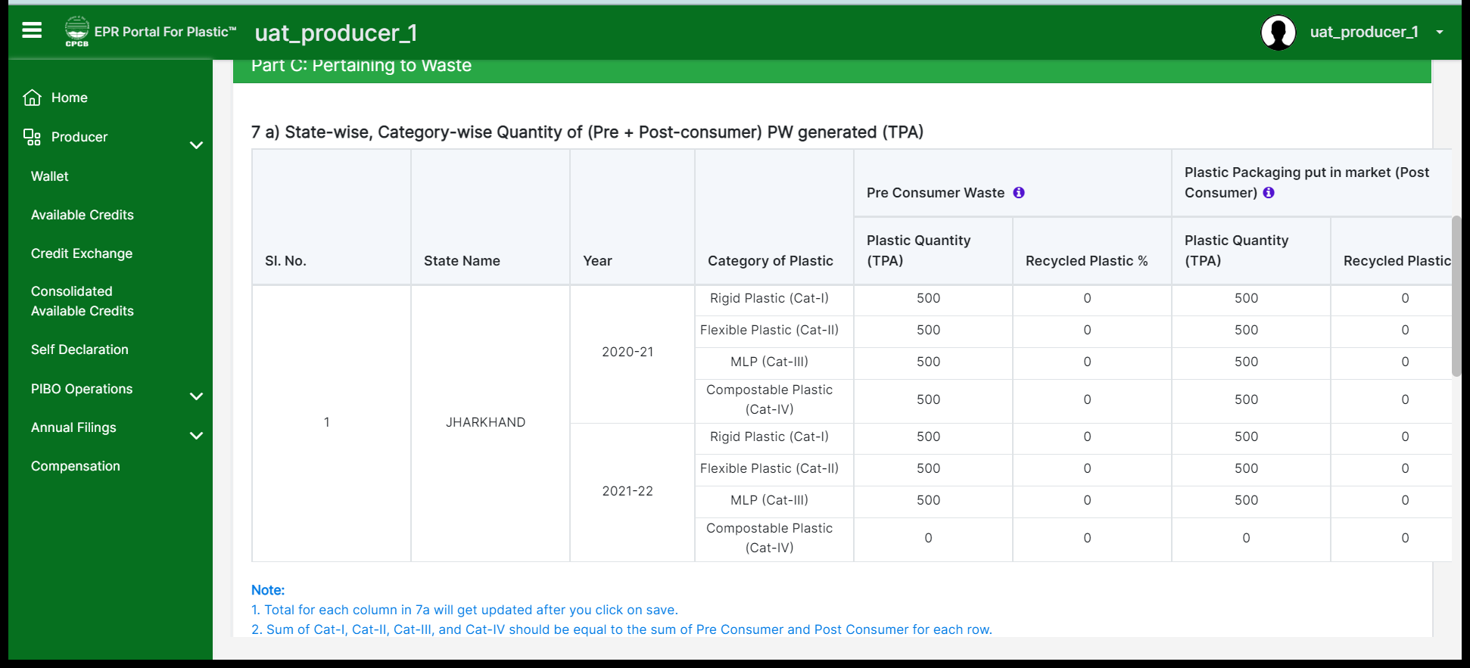
PRODUCER
Part C: Producer should provide the state wise and category wise generation of plastic waste (both pre-consumer and post-consumer)
Percent of recycled plastic should be provided for these categories.

Slide 14
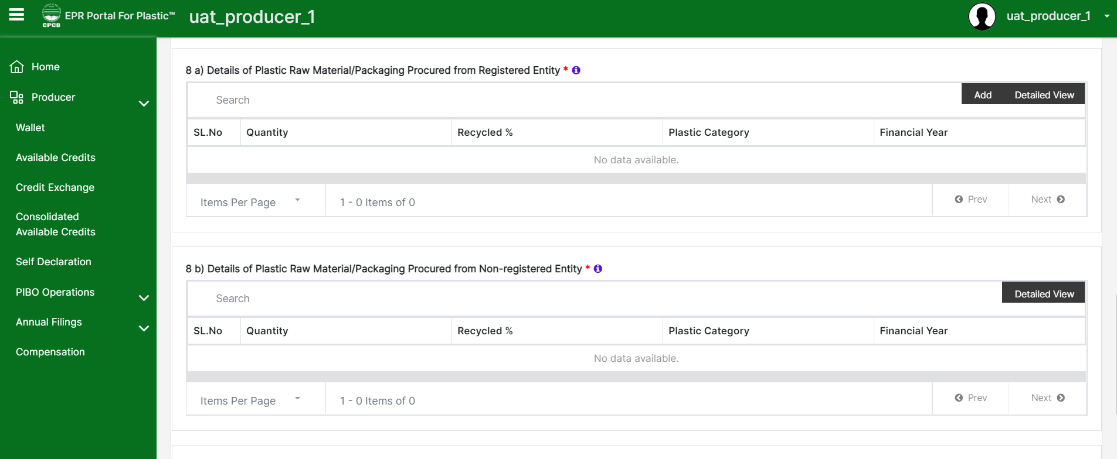
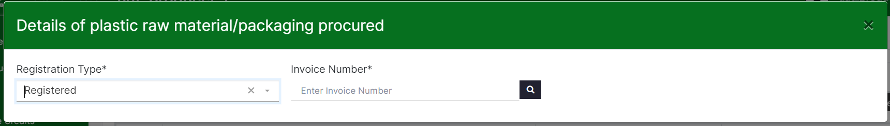
PRODUCER
8(a): Details of raw materials procured from registered entities – Producers to input the procurement details.
System generated invoice id should be entered and the system would fetch all the procurement details from the registered seller.

Slide 15
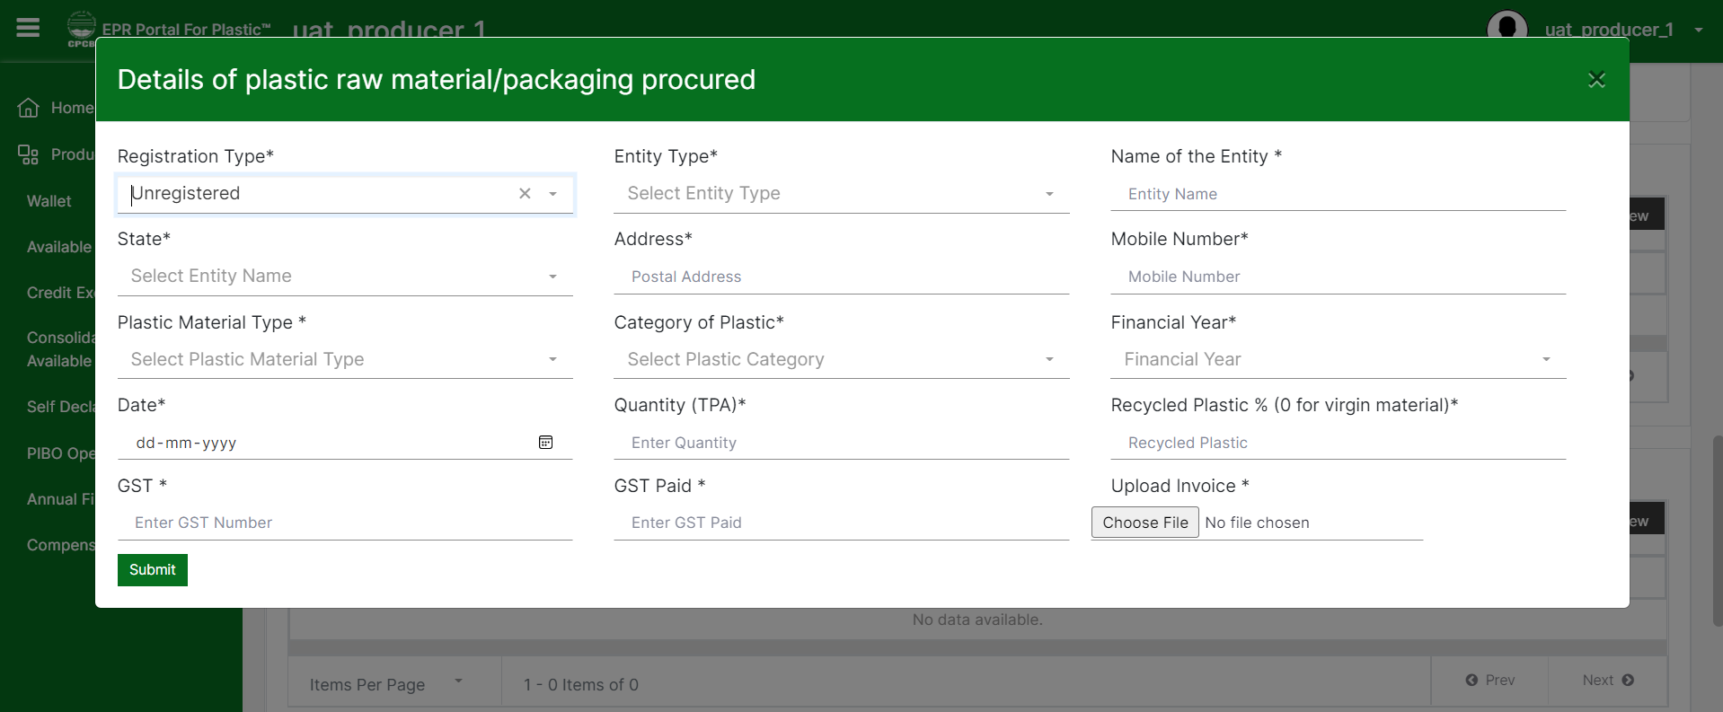
8 B
8(b): Details of raw materials procured from unregistered entities – Producers to input all the procurement details along with original invoice number.

Slide 16
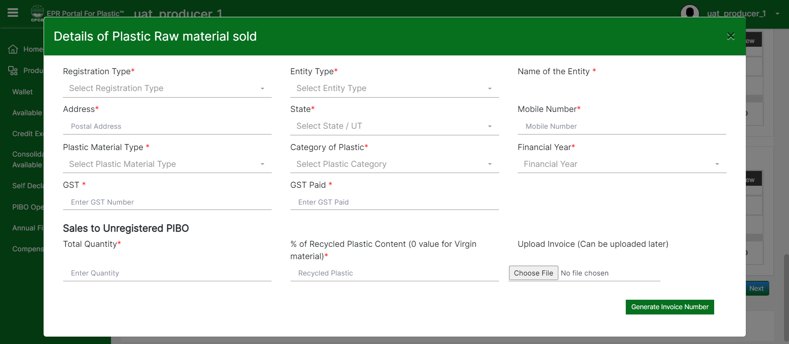
8 C
8(c): Details of raw materials sold to registered and unregistered PIBOs. After entering all the required sales details, the system will generate an invoice number which should be available on the uploaded invoice.

Slide 17
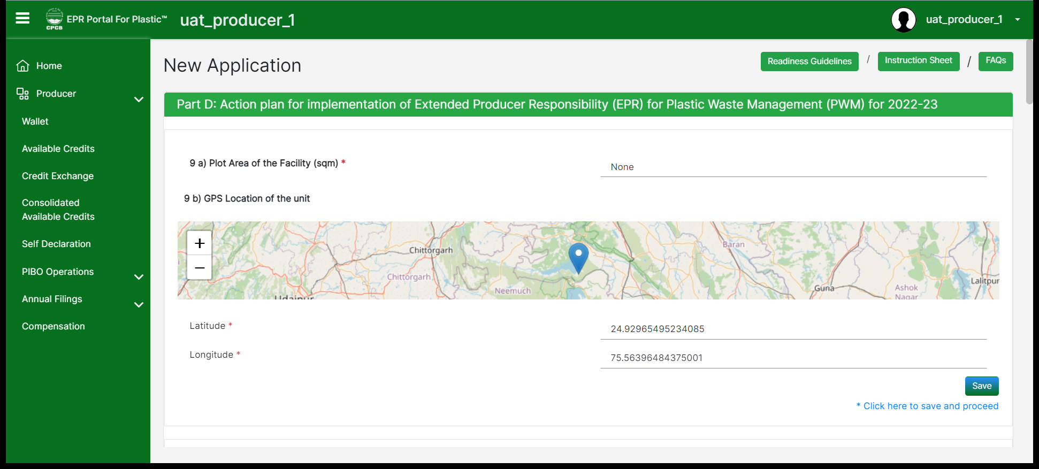
PRODUCER
Part D: Area and location of the production facility should be entered by the producer.
Note: Details of 9(a) to 9(g) containing production facility details are not to be provided in case of importers

Slide 18
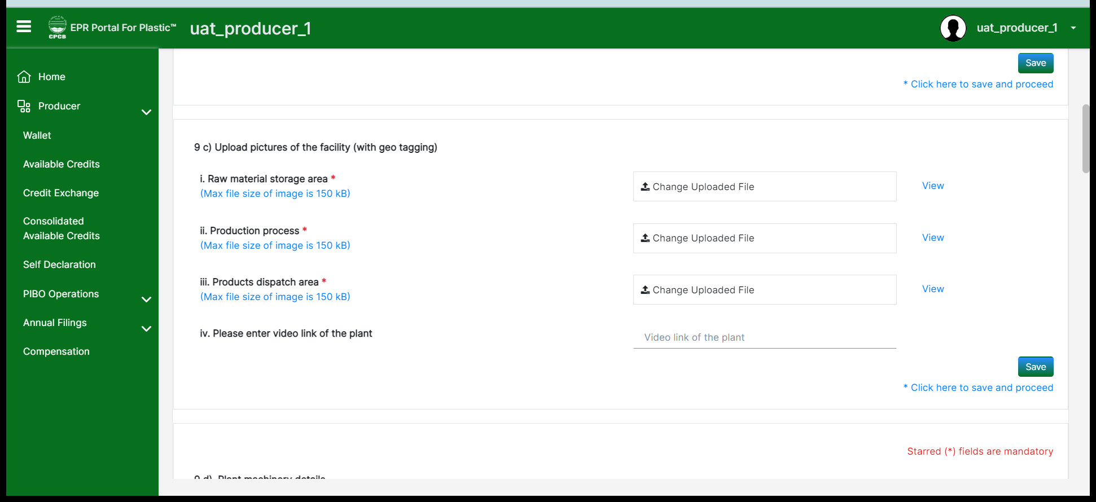
PRODUCER
9(c): Pictures of the facility and video of the plant operations should be uploaded.
Note: Details of 9(a) to 9(g) containing production facility details are not to be provided in case of importers

Slide 19
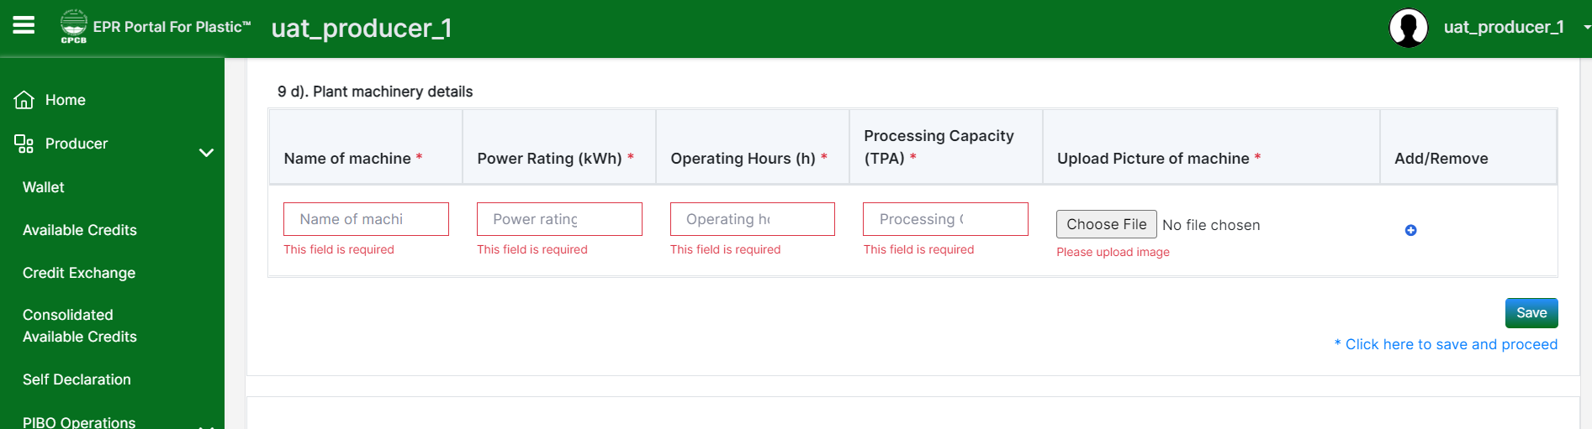
PRODUCER
9(d): Plant machinery details including the power rating, operations, processing capacity with picture of machinery should be provided. Please provide the details carefully with respect to the units mentioned.
Note: Details of 9(a) to 9(g) containing production facility details are not to be provided in case of importers

Slide 20
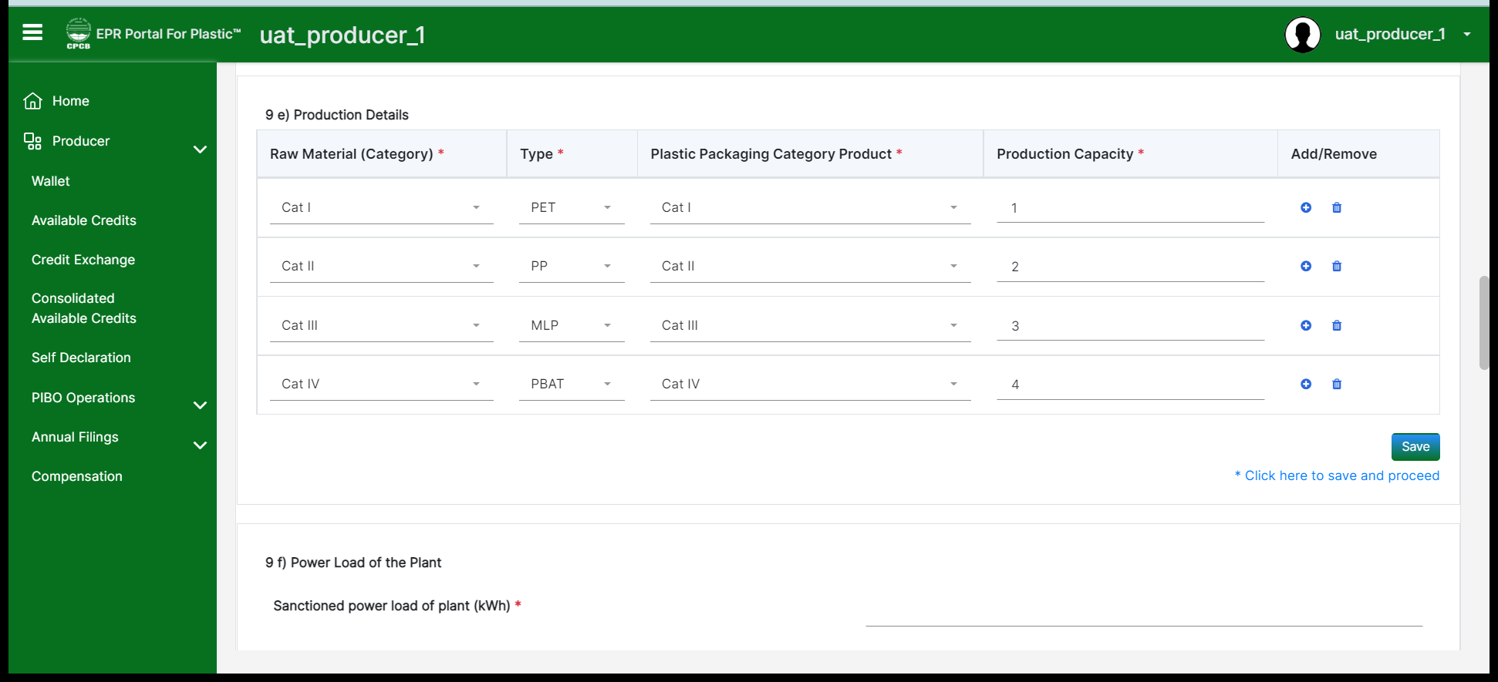
PRODUCER
9(e): Please provide the production details for raw material used category wise and type of plastic. Correspondingly plastic packaging category should also be entered and with the relevant production capacities.
Note: Details of 9(a) to 9(g) containing production facility details are not to be provided in case of importers

Slide 21
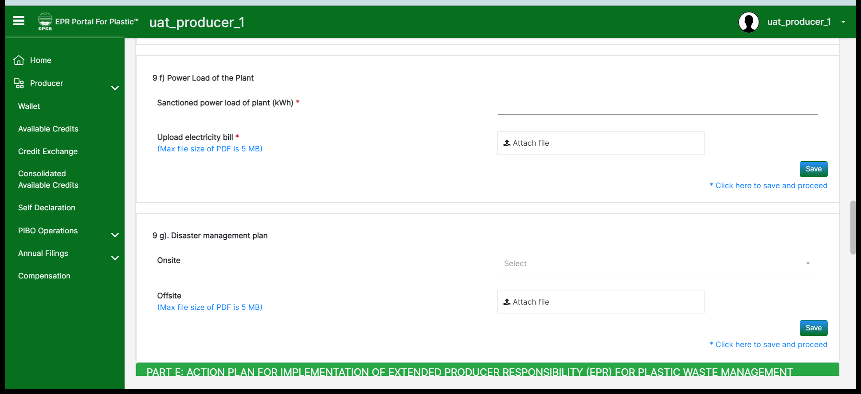
PRODUCER
9(f) and 9(g): Sanctioned power load of the plant and recent electricity bill document should be uploaded for the same.
9(g): Disaster management plan for onsite and offsite should be provided.
Note: Details of 9(a) to 9(g) containing production facility details are not to be provided in case of importers

Slide 22
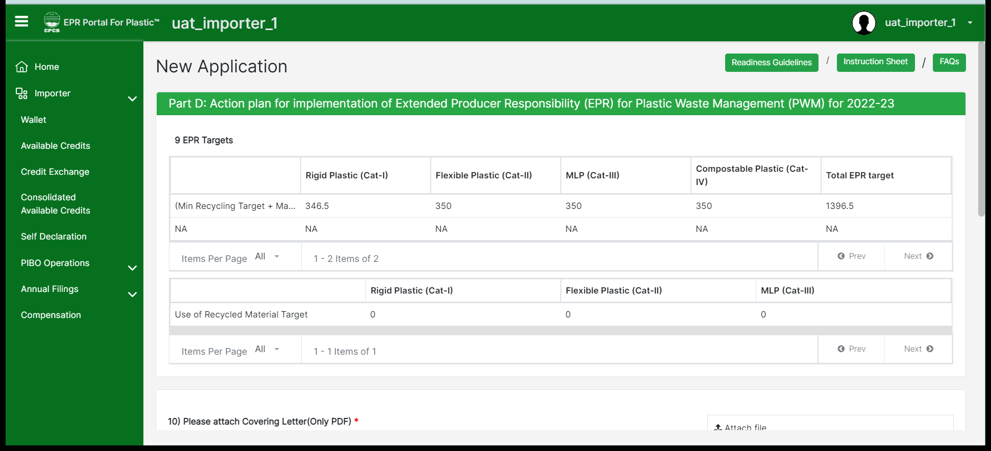
IMPORTERS
Details containing production facility details are not to be provided in case of importers. EPR targets will be auto calculated in section 9 for importers.

Slide 23
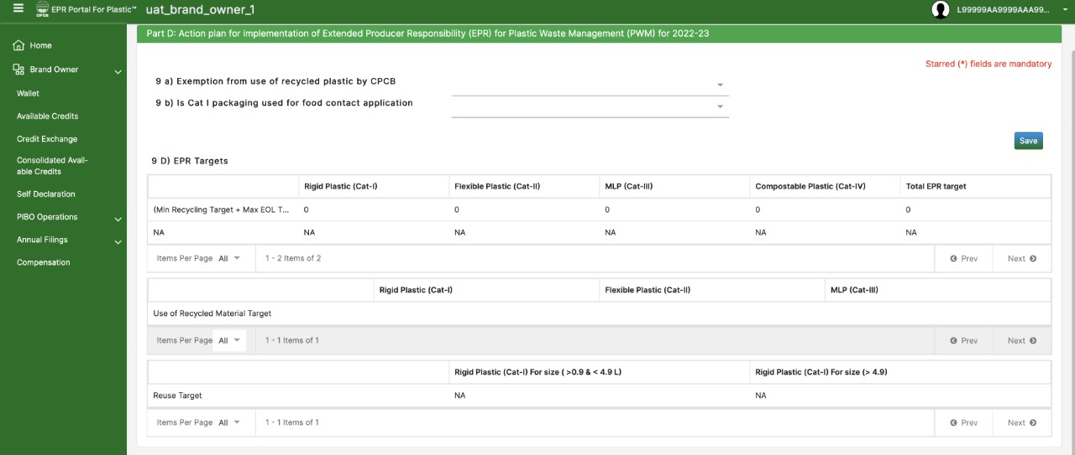
BRAND OWNERS
9(a): Exemption from use of recycled plastic by CPCB to be mentioned by the brand owners
9(b): Cat-I packaging use for food contact application should be mentioned by the brand owners

Slide 24
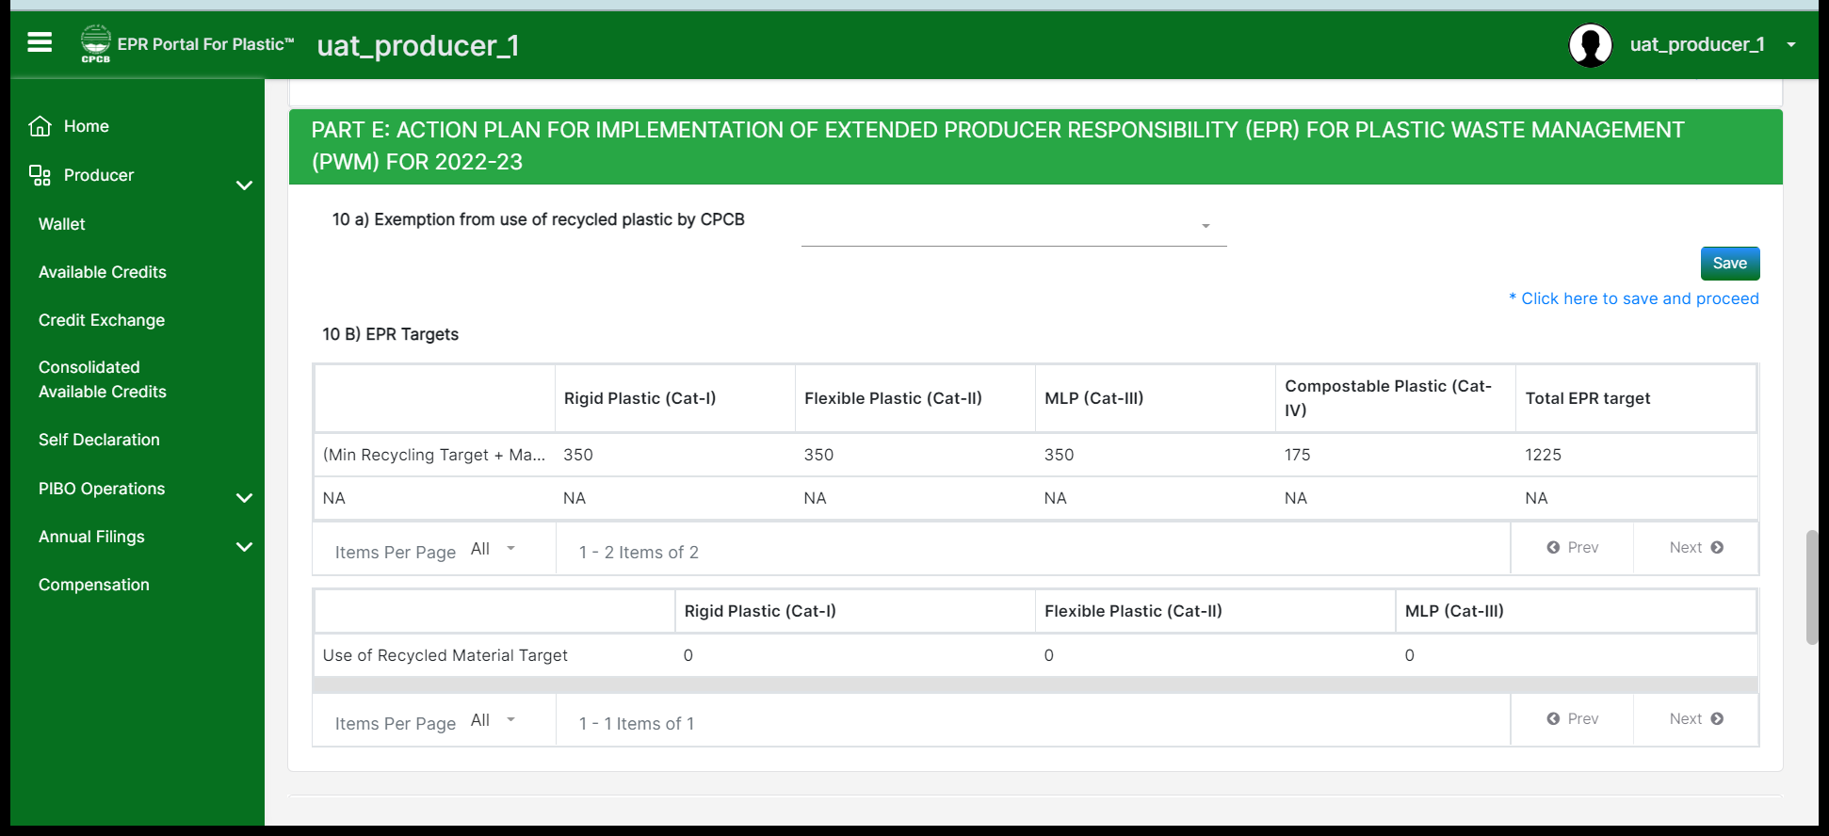
PRODUCER
10(a): Exemption from use of recycled plastic by CPCB is available, then the producers can procure/buy certificates for use of recycled plastic from other PIBOs to meet the EPR obligations.
10(b): EPR targets will be auto calculated based on the input details that has been provided.

Slide 25
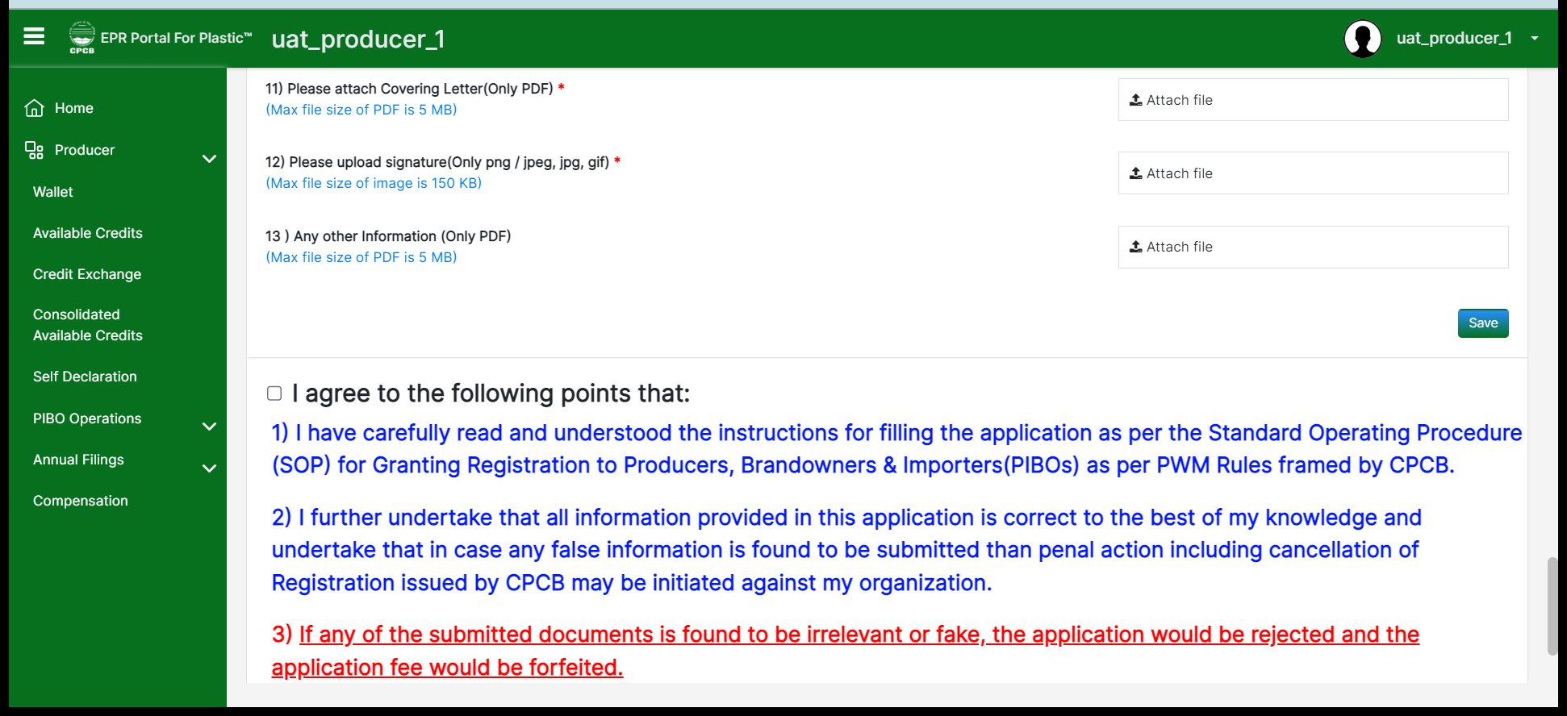
PRODUCER
Covering letter with signature should be uploaded in the relevant formats. Keep saving the details of the relevant sections and verify before submitting the application.

