Slide 1
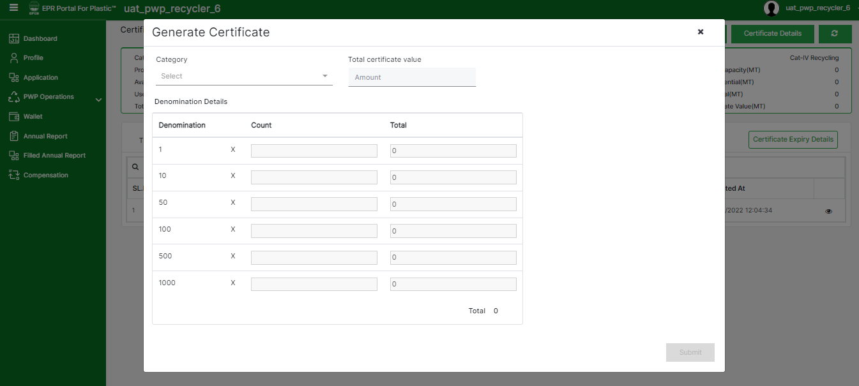
Generation of EPR CERTIFICATE
The certificates can be generated by PWPs by accessing their respective Wallets.
The Available Potential must be greater than 0 to generate certificates.
The PWP needs to click on the Generate Certificate button.
In the modal window that appears, the PWP needs to select the Category of certificates that are required and may input the required denomination in which the certificate needs to be generated.
After clicking on Submit the certificates will be generated and an equivalent amount for Available Potential will be reduced and Certificate Value will be added to the PWPs wallet.

Slide 2
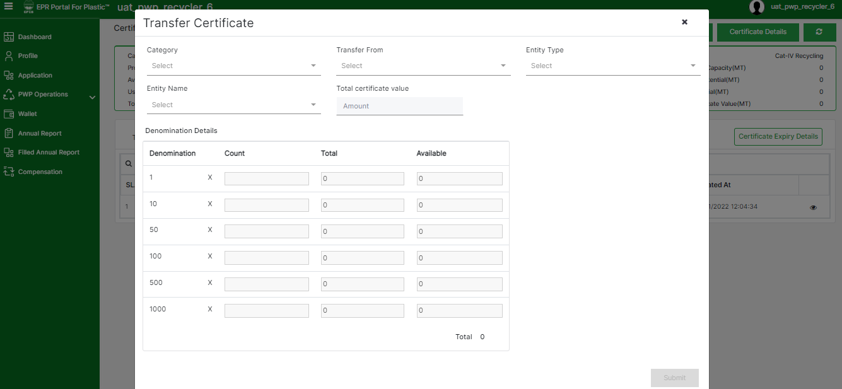
TRANSFER of EPR CERTIFICATE
The certificates can be transferred by PWP to a PIBO by accessing their respective Wallets.
The Certificate Value must be greater than 0 to transfer certificates.
The PWP needs to click on the Transfer Certificate button.
In the modal window that appears, the PWP needs to select the Category of certificates that are required to be transferred, the PIBO to whom the certificates are to be transferred needs to be selected and the denomination is required in which the certificate needs to be transferred.
After clicking on Submit the certificates will be transferred and an equivalent amount for Certificate Value will be reduced from the PWPs wallet.

