Slide 1


Broken Tree Detection on road
Presented by,
Asish Chowdhury
Roll no. 205120023

Slide 2
CONTENTS
Abstract
Proposed Solution
Procedure

Slide 3
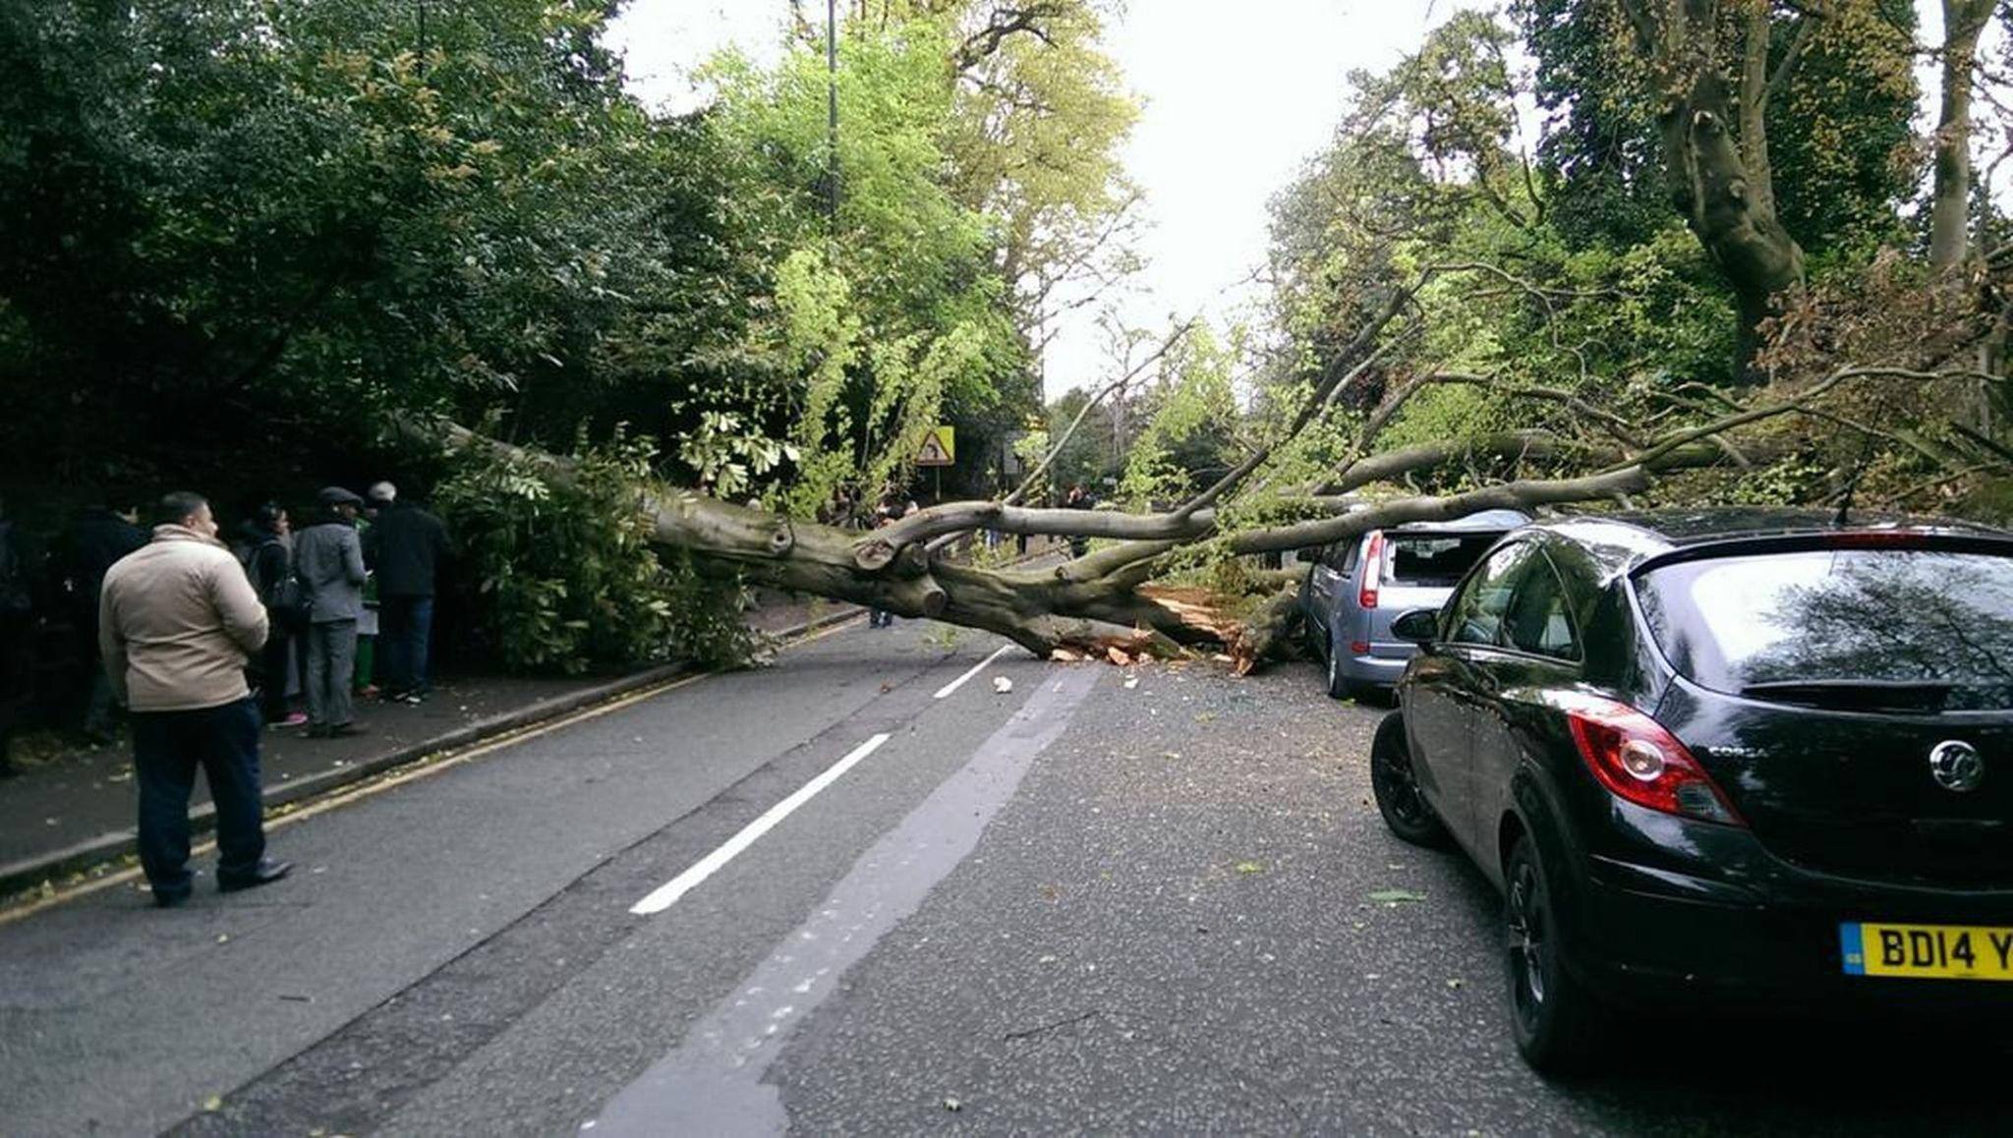
1
Abstract
In a smart city, There will be a central server or hub.
Where everyone can post photos that are related to the city problem.
And my project is responsible for detecting broken trees on the road by the provided image and alerting concerned authorities.

Slide 4
2
Proposed Solution
Image Classification using CNN
There will be two types of classes of images
Images are collected from Kaggle.
VGG 19 model Architecture is followed.
And finally I will train and test my model.

Slide 5


3
Procedure
Dataset
Create Model
1900+ images
VGG 19 model is followed
Input size : 128x128
Prediction : 2 classes
Testing Model
1
5
3
Prediction
2
4
Preprocessing
Training Model
Data Cleaning
Dimension Reduction

Slide 6
THANK YOU !

