Slide 1
Methodology: Networks of Comorbidity
Georgia Smith
CSC 4990 Spring 2021

Slide 2
Methodology: Overview
Expected input
NCS-R Description Data [1] [http://www.icpsr.umich.edu/SDA/NAHDAP/20240-0002/CODEBOOK/tree_items.js]
NCS-R Questionnaire Data [1] [https://www.icpsr.umich.edu/web/ICPSR/studies/20240]
Implementation platform
Python
Libraries:
NetworkX
MatplotLib
Numpy
Pandas

Slide 3
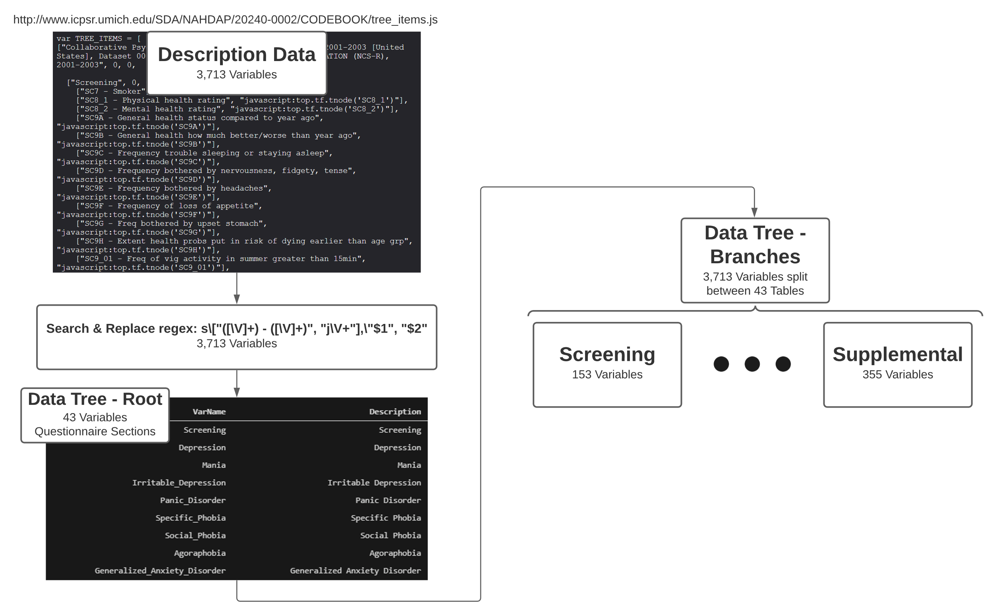
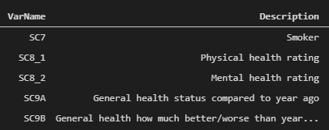
Step 1 – Data Descriptions

Slide 4
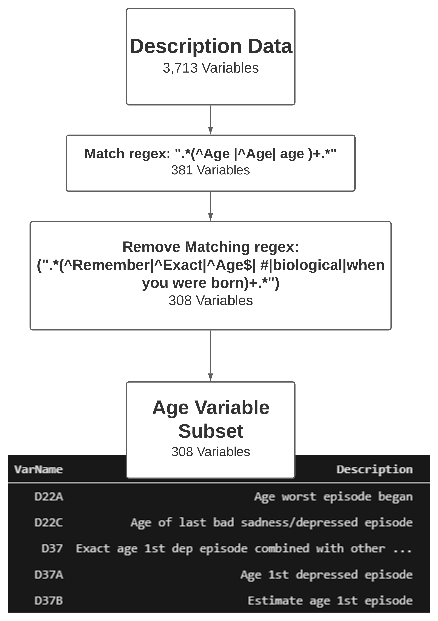
Step 2 – Age Variable Subset

Slide 5
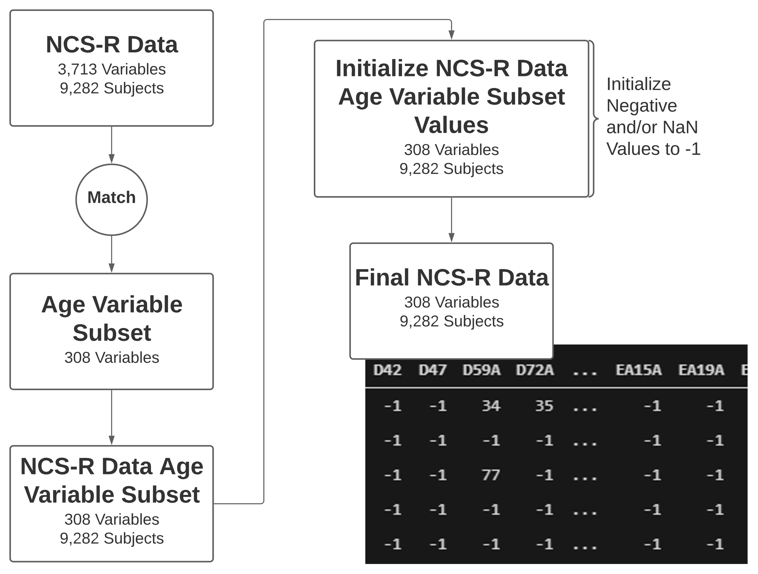
Step 3 – Initialize NCS-R Data

Slide 6
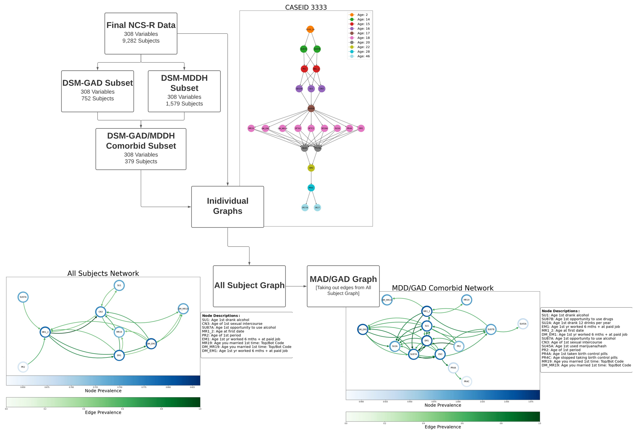
Step 4 – Develop Graphs

Slide 7
Step 4 – Develop Graphs

Slide 8
Step 4 – Develop Graphs
Hawkes LSTM RNN

Slide 9
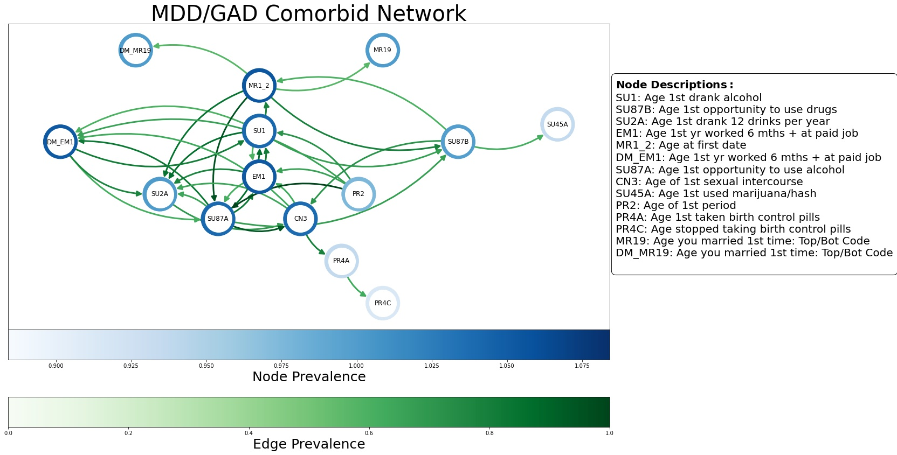
MDD/GAD Comorbid Network

Slide 10
Methodology: Output Overview
Update
LSTM/Hawkes Errors
Deep Diffusion Process (DDP) [2]
Algorithms to Implement
Hawkes Process
LSTM/DDP
Recurrent Neural Network
Algorithm Implementation Platform
Python Libraries:
tick.hawkes
pytorch
hawkeslib
Rivanna High Performance Computing

Slide 11
References
[1] Alegria, M., Jackson, J. S. J. S., Kessler, R. C., and Takeuchi, D. (2016). Collaborative psychiatric epidemiology surveys (cpes), 2001-2003 [united states].
[2] Qian, Z., Alaa, A., Bellot, A., Schaar, M., and Rashbass, J. (2020). Learning dynamic and personalized comorbidity networks from event data using deep diffusion processes. In International Conference on Artificial Intelligence and Statistics, pages 3295–3305. PMLR.

