Slide 1

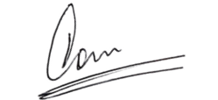
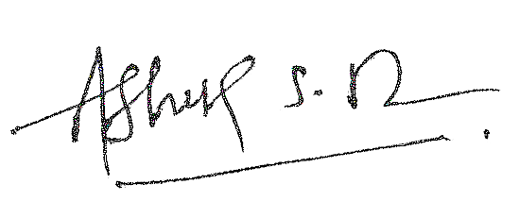
CERTIFICATE OF COMPLETION
Anandibai Damodar Kale Shaikshanik Sanstha’s
Anandibai Damodar Kale Degree College of Arts & Commerce
Saibaba Nagar, Borivali (West), Mumbai 400092
IS HEREBY GRANTED TO
<<NAME_PLACEHOLDER>>
TO CERTIFY COMPLETION OF ADVANCE EXCEL TRAINING
Laxmidevi Gupta
Course Co-Ordinator
Dr. Ashok Luhar
In-Charge Principal

