Slide 1
CLASSIBILITY
PRESENTATION

Slide 2


INTRODUCTION
Background
There was a word says “ Learning is one of the most important part of growing up”. Education is everywhere but there are some flaws in the system. classroom attendance is huge process and it is time consumer.
So this is become an inspiration for the new Developing Project
“Classibility”

Slide 3
INTRODUCTION
CLASSIBILITY
Classibility, the name of project come from combining “Class + Ability” which mean it offer user an ability to manage classroom.
Classibility is an check-in classroom data store based mobile application. It aims to solve and save time consuming tasks of the class.
Main functions of application are
-Face recognise check-in
-Class room authentication
-History

Slide 4
Design

Slide 5
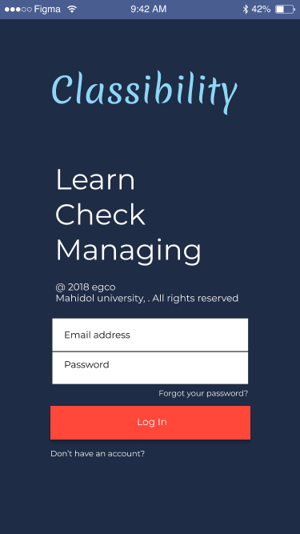
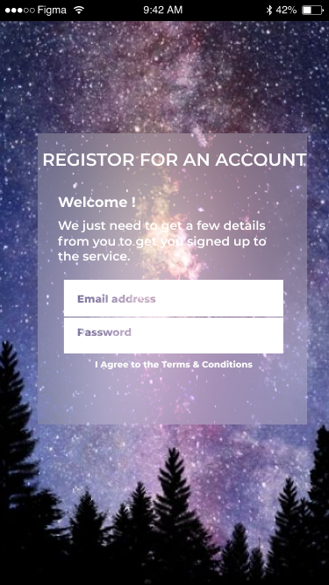
Login
Login
Sign-up

Slide 6
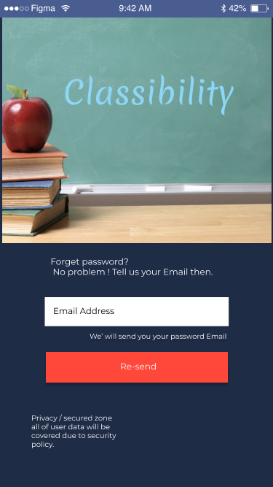
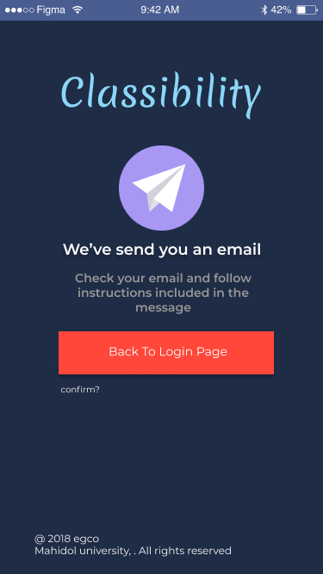
Password Recovery
Forget
Confirm

Slide 7
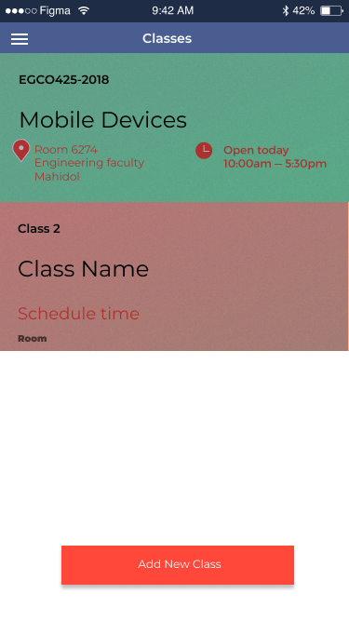
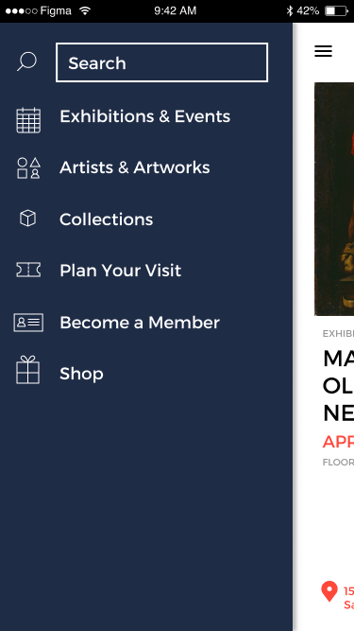
Home
Forget
Confirm

Slide 8
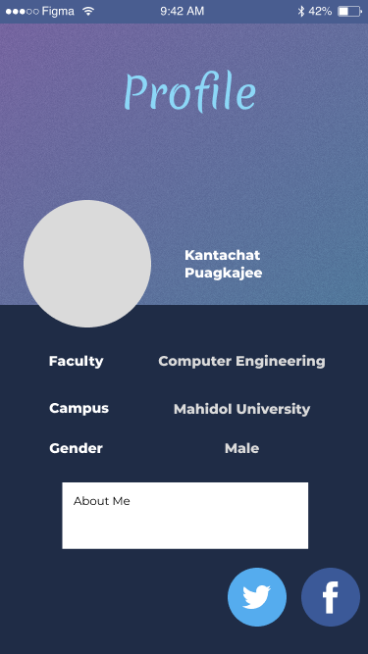
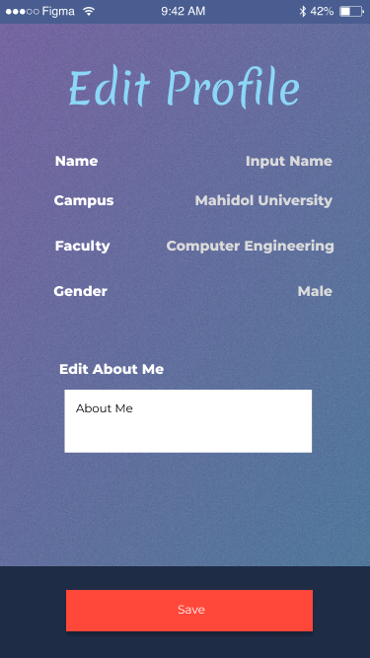
Profile
Forget
Confirm

Slide 9
Profile
Forget
Confirm

Slide 10
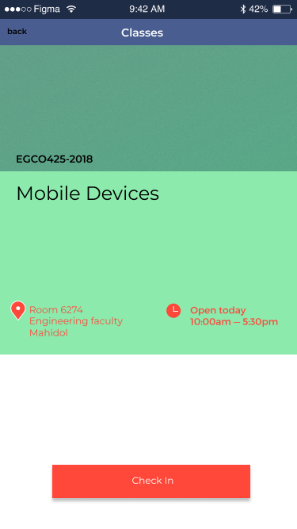
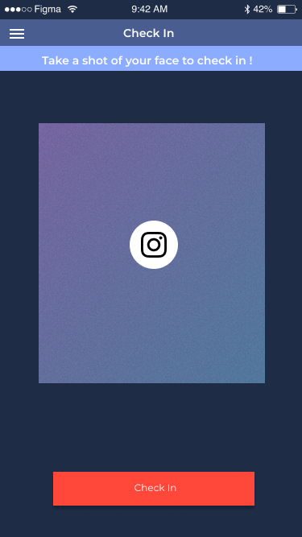
Check-in
Forget
Confirm

Slide 11
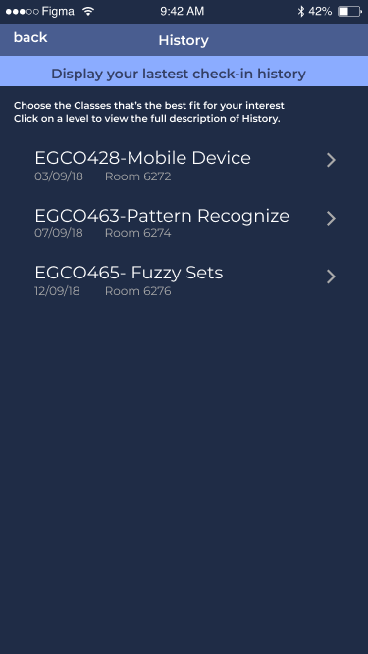
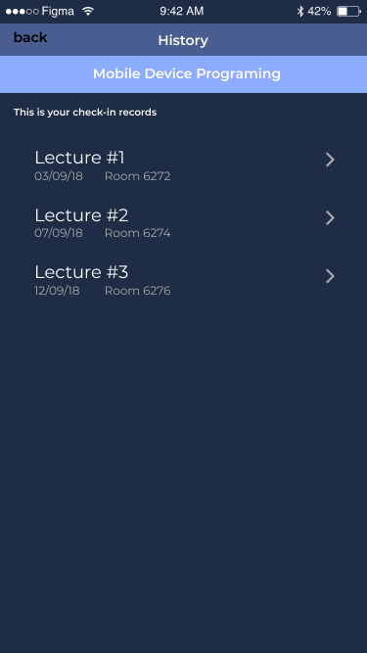
History
Forget
Confirm

Slide 12
Functions

Slide 13
Functions
Face Recognition
Database
Profile
Classibility use face as a biomedical identification for validate class attendance.
Class,Lecture and attendance is stored in online database.
Allow students to edit and display their own profile.
Authentication
Navigate
History
Account management, Registration, Account recovery and Sign-in are all included in this category.
Navigation bar allow user to navigate through out an entire application.
check from the student’s history for their attendance in the class.

Slide 14

Face Recognition
Classibility come with face recognition for student. It allow student to check-in in the time Lectures happens.
False attendance is considered the main problem of checkin system. so we use face as a biomedical identity.

Slide 15
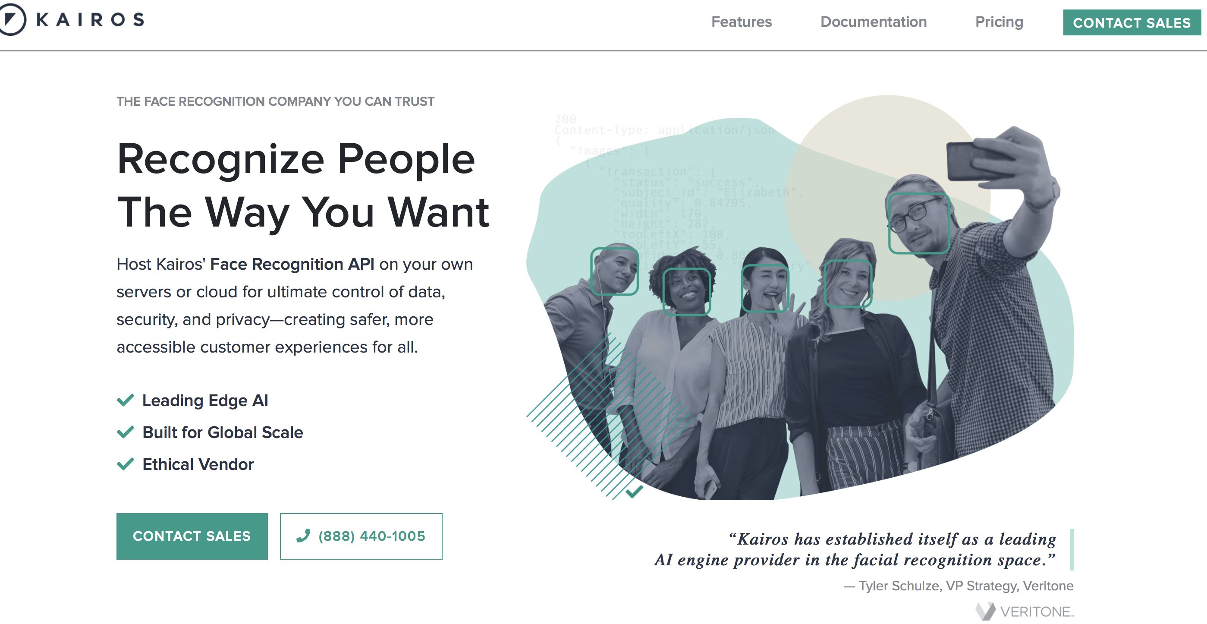
Kairos
Face Recognition API for ultimate control of data security, and privacy— creating safer, more accessible customer experience for all.

Slide 16

Database
Classibility come with online web service from Google “ Firebase” . it is used for class, student’s profile and lecture attendance in the application.

Slide 17
Reatime Database
We used realtime database for class and class attendances.

Slide 18
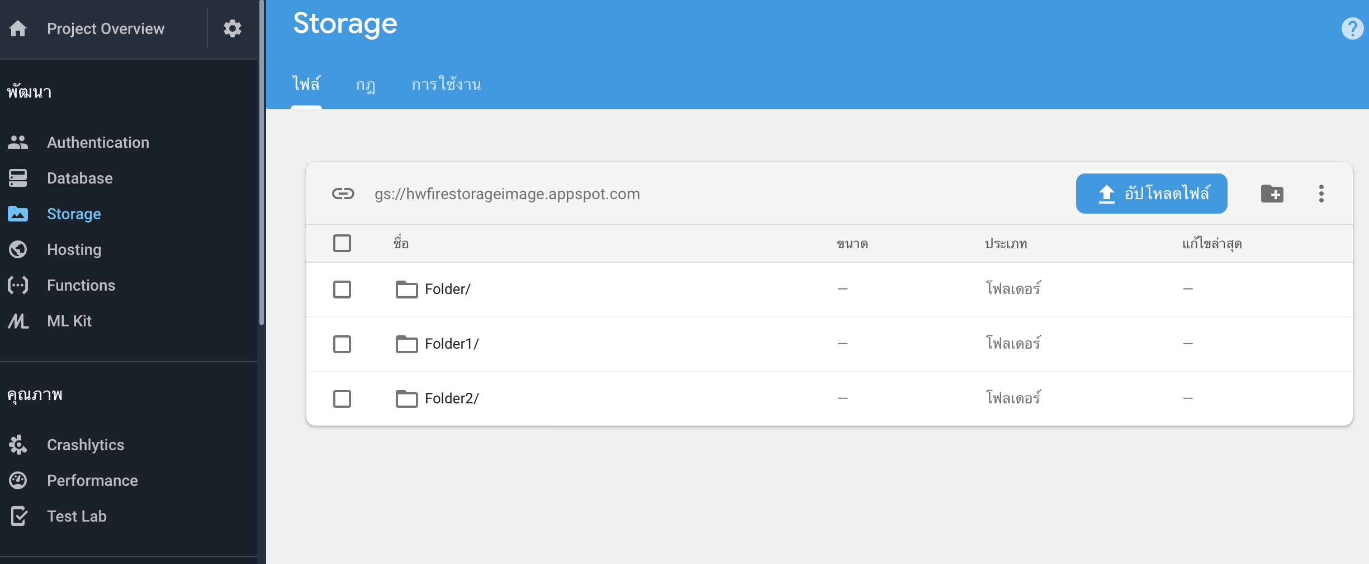
Storage
We used storage database for class and class attendances.

Slide 19
Profile
Classibility allows user to edit their own profile. it is also requires user to upload picture for face identification feature as well.
Confirm

Slide 20
Authentication
Authentication is the process of determining whether someone or something is, in fact, who or what it declares itself to be. Authentication technology provides access control for systems by checking to see if a user's credentials match the credentials in a database of authorised users or in a data authentication server.

Slide 21
History
Once user registered into the class and checked in. Application allow user to check their lecture history of each Classes.

Slide 22
Demo

Slide 23

THANK YOU!
ANY QUESTIONS?
Mr. Thavatchai Tangsritavon
Mr. Kantachat Puagkajee

