Slide 1
Zomato Restaurant Analysis
Insights & Business Recommendations

Slide 2
The Problem
Where should Zomato expand next
Which markets have low competition
What factors influence success

Slide 3
Dataset Overview
1 table with 23 attributes
14 categorical variables
Data cleaned and prepared for analysis
Clean, Consistent and Standardized Data

Slide 4
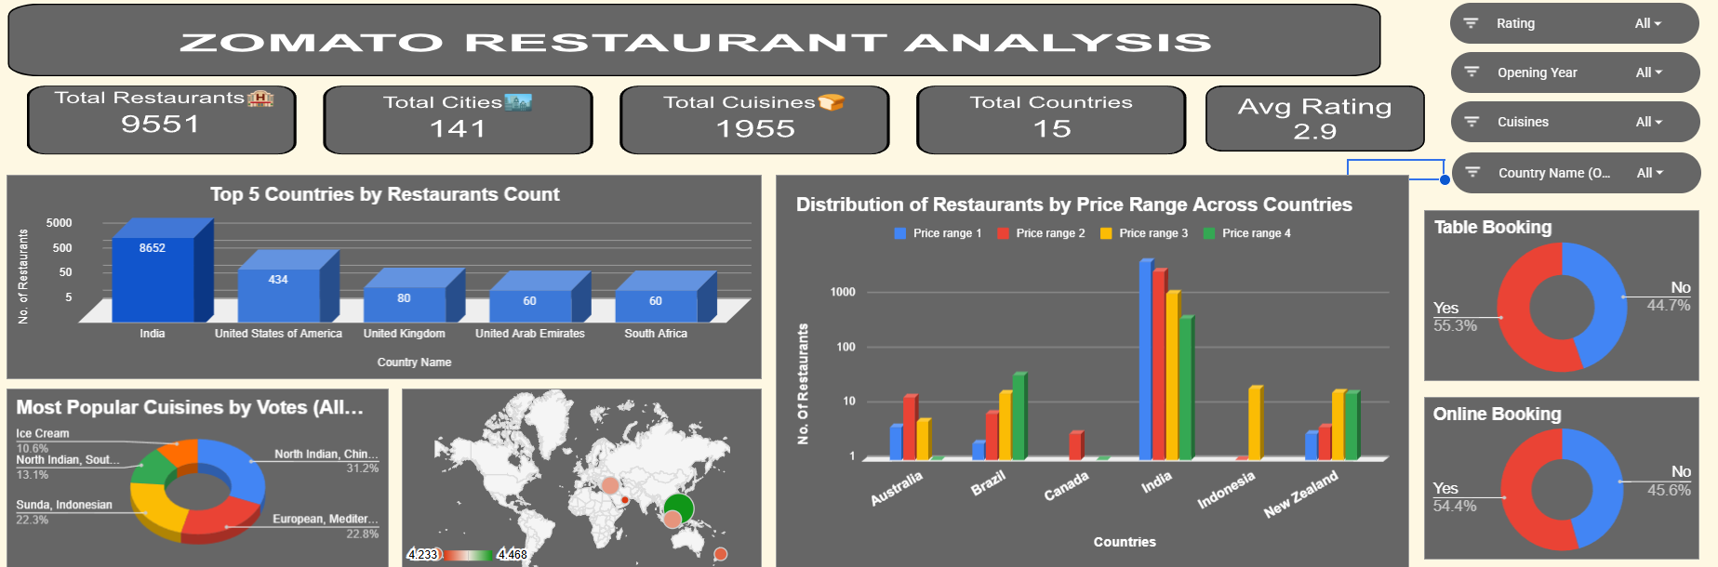
Key KPI Summary
Total Restaurants: 9551
Average Rating: ~2.9
Total Votes analyzed:14,98,645
Average cost evaluated:1199.21

Slide 5
Country Insights
India dominates with 8652 restaurants (>90%)
Canada has lowest presence (4 restaurants)
Indicates high competition in India and opportunity elsewhere

Slide 6
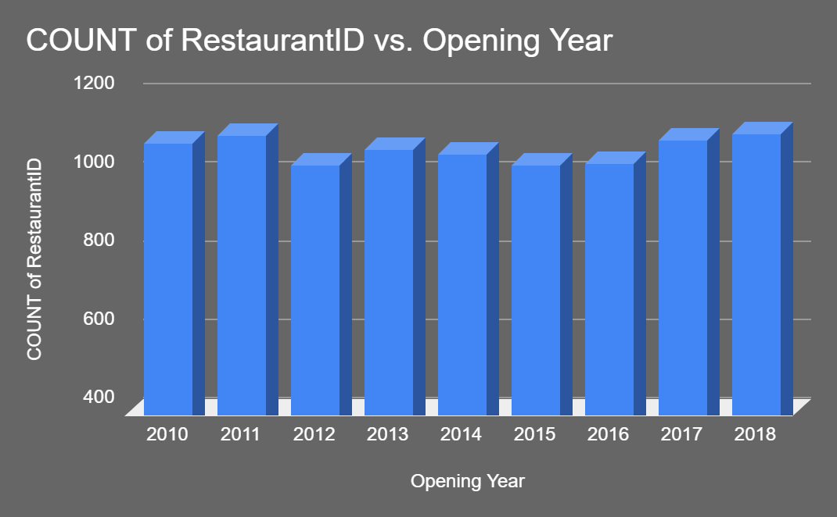
Year-wise Trend
Restaurant openings stable (~1050–1100 yearly)
Peak observed in 2018 with 1102 restaurants
Indicates steady market growth

Slide 7
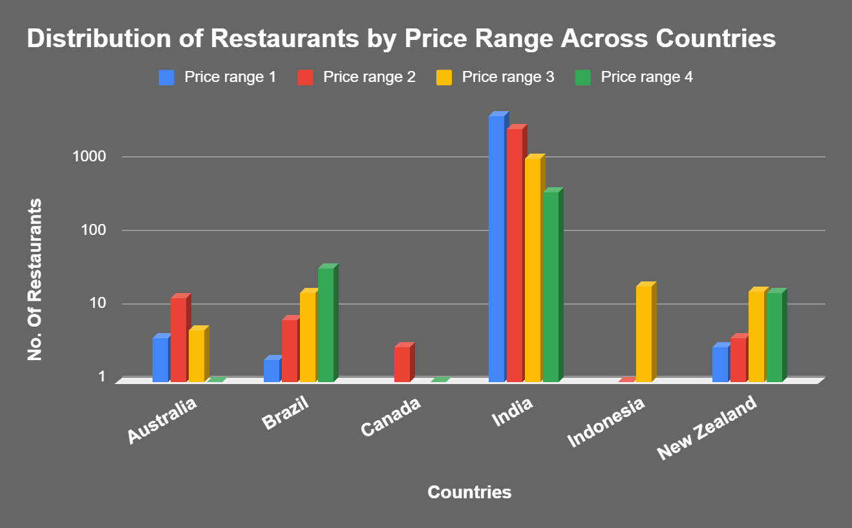
Price Range Analysis
Majority restaurants in Price Range 1 & 2
Mid-range stable
Premium segment limited

Slide 8
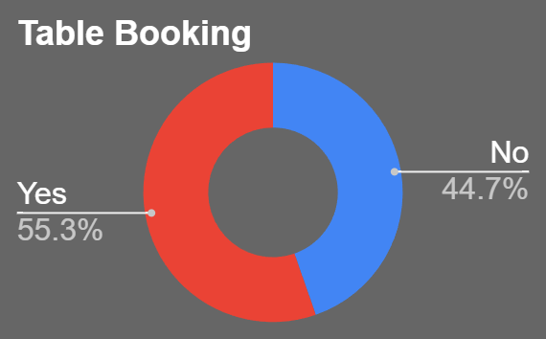
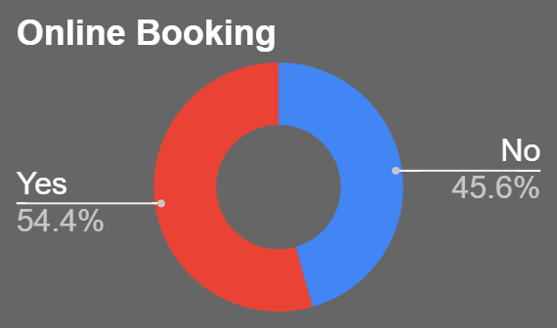
Customer Behavior
Online delivery improves ratings
Table booking enhances experience
Convenience impacts satisfaction

Slide 9
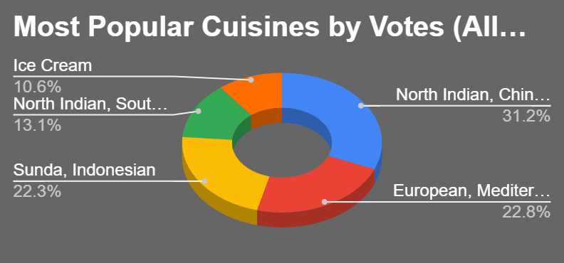
Cuisine Insights
Multi-cuisine performs best
Popular cuisines receive higher ratings
Cuisine choice affects feedback

Slide 10
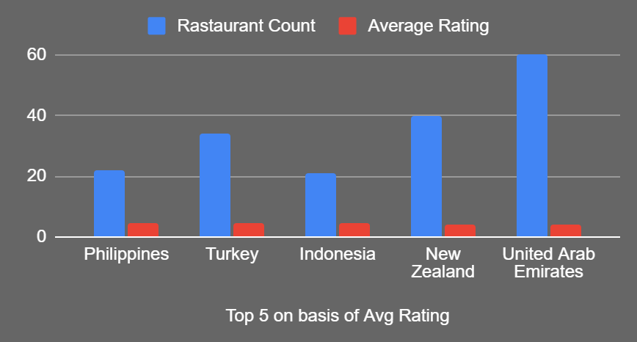
Competitor Analysis
High rating + high votes = strong competitors
Low-rated restaurants indicate opportunity
Scope for improvement in weak segments

Slide 11
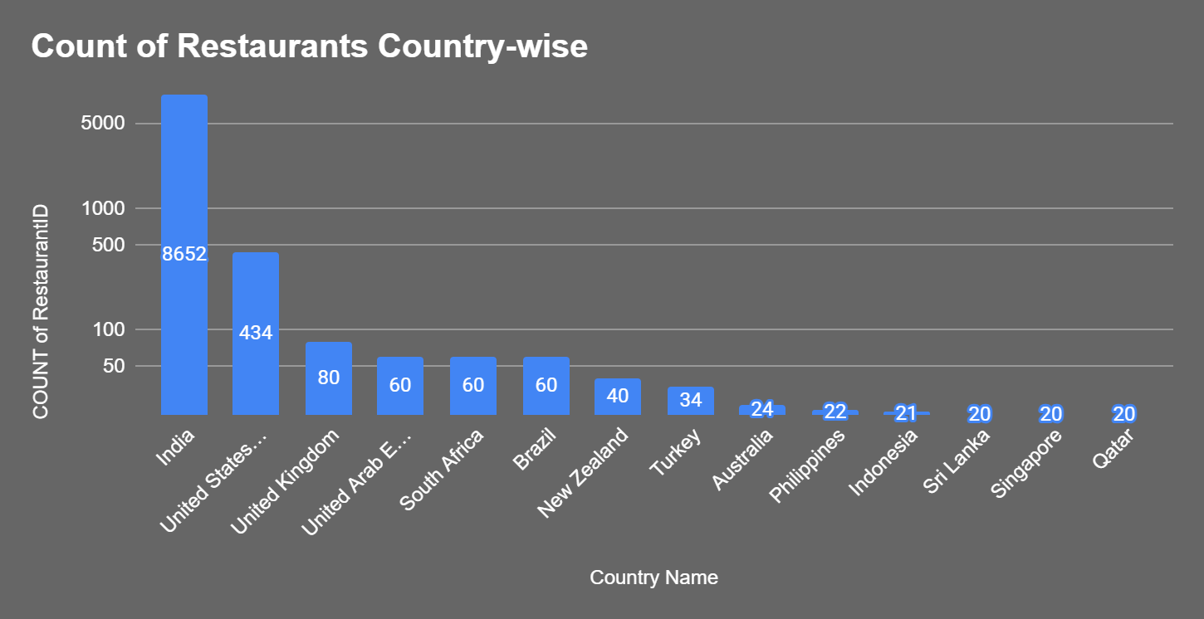
Count of Restaurants Country-wise
India dominates the dataset with 8,652 restaurants, accounting for over 90% of all restaurants.
Most other countries have fewer than 100 restaurants, indicating the dataset is heavily concentrated in India.

Slide 12
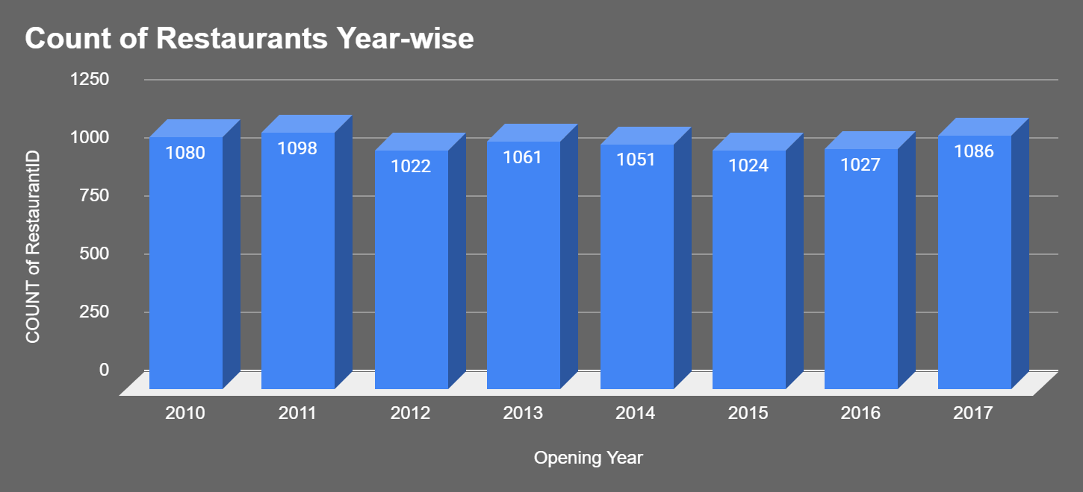
Count of Restaurants Year-wise
The number of restaurant openings remains relatively stable between 2010 and 2017, ranging around 1,000 restaurants annually.
2011 records the highest number of restaurant openings, while 2016 shows a slight dip.

Slide 13
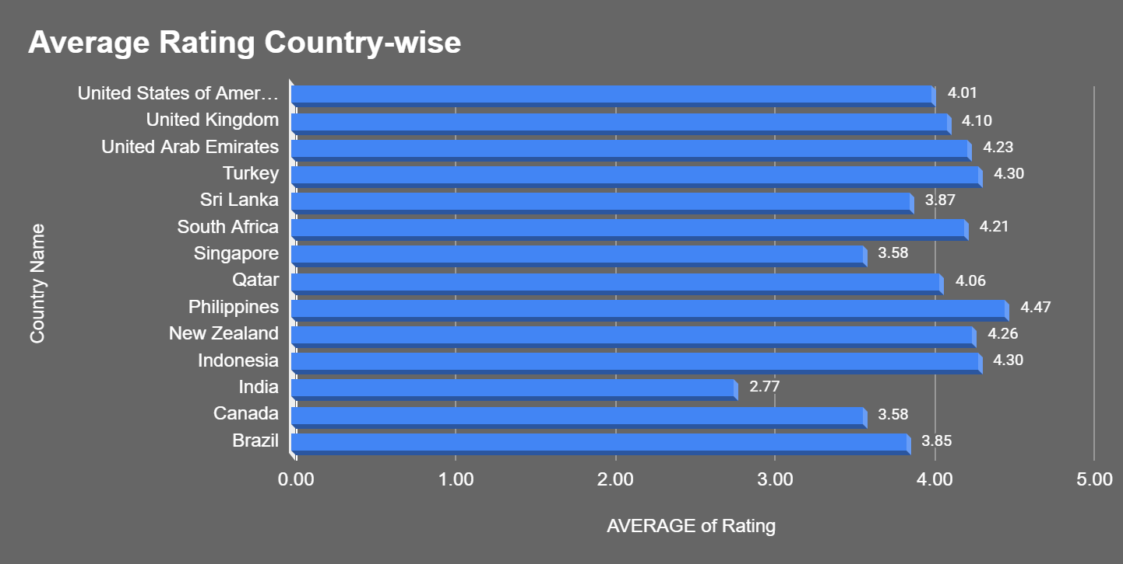
Average rating country- wise
The Philippines has the highest average restaurant rating of approximately 4.5.
Turkey, Indonesia, and New Zealand also maintain high average ratings above 4.3, indicating strong customer satisfaction.

Slide 14
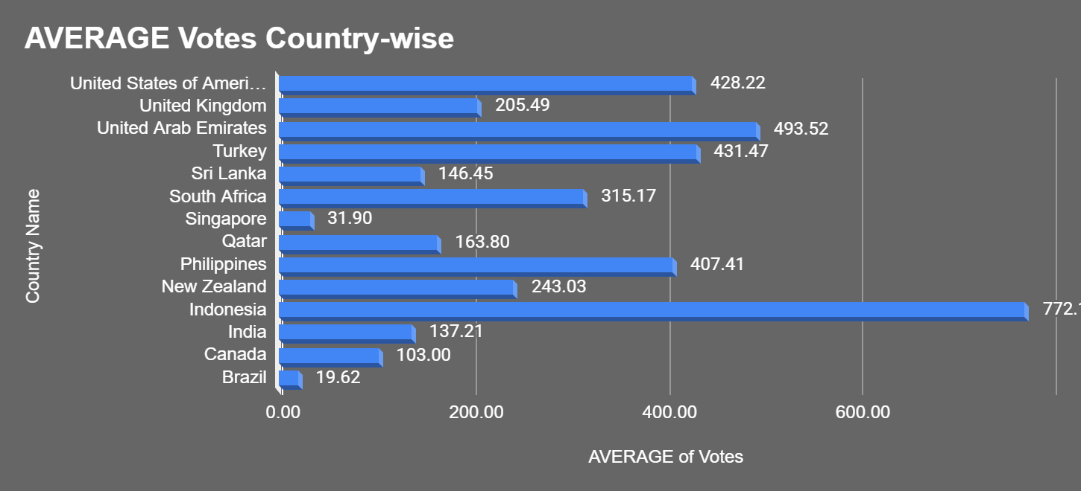
Average votes country-wise
Indonesia records the highest average votes (772), indicating very active customer participation.
Brazil and Canada receive relatively fewer votes, suggesting lower customer review activity.

Slide 15
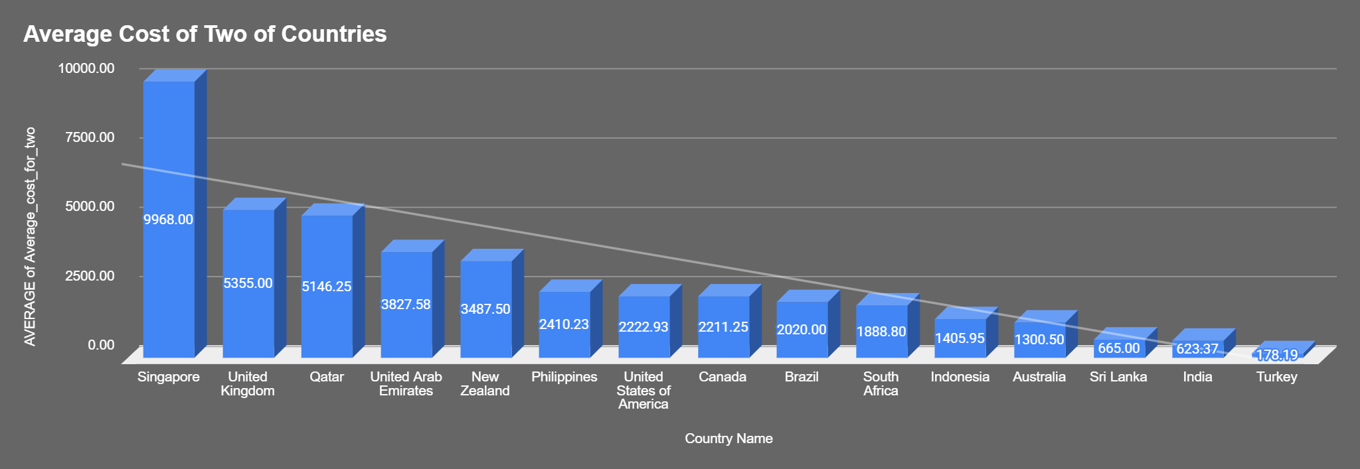
Average cost of two of countries(converted into INR)
Singapore has the highest average dining cost, making it the most expensive market in the dataset.
Turkey offers the most affordable dining experience among the listed countries.

Slide 16
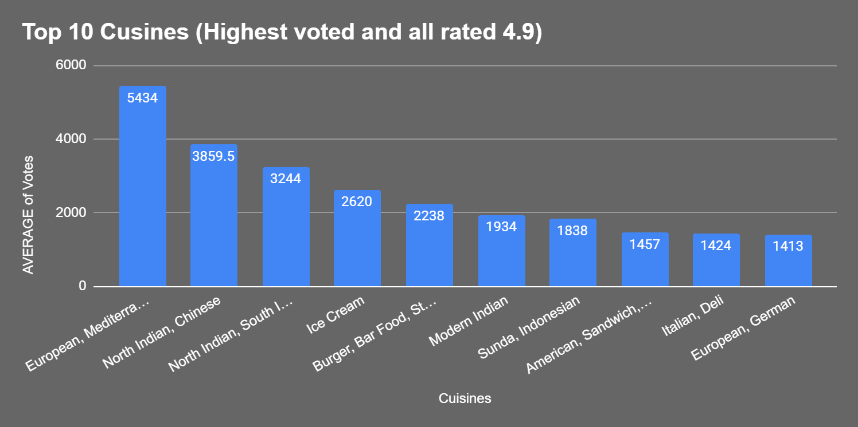
Top 10 Cuisines (Highest voted and all rated 4.9)
European cuisine receives the highest total votes, indicating strong customer engagement.
North Indian and Chinese cuisine combinations are among the most popular food preferences.

Slide 17
Business Recommendation
Expand in low competition countries
Focus on mid-range pricing
Leverage delivery and popular cuisines
Target high-rating cities
Expansion Destinations include Indonesia,
Turkey and Philippines.

Slide 18
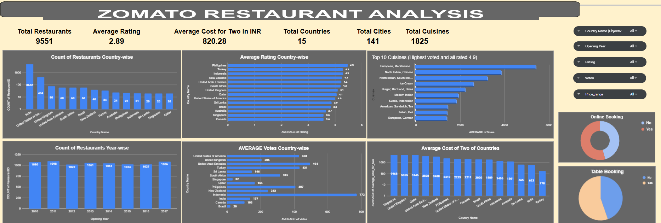
Interactive Dashboard 1

Slide 19
Final Recommendation
Target Indonesia, Turkey, Philippines
Focus on customer experience
Use data-driven expansion strategy

Slide 20
Conclusion
Market dominated by affordable dining
Stable growth observed
Data-driven expansion strategy recommended
Affordable, quality-driven strategy wins
Strong opportunity for expansion

