Slide 1
“Sales Analysis and Predictive Modeling for Walmart Stores"
Name: Suraj Shete
Stream: Data Analytics
Gmail: 02surajshete@gmail.com
My LinkedIn Profile

Slide 2
Why I had selected this project:
Analyzing Sales and predictive modeling is a practical and valuable skill in many industries.
Walmart is a large retail chain with extensive sales data. Access to such a rich dataset can provide you with ample opportunities to explore different aspects of data analysis and modeling.
This project covers a wide range of skills that are valuable in the field of data science.

Slide 3
Problem Definition:
There is a sales data available for 45 stores of Walmart.
The business is facing a challenge due to unforeseen demands and runs out of stock some times, due to the inappropriate machine learning algorithm.
So the Machine Learning algorithm will predict demand accurately.
I tried to build two model in this project

Slide 4
Flow of Work:
Reading and loading data
Data exploration
Data summarization:
Data visualization
Outlier detection and removal
Correlation analysis
Creating dummy variables
Linear regression model
Random Forest model

Slide 5
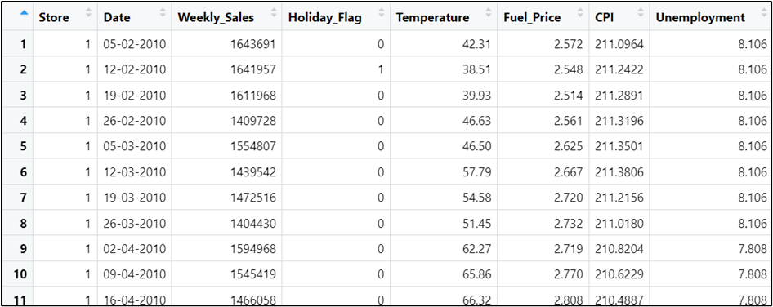
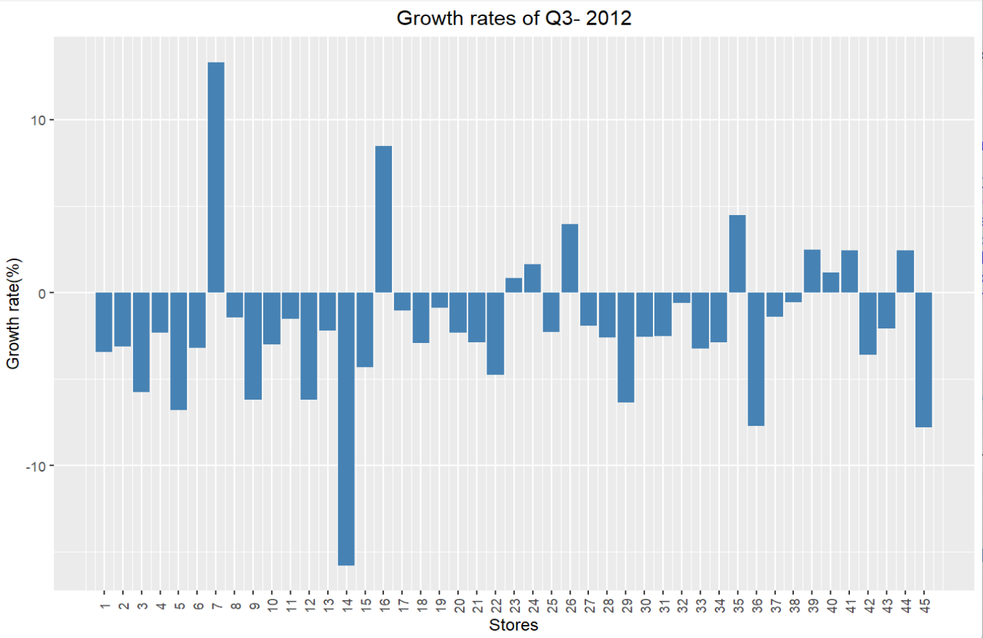
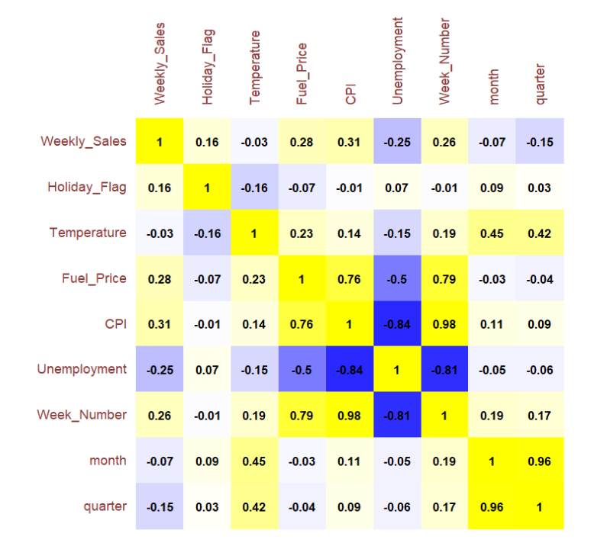
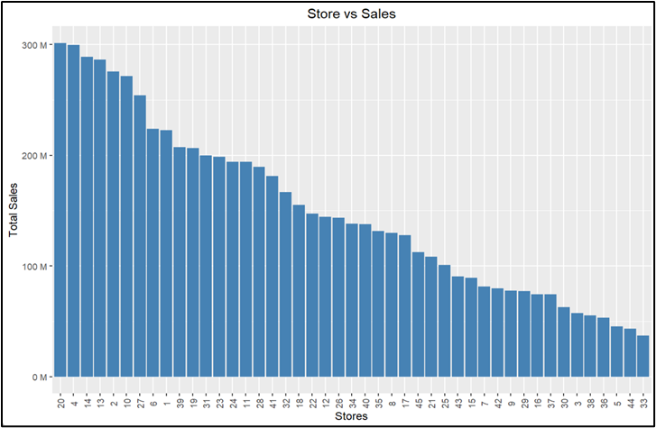

Slide 6
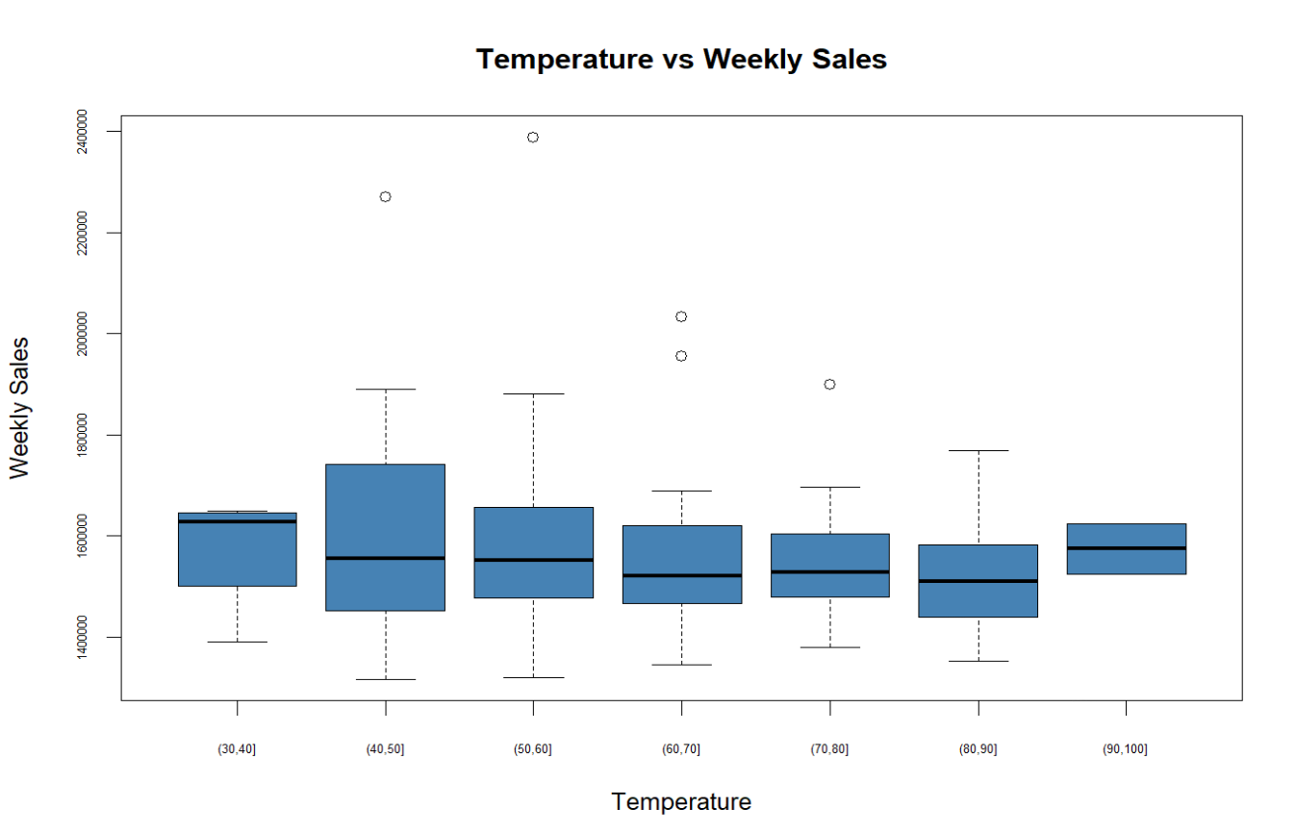
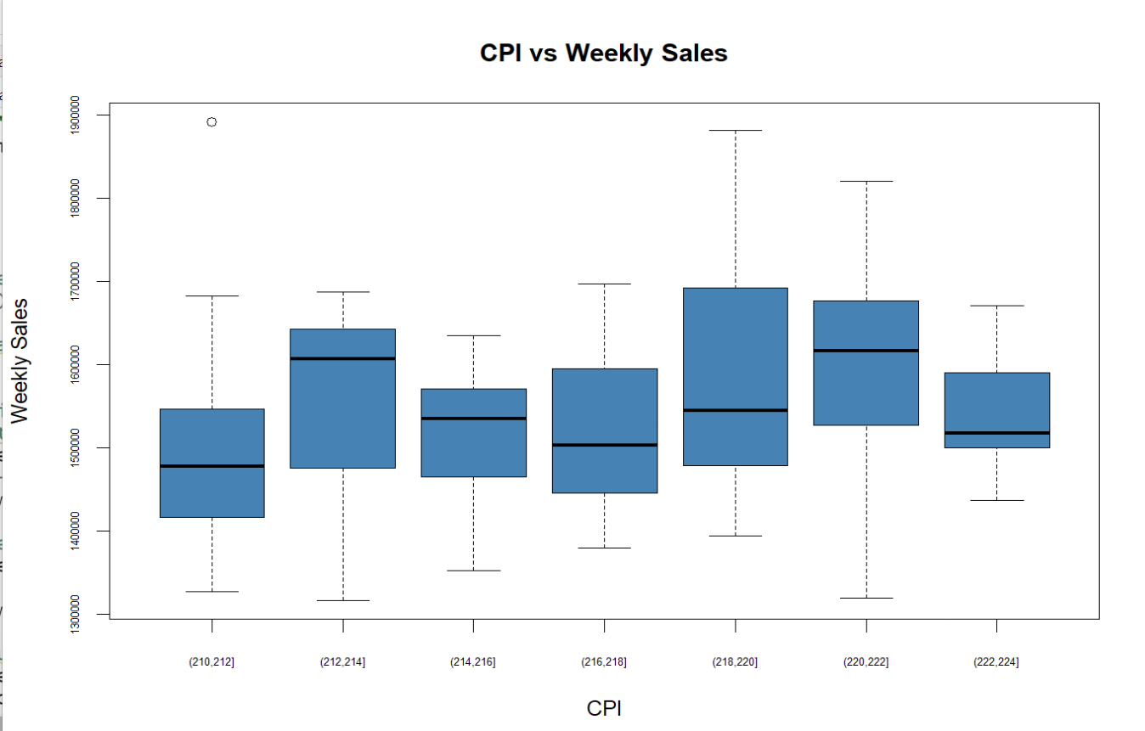
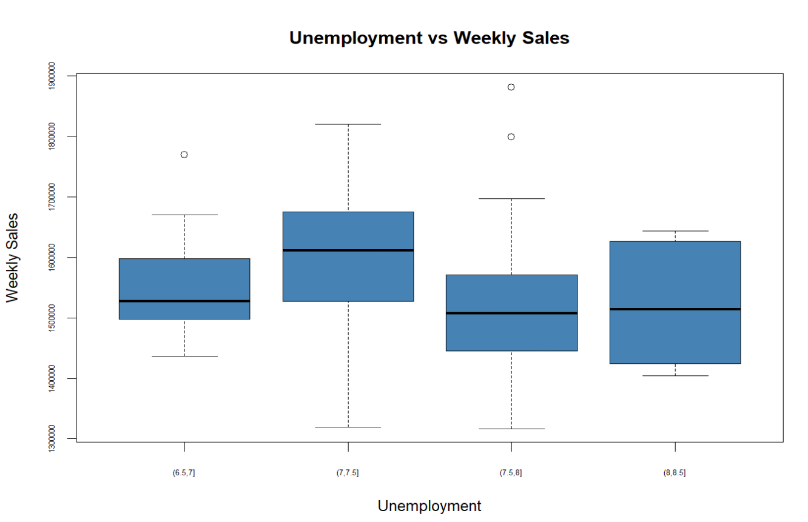
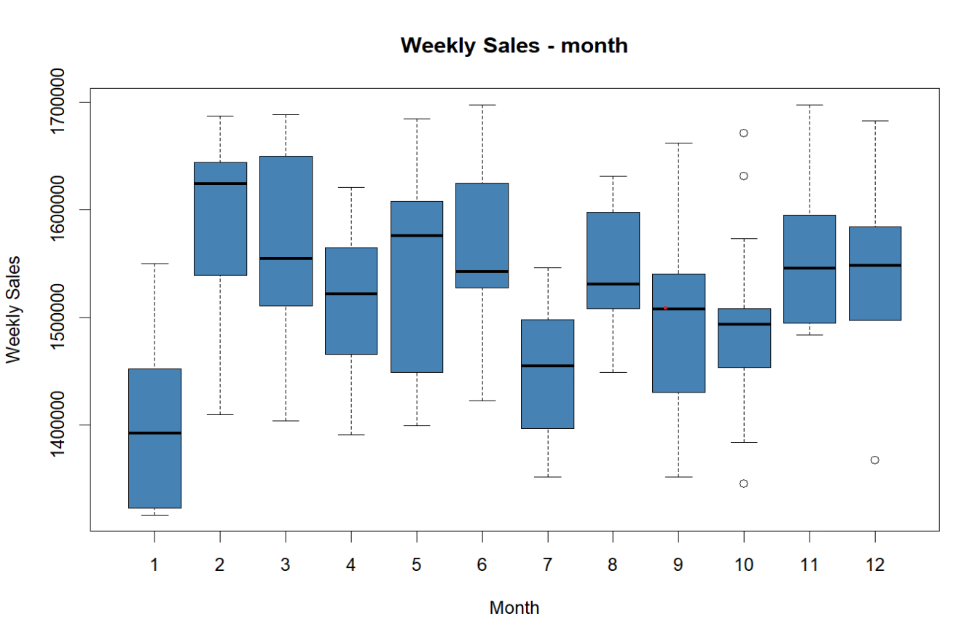
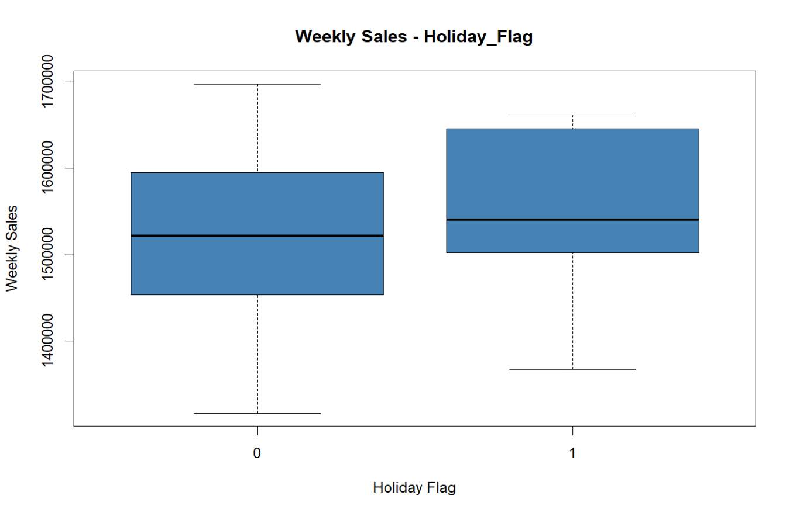
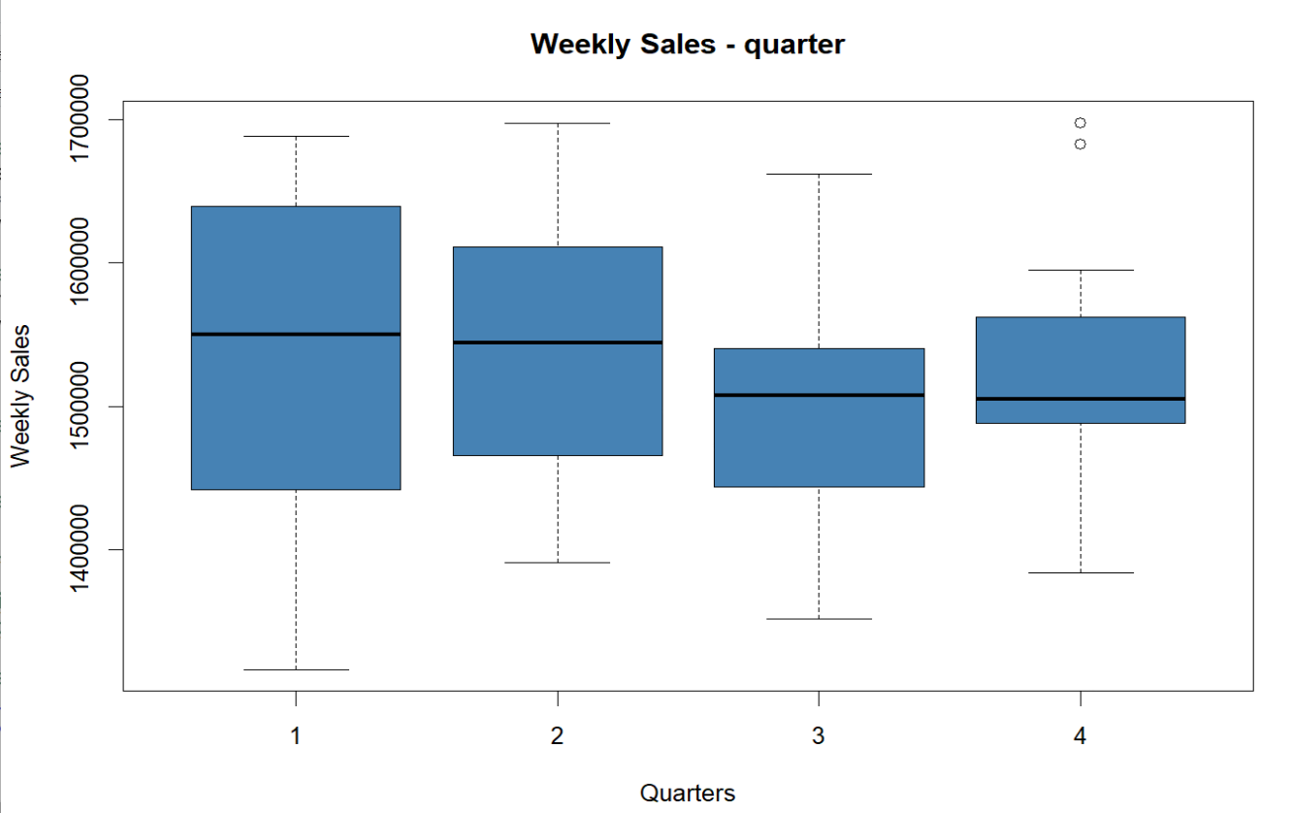
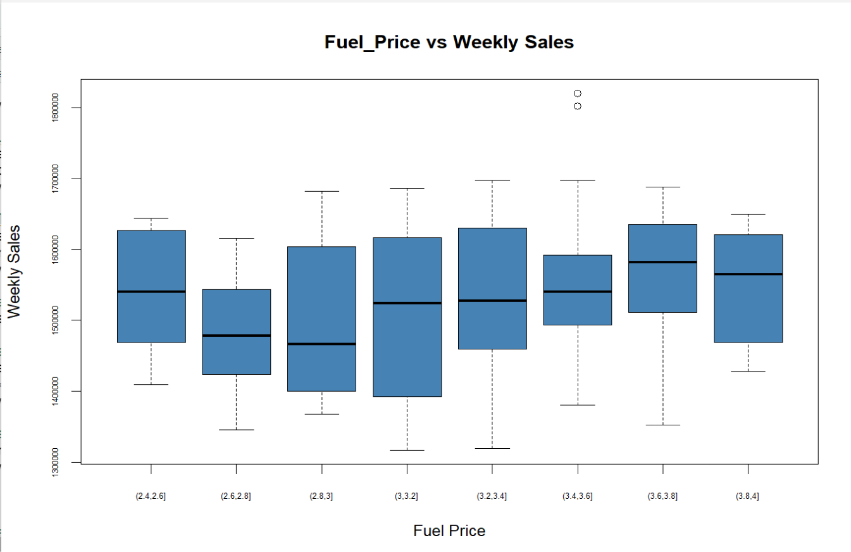

Slide 7
Model used and its explanation:
LINEAR REGRESSION
The code sets a random seed for reproducibility, loads necessary libraries, and selects specific columns from the dataset for analysis, including parameters like Weekly Sales, Holiday Flag, Temperature, Fuel, CPI, Unemployment, Week number, Event (categorical), quarter (categorical), and month (categorical).
The dataset is split into training and test sets using a 70-30 ratio.
Weekly_sales is my dependent variable and rest all are independent.
The model is used to make predictions on test data sets and that data is been stores in the linear_predictions variable.
Two scatterplots are generated, one for actual vs predicted sales on train dataset and another on test data.
Test data is stored in the result data frame
The Mean Absolute Percentage Error (MAPE) and Root Mean Squared Error (RMSE) are calculated to assess the accuracy of the linear regression model.

Slide 8
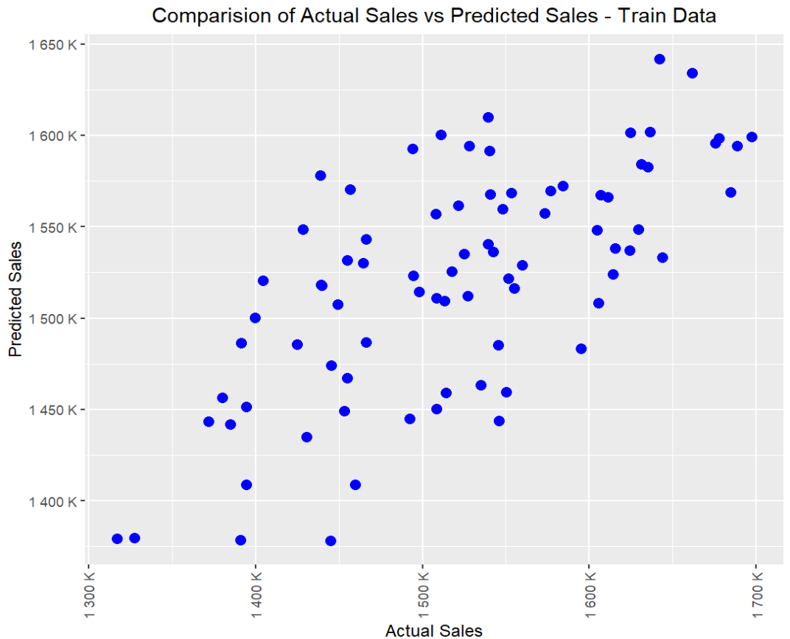
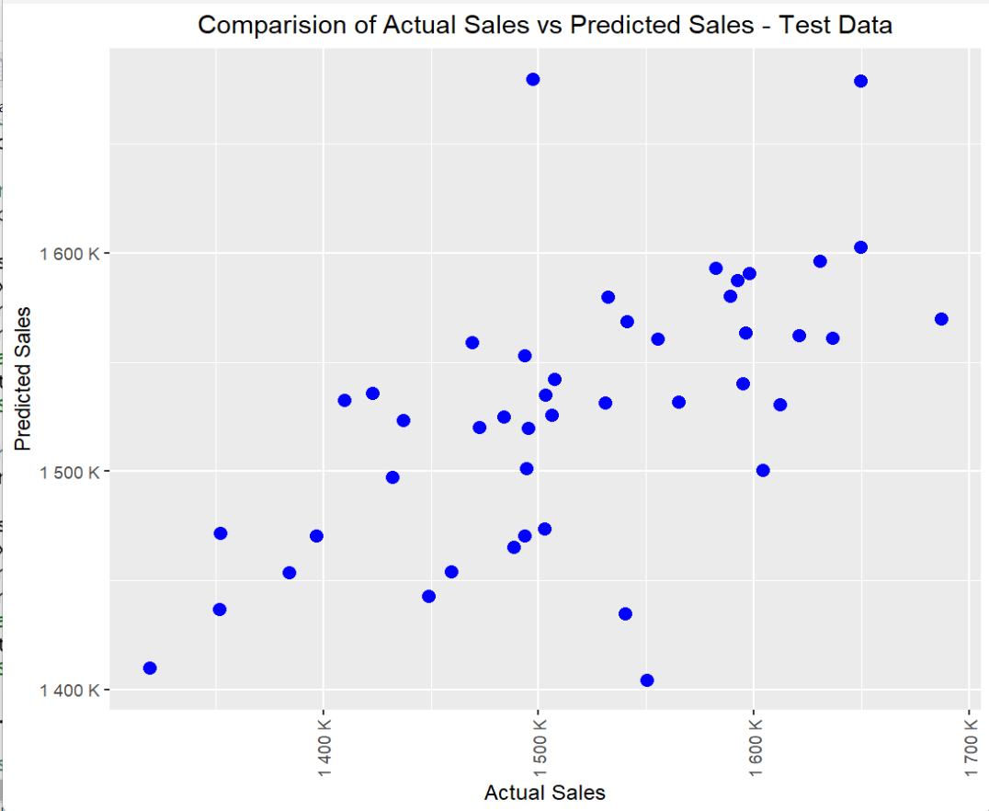
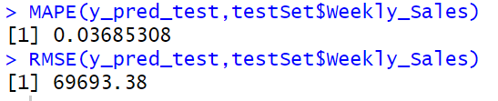
Plots for Linear Regression:
Actual vs predicted for
Train Data
Test Data

Slide 9
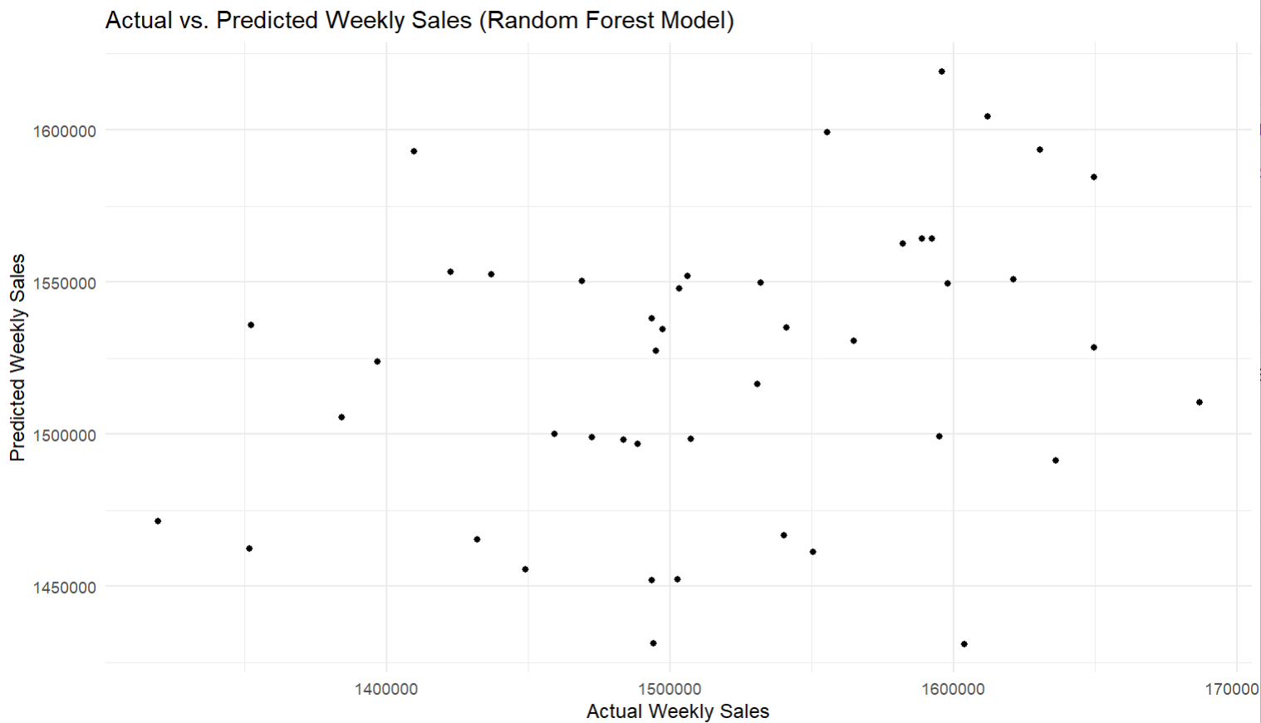
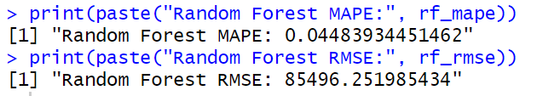
Model used and its explanation:
RANDOM FOREST:
The code loads necessary libraries.
Weekly_sales is my dependent variable and rest all are independent.
The Mean Absolute Percentage Error (MAPE) and Root Mean Squared Error (RMSE) are calculated for the Random Forest model to assess its accuracy.
The model is used to make predictions on test data sets and that data is been stores in the rf_predictions variable.
Actual vs predicted for test data

Slide 10
Conclusion:
Overall, these two algorithms, Linear Regression and Random Forest, are applied to the same dataset to predict Weekly Sales and are evaluated using MAPE and RMSE to gauge their performance.
Random Forest has a slightly higher MAPE (0.0466) compared to Linear Regression (0.0449).
Lower MAPE indicates a better percentage accuracy in predicting sales. Therefore, Linear Regression has a slightly better performance in this regard.
Random Forest has a slightly lower RMSE (82445.91) compared to Linear Regression (83085.05).
Lower RMSE indicates better accuracy in predicting the actual sales values. In this case, Random Forest has a slightly better RMSE. The differences in MAPE and RMSE between the two models are relatively small.
But here our main concern is percentage accuracy MAPE(Mean Absolute Percentage Error) that is predicting sales rather than predicting actual sales, Linear Regression performs slightly better.
Predicting sales is crucial for strategic planning, inventory management, resource allocation, and overall business decision-making.
THANKYOU

