Slide 1

CUSTOMER BOOKING PREDICTIONS

Slide 2
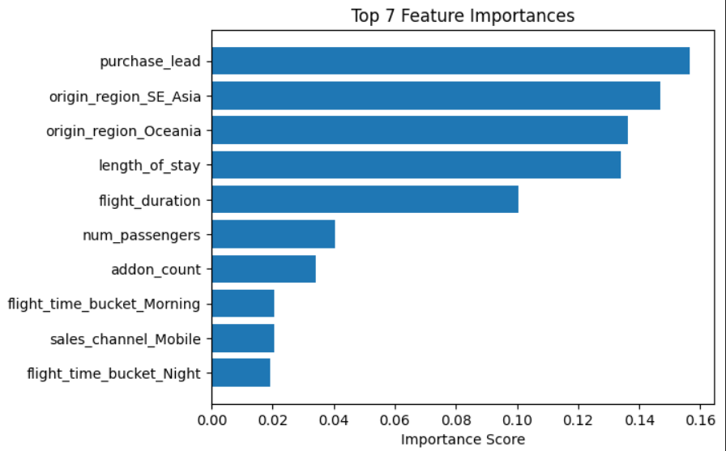
WHAT INFLUENCES A CUSTOMER’S DECISION TO BOOK?
The most influential variable in our predictive model is purchase_lead, representing how early customers plan their travel. Travel characteristics such as length_of_stay, flight_duration (haul type), and origin region (booking_origin in dataset) like South-East Aisa (Malaysia, Singapore, Indonesia, Thailand, Vietnam) and Oceania (Australia, New-Zealand) also significantly influence booking behavior. Customers selecting add-ons (meals, baggage, seat preferences) demonstrate higher engagement and booking likelihood.
EVALUATION
ROC-AUC: 0.76 (strong separation between buyers and non-buyers, so we can save resource on promotions).
Recall (Threshold = 0.4): 61%
  The model correctly identifies 61% of actual buyers, reducing missed revenue opportunities.
Precision: 31%
  Approximately one in three targeted customers is likely to convert, supporting efficient marketing outreach.
Stratified Cross-Validation Mean AUC: 0.756 ± 0.004
  Indicates consistent and stable model performance across multiple data splits.
RESULTS FROM PREDICTION MODEL
The model can serve as a decision-support tool to prioritize high-intent customers, improve campaign targeting efficiency, and increase conversion rates. Future improvements may include incorporating loyalty data and customer browsing behavior.

