Slide 1
DATA SCIENCE naive bayes classification

Slide 2
I. probability and Bayes’ Theorem iI. Naïve Bayes classification
agenda

Slide 3
I. probability And Bayes’ Theorem
DATA SCIENCE

Slide 4
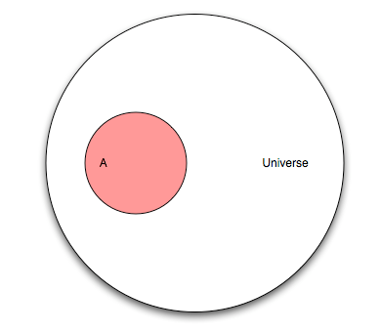
Probability
Let’s pretend you are flipping a coin. This diagram represents the “universe” of all possible outcomes, also known as events. This universe is known as the sample space.
Q: What are the mutually exclusive events that make up the sample space for a coin flip?
A: Heads and tails

Slide 5
Probability
Let’s now pretend that our universe involves a research study on humans. Event “A” is people in that study who have cancer.
Q: If our study has 100 people and “A” has 25 people, what is the probability of A?
A: P(A) = 25/100
Q: What is the max probability of any event?
A: 1

Slide 6
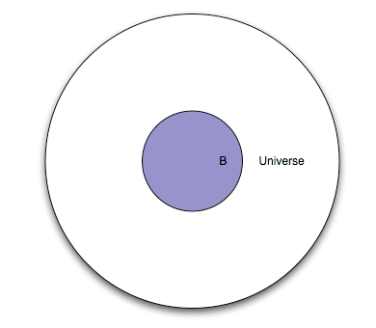
Probability
This represents the same set of people, except everyone in the study is given a test. Event “B” is everyone in the study for whom the test is positive.
Q: What portion of the diagram represents the subset of people with a negative test?
A: The white area between the smaller circle and the larger circle.

Slide 7
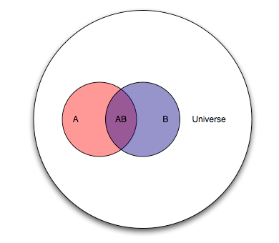
Probability
Because “A” and “B” are events from the same study, we can show them together.
Q: How would you describe the “cancer status” and “test status” of people in each area of the diagram?
A: Pink: cancer, negative test
Purple: cancer, positive test
Blue: no cancer, positive test
White: no cancer, negative test

Slide 8
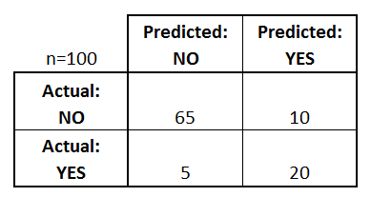
Probability
The purple section is known as the intersection of A and B, denoted as P(AB).
Thinking of this test as a classifier for predicting cancer, draw the confusion matrix.
10
20
5

Slide 9
Probability
Q: Let’s pick an arbitrary person from this study. If you were told their test result was positive, what is the probability they actually have cancer?
A: 20/30
This is the conditional probability of A given B, denoted as P(A|B).
P(A|B) = P(AB) / P(B) = (20/100) / (30/100)
10
20
5

Slide 10
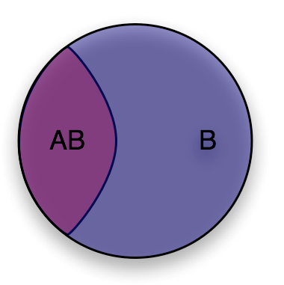
Probability
You can think of conditional probability as “changing the relevant universe.” P(A|B) is a way of saying “Given that my entire universe is now B, what is the probability of A?”
This is also known as transforming the sample space.

Slide 11
Probability
10
20
Q: Let’s pick another arbitrary person from this study. If you were told they have cancer, what is the probability they had a positive test result?
A: P(B|A) = P(AB) / P(A) = 20/25
5

Slide 12
Bayes’ theorem
Deriving Bayes’ theorem:
We know: P(A|B) = P(AB) / P(B) and P(B|A) = P(AB) / P(A)
Thus: P(AB) = P(A|B) * P(B) = P(B|A) * P(A)
Rearrange to get Bayes’ theorem: P(A|B) = P(B|A) * P(A) / P(B)

Slide 13
II. Naïve bayes classification
DATA SCIENCE

Slide 14
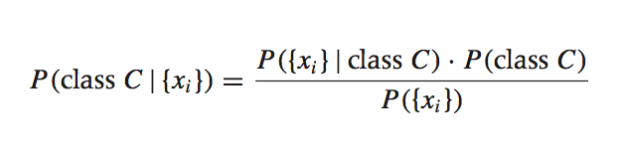
Bayesian inference
Suppose we have a dataset with features x₁, …, x_{n} and a class label C. What can we say about classification using Bayes’ theorem?
Bayes’ theorem can help us to determine the probability of a record belonging to a class, given the data we observe.
source: Data Analysis with Open Source Tools, by Philipp K. Janert. O’Reilly Media, 2011.

Slide 15
Bayesian inference
This term is the prior probability of C. It represents the probability of a record belonging to class C before the data is taken into account.

Slide 16
Bayesian inference
This term is the likelihood function. It represents the joint probability of observing features {x_{i}} given that that record belongs to class C.

Slide 17
Bayesian inference
This term is the normalization constant. It doesn’t depend on C, and is generally ignored.

Slide 18
Bayesian inference
This term is the posterior probability of C. It represents the probability of a record belonging to class C after the data is taken into account.
The idea of Bayesian inference, then, is to update our beliefs about the distribution of C using the data (“evidence”) at our disposal.

Slide 19
Naïve bayes classification
Q: What piece of the puzzle we’ve seen so far looks like it could intractably difficult in practice?
A: Estimating the full likelihood function.
P({x_{i}}|C) = P({x₁, x₂, …, x_{n}})|C)
Observing this exactly would require us to have enough data for every possible combination of features to make a reasonable estimate.

Slide 20
Naïve bayes classification
Q: So what can we do about it?
A: Make a simplifying assumption. In particular, we assume that the features x_{i} are conditionally independent from each other:
P({x_{i}}|C) = P({x₁, x₂, …, x_{n}}|C) ≈ P(x₁|C) * P(x₂|C) * … * P(x_{n}|C)
This “naïve” assumption simplifies the likelihood function to make it tractable.

Slide 21
Naïve bayes classification
In summary, the training phase of the model involves computing the likelihood function, which is the conditional probability of each feature given each class.
The prediction phase of the model involves computing the posterior probability of each class given the observed features, and choosing the class with the highest probability.

Slide 22
DATA SCIENCE

