Slide 1
DATA SCIENCE natural Language Processing

Slide 2
I. Natural Language Processing II. NLP Applications iII. NLP IN Python
agenda

Slide 3
I. Natural Language Processing
DATA SCIENCE

Slide 4
Natural language processing (NLP) is a field of computer science, artificial intelligence, and linguistics concerned with the interactions between computers and human (natural) languages. As such, NLP is related to the area of human–computer interaction. Many challenges in NLP involve natural language understanding -- that is, enabling computers to derive meaning from human or natural language input. -Wikipedia
What is Natural Language Processing?

Slide 5
The interface between human and computer language
What is Natural Language Processing?
However, language is often ambiguous. Many words have different meanings based upon context.
Humans can often decipher the ambiguity; computers cannot.
How do we deal with that?

Slide 6
Create a complex set of rules?
What is Natural Language Processing?
That’s too fragile as language constantly changes.
Semantic models work well but are computationally expensive.
Statistical models provide a good balance.

Slide 7
II. NLP Applications
DATA SCIENCE

Slide 8
Take five minutes and jot down any common, real-world examples of NLP that you can think of.
NLP Applications
Let’s talk about some common applications.

Slide 9
Speech Recognition Siri or Google Now Speech recognition software incorporate language models along with audio signal.
NLP Applications

Slide 10
Machine Translation Google Translate Can translate almost any word in any language to another language.
NLP Applications

Slide 11
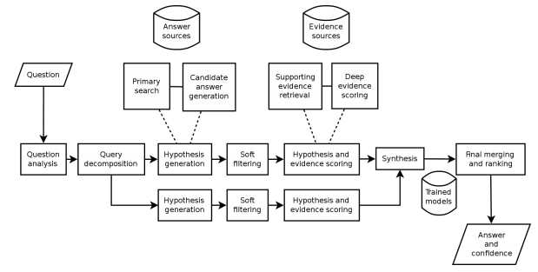
Question Answering IBM Watson, Wolfram Alpha
NLP Applications

Slide 12
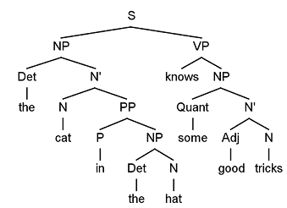
Part of Speech Tagging Aids in many other NLP tasks such as Named Entity Recognition
NLP Applications

Slide 13
Topic Modeling Finding latent groupings of documents based upon the words in them. Useful for news aggregators
NLP Applications

Slide 14
Sentiment Analysis Determining the emotional content of a document. Not only the emotion but the intensity of the emotion. Not always straight forward
NLP Applications

Slide 15

NLP Applications

Slide 16
III. NLP In Python
DATA SCIENCE

Slide 17
Libraries NLTK TextBlob SpaCy
NLP Applications

Slide 18
DATA SCIENCE

