Slide 1
DATA SCIENCE Model Evaluation Metrics

Slide 2
EVALUATION METRICS
Regression:
Root Mean Squared Error
Classification:
Confusion Matrix
ROC Curve (and AUC)

Slide 3
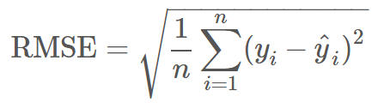
Root Mean Squared Error
Used for regression problems
Square root of the mean of the squared errors
Easily interpretable (in the “y” units)
“Punishes” larger errors

Slide 4
Root Mean Squared Error
Example:
y_true = [100, 50, 30]
y_preds = [90, 50, 50]
RMSE = np.sqrt((10**2 + 0**2 + 20**2) / 3) = 12.88

Slide 5
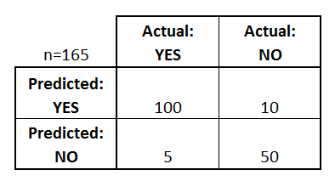
Confusion Matrix
Confusion Matrix: table to describe the performance of a classifier
How many classes are there?
How many patients?
How many predictions of disease?
How many patients actually have the disease?
Example: Test for presence of disease
YES = positive test = True = 1
NO = negative test = False = 0

Slide 6
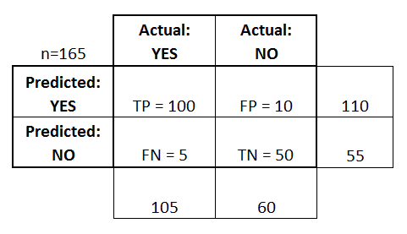
Confusion Matrix
Basic Terminology:
True Positives (TP)
True Negatives (TN)
False Positives (FP)
False Negatives (FN)
Accuracy:
Overall, how often is it correct?
(TP + TN) / total = 150/165 = 0.91
Misclassification Rate (Error Rate):
Overall, how often is it wrong?
1 - accuracy = 1 - 0.91 = 0.09

Slide 7
Confusion Matrix
True Positive Rate:
TP / actual yes = 100/105 = 0.95
“sensitivity” or “recall”
False Positive Rate:
FP / actual no = 10/60 = 0.17
Precision:
TP / predicted yes = 100/110 = 0.91
Specificity:
1 - FPR = 1 - 0.17 = 0.83

Slide 8
ROC Curve / AUC
Every email gets a spamminess score.
Choosing a cut-off, this becomes a classification.
How do we choose a cut-off?
How do we evaluate the ranking without choosing a cut-off?
Email Number | Score | True Label
5 | 0.93 | Spam
8 | 0.91 | Spam
2 | 0.84 | Spam
1 | 0.6 | Ham
7 | 0.54 | Spam
3 | 0.22 | Ham
4 | 0.10 | Ham
6 | 0.02 | Ham

Slide 9
ROC CURVE / AUC
ROC curve
Email Number | Score | True Label
5 | 0.93 | Spam
8 | 0.91 | Spam
2 | 0.84 | Spam
1 | 0.6 | Ham
7 | 0.54 | Spam
3 | 0.22 | Ham
4 | 0.10 | Ham
6 | 0.02 | Ham
TPR
FPR

Slide 10
DATA SCIENCE

