Slide 1

Revenue Maximization in Delay-Aware Computation Offloading Among Service Providers With Fog Federation
GROUP 20
K A Midhunkumar
Celestine Joy
Mohammed Jawad T P
B190439CS
B190468CS
B190441CS

Slide 2

Introduction
Fog computing – extension of cloud computing.
Cloud servers are far leading to latency.
Fog nodes – B/W cloud server and user
Fog nodes provide computational resources to users at a cost.
Tasks offloaded to fog nodes based on available computation resources, cost, transmission rate, etc.
How to allocate fog node resources to maximize revenue while meeting end user requirements?

Slide 3
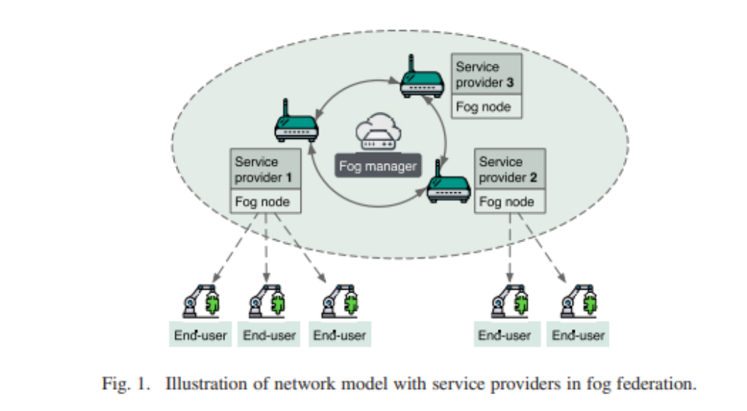
Problem definition
Introduced fog federation – fog manager coordinates fog nodes.
Individual fog nodes serve the end users.

Slide 4
OBJECTIVES
Maximize the revenue of the fog nodes.
Also provide another opportunity for offloading for end users who couldn’t offload due to primary node having limited computational resources.

Slide 5
motivation
To maximize revenue, fog nodes try to exploit their computational resources to end users under coverage.
A significant amount of computational resources may remain unused in the fog nodes.
This motivates us to study how to maximize the unused computational resources of the fog node while satisfying the delay-sensitive task provisioning.

Slide 6
design
The optimal value of the offloaded data is obtained such that the offloading time and local processing time at the end-user are equal.
Only this amount is offloaded.
Rest is processed locally by the end user.

Slide 7
design
For every fog node i, there are k end users under it. A subset of these users needs to be chosen to maximize the revenue.
This is the classic 0-1 knapsack problem.

Slide 8
Genetic algorithm (Ga)
A genetic algorithm is a computer algorithm that searches for good solutions from possible solutions.
Consists of set of solutions called population
One chromosome – one solution
Better population created from old population.
Chromosomes selected based on ‘fitness’.
Repeated several times.

Slide 9
Outline of basic GA
Start: Randomly generate a population of N chromosome
Create a new population:
Selection: Randomly select 2 chromosomes from the population.
Crossover: Perform crossover on the 2 chromosomes selected.
Mutation: Perform mutation on the chromosomes obtained.
Replace: Replace the current population with the new population.
Test: Test whether the end condition is satisfied. If so, stop. If not, go to Step 2.

Slide 10
Genetic algorithm
Run time complexity = O(size * N)
Where size = no of chromosomes in each generation and N = no of items

Slide 11
design
Second chance for offloading:
Provide another opportunity for offloading for end users who couldn’t offload due to primary node having limited computational resources.
For m end-users that have not offloaded yet, optimally offload to n fog nodes with remaining computational resources.
This can be formulated as a multiple knapsack problem.
It is an NP-complete problem and we can solve it using branch-and-bound algorithm, PTAS, etc.

Slide 12
references
[1] Y.-D. Lin, E. T.-H. Chu, Y.-C. Lai, and T.-J. Huang, “Time-and-energy-aware computation offloading in handheld devices to coprocessors and clouds,” IEEE Systems Journal, vol. 9, no. 2, pp. 393–405, 2013.
[2] X. Chen, L. Jiao, W. Li, and X. Fu, “Efficient multi-user computation offloading for mobileedge cloud computing,” IEEE/ACM transactions on networking, vol. 24, no. 5, pp. 2795–2808, 2015.
[3] E. Meskar, T. D. Todd, D. Zhao, and G. Karakostas, “Energy aware offloading for competing users on a shared communication channel,”

