Slide 1

Lecture 12 Intro to JavaFX

Slide 2
Lecture 12 Topics
12.1 Graphical User Interface
12.2 Intro To JavaFx
12.3 Creating Scenes
12.5 More about The HBox…
12.6 Button Controls and Events
12.7 Reading Input with TextField
12.9 The BorderPane Layout
13.2 Radio Button Controls
Layout Managers
Nested Panes
Drawing Shapes

Slide 3
Introduction
Many Java applications use a graphical user interface or GUI (pronounced “gooey”).
A GUI is a graphical window or windows that provide interaction with the user.
GUI’s accept input from:
the keyboard
a mouse.
A window in a GUI consists of components that:
present data to the user
allow interaction with the application.

Slide 4
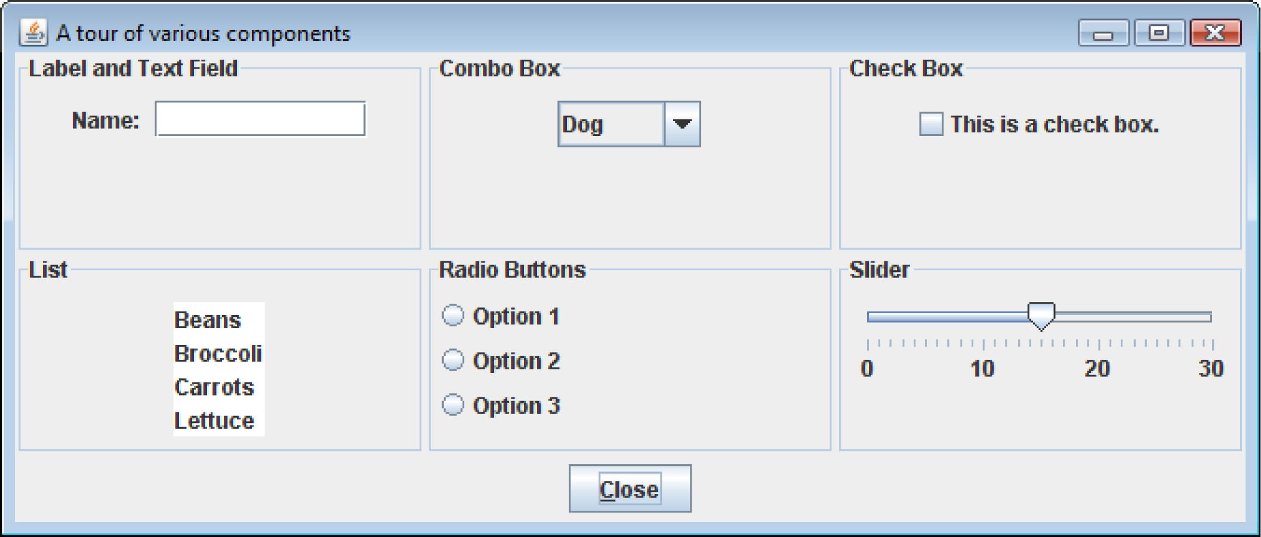
Introduction
Some common GUI components are:
buttons, labels, text fields, check boxes, radio buttons, combo boxes, and sliders.

Slide 5
AWT, Swing, or JavaFX: What will we use in CMSC 203?
Develop projects and labs in FX.
Know about Swing.
You may encounter Swing online or in other courses.
AWT underlies Swing.

Slide 6
JFC, AWT, Swing, and JavaFX
The Java Foundation Classes (JFC) are used to create GUI applications in AWT and Swing.
The JFC consists of several sets of classes, many of which are beyond the scope of the book.
The two sets of JFC classes that are used in Chapter 12 are AWT and Swing classes.
Java is equipped with a set of classes for drawing graphics and creating graphical user interfaces.
These classes are part of the Abstract Windowing Toolkit (AWT).
Swing encapsulates much of AWT.
JavaFX is a new framework to build GUIs.

Slide 7
JFC, AWT, Swing
The AWT allows creation of applications and applets with GUI components.
The AWT does not actually draw user interface components on the screen.
The AWT communicates with a layer of software, peer classes.
Each version of Java for a particular operating system has its own set of peer classes.

Slide 8
JFC, AWT, Swing
Java programs using the AWT:
look consistent with other applications on the same system.
can offer only components that are common to all the operating systems that support Java.
The behavior of components across various operating systems can differ.
Programmers cannot easily extend the AWT components.
AWT components are commonly called heavyweight components.

Slide 9
JFC, AWT, Swing
Swing was introduced with the release of Java 2.
Swing is a library of classes that provide an improved alternative for creating GUI applications and applets.
Very few Swing classes rely on peer classes, so they are referred to as lightweight components.
Swing draws most of its own components.
Swing components have a consistent look and predictable behavior on any operating system.
Swing components can be easily extended.

Slide 10
How Does FX differ from Swing and AWT?
Where they come from:
Swing and AWT are derived from the JFC
FX is a new framework
What their target is:
Swing and AWT are primarily for desktop apps
FX is for desktop, server, and mobile apps
How do they work:
Similar behavior
Different classes and methods
FX can separate GUI design from functionality.

Slide 11
Two Approaches to Using FX
Java FX code style
Programmer implements everything in code (similar to how Swing is used)
FXML style
FXML is like HTML
GUI design is in FXML, separate from Java code
Scene Builder is a drag-and-drop app that generates FXML for you (currently only available from third-party sources)
We will learn the first approach.

Slide 12
A General Approach to Building Applications with a GUI
Concept: Separate Display from Functionality
Four separable parts:
GUI, Data Manager, Data Structure(s), Data Element(s)
Data Manager
does not do any user interaction
incorporates the functionality of the application
GUI uses the data manager
creates a data manager object
interacts with user
calls data manager methods to send and receive data for display
See GUI_Template for examples of Swing and JavaFX
Note that they both use the same Data Manager, illustrating the separation of Data Manager from GUI

Slide 13
Creating Windows
Often, applications need one or more windows with various components.
A window is a container, which is simply a component that holds other components.
A container that can be displayed as a window is a frame.
In a Swing application, you create a frame by extending the JFrame class.
In a JavaFX application, you create a frame (or “stage”) by extending the Application class.

Slide 14
Creating Windows
A frame is a basic window that has:
a border around it,
a title bar, and
a set of buttons for:
minimizing,
maximizing, and
closing the window.
These standard features are sometimes referred to as window decorations.

Slide 15
Introduction to JavaFX (1 of 7)
JavaFX is a Java library for developing rich applications that employ graphics.
You can use it to create:
GUI applications, as well as applications that display 2D and 3D graphics
standalone graphics applications that run on your local computer
applications that run from a remote server
applications that are embedded in a Web page

Slide 16
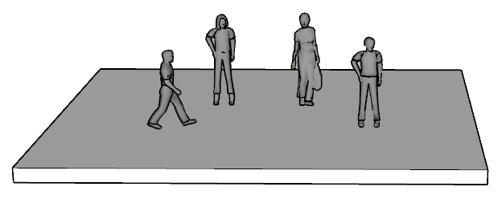
Introduction to JavaFX (2 of 7)
JavaFX uses a theater metaphor to describe the structure of a GUI.
A theater has a stage
On the stage, a scene is performed by actors

Slide 17
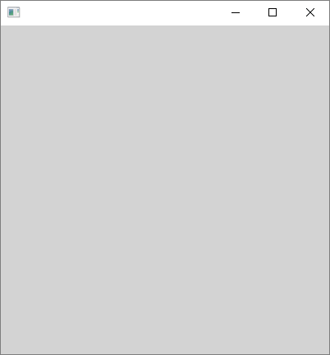
Introduction to JavaFX (3 of 7)
In JavaFX, the stage is an empty window
Stage

Slide 18
Introduction to JavaFX (4 of 7)
The scene is a collection of GUI objects (controls) that are contained within the window.
You can think of the GUI objects as the actors that make up the scene.
Stage
Scene

Slide 19
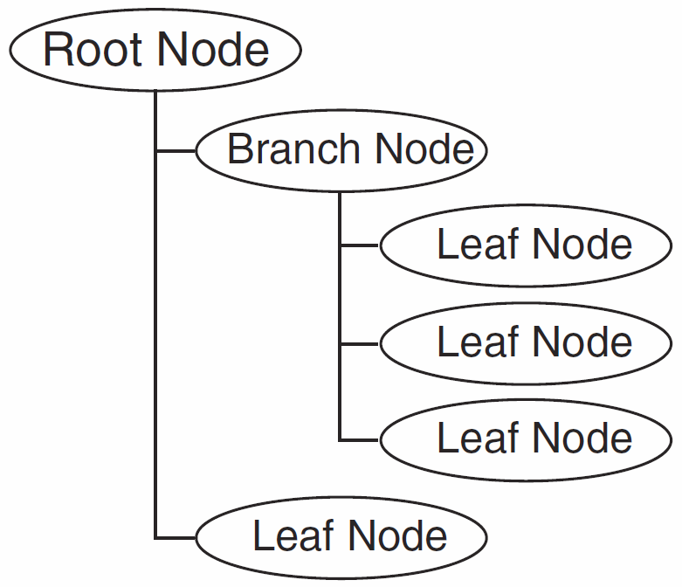
Introduction to JavaFX (5 of 7)
In memory, the GUI objects in a scene are organized as nodes in a scene graph, which is a tree-like hierarchical data structure.
Stage
Scene

Slide 20
Introduction to JavaFX (6 of 7)
The scene graph has three types of nodes:
Root Node: There is only one root node, which is the parent of all the other nodes in the scene graph.
Branch Node: A node that can have other nodes as children
Leaf Node: A node that cannot have children

Slide 21
Introduction to JavaFX (7 of 7)
The Application Class
An abstract class that is the foundation of all JavaFX applications
JavaFX applications must extend the Application class
The Application class has an abstract method named start, which is the entry point for the application
Because the start method is abstract, you must override it

Slide 22
General Layout of a JavaFX Program
Various import statements
A class that extends the Application class
A start method
A main method

Slide 23
import javafx.application.Application; import javafx.stage.Stage; import javafx.scene.Scene; Other import statements…
public class ClassName extends Application
{
public static void main(String[] args)
{
// Launch the application.
launch(args);
}
@Override
public void start(Stage primaryStage)
{
// Insert startup code here.
}
}
Necessary import
statements

Slide 24
import javafx.application.Application; import javafx.stage.Stage; import javafx.scene.Scene; Other import statements…
public class ClassName extends Application
{
public static void main(String[] args)
{
// Launch the application.
launch(args);
}
@Override
public void start(Stage primaryStage)
{
// Insert startup code here.
}
}
Necessary import
statements
A class that extends
the Application
class

Slide 25
import javafx.application.Application; import javafx.stage.Stage; import javafx.scene.Scene; Other import statements…
public class ClassName extends Application
{
public static void main(String[] args)
{
// Launch the application.
launch(args);
}
@Override
public void start(Stage primaryStage)
{
// Insert startup code here.
}
}
Necessary import
statements
A static main method
that calls the inherited
launch method
A class that extends
the Application
class

Slide 26
import javafx.application.Application; import javafx.stage.Stage; import javafx.scene.Scene; Other import statements…
public class ClassName extends Application
{
public static void main(String[] args)
{
// Launch the application.
launch(args);
}
@Override
public void start(Stage primaryStage)
{
// Insert startup code here.
}
}
Necessary import
statements
A static main method
that calls the inherited
launch method
A class that extends
the Application
class
A start method that
accepts a Stage
argument. This method
is called by the inherited
launch method.

Slide 27
Creating a Scene
All the UI components that will appear on the screen are nested in such a way that they form a hierarchical tree structure called the scene graph
The top-most container is called the root of the scene graph; it must be an instance of the Parent class
The root of the scene graph is used to create a scene via one of the constructors for the Scene class:
Scene(Parent root, double width, double height)
Scene(Parent root)
The created scene object is set onto the stage and the stage is shown:
Parent root = new Label(“Hello World”);
Scene scene = new Scene(root);
stage.setScene(scene);
stage.show();

Slide 28
Example JavaFX Program
public class JavaFXHelloWorld extends Application
{
@Override
public void start(Stage stage)
{
// Create label
Label label = new Label("Hello World!");
// Set label as root of scene graph.
Scene scene = new Scene(label , 300, 80);
stage.setScene(scene);
// Set stage title and show the stage.
stage.setTitle("Hello World!");
stage.show();
}
}

Slide 29
Panes and Component Layout
Pane objects keep their child nodes in a collection of type
ObservableList<Node>
which has two method that can be used to add nodes
boolean add(Node child)
boolean addAll(Node …children)
The Pane class exposes this list of child nodes through a method
ObservableList<Node> getChildren()

Slide 30
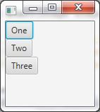
The Vbox Pane arranges is children in one vertical column:
public void start(Stage stage)
{
Button b1 = new Button("One");
Button b2 = new Button("Two");
Button b3 = new Button("Three");
VBox vPane = new VBox();
vPane.getChildren().addAll(b1, b2, b3);
stage.setScene(new Scene(vPane));
stage.show();
}

Slide 31
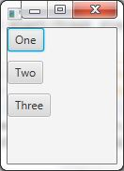
A Vbox(double spacing) constructor inserts vertical spacing between its children:
public void start(Stage stage)
{
Button b1 = new Button("One");
Button b2 = new Button("Two");
Button b3 = new Button("Three");
VBox vPane = new VBox(10);
vPane.getChildren().addAll(b1, b2, b3);
stage.setScene(new Scene(vPane));
stage.show();
}

Slide 32
Alignment
By default, children of Vbox huddle together in the top left corner of the pane
This default alignment can be changed by calling the Vbox method
void setAlignment(Pos value)
and specifying a Pos enumerartion value as parameter

Slide 33
Pos Values
Pos is an enumeration type whose values specify vertical and horizontal alignment of content:
TOP_LEFT TOP_CENTER TOP_RIGHT
CENTER_LEFT CENTER CENTER_RIGHT
BOTTOM_LEFT BOTTOM_CENTER BOTTOM_RIGHT
You can set alignment on a pane to CENTER:
vPane.setAlignment(Pos.CENTER);
The Label class has a similar method for setting alignment of content:
myLabel.setAlignment(Pos.CENTER);

Slide 34

The Hbox Pane is similar to Vbox, except it lays out its children in a single horizontal row: Button b1 = new Button("One"); Button b2 = new Button("Two"); Button b3 = new Button("Three"); HBox hPane = new HBox(10); hPane.getChildren().addAll(b1, b2, b3);

Slide 35
Margin and Padding
Margin and Padding are used to achieve spacing and give the UI a pleasing look
Margin is the spacing around the outside border of a node
Padding is the spacing just inside the border of a node: padding surrounds the node’s content and sets it off from the node’s border

Slide 36

Margin and Padding
Margin and Padding are specified by objects of type Inset:
Insets(double top, double right, double bottom, double left)
Insets(double width)

Slide 37
Margin and Padding
Padding: space inside a Node
myNode.setPadding(new Insets(5,10,5,10));
Margin: space outside a Node
myVBox.setMargin(myNode, new Insets(5,10,5,10));
VBox myVBox = new VBox();
padding
Content
Node myNode
margin

Slide 38
Setting Margin and Padding
Pane has method for setting the padding around its content:
void setPadding(Insets value)
Pane has a static method that sets the margin around a a specific child node.
static void setMargin(node child, insets value)

Slide 39




Effect of Margin, Padding and Alignment
HBox hPane = new HBox();
hPane.getChildren().addAll(b1, b2, b3);
hPane.setPadding(new Insets(10));
HBox.setMargin(b2, new Insets(0, 20, 0, 10));
hPane.setAlignment(Pos.CENTER);

Slide 40
Three Steps to Display any Node
Define it:
example: HBox myPane;
Instantiate it:
example: myPane = new HBox();
Add it to a higher component:
example: rootPane.getChildren().addAll(myPane);
The Root (top-level) Component gets added to the scene:
Add the root component to the scene:
example: stage.setScene(new Scene(rootPane, 500, 350));

Slide 41
Adding Components
FX provides numerous components that can be added to a window.
Three fundamental components are:
Label : An area that can display text.
TextField : An area in which the user may type a single line of input from the keyboard.
Button : A button that can cause an action to occur when it is clicked.

Slide 42
Designing a GUI
Before coding, draw the layout by hand.
It is usually easiest to embed Panes and Controls inside other Panes to get the effect you want.
Label each drawn box with its type of Node
Stage
root/Scene: VBox
radioButtons: HBox
bottomHBox: HBox
textBoxes: VBox
Buttons: VBox
text1: TextBox
text2: TextBox
text3: TextBox

Slide 43
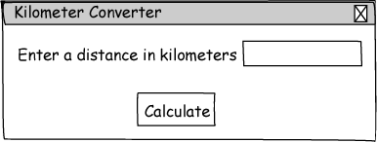
Sketch of Kilometer Converter Graphical User Interface
Text Field
Window Title
Label
Button

Slide 44
Adding Components
private Label message;
private TextField kilometers;
private Button calcButton;
…
message = new Label(
"Enter a distance in kilometers");
kilometers = new TextField(10);
calcButton = new Button("Calculate");
This code declares and instantiates three FX components.

Slide 45
Adding Components
Start is called by launch(args): public void start(Stage stage)
{ …
private HBox hbox = new Hbox(10);
…
hBox.getChildren().addAll(message, kilometers,
calcButton);
stage.setScene(new Scene(hBox));
stage.setTitle("TextField Demo");
stage.show();
}
This code adds the three FX components to a Pane, which is added to the scene.

Slide 46
Creating a Hidden Component
The following code hides the component :
myPane.setVisible(false);
The setVisible method takes a boolean argument.
true - display the window.
false - hide the window.
Later you can display the component
myPane.setVisible(true);

Slide 47
Creating a Border
To create a border around a Pane, use FXML syntax as the argument to the setStyle method:
myPane.setStyle("-fx-border-color: gray;");
Various common color names can be used:
blue, red, orange, green, black, etc.
Note: Swing has an easy way to create a title in the border, but it is more complicated to do this in FX

Slide 48
Event Driven Programming
Programs that operate in a GUI environment must be event-driven.
An event is an action that takes place within a program, such as the clicking of a button.
Part of writing a GUI application is creating event listeners.
An event handler is an object that automatically executes one of its methods when a specific event occurs.
So far, our buttons and other controls have no way of responding to user input. This is what events are for.
Event handlers are set on UI components to respond to events that occur on those components

Slide 49
Handling Action Events
An event is an action that takes place within a program, such as the clicking of a button.
When an event takes place, the component that is responsible for the event creates an event object in memory.
The event object contains information about the event.
The component that generated the event object is know as the event target.
It is possible that the target component is connected to one or more event listeners.

Slide 50
ActionEvent
The ActionEvent class describes certain types of events where the user is expecting the program to respond by performing some sort of action
An ActionEvent is generated by Button when the user clicks a button
An ActionEvent is generated by TextField when the user types ENTER in the text field

Slide 51
Handling Action Events
An event handler is an object that responds to events.
The source component fires an event which is passed to a method in the event listener.
Event handler classes are specific to each application.
Event handler classes are commonly written as private inner classes in an application.
Java 8 also provides for lambda expressions

Slide 52
Event Handlers Must Implement an Interface
All event handler classes must implement an interface.
Swing:
class ButtonListener implements ActionListener
you write the method actionPerformed(ActionEvent e))
FX:
class ButtonListener implements EventHandler<ActionEvent>
you write the method handle(ActionEvent e))
An interface is something like a class containing one or more method headers.
When you write a class that implements an interface, you are agreeing that the class will have all of the methods that are specified in the interface.

Slide 53
Handling ActionEvent
An event handler for ActionEvent is an object of a class that implements the interface EventHandler<ActionEvent>
This interface has a single abstract method void handle(ActionEvent evt)
An example of such a class is
class SimpleHandler implements EventHandler<ActionEvent>
{
public void handle(ActionEvent event)
{
JOptionPane.showMessageDialog(null, "Hello World!");
}
}

Slide 54

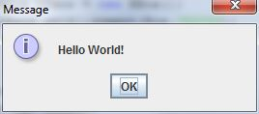
Setting an Event Handler on a Component
Here is how to create and set an event handler on a button:
public void start(Stage stage)
{
// Button in HBox
Button b1 = new Button("Click Me");
HBox hPane = new HBox();
hPane.setAlignment(Pos.CENTER);
hPane.getChildren().add(b1);
// Create scene and show on stage
stage.setScene(new Scene(hPane));
stage.show();
// Set handler on button
b1.setOnAction(new SimpleHandler());
}

Slide 55
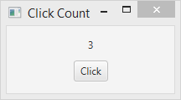
Passing Information to Event Handlers
Imagine a program that displays a label with a number that starts at 0, together with a button
Every time the button is clicked, the number on the label is incremented by 1

Slide 56
Handling Action Events
Event
Object
Button Component
EventHandler Object
void handle(ActionEvent e)
When the button is pressed …
The Button component generates an event object and passes it to the action listener object's handle method.

Slide 57
Passing Information to an Event Handler
Create the Label and Button
Label label = new Label("0");
Button button = new Button("Click");
and add them to a Vbox pane
Create an event handler class called ClickHandler
The click handler object will need access to the label so it can increment. The label will be passed to handler when it is being created:
new ClickHandler(label);

Slide 58
Registering A Listener
The process of connecting an event listener object to a component is called registering the event handler.
FX Controls (e.g., Button) have a method named setOnAction.
button.setOnAction(
new ClickHandler());
When the user clicks on the source button, the action listener object’s handle method will be executed.

Slide 59
Passing Information to an Event Handler
public void start(Stage stage)
{
// Create label, button, attach handler to button.
Label label = new Label("0");
Button button = new Button("Click");
button.setOnAction(new ClickHandler(label));
// Add the label and button to a pane.
VBox pane = new VBox(10);
pane.setAlignment(Pos.CENTER);
pane.getChildren().addAll(label, button);
// Set up the stage.
stage.setScene(new Scene(pane, 200, 80));
stage.setTitle("Click Count");
stage.show();
}

Slide 60
The ClickHandler Class
The ClickHandler class has a Label field to hold the information passed to its constructor:
// Reference to label that will be updated
private Label rLabel;
public ClickHandler(Label cParamLabel)
{
rLabel = cParamLabel;
}

Slide 61
The ClickHandler handle() Method
The handle()method has access to the label so it can retrieve the number from the label, increment it, and set it back onto the label:
class ClickHandler implements EventHandler<ActionEvent>
{
private Label rLabel;
public ClickHandler(Label cParamLabel)
{
rLabel = cParamLabel;
}
@Override
public void handle(ActionEvent event)
{
int count = Integer.parseInt(rLabel.getText());
count ++;
rLabel.setText(String.valueOf(count));
}
}

Slide 62
Inner classes as Event Handlers
If you define the handler as a local inner class, it will automatically have access to all local variables that are effectively final
Local inner classes are convenient to use as handlers because you do not need to use constructor parameters to pass information
Using a separate class for the handler often makes for cleaner and more reusable code

Slide 63
Event Driven Programming
In Swing an event handler is one of two types of classes:
Named
Anonymous, for one-time use
In FX, you can also take advantage of the new (in Java 8) syntax for “lambda expressions”
Lambda expressions implicitly derive that the handle method needs implementation and the ActionEvent type is the argument to the handle method
In the following slides are examples of these three ways to implement an event handler.

Slide 64
Event Handler (Named Class)
public void start(Stage primaryStage) {
primaryStage.setTitle("Hello World!");
Button myButton = new Button();
myButton.setText("Say 'Hello World'");
myButton.setOnAction(new ButtonHandler());
StackPane root = new StackPane();
root.getChildren().add(myButton);
primaryStage.setScene(new Scene(root, 300, 250));
primaryStage.show();
}
public class ButtonHandler implements EventHandler<ActionEvent> { @Override
public void handle(ActionEvent event) {
System.out.println("Hello World");
}
}

Slide 65
Anonymous Local Inner Classes
In Java, you can create on object of a class that implements an interface without defining the class and giving it a name
Such a class (with no name) is called an anonymous class
You instantiate an object of such a class by specifying the interface, providing definitions for the methods in the interface, and using the new operator to instantiate the object
EventHandler <ActionEvent> handler = null;
handler = new EventHandler<ActionEvent> ()
{
public void handle(ActionEvent evt)
{
// handler logic goes here
}
};
button.setOnAction(handler);

Slide 66
Event Handler (Anonymous Class)
public void start(Stage primaryStage) {
primaryStage.setTitle("Hello World!");
Button myButton = new Button();
myButton.setText("Say 'Hello World'");
myButton.setOnAction(new EventHandler<ActionEvent>() {
@Override
public void handle(ActionEvent event) {
System.out.println("Hello World");
}
});
StackPane root = new StackPane();
root.getChildren().add(myButton);
primaryStage.setScene(new Scene(root, 300, 250));
primaryStage.show();
}

Slide 67
Lambda Expressions for Event Handling
You can also use a lambda expression for an event handler
EventHandler <ActionEvent> handler = null;
handler = evt - >
{
// handler logic goes here
};
button.setOnAction(handler);
Lambda expressions are just short hand for objects of local anonymous inner classes, so any variable accessed by a lambda expression must be effectively final

Slide 68
Lambda Expressions for Event Handling
public void start(Stage stage)
{
// Create label, button
Label label = new Label("0");
Button button = new Button("Click");
// Use a lambda expression for the event handler.
button.setOnAction(
event ->
{
int count = Integer.parseInt(label.getText());
count++;
label.setText(String.valueOf(count));
});
// additional code ….
}

Slide 69
Event Handler (lambda expression)
public void start(Stage primaryStage) {
primaryStage.setTitle("Hello World!");
Button myButton = new Button();
myButton.setText("Say 'Hello World'");
myButton.setOnAction(event ->
System.out.println("Hello World")
);
StackPane root = new StackPane();
root.getChildren().add(myButton);
primaryStage.setScene(new Scene(root, 300, 250));
primaryStage.show();
}

Slide 70
The ActionEvent Object
Event objects contain certain information about the event.
This information can be obtained by calling one of the event object’s methods.
Two of these methods are:
getTarget - returns a reference to the object (e.g., the button) that generated this event.
toString - returns the action command for this event as a String.
getTarget allows you to implement a single event handler class that handles more than one control’s event

Slide 71
Using a Single Handler on Multiple Components
We often want to use the same handler to respond to the same event on several components of the same type:
EventHandler<ActionEvent> handler1= evt ->
{
// handler logic here
};
button1.setOnAction(handler1);
button2.setOnAction(handler1);
When button1 is clicked and handler1’s handle() with parameter evt, then evt.getTarget() will return a reference to button1. Similarly for button2. Thus the handle() method can distinguish which button is ``calling”

Slide 72
The EventTarget Interface
Any component that can generate an event implements the EventTarget interface
The evt.getTarget()method returns a reference to EventTarget:
EventTarget getTarget()
Typical use of getTarget() casts the returned object to a known class type, for example
public void handle(ActionEvent evt)
{
Button b = (Button) evt.getTarget();
// Use b
}

Slide 73



Determining the Event Target
Consider a JavaFX program that displays two buttons on a stage
The title of the stage is the text of whichever button was last clicked

Slide 74
The Event Target Program
public void start(Stage stage)
{
Button button1 = new Button("One");
Button button2 = new Button("Two");
// Create the event handler using a lambda expression.
EventHandler<ActionEvent> handler = event ->
{
Button clickedButton = (Button) event.getTarget();
String newTitle = clickedButton.getText();
// set the new stage title.
stage.setTitle(newTitle);
};
// Set the same event handler to BOTH buttons.
button1.setOnAction(handler);
button2.setOnAction(handler);
// More code ...
}

Slide 75

Radio Buttons
Radio buttons are used to select a single option from a group of choices
A radio button becomes selected when it is clicked on
Radio buttons are typically used in groups, with each radio button corresponding to a single choice in an associated group of choices
An object called a toggle group is used to manage the radio buttons in a single group, ensuring that at most one of them is selected at any time

Slide 76
RadioButton Constructors and Methods
RadioButton()
RadioButton(String text)
boolean isSelected()
void setSelected(boolean value)
void setToggleGroup(ToggleGroup value)

Slide 77
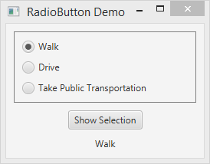
Programming with Radio Buttons
Consider a program that allows the user to select one of a group of choices and click a button to display the currently selected choice in a label

Slide 78
Radio Button Demo Program
First, create a Vbox with a gray border. This will be used to hold the radio buttons. The gray border is a visual cue that the radio buttons form a group:
// Vertical Box to hold the radio buttons.
VBox radiosBox = new VBox(10);
radiosBox.setPadding(new Insets(10, 10, 10, 10));
// Set a gray border around the radio button box.
radiosBox.setStyle("-fx-border-color: gray;");

Slide 79
Creating a ToggleGroup
Radio Buttons are usually mutually exclusive (i.e., if one is selected the others are off)
To implement this, create a ToggleGroup, and use the setToggleGroup method to set each radio button’s toggle group.
You still add each radio button to it’s parent Pane individually, but the ToggleGroup goes along with them.

Slide 80
Radio Button Demo Program
Create an array of strings to use as text for the radio buttons, create a toggle group object, and then create an array of radio buttons:
String [] optionLabels =
{"Walk", "Drive", "Take Public Transportation"};
// Create a toggle group, and the array of radioButtons
ToggleGroup radiosGroup = new ToggleGroup();
RadioButton [] radioButtons =
new RadioButton[optionLabels.length];
for (int k = 0; k < radioButtons.length; k++)
{
radioButtons[k] = new RadioButton(optionLabels[k]);
radioButtons[k].setToggleGroup(radiosGroup);
}

Slide 81
Radio Button Demo Program
Add the radio buttons to the Vbox and select the first radio button
radiosBox.getChildren().addAll(radioButtons);
radioButtons[0].setSelected(true);
Construct the top-level box that will be the root of the scene graph
VBox topLevelBox = new VBox(10);
topLevelBox.setAlignment(Pos.CENTER);
topLevelBox.setPadding(new Insets(10,50,10,50));

Slide 82
The Radio Demo Program
Create the show selection Button and the label to display the selected option and add them to the top-level box
Button showSelectionButton =
new Button("Show Selection");
Label selectionLabel = new Label();
topLevelBox.getChildren().
addAll(radiosBox,showSelectionButton, selectionLabel);

Slide 83
Determining Selected Radio Buttons
The RadioButton class’s isSelected method returns a boolean value indicating if the radio button is selected.
if (radio.isSelected()) {
// Code here executes if the radio
// button is selected. }
A RadioButton can be selected or deselected in code using the method setSelected (boolean)
if (turnon) //I want to turn on radio button
radio.setSelected(true);
else radio.setSelected(false);

Slide 84
Radio Button Demo Program
Finally, create an event handler for the button. The handler determines the selected radio button and sets its text as the text of the selection label
// Set the handler for the show selection button.
EventHandler<ActionEvent> handler = event ->
{
for (RadioButton rb : radioButtons)
{
if (rb.isSelected())
{
selectionLabel.setText(rb.getText());
return;
}
}
};
showSelectionButton.setOnAction(handler);

Slide 85

Check Boxes
Check boxes are a used to select any number of options from a group of options
Programming with check boxes is just like programming with radio buttons, except you do not need to use a toggle group

Slide 86
Displaying Images
Using images requires the use of the Image and ImageView classes
Image is used to create an in-memory representation of an image.
The image may be in an InputStream object, or may be in a location online (specified by a URL string), or on the local file system (specified by a pathname string)
An Image object is not a JavaFX node, so cannot be displayed on the screen
ImageView is a subclass of Node: it is used to wrap Image objects for screen display

Slide 87
The Image Class and ImageView Classes
Image(InputStream stream): This constructor creates an image from an input stream, for example
new Image(new FileInputStream(“tiger.jpg”);
Image(String location): Creates an image by fetching content from a local file system location or from a URL, for example
new Image(“c:\\temp\\images\\tiger.jpg”);
ImageView(Image image): Creates an ImageView object by wrapping an in-memory Image
ImageView(String location): Fetches content from the given location, internally creates an Image object, and wraps it.
ImageView(): creates an ImageView object without an Image. The image can be set with the setImage(Image im) method.

Slide 88

The TextField Control
The TextField control allows the user to enter a single line of input
You can create TextField objects using the following constructors
TextField()
TextField(String text)

Slide 89
TextField Methods
void setText(String text)
String getText()
void setEditable(boolean value)
boolean isEditable()
void clear()
void setPrefColumnCount(int count)

Slide 90
Working With TextField Controls
Most of the time, we want to process the content of the TextField only after the user presses the ENTER key, and not after every character typed
When the user types ENTER, the text field will fire an ActionEvent
We can handle these events by setting an ActionEvent handler on the text field:
EventHandler<ActionEvent> handler = ….;
myTextField.setOnAction(handler)

Slide 91

TextField Demo Program
This progam allows a user to enter an integer in one text field, and it displays the square in a second (uneditable) text field
The user interface uses a couple of labels to identify the purpose of the text fields to the user

Slide 92
TextField Demo Program
Create the two labels and the two text fields
// Create labels for the user interface.
Label inputLabel = new Label("Number: ");
Label outputLabel = new Label("Square of Number: ");
// Create the text fields for the user interface.
TextField inputTextField = new TextField();
TextField outputTextField = new TextField();
inputTextField.setPrefColumnCount(4);
outputTextField.setPrefColumnCount(4);
outputTextField.setEditable(false);

Slide 93
TextField Demo Program
Create an Hbox to hold the labels and text fields
// Create HBox and add the labels and textfields.
HBox hBox = new HBox(10);
hBox.setAlignment(Pos.CENTER);
hBox.setPadding(new Insets(10));
hBox.getChildren().addAll(inputLabel, inputTextField,
outputLabel, outputTextField);

Slide 94
TextField Demo Program
Create the event handler and set it on the input text field:
EventHandler<ActionEvent> handler = event ->
{
// Get Number from input text field.
String inputText = inputTextField.getText().trim();
int number = Integer.parseInt(inputText);
// Write the square to the output text field.
int square = number*number;
outputTextField.setText(String.valueOf(square));
};
// Set the handler on the input text field
inputTextField.setOnAction(handler);

Slide 95
Layout Managers
An important part of designing a GUI application is determining the layout of the components.
The term layout refers to the positioning and sizing of components.
In Java, you do not normally specify the exact location of a component within a window.
In Swing, a JPanel is given a layout manager object.
In FX, the various subclasses of Pane have differing layouts already associated with them.

Slide 96
Layouts
JavaFX provides several Panes with different layouts:
VBox - Arranges components in one vertical column.
HBox - Arranges components in one horizontal row.
TilePane - Arranges components in a grid of uniformly-sized “tiles” (horizontally or vertically), wrapping around when the desired size is exceeded.
FlowPane - Arranges components in a grid of possibly uneven “tiles”, wrapping around when the desired size is exceeded.
BorderPane - Arranges components in five regions:
North, South, East, West, and Center.
GridPane - Arranges components in rows and columns.

Slide 97
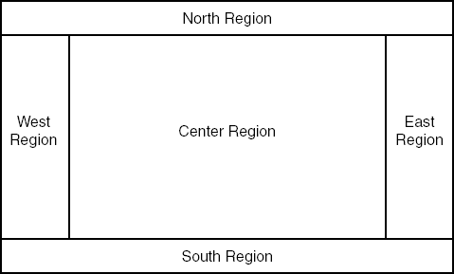
BorderPane Layout
BorderPane manages five regions where components can be placed.

Slide 98
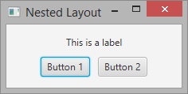
Nested Layouts
You can achieve the look you want by nesting different types of panes
The above UI uses a Vbox with center alignment containing a label and a Hbox, also with center alignment

Slide 99
Nested Panes
Containers that contain other components make up the containment hierarchy of an interface
This hierarchy can be as intricate as needed to create the visual effect desired
The following example nests two panes inside a third pane – note the effect this has as the frame is resized.

Slide 100
import javafx.application.Application;
import javafx.scene.Scene;
import javafx.scene.layout.*;
import javafx.stage.Stage;
public class SubPanelsFX extends Application{
//-----------------------------------------------------------------
// Creates and presents the program Scene.
//-----------------------------------------------------------------
public static void main (String[] args)
{
launch(args);
}
public void start(Stage stage)
{
BorderPane mainPanel = new BorderPane();
mainPanel.setStyle("-fx-background-color: yellow;");
mainPanel.setCenter(new CenterPane());
Scene scene = new Scene(mainPanel);
stage.setScene(scene);
stage.setTitle("SubPanels");
stage.show();
}
}

Slide 101
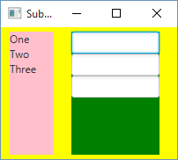
import javafx.geometry.Insets;
import javafx.scene.control.Label;
import javafx.scene.control.TextField;
import javafx.scene.layout.*;
public class CenterPane extends HBox {
public CenterPane()
{
setPrefWidth(200);
setPrefHeight(150);
VBox pane1 = new VBox();
pane1.setPrefWidth(50);
pane1.setPrefHeight(100);
Label label1 = new Label ("One");
Label label2 = new Label ("Two");
Label label3 = new Label ("Three");
pane1.setStyle("-fx-background-color: pink;");
pane1.getChildren().addAll(label1,label2,label3);
VBox pane2 = new VBox();
pane2.setPrefWidth(100);
pane2.setPrefHeight(100);
TextField text1 = new TextField();
text1.setPrefColumnCount(5);
TextField text2 = new TextField();
text2.setPrefColumnCount(10);
TextField text3 = new TextField();
text3.setPrefColumnCount(7);
pane2.setStyle("-fx-background-color: green;");
pane2.getChildren().addAll(text1,text2,text3);
getChildren().addAll(pane1,pane2);
HBox.setMargin(pane1, new Insets(5,10,5,10));
HBox.setMargin(pane2, new Insets(5,10,5,10));
}
}

Slide 102
import javafx.geometry.Insets;
import javafx.scene.control.Label;
import javafx.scene.control.TextField;
import javafx.scene.layout.*;
public class CenterPane extends HBox {
public CenterPane()
{
setPrefWidth(200);
setPrefHeight(150);
VBox pane1 = new VBox();
pane1.setPrefWidth(50);
pane1.setPrefHeight(100);
Label label1 = new Label ("One");
Label label2 = new Label ("Two");
Label label3 = new Label ("Three");
pane1.setStyle("-fx-background-color: pink;");
pane1.getChildren().addAll(label1,label2,label3);
VBox pane2 = new VBox();
pane2.setPrefWidth(100);
pane2.setPrefHeight(100);
TextField text1 = new TextField();
text1.setPrefColumnCount(5);
TextField text2 = new TextField();
text2.setPrefColumnCount(10);
TextField text3 = new TextField();
text3.setPrefColumnCount(7);
pane2.setStyle("-fx-background-color: green;");
pane2.getChildren().addAll(text1,text2,text3);
getChildren().addAll(pane1,pane2);
HBox.setMargin(pane1, new Insets(5,10,5,10));
HBox.setMargin(pane2, new Insets(5,10,5,10));
}
}
Main Pane
pane1
pane2

Slide 103
Nested Panes
Each container can have its own Layout Manager
setPrefWidth(int) sets the width of the pane
setPrefHeight(int) sets the height of the pane
setFont() sets the size of text
It requires a Font object
new Font(font name, font style, font size)
Each container can have it’s own border

Slide 104
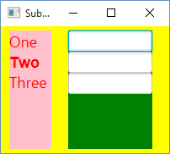
VBox pane1 = new VBox();
pane1.setPrefWidth(50);
pane1.setPrefHeight(100);
Label label1 = new Label ("One");
Label label2 = new Label ("Two");
Label label3 = new Label ("Three");
label1.setStyle("-fx-text-fill: red; -fx-font-size: 18;");
label2.setFont(Font.font("Arial", FontWeight.BOLD, 18));
label2.setTextFill(Color.RED);
label3.setStyle("-fx-text-fill: red; -fx-font-size: 18;");
pane1.setStyle("-fx-background-color: pink;");
pane1.getChildren().addAll(label1,label2,label3);
2 ways to set the font and color

Slide 105
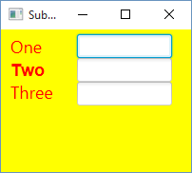
// Set up first subpane
. . .
pane1.setStyle("-fx-background-color: yellow;");
// Set up second subpane
. . .
pane2.setStyle("-fx-background-color: yellow;");

Slide 106
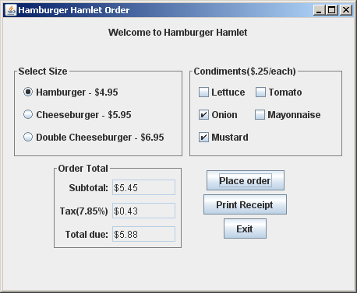
Pane1 size (400,50)
Pane2 size
(220,120)
Pane3 size
(200,120)
Pane5 size
(150,100)
Pane4 size
(180,100)
Main Pane size
(450,350)

Slide 107
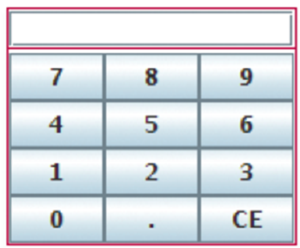
Main pane could
be BorderPane
Place TextField in
North
GridPane that is
placed in Center of
BorderPane

Slide 108
Drawing Shapes
A GraphicsContext object may be used to draw lines and shapes.
Java allows drawing of lines and graphical shapes such as rectangles, ovals, and arcs.
Override the start method. This is the main entry point for all JavaFX applications.

Slide 109
XY Coordinates
The location of each pixel in a component is identified with an X coordinate and a Y coordinate.
The coordinates are usually written in the form (X, Y).
Unlike Cartesian coordinates, the upper-left corner of a drawing area is (0, 0).
The X coordinates increase from left to right, and the Y coordinates increase from top to bottom.
When drawing a line or shape on a component, you must indicate its position using X and Y coordinates.

Slide 110
GraphicsContext Objects
This class is used to issue draw calls to a Canvas using a buffer
This object has numerous methods for drawing graphical shapes on the surface of the Canvas.

Slide 111
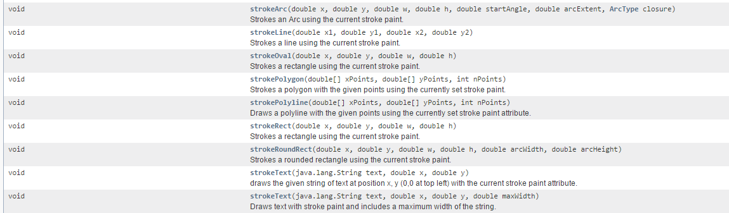
GraphicsContext Objects
These methods allow for the drawing of Arcs, lines, ovals/circles, polygons, rectangles and text

Slide 112
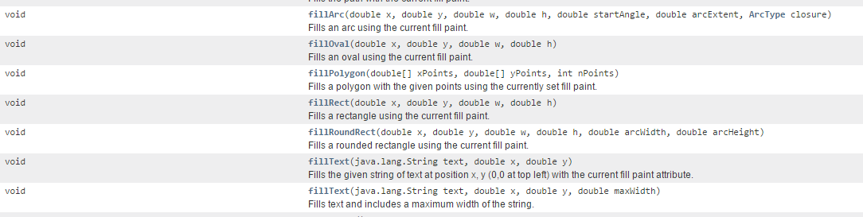
GraphicsContext Objects
These methods allow for the filling of Arcs, lines, ovals/circles, polygons, rectangles and text

Slide 113
GraphicsContext Objects
In order to call these methods, you must get a reference to a canvas’GraphicsContext object.
GraphicsContext gc = canvas.getGraphicsContext2D();

Slide 114
GraphicsContext Objects
The start method is automatically called
when the component is first displayed and
any time the component needs to be redisplayed.
The header for the start method is:
public void start(Stage primaryStage)
The method’s argument is a Stage object, which is automatically passed by the calling component.

Slide 115
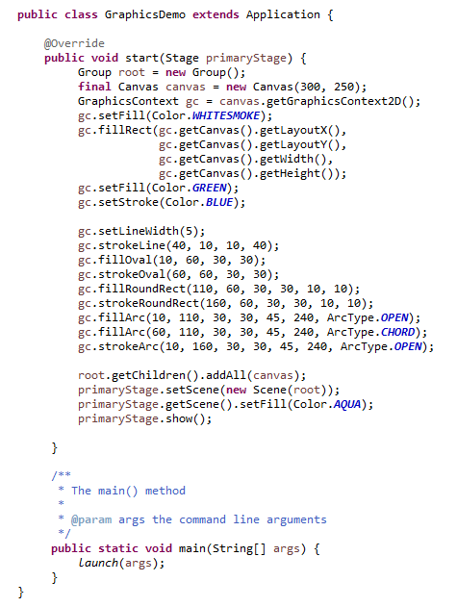
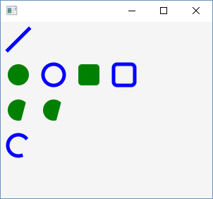

Slide 116
Rectangles
Rectangles can be drawn or filled.
gc.strokeRect(10, 10, 50, 50);
gc.fillRect(10, 10, 50, 50);
The fillRect and strokeRect take four integers as parameters:
strokeRect(int x, int y, int width, int height)

Slide 117
Ovals and Bounding Rectangles
Ovals are created by drawing the oval inside of a “bounding rectangle”.
This rectangle is invisible to the viewer of the Graphics object.
gc.fillOval(x, y, width, height);
Width
(x,y)
Height

Slide 118
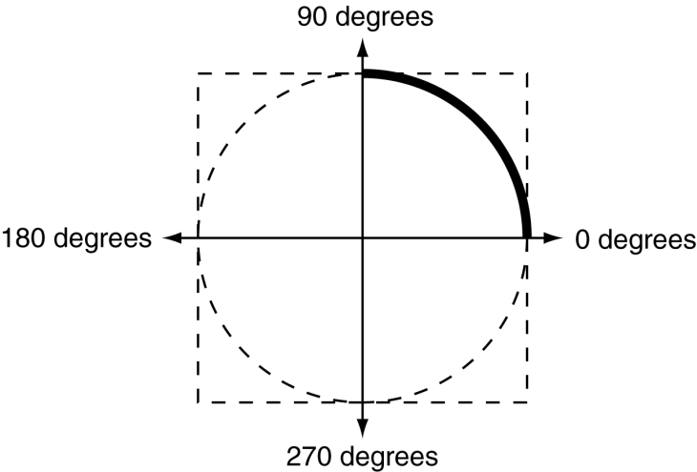
Arcs
Arcs are drawn from the 90 degree position counterclockwise and can be filled or unfilled
gc.strokeArc(0, 20, 120, 120, 0, 90);
gc.fillArc(0, 20, 120, 120, 0, 90);
The fillArc and strokeArc take six integers as parameters and a closure (round, chord, open):
strokeArc(int x, int y, int width, int height, int start, int end, ArcType.OPEN)

Slide 119

Drawing Text
gc.strokeText("Message", 50, 100);

Slide 120
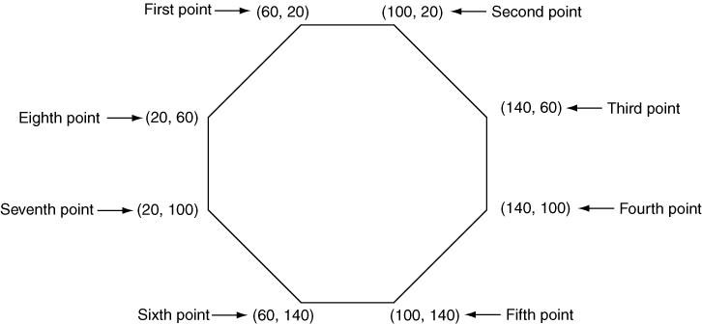
Polygons
Polygons are drawn using arrays of integers representing x, y coordinates, they are closed shapes
int[]xCoords={60,100,140,140,100,60,20,20};
int[]yCoords={20,20,60,100,140,140,100,60};

Slide 121
Polygons
The fillPolygon and strokePolygon use the arrays as parameters:
fillPolygon(xCoords, yCoords, 8)
Number of points

Slide 122
Polylines
Polylines are drawn using arrays of integers representing x, y coordinates, they are NOT closed shapes unless the first and last point are the same
int[]xCoords={60,100,140,140,100,60,20,20};
int[]yCoords={20,20,60,100,140,140,100,60};

Slide 123
Polylines
The fillPolyline and strokePolyline use the arrays as parameters:
fillPolygon(xCoords, yCoords, 8)
Number of points

Slide 124
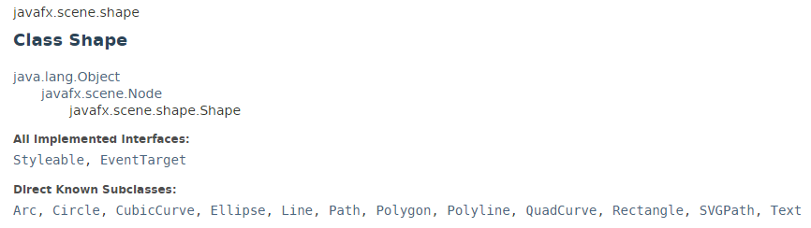
Drawing Shapes using Shape objects
Another way to draw shapes is by creating a shape object and adding it to the scene where it is drawn
Rectangle rect1 = new Rectangle(10, 10, 200, 200);
rect1.setFill(Color.BLUE);

Slide 125
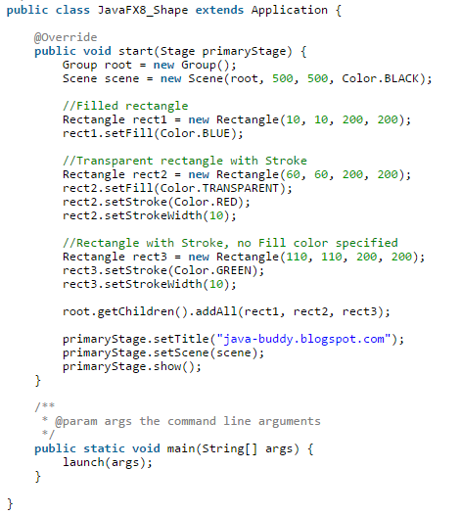
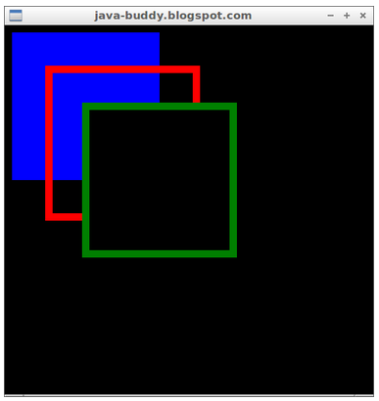

Slide 126
Logo Lab – Graphical Objects
Using a GraphicsContext object, create a logo with text for your fictional company letterhead.
Use at least 3 colors, and at least 5 GraphicContext methods, and at least 1 Shape object (rectangle, ellipse, etc.)
Be creative!
Upload your .java files and a screenshot of your logo.

