Slide 1
C
CIVICFIX
CivicFix
Report it. Route it. Fix it.
An AI-assisted public infrastructure issue reporting system
Citizen reports → System triages → Officer resolves

Slide 2
The Problem
Civic complaints disappear into a black box
?
!
x
No tracking
No prioritization
No accountability
Citizens report a pothole or dead streetlight by phone or in person, get no ticket number, and never learn what happened.
Staff receive complaints in mixed formats with no way to tell which ones are urgent or dangerous.
There is no record of who is responsible for a complaint, so nothing forces it to get fixed.
Real example: A deep pothole sits outside a school. Today the complaint disappears — a week later, a cyclist is injured.
02

Slide 3
The Solution
Every complaint becomes a tracked, routed, accountable ticket
1
2
3
4
Report
→
Triage
→
Route
→
Resolve
Citizen submits an issue with GPS location, address auto-lookup, and a map preview.
AI suggests category, department and priority, with the reasons behind it.
Admin assigns the ticket to a named officer, balanced by current workload.
Officer moves it through a strict workflow; the citizen is notified at every step.
Three roles: Citizen · Field Officer · Administrator — each with a role-scoped view and permissions.
03

Slide 4
Issue Workflow
A strict state machine — illegal jumps are refused, every change is timestamped
REPORTED
IN_REVIEW
IN_PROGRESS
RESOLVED
REJECTED
← requires a written reason
Only the assigned officer (or an admin) may change an issue's status.
Every transition is written to a status_history timeline entry.
Citizens are notified in-app at each step of the journey.
04

Slide 5
Features by Role
C
Citizen
O
Officer
A
Admin
Register / login, report an issue with GPS + map preview
Queue of all issues, plus “assigned to me” tab
Dashboard: totals, unassigned, high-priority open
AI-suggested category, department, priority
Filter by status
Assign / reassign issues by officer workload
Dashboard, “My issues”, timeline, in-app notifications
Move issues through the workflow; reason mandatory to reject
Manage users, roles, categories, departments
05

Slide 6
AI-Assisted Triage
The specialization enhancement: from keyword rules to a trained classifier
Citizen types a description
source: “ml-model”
or “keyword-rules”
1
“The lamp above my gate has died”
API response always names its source
ML service scores it
2
TF-IDF + Logistic Regression → category, priority, confidence
Honest limits
The bundled training set is synthetic — near-100% accuracy only proves the pipeline works. Real accuracy is measured only after training on real, labelled complaints.
Rule engine as fallback
3
If the ML service is down, the deterministic keyword engine takes over automatically
06

Slide 7
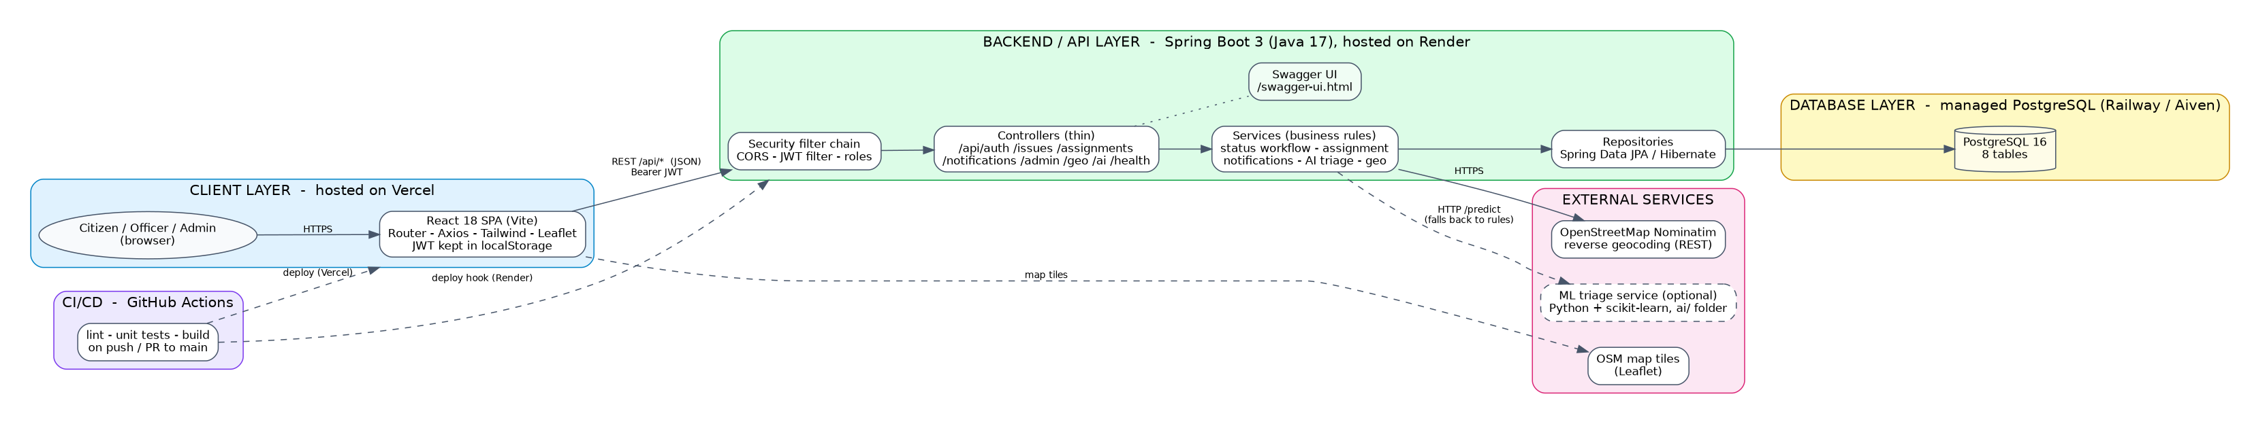
System Architecture
Client → API → Database, with external geocoding and an optional ML service
07

Slide 8
Tech Stack
Frontend
React 18 · Vite · React Router · Axios · Tailwind CSS · Leaflet
Backend
Spring Boot 3.4 (Java 17) · Spring Security + JWT · Bean Validation
Data
Spring Data JPA + Hibernate · PostgreSQL 16 (H2 for tests)
Auth
JWT · bcrypt password hashing · roles: CITIZEN / OFFICER / ADMIN
Testing
JUnit 5 + Mockito (backend) · pytest (AI service)
API Docs
springdoc-openapi — Swagger UI
CI / CD
GitHub Actions — Checkstyle, ESLint/Prettier, tests, deploy hooks
Hosting
Render (backend) · Vercel (frontend) · Railway / Aiven (PostgreSQL)
08

Slide 9
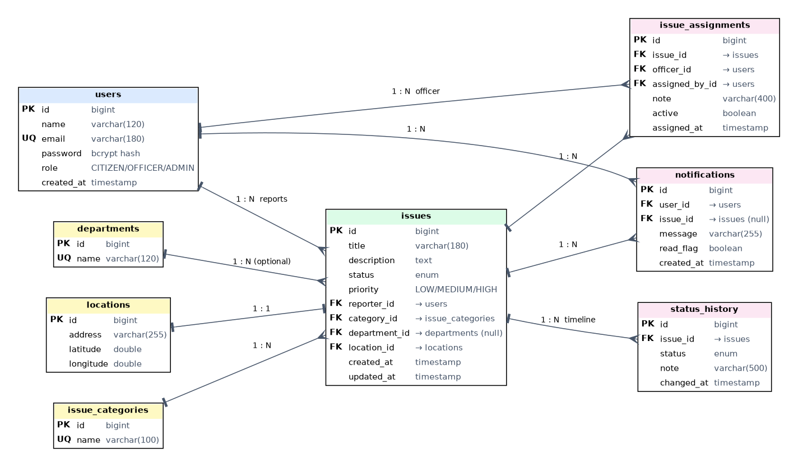
Database — Entity Relationship Diagram
9 tables · PostgreSQL 16 · modeled with Spring Data JPA / Hibernate
09

Slide 10
Core Entities
users
issues
Citizens, officers, admins (bcrypt password hash)
The reported problem, its status and priority
issue_categories
status_history
Kinds of problems (pothole, streetlight, etc.)
One timeline entry per workflow change
departments
issue_assignments
Municipal departments that own a category
Which officer handles which issue, history kept
locations
notifications
Address + GPS coordinates, one-to-one with an issue
In-app messages per user
10

Slide 11
API & Platform Operations
✓
Uniform `{ success, data, message }` response envelope
✓
Structured, greppable application logs
✓
Role-based access control on every endpoint
✓
Interactive API docs via Swagger UI
✓
Brute-force login lockout
✓
OpenStreetMap Nominatim reverse-geocoding
✓
`/api/health` endpoint for uptime checks
✓
Leaflet map tiles for location preview
11

Slide 12
Running the Project
Two supported paths, both documented in SETUP_GUIDE.md
D
Docker (easiest)
M
Manual
Needs Java 17, Maven, Node 20, PostgreSQL 16
1
Install & start Docker Desktop
1
createdb -U postgres civic_issue
2
Open a terminal where docker-compose.yml lives
2
cp .env.example backend/.env — set DB_PASSWORD, JWT_SECRET (32+ chars)
3
Run ./run.sh (or run.bat on Windows)
3
cd backend && mvn spring-boot:run
4
Auto-creates .env with a random JWT secret, then builds everything
4
cd frontend && cp .env.example .env && npm install && npm run dev
5
Open localhost:5173 · Swagger at :8080/swagger-ui.html
12

Slide 13
C
CivicFix
Report it. Route it. Fix it.
Thank you

