Slide 1

NorthBridge Bank
NorthBridge Bank
Analysis
Presentd By:
  Hue-Mai T.
  Zsolt S.
  Mobeen R.
  Dulce A.

Slide 2



Presentation Summary
  Revenue Insights
  Churn-Satisfaction Correlation
  Data Quality Findings
  Recommendations
Notes:
Q3 revenue discrepancy
Churn satisfaction correlation, and the Manchester branch
Data Quality - Missing Satisfaction Ratings

Slide 3
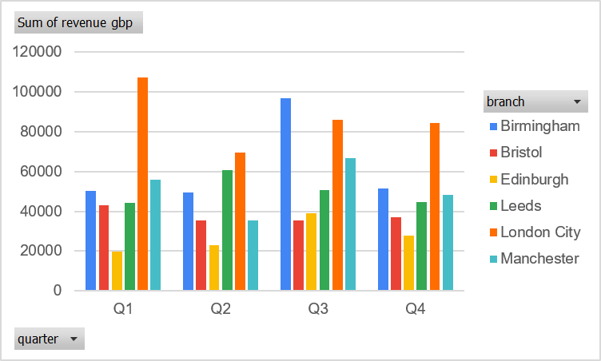
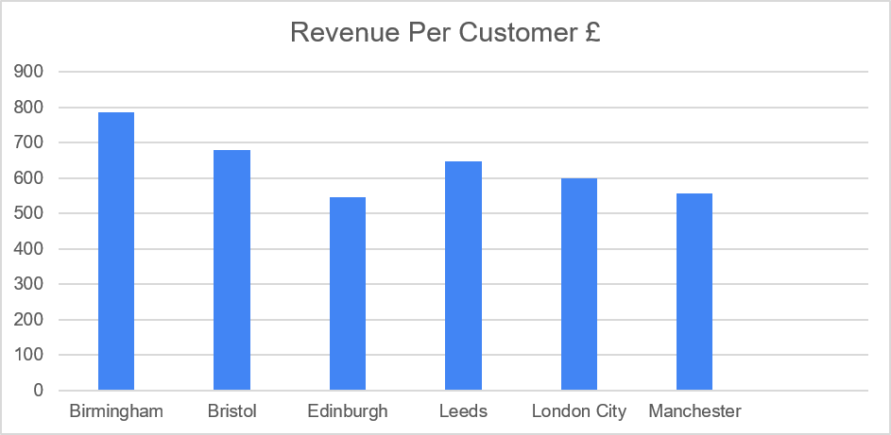
Revenue & Branch Performance
  London - Top performing Branch
  Revenue did not drop in Q3, but was the highest
  Edinburgh has the lowest revenue per customer

Slide 4
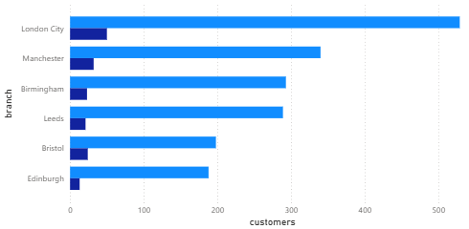
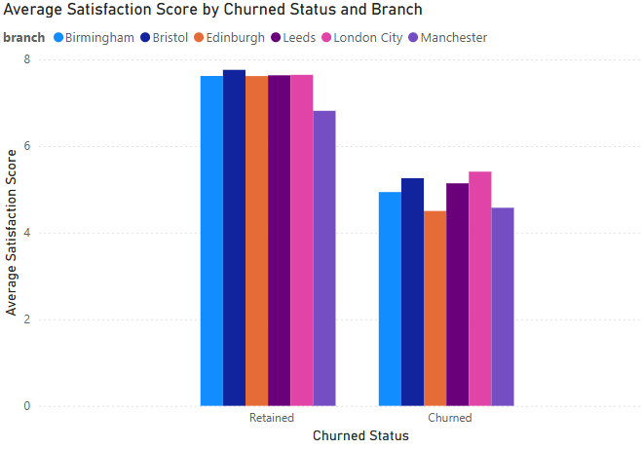
  Some satisfaction scores are missing in the dataset
  Filtered out missing satisfaction scores before investigating
  Churned customers have a lower average satisfaction score
  Retained customers have a higher average satisfaction score
  There is a correlation between the satisfaction score and churn status
Churn & Satisfaction
Notes:
Churn:
Average - 5.10%
Manchester - 9.68%
Edinburgh - 2.99%
Average Satisfaction:
Manchester - 6.59
Bristol - 7.67
Rest - 7.52/7.53
Some of the satisfaction scores are missing in the dataset.
To handle this issue, we filtered out the missing satisfaction scores before investigating the link between churn and satisfaction.
We had a look at the number of missing satisfaction scores per branch. There does not seem to be a correlation between branch and missing data.

Slide 5
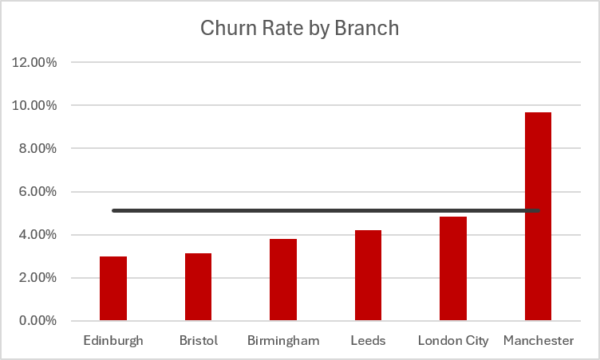
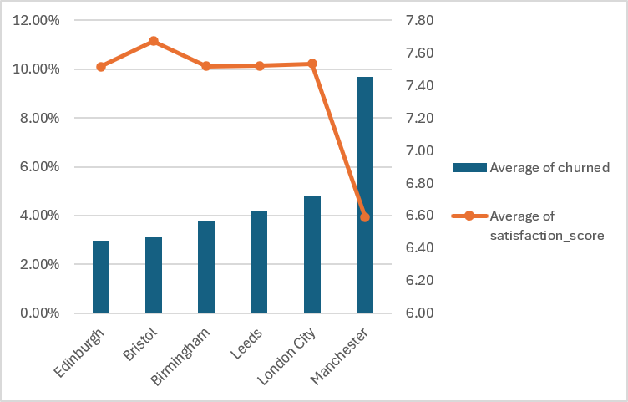
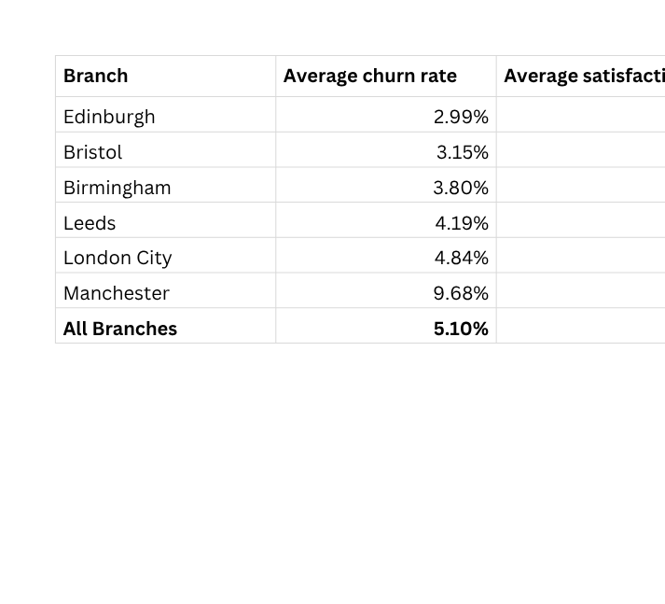
  Manchester branch – Highest Churn rate
  Significant drop in satisfaction score for the Manchester branch
  Also, a steep increase in the average churn rate compared to the other branches
  Edinburgh and Bristol have the highest average satisfaction scores and lower churn rates
  suggesting they are delivering better service and retaining customers.
Churn & Satisfaction
Notes:
Churn:
Average - 5.10%
Manchester - 9.68%
Edinburgh - 2.99%
Average Satisfaction:
Manchester - 6.59
Bristol - 7.67
Rest - 7.52/7.53
The average can be seen in the line on the left graph.
Significant drop in satisfaction score when it comes to the Manchester branch, and a steep increase in average churn rate

Slide 6
Data Quality Findings
NorthBridge Bank
Why This Matters?
1. Weakens churn analysis
Missing values make it harder to:
  Compare churned vs non‑churned customers
  Identify early warning signs
  Understand customer experience accurately
2. Reduces confidence in insights
The Head of Retail Banking needs reliable data for a board meeting.
  Missing satisfaction scores mean:
  Averages may be biased
  Trends may be incomplete
  Recommendations may be less accurate
3. Indicates operational gaps
Missing customer feedback may point to:
  Surveys not completed
  Data not captured
  Inconsistent processes across branches
Key data quality issue: Several customers are missing satisfaction scores. This matters because satisfaction is strongly linked to churn, so missing values weaken our ability to understand why customers leave.
Key Issue Identified: Missing Satisfaction Scores, for example:
  CUST00025
  CUST00049
  CUST00152
  CUST00226
Missing Data Affects KPIs
Satisfaction is a key customer KPI.
Missing values mean:
  Average satisfaction may be overestimated
  Branch comparisons may be inaccurate
  Customer experience decisions may be misguided

Slide 7

Recommendations
  Increase revenue per customer in Edinburgh
  cross-selling products: credit cards, loans, mortgages, and savings accounts to existing customers
01.
Revenue
Manchester Branch - research how the services at the Edinburgh and Bristol branches operate
02.
Satisfaction and Churn
Make satisfaction scores a mandatory field and standardise feedback collection across all channels
Validation checks will prevent missing values in the future, and regular data quality reviews will ensure complete and reliable data
03.
Data Quality
Notes:
There is a clear issue with the retention of customers at the Manchester branch. In order to improve, Manchester branch, which has highest churn rate should research the service at the Edinburgh and Bristol branches, which have the least churn rate and highest satisfaction scores.

Slide 8

Thank You
NorthBridge Bank

