Slide 1


Major Project II
Title:
Detection of Emotion of Speech using Hybrid CNN
Presented by:
Vansh Gupta, R2142201652- CSE AIML
Vartika Rawat, R2142201670- CSE AIML
Komal Rajpoot, R2142201635- CSE AIML
Satyam Raj, R2142201917- CSE AIML
Guided by:
Dr. Bhupendra Singh
-Assistant Professor (SS)
Dr. Anil Kumar
-AIML Cluster SOCS

Slide 2
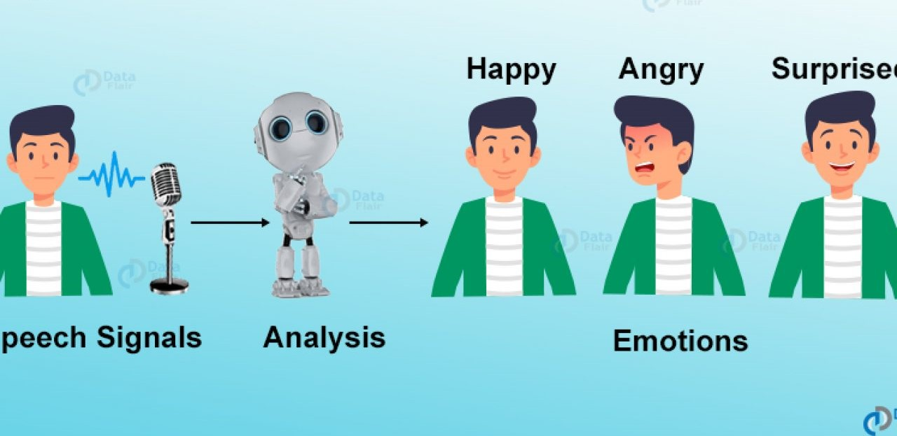
Content
Introduction
Problem Statement
Motivation
Objectives
Methodology
Flowchart
SWOT Analysis
Application of the Project
References
Screenshots

Slide 3
1.) Introduction
The ability to understand human emotions through speech has garnered significant attention.
Emotion recognition systems analyze speech to discern underlying emotions accurately. These systems find applications in education, where they can adapt learning materials based on students' emotional states.
Additionally, in communication settings like call centres, integrating emotion recognition into customer service processes can lead to more personalized interactions and improved satisfaction.
While the focus primarily remains on analyzing visual and auditory signals, particularly acoustic signals, advancements in machine learning have introduced various models for emotion recognition.

Slide 4
2.) Problem Statement
The necessity for Speech Emotion Recognition (SER) systems to complement existing automated systems.
The need for accurate and efficient SER models capable of analyzing speech signals and detecting emotional states.
The challenge of selecting suitable speech segments and extracting relevant features to improve SER performance.
The ongoing quest to optimize SER algorithms and classification techniques to achieve higher recognition rates and enhance user experience.

Slide 5
3.) Motivation
Understanding Human Emotion: Emotions play a crucial role in human communication and interaction. Being able to accurately detect emotions from speech can lead to advancements in various fields such as psychology, human-computer interaction, and customer service.
Practical Applications: There are numerous practical applications for emotion detection from speech. For example, it can be used in call centers to assess customer satisfaction or in healthcare to monitor patients' emotional states. Additionally, in the entertainment industry, emotion detection can enhance user experiences in gaming or virtual reality environments.
Technological Advances in Deep Learning: Convolutional Neural Networks (CNNs) have shown remarkable success in various image recognition tasks. By extending CNNs to analyze sequential data such as speech signals, researchers can leverage the power of deep learning for emotion detection from audio inputs.
Hybrid Models for Improved Performance: Combining different types of neural network architectures, such as CNNs with recurrent neural networks (RNNs) or attention mechanisms, can often lead to enhanced performance. Hybrid models leverage the strengths of each architecture to capture complex patterns in the data more effectively.

Slide 6
4.) Objectives
Developing a Robust Emotion Recognition System: The primary objective is to build a robust system capable of accurately recognizing emotions from speech signals. This involves training the hybrid CNN model to extract relevant features from audio inputs and classify them into different emotion categories.
Enhancing Accuracy and Performance: Another objective is to improve the accuracy and performance of emotion recognition compared to existing methods. By leveraging the capabilities of CNNs to learn hierarchical representations of speech features, the hybrid model aims to achieve better performance in capturing subtle nuances and variations in vocal expressions.
Handling Variability in Speech Data: Speech signals exhibit variability due to factors such as speaker characteristics, language differences, and emotional intensity. An objective of the project is to design the hybrid CNN model to effectively handle this variability and generalize well across diverse datasets.
Exploring Feature Representation: The project may aim to explore different ways of representing speech features and learning meaningful representations using CNNs. This involves experimenting with various architectures, layers, and preprocessing techniques to identify the most informative features for emotion recognition.

Slide 7
5.) Methodology
Data Collection: Gather a dataset of speech samples labelled with different emotions (e.g., happy, sad, angry, etc.).
Pre-processing: Clean the audio data, remove noise, and possibly segment it into smaller chunks for analysis.
Feature Extraction: Extract relevant features from the audio data, such as MFCCs (Mel-frequency cepstral coefficients), spectrograms, or other time-frequency representations.
Model Architecture Design: Design a hybrid CNN architecture that combines convolution layers with other types of layers (e.g., recurrent layers, dense layers) to effectively learn features from the audio data.
Model Training: Train the hybrid CNN model on the pre-processed and feature-extracted data, using appropriate training techniques such as data augmentation to prevent over fitting.
Model Evaluation: Evaluate the trained model using metrics such as accuracy, precision, recall, and F1-score on a separate validation set to assess its performance.
Fine-tuning: Fine-tune the model and hyper parameters based on the evaluation results to improve performance if necessary.
Testing: Test the final model on unseen data to assess its generalization ability and real-world performance.
Analysis and Interpretation: Analyze the results, interpret the model's behaviour, and identify areas for improvement or further research.

Slide 8
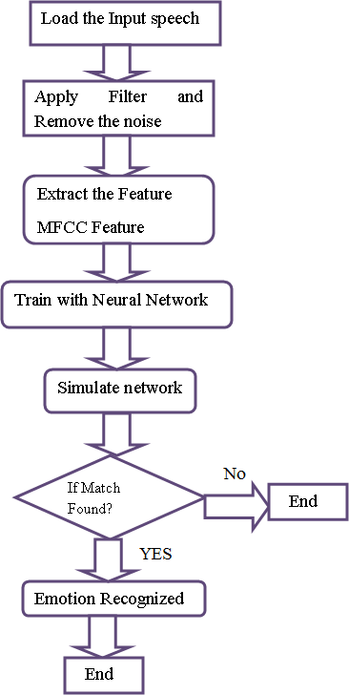
6.) Flowchart

Slide 9
7.) SWOT Analysis
STRENGTHS
High Accuracy: Hybrid CNN models have the potential to achieve high accuracy in detecting emotions from speech due to their ability to learn complex hierarchical representations of features.
Robust Feature Extraction: CNNs excel at automatically extracting relevant features from raw data, making them suitable for processing speech signals and capturing subtle nuances in vocal expressions.
WEAKNESS
Data Dependency: Hybrid CNN models for emotion recognition require large amounts of labeled data for training, which may be challenging to obtain, particularly for certain emotion categories or languages.
Complexity: Designing and training hybrid CNN architectures can be complex, requiring expertise in deep learning, signal processing, and model optimization techniques.

Slide 10
7.) SWOT Analysis (cont.)
OPPORTUNITIES
Integration with Applications: Emotion recognition from speech has numerous applications in various domains such as healthcare, customer service, and entertainment. There is an opportunity to integrate hybrid CNN models into these applications to enhance user experiences and improve decision-making processes.
Continuous Improvement: Ongoing advancements in deep learning techniques, hardware infrastructure, and availability of labeled datasets present opportunities for continuous improvement in emotion recognition performance.
THREATS
Competition: The field of emotion recognition from speech is highly competitive, with new methods and models being developed rapidly. Keeping up with the latest advancements and staying ahead of competitors poses a threat to the success of the project.
Privacy and Ethical Concerns: Emotion recognition technology raises privacy and ethical concerns related to data collection, consent, and potential misuse of emotional information.

Slide 11
8.) Application of the Project
Customer Service and Support: Companies can use emotion detection to analyze customer calls and gauge customer satisfaction levels in real-time. This information can help improve customer service strategies and identify areas for improvement.
Healthcare: Emotion detection from speech can assist healthcare professionals in assessing patients' emotional states remotely. It can be particularly useful in mental health monitoring, where subtle changes in speech patterns may indicate changes in emotional well-being.
Education: Emotion recognition technology can be integrated into educational platforms to provide personalized learning experiences. By analyzing students' speech during online lectures or tutoring sessions, educators can adapt teaching methods to better suit individual learning styles and emotional needs.
Market Research: Companies can use emotion detection to analyze consumer feedback from surveys, focus groups, or social media posts. Understanding customers' emotional responses to products or advertisements can inform marketing strategies and product development decisions.
Call Center Optimization: Call centers can use emotion detection to categorize incoming calls based on customers' emotional states and prioritize them accordingly. This can help streamline call handling processes and improve overall customer experience.

Slide 12
9.) References
K. He, X. Zhang, S. Ren, and J. Sun, “Spatial pyramid pooling in deep convolutional networks for visual recognition,” in Proceedings of the 13th European Conference on Computer Vision, pp. 346–3610, Springer, Zurich, Switzerland, September 2014.
K. Han, D. Yu, and I. Tashev, “Speech emotion recognition using deep neural network and extreme learning machine,” in Proceedings of the 15th Annual Conference of the International Speech Communication Association Interspeech, pp. 223–227, Singapore, September 2014.
Y. LeCun, Y. Bengio, and G. Hinton, “Deep learning,” Nature , vol. 521, no. 7553, pp. 436–444, 2015.
. Huang, Y. Li, J. Tao, Z. Lian, M. Niu, and J. Yi, “Speech emotion recognition using semi-supervised learning with ladder networks. First asian conference on affective computing and intelligent interaction (ACII asia),” IEEE Deep Learning Approaches for Speech Emotion Recognition, vol. 289, pp. 1–5, 2018.

Slide 13
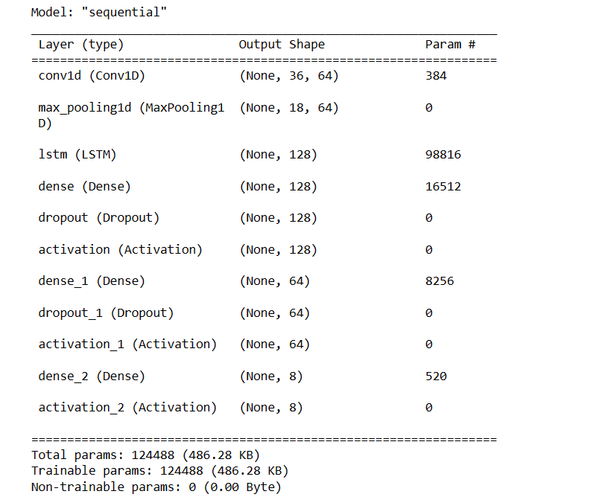
10.) Screenshots

Slide 14
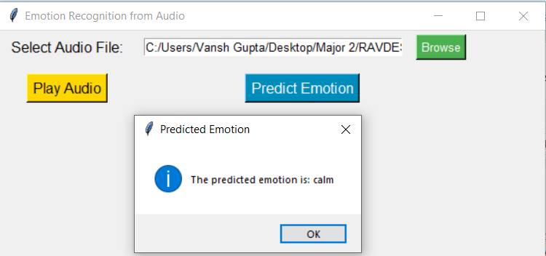
10.) Screenshots (cont.)
(Made a GUI which takes audio.wav as input and predicts its emotion as output)

Slide 15
Thank You

