Slide 1
Lab 5 Low Complexity Model

Slide 2
Why do we need low-complexity model
Reduce execution time
Include computation time and memory access time
Reduce parameters
Reduce memory access
Reduce FLOPs
Reduce computation time
Objective in this Lab: fewer parameters, lower FLOPs, maintain accuracy

Slide 3
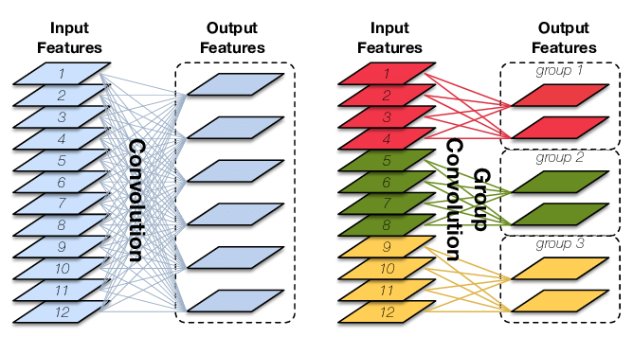
Decomposition
Convolution has high computational and memory demands.
Decomposition can reduce both FLOPs and parameters
Group convolution
Example: ResNeXt
Separable convolution
Depth-wise convolution + point-wise convolution
Example: MobileNet, Xception, EfficientNet

Slide 4
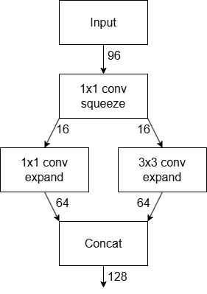
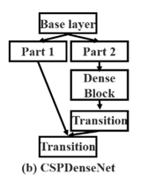
Channel reduction and partition
Reducing the channel might also be a good method to reduce parameters and FLOPs
Channel reduce
Reduce the channel by performing 1x1 convolution
Example: SqueezeNet
Channel partition
Calculate only on part of the channel, and then concatenate the result
Example: CSPNet

Slide 5
Other methods
The method used in Lab 4 can also be effectively applied in this lab, alongside the approaches mentioned above.
Pruning
Quantization

Slide 6
Accuracy Restore
The former methods might cause a drop in accuracy. How could we restore it?
create or reuse gradient diversity as much as possible
Scale input size/depth/width
Multiple gradient path
Example: Dense layer in DenseNet
Channel Shuffle
Example: ShuffleNet
Attention
Example: Squeeze-Excitation network in SqueezeNet

Slide 7
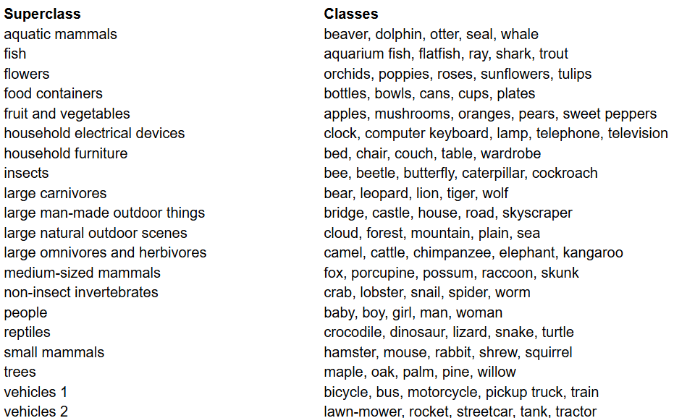
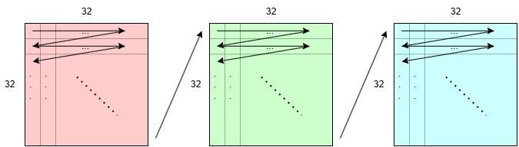
Dataset – Cifar100
Image classification
32 x 32 pixels each image
60000 images
40000 training images
10000 validation images
10000 test images (Hidden)
Input size : 3(channels) x 32(pixels) x 32(pixels) each image

Slide 8
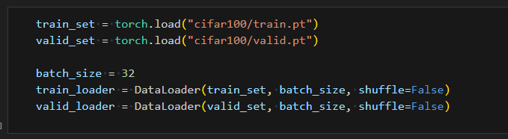
Task (Lab5.ipynb)
Step 1：load dataset
The batch size values for the train and valid could be set whatever you want, and they could be different.

Slide 9
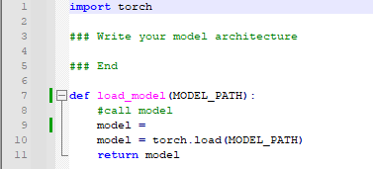
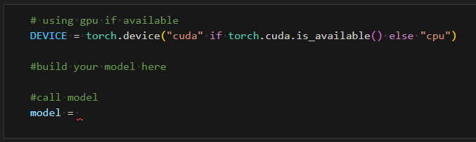
Task (Lab5.ipynb)
Step 2：
Select the desired model architecture as backbone
Build and adjust it on network.py
Any method can be used as long as it effectively reduces model complexity.
Call the model on jupyter notebook

Slide 10
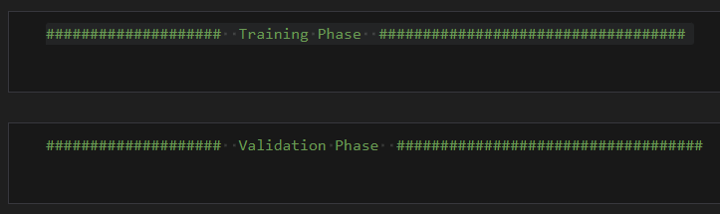
Task (Lab5.ipynb)
Write both training and validation phase by yourself
Save your best model as .pth file after the process
Only .pth files are accepted. Submitting other types of files will result in a zero grade.

Slide 11

Testing flow
You need to prepare
network.py： your model architecture
model.pth：saved model file
Command
python test.py <DATA_PATH> <MODEL_PATH>
Example output
Please make sure you can successfully run the test.py and have the results.
Do not modify the test.py!

Slide 12
Report should contain
Which methods do you apply to lower complexity and bridge the accuracy gap
Why do you apply the methods
How do you implement
Screenshot of your testing results
FLOPs
Model size
Accuracy

Slide 13
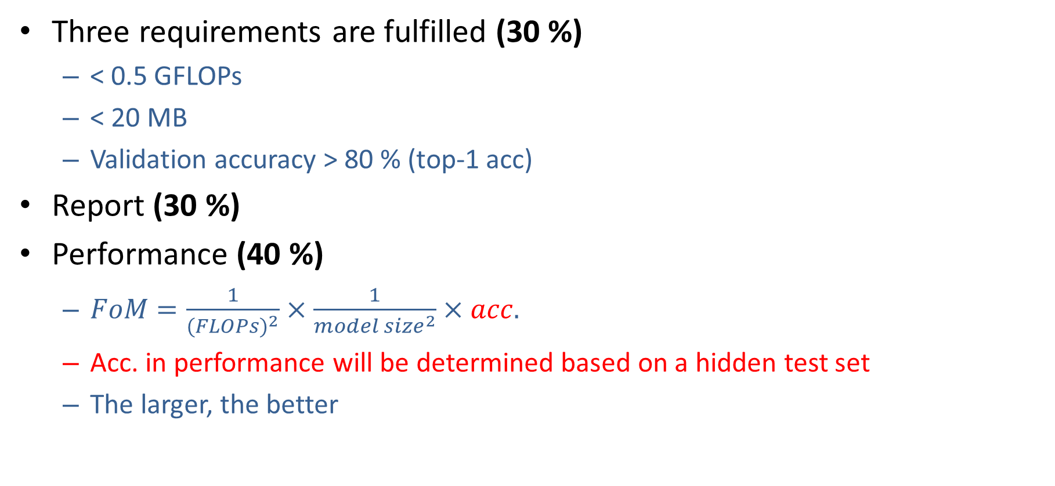
Grading Policy
Three requirements are fulfilled (30 %)
< 0.5 GFLOPs
< 20 MB
Validation accuracy > 80 % (top-1 acc)
Report (30 %)
Performance (40 %)
$FoM=\frac{1}{(FLOP{s)}^{2}}×\frac{1}{{model size}^{2}}×acc.$
Acc. in performance will be determined based on a hidden test set
The larger, the better

Slide 14
Reminder
Submit Deadline : 2 weeks (2024/11/25 23:59)
Please strictly follow the naming rules !!!
Upload 4 files to new e3
Lab05.ipynb
network.py
model.pth
StudentID_report.pdf (example: 311555555_report.pdf)

Slide 15
Have Fun !!!!!!

