Slide 1
Google Colab Tutorial

Slide 2
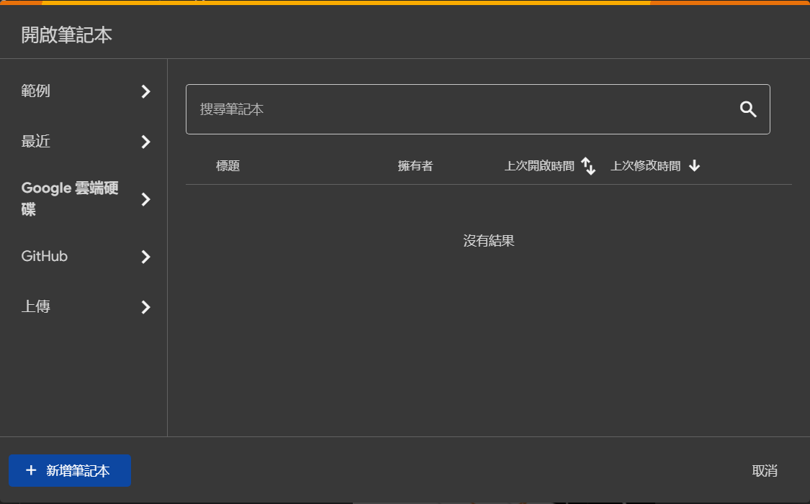
Open the desired notebook on Colab
Unzip the file and upload the whole directory to Google drive first
https://colab.research.google.com/?hl=zh-tw
If you are using Colab for the first time and find that you cannot open ipynb files, please refer to pages 3 and 4. If you are able to open it, you can skip pages 3 and 4.
You can try these two options to try to locate the files

Slide 3
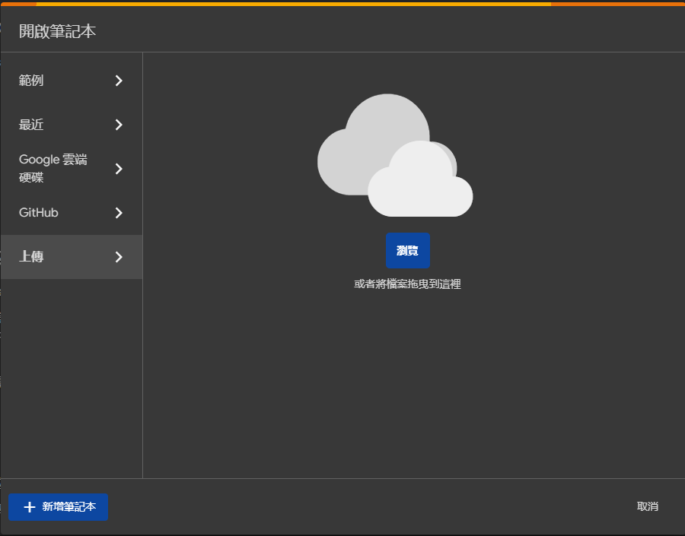
Open the desired notebook on Colab
Unzip the file and upload it to Google drive first (except ipynb)
https://colab.research.google.com/?hl=zh-tw
Upload your .ipynb file on colab website

Slide 4
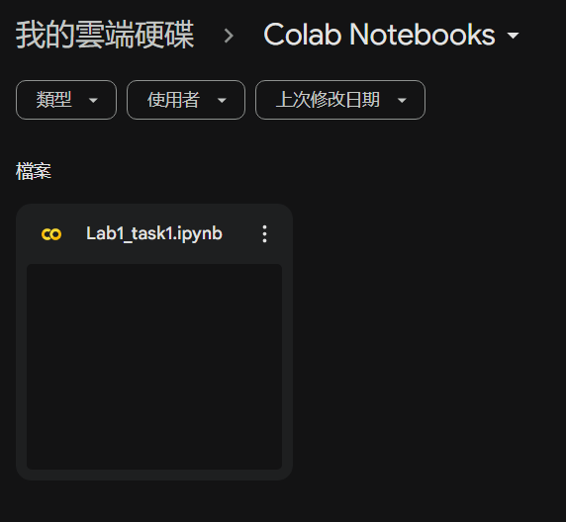
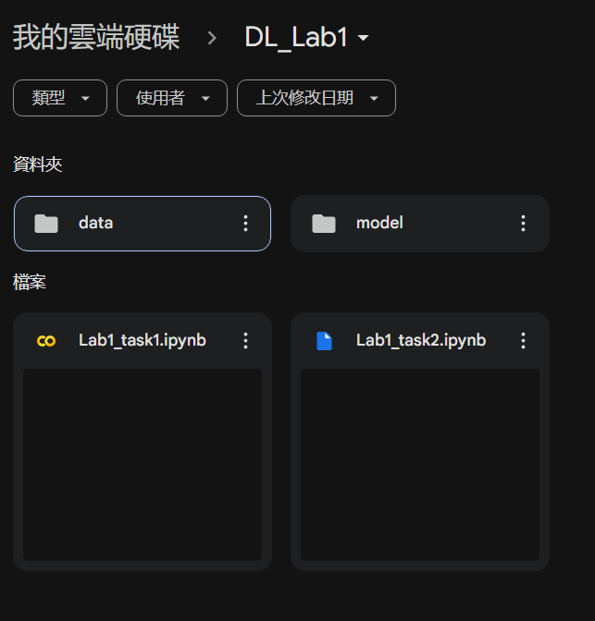
Move ipynb to the same directory as other data
After you upload your .ipynb file to the Colab website, you may find that your Google Drive has a directory called ‘Colab Notebooks’.
Move the ipynb to the same directory as the other data

Slide 5
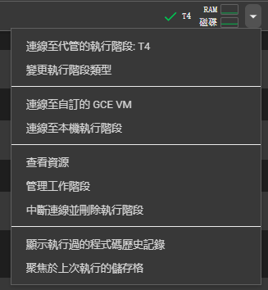
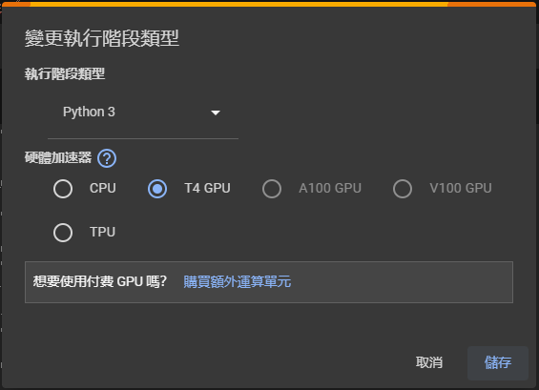

Connect to GPU resource
You can check whether the connection to GPU is set.
In Lab1, you can skip this step
You don’t need to use GPU in Lab1

Slide 6

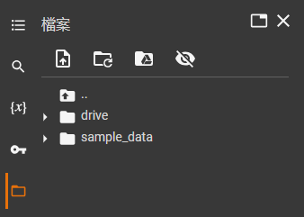
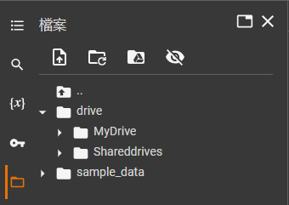
Mount your google drive to notebook
Insert the following code cell at the top of your code.

Slide 7
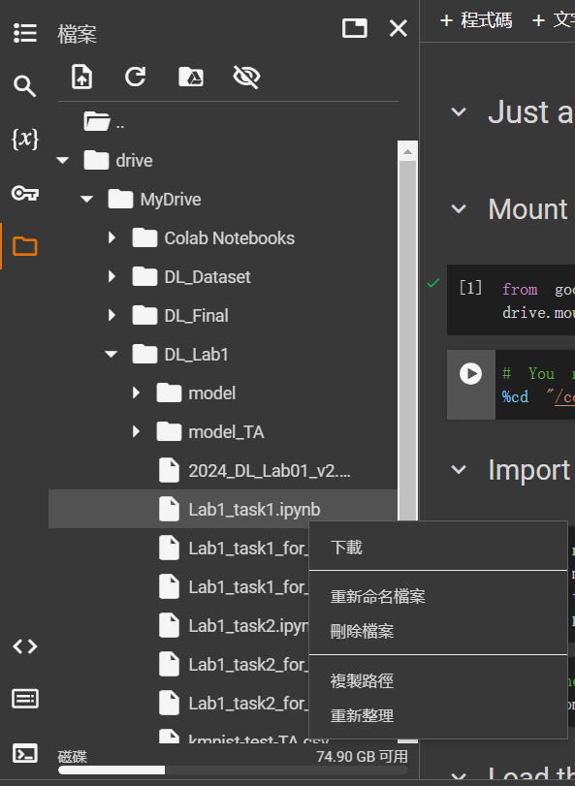
Go to the directory where the code and dataset is located
Either <w> or <w/o> “%” in front of the command of cd is allowed

Slide 8
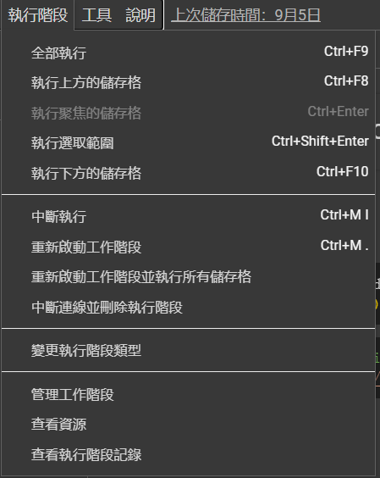
Run your program
It’s similar to jupyter notebook
You can run a specific cell
You can also select “run all” to execute all cells

Slide 9

Reminder
If you change any of the cells, you need to run the cell you edited before training in order to apply the new settings.
If you edited layer.py and network.py, you should restart kernel (runtime)
You can use Google Gemini to help you complete the code

Slide 10
Reference
常見問題
https://research.google.com/colaboratory/faq.html?hl=zh-cn
長時間執行
https://blog.csdn.net/weixin_42722532/article/details/127540028
https://blog.csdn.net/weixin_42166222/article/details/123229420

