Slide 1

Lab4 Model Compression：Pruning & Quantization

Slide 2
Concept (pruning)
Network pruning is widely used for reducing the heavy inference cost of deep models in low-resource settings. A typical pruning algorithm is a three-stage
pipeline.
Training
Pruning
Fine-tuning
repeat

Slide 3
Why pruning?
According to “Lottery Ticket Hypothesis” (Frankle & Carbin, 2019), we find that large network is easier to train than small network.
easy to train
hard to train

Slide 4

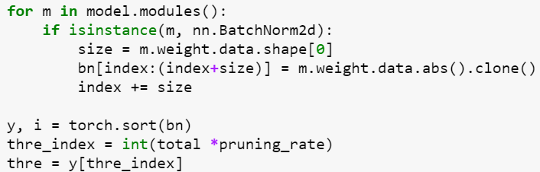
Method (pruning)
Pruning the channel of each convolution layer based on the weight of batch normalization.
BN：
The smaller the value of γ , the less important of $\hat{X}$.

Slide 5
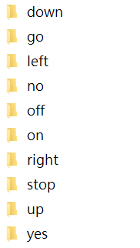
DATASET
Speech Commands
TensorFlow released the Speech Commands Datasets. It includes 65,000 one-second long utterances of 30 short words, by thousands of different people.
We only use 10 short words.

Slide 6
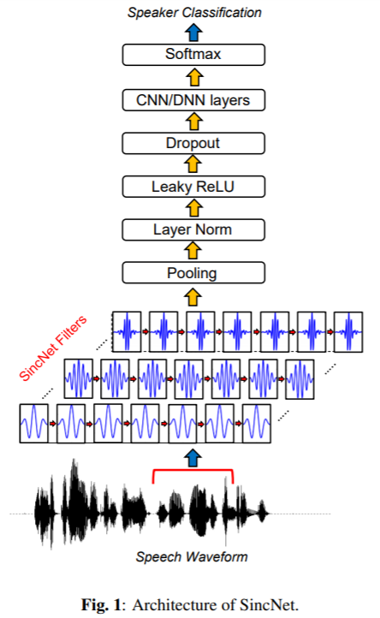
Network
SincNet
SincNet is a neural architecture for processing raw audio samples.
It is a novel Convolutional Neural Network (CNN) that encourages the first convolutional layer to discover more meaningful filters.

Slide 7
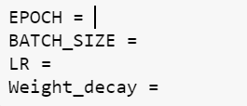
Task 1 (sincnet_training.ipynb)
Train SincNet
Determine super parameter.
Let the best validation accuracy be larger than 80%.

Slide 8

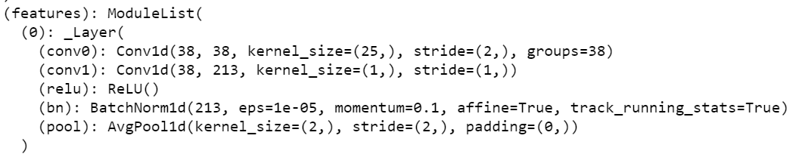
Task 2 (sincnet_pruning.ipynb)
Prune SincNet
Determine the pruning rate (percentage of total channel will be pruned).
Observe channel amount and accuracy before and after pruning.
Don’t set too large at the first iteration.
After pruning

Slide 9
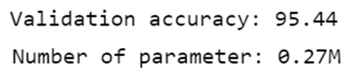

Task 2 (sincnet_pruning.ipynb)
Prune SincNet
Observe parameter of network and accuracy before and after pruning.
Prune the model that have been fine-tuned repeatedly for twice.
?
?
Before pruning
After pruning
Fine-tuning

Slide 10
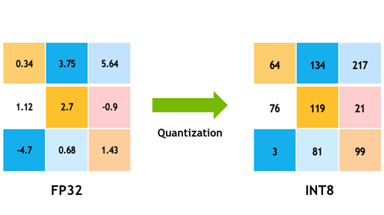
Concept (quantization)
Quantization stores tensors at lower bit-widths than floating point. This allows for a more compact model representation and the use of high performance vectorized operations on many hardware platforms.

Slide 11
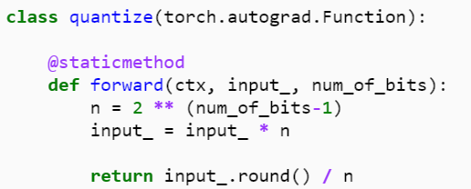
Method (quantization)
Change the range and precision of initial weight.
Ex: number_of_bits = 8
0.73
187
weight
Range: 0~1
Range: 0~255
FP32
INT

Slide 12
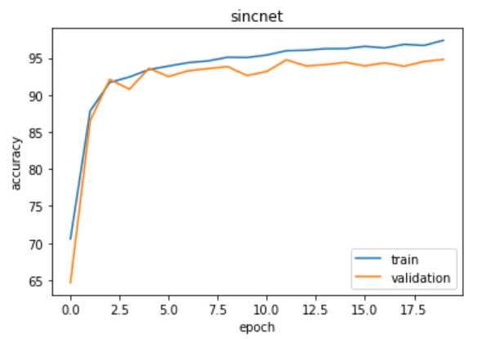
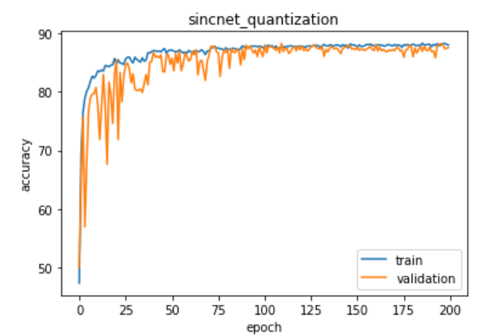
Task 3 (sincnet_quat.ipynb)
Train SincNet_Quat
Determine super parameter.
Let the best validation accuracy be larger than 70%.
Observe the training process between with and without quantization.

Slide 13
Task 4 (Report)
Report should include
The screenshot of training result from task 1 (score：10%)
The screenshot of training result from task 2 (score：10%)
Explain Pruning briefly (What/Why/How) (score：20%)
The screenshot of training result from task 3 (score：10%)
Explain Quantization briefly (What/Why/How) (score：20%)
Compare the difference from above methods of compression (score：30%)
Submit deadline：1 week only (2024/11/11, 23:59)
You only need to submit your report file
Please strictly follow the naming rule !!!!!
學號_lab4_report.pdf

Slide 14
Reference
PRUNING TUTORIAL
https://pytorch.org/tutorials/intermediate/pruning_tutorial.html
Rethinking the Value of Network Pruning
https://github.com/Eric-mingjie/rethinking-network-pruning
SincNet
https://github .com/mravanelli/SincNet
Post-training Static Quantization — Pytorch
https://medium.com/@sanjanasrinivas73/post-training-static-quantization-pytorch-37dd187ba105
Speech commands
https://arxiv.org/abs/1804.03209

Slide 15
Shut down your kernel !!!!!
Remember to SHUTDOWN the kernel to release resources for others

