Slide 1
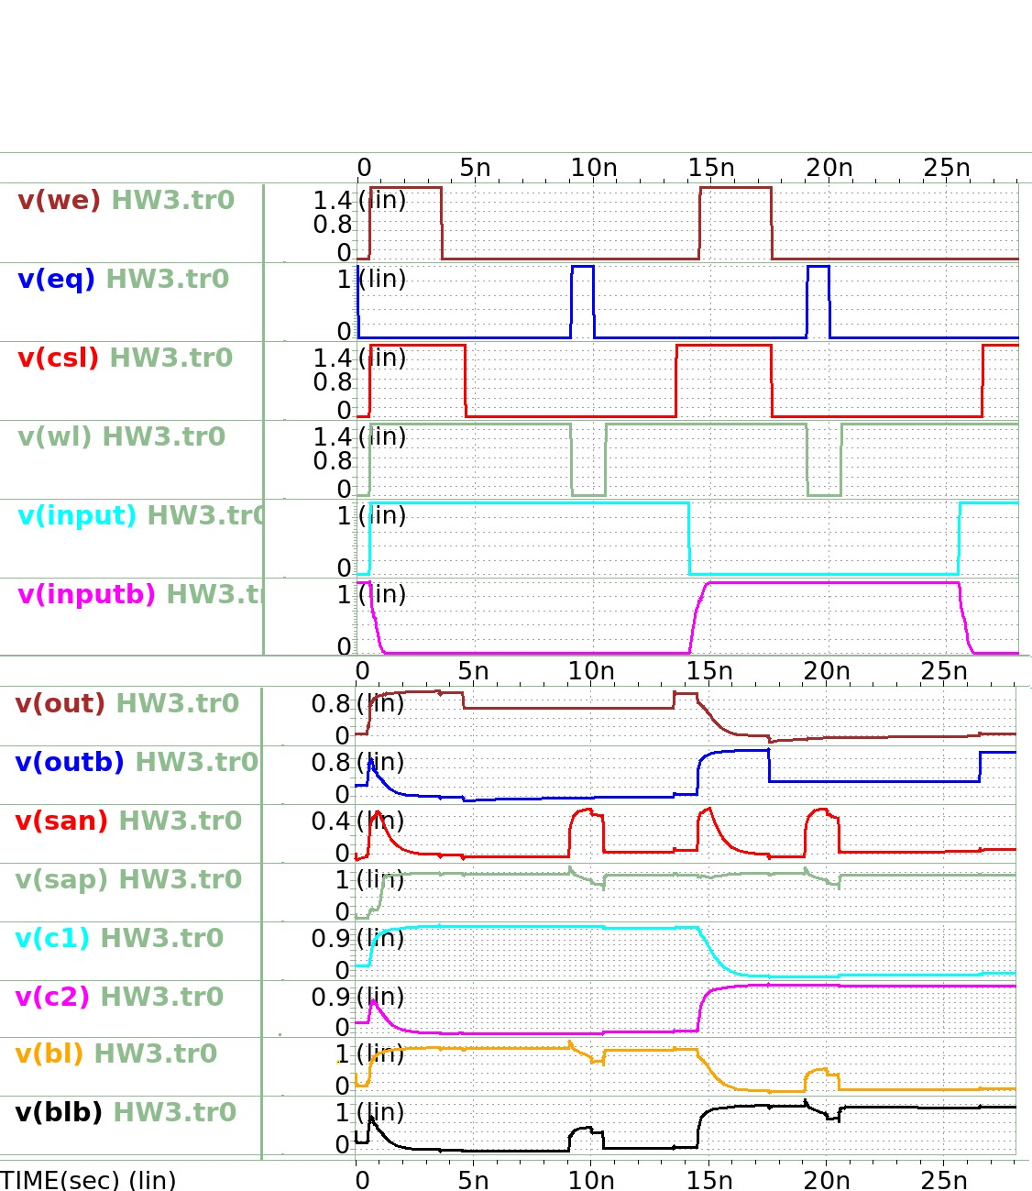
Write1
Read1
Write0
Read0
1
2, 3
4
1
2, 3
4

Slide 2
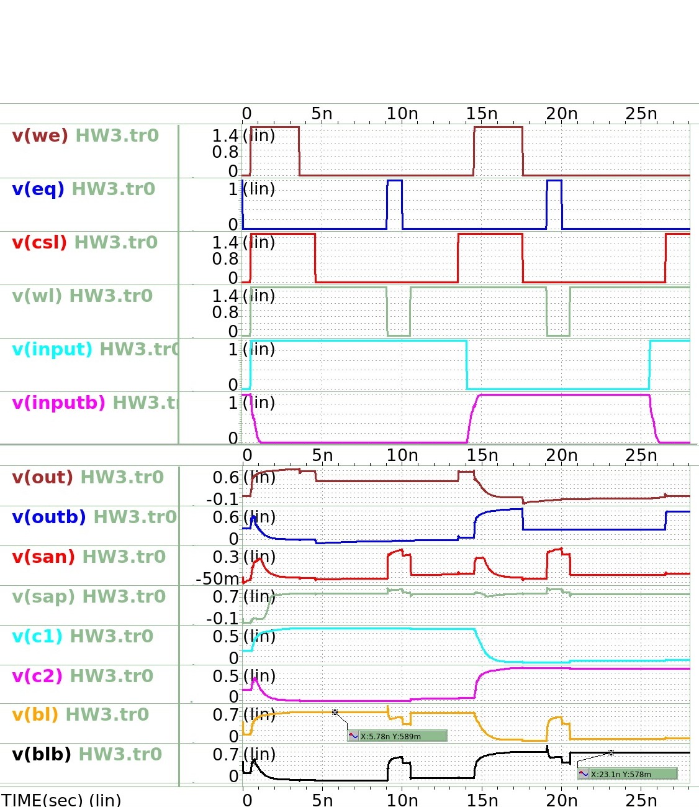
Write1
Read1
Write0
Read0
1
2, 3
4
1
2, 3
4

