Slide 1

MSA
It’s the little things that matter

Slide 2

Quick Recap of Different Architectural Styles
Monolithic Architecture
Service Oriented Architecture
Micro Service Architecture

Slide 3
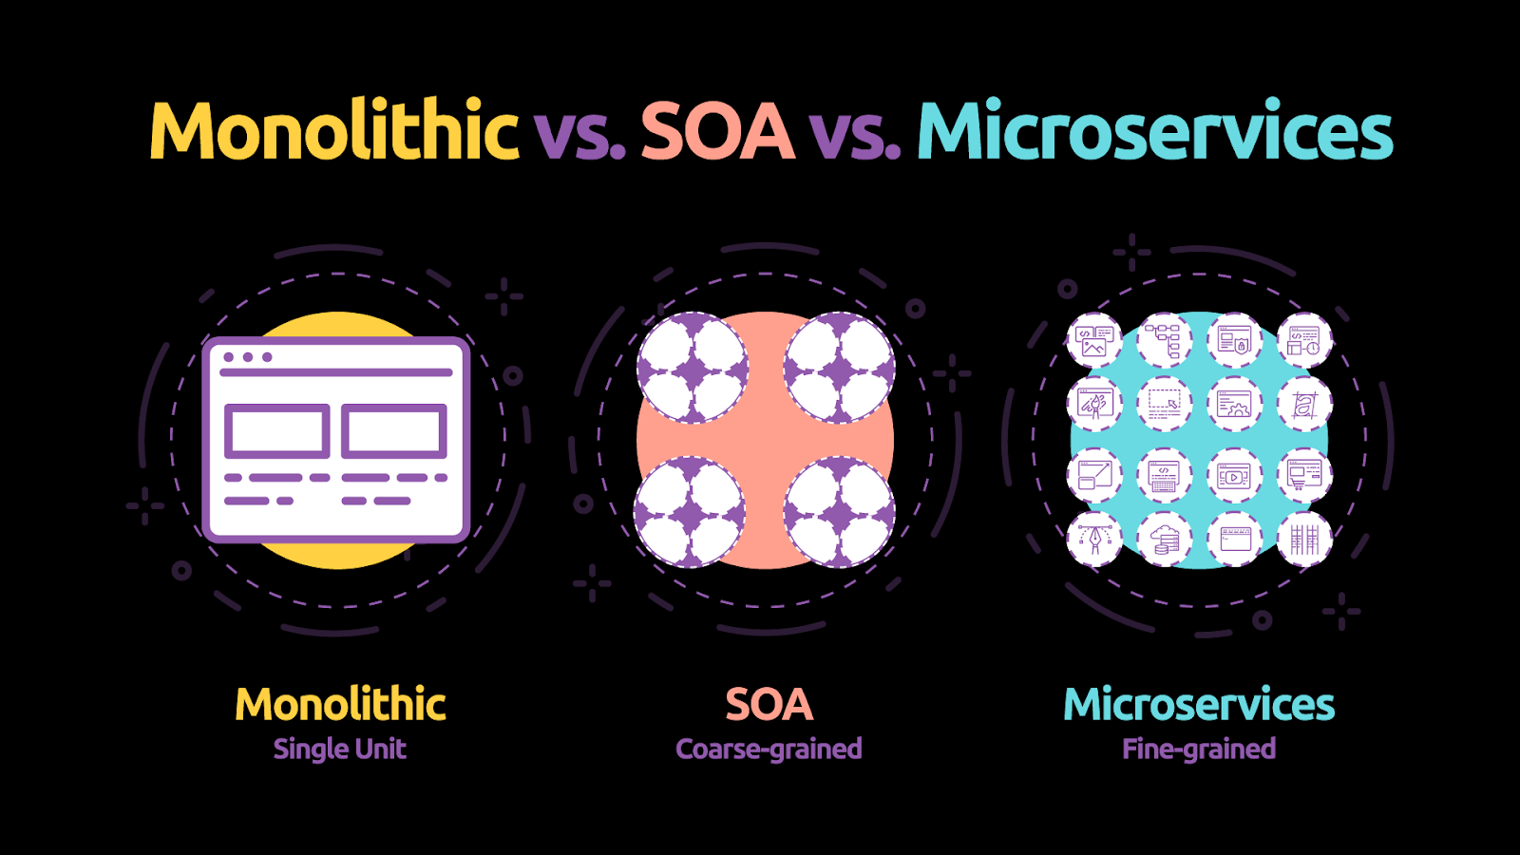

Slide 4
Microservice Characteristics
SRP
Encapsulated
Independent

Slide 5
MSA Benefits
Scalability
Deployment
Simplicity
Fault tolerant
Testability
Language agnostic

Slide 6
MSA Drawbacks
Deployment
Complexity
Monitoring
Eventual Consistency
Chattiness

Slide 7
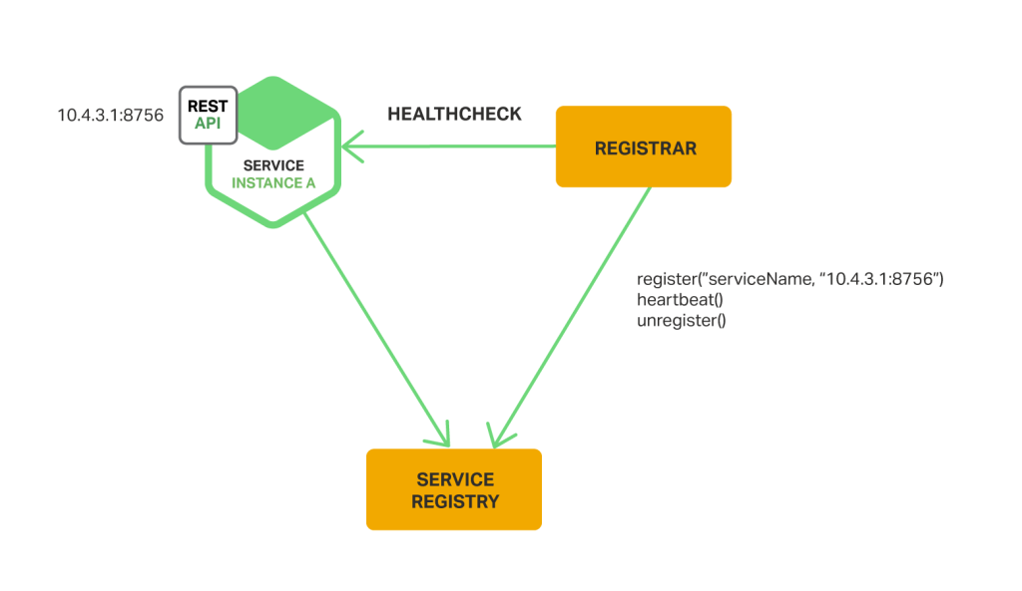
Service Discoverability

Slide 8
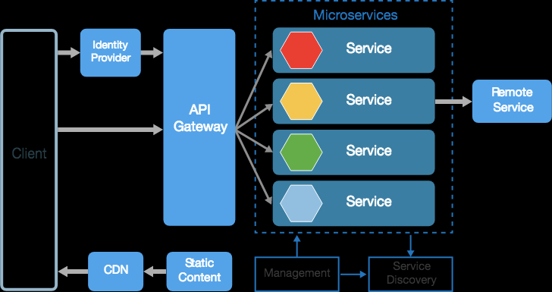
Gateways

Slide 9
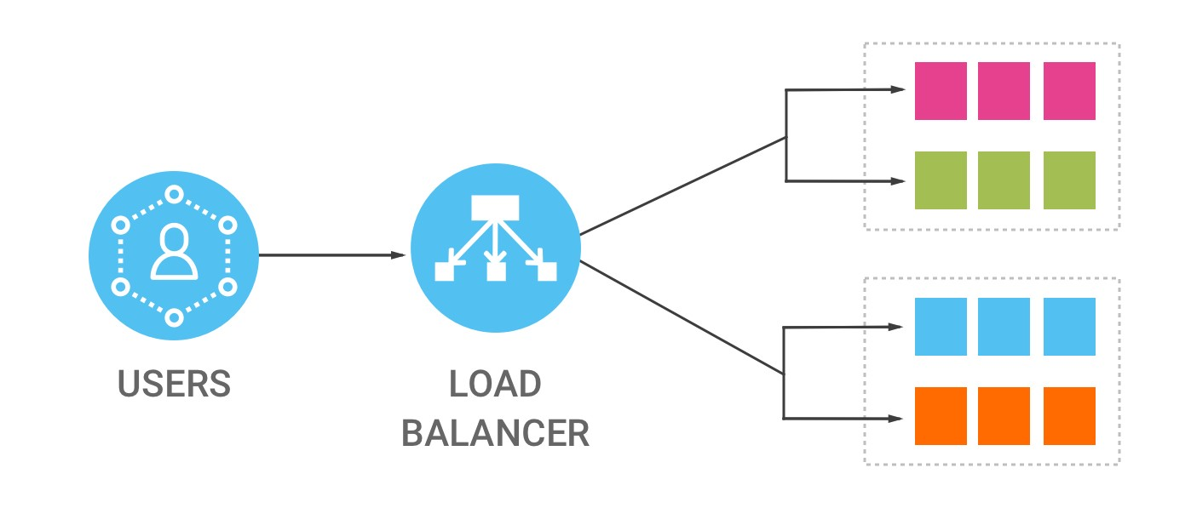

Slide 10
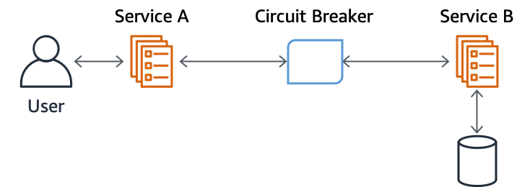
Circuit breaker

Slide 11
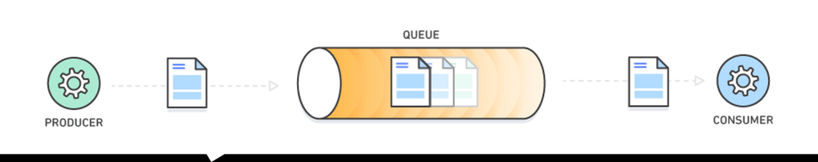
Message Queues

Slide 12
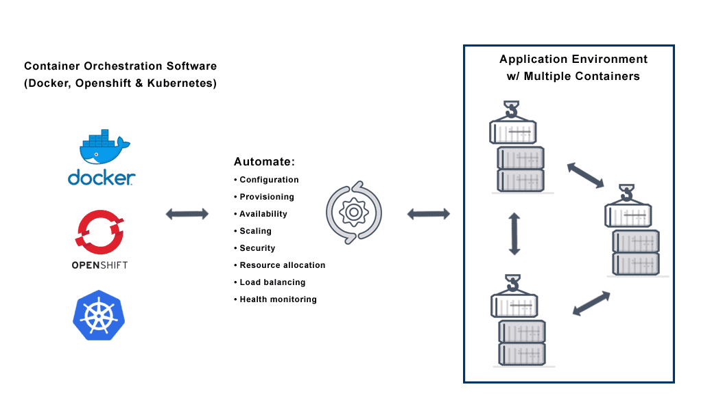

Slide 13

Questions?
Comments? Concerns? Violent Reactions?

Slide 14

Discussion Q’s
What is MSA? How does it differ from monolithic apps? From SOA?
When do you want to implement MSA?
What are the benefits of MSA? Monolithic architecture? SOA?
MSA vs SOA?
What are the drawbacks of MSA? Monolithic architecture? SOA?
What are some MSA development practices that help in implementation/production?

