Slide 1
AWS Course Introduction

Slide 2

About Me
Developer, Team Lead
Many Java Project, 1-2 AWS projects
Accounts: Thomson Reuters, Syngenta
10 years in Development, Support and Customer Face fronts

Slide 3
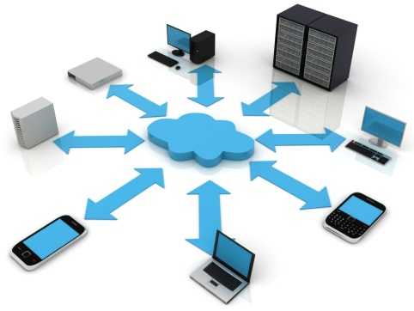




Cloud Computing Essentials
On-demand self-service
Broad network access
Resource pooling
Rapid elasticity
Measured service

Slide 4

Business Demand

Slide 5
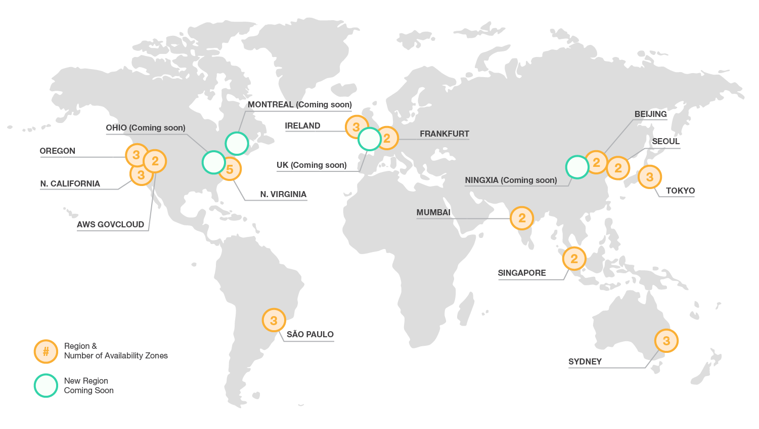
Global Infrastructure
https://aws.amazon.com/about-aws/global-infrastructure/

Slide 6
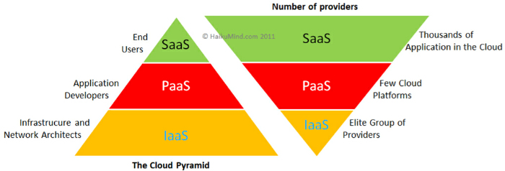
Cloud Computing types - SaaS (Office 365) - PaaS (OpenShift) - IaaS (AWS)

Slide 7
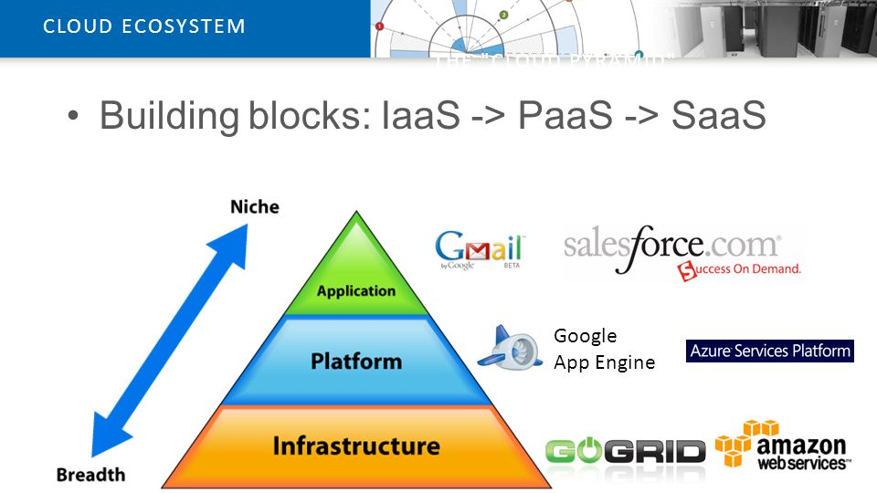
Vertical Structure of Cloud Computing platforms

Slide 8
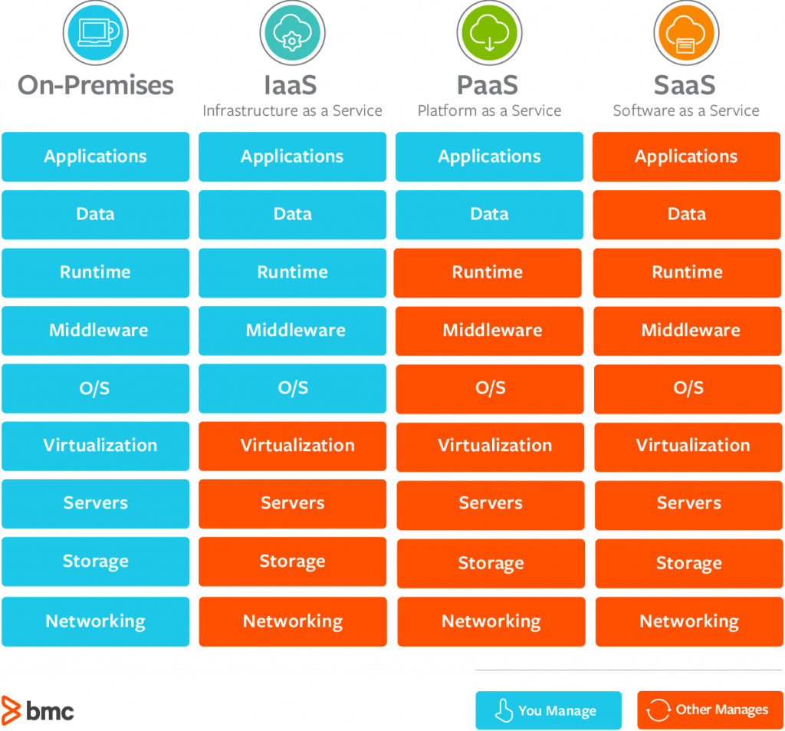
The Key Differences Between On-Premise, SaaS, PaaS, IaaS

Slide 9
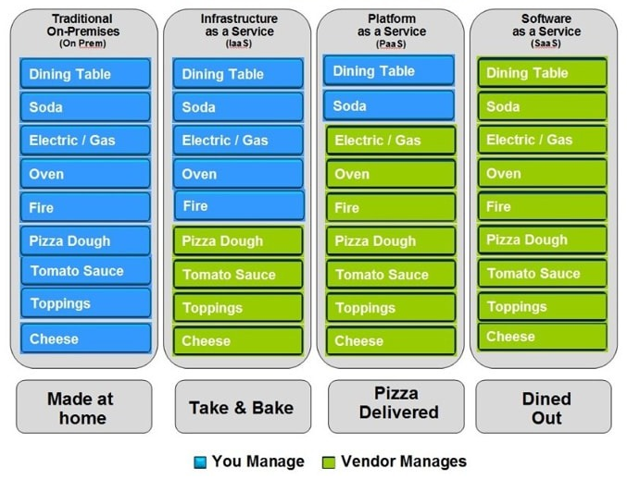
Pizza as a Service

Slide 10
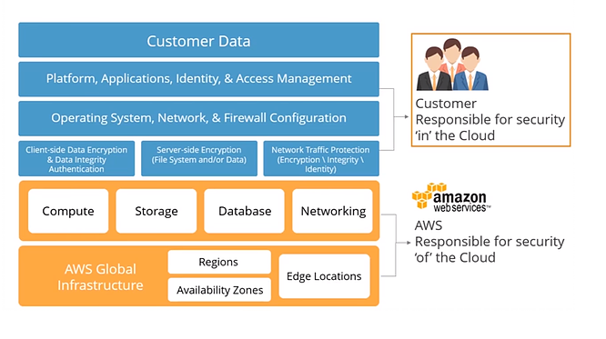
AWS shared responsibility model

Slide 11
Services to be discussed
EC2
Auto Scaling
CloudFormation
VPC
IAM
S3
DynamoDB
ElastiCache
RDS
CloudWatch Metrics, Logs
ECS
Lambda, API GW

Slide 12
Tools and languages will be used
AWS Web Console
AWS CLI
AWS SDK
OpenShift
CloudFormation
Troposphere
Python

