Slide 1
Compute Resources

Slide 2
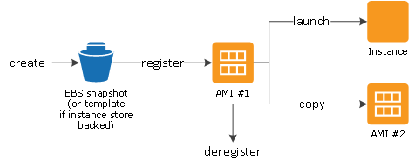
EC2 / AMI Lifecycle
Virtual machine
Machine Image (AMI)
Ephemeral storage
Type = vCPU + Mem
EBS
Tags
EC2 <-User Data (bootstrap)
Meta Data

Slide 3
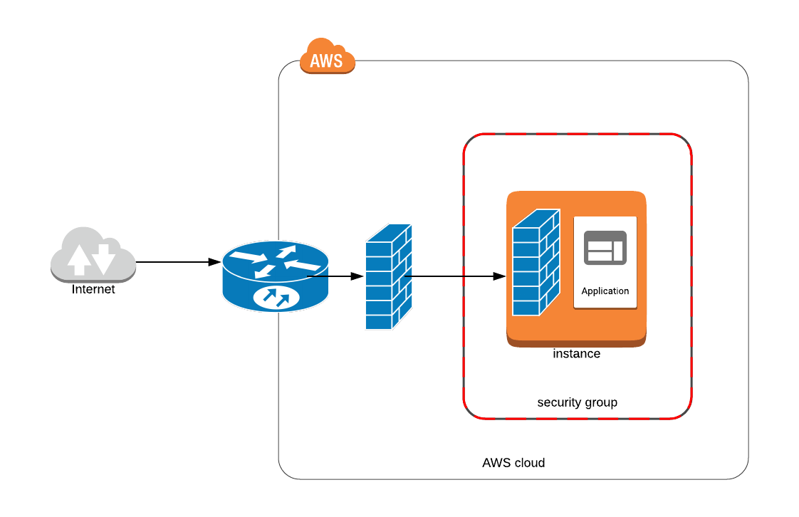
Security Groups
Configurable via API Router
You can have additional OS firewall
Elastic Network Interface
Limit of 250 rules per interface
Defines Inbound and Outbound ports mapping

Slide 4
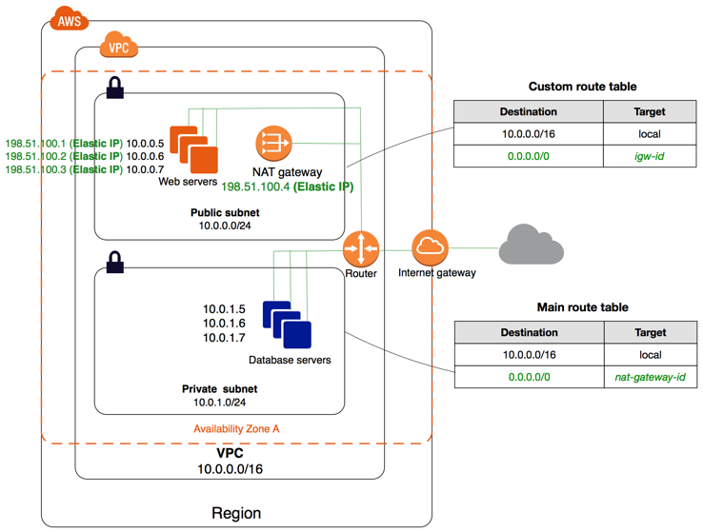
VPC
VPC
Region
Availability zone
Private Net
Public Net
Subnet
NAT
Route 53 (DNS)
Route table

Slide 5
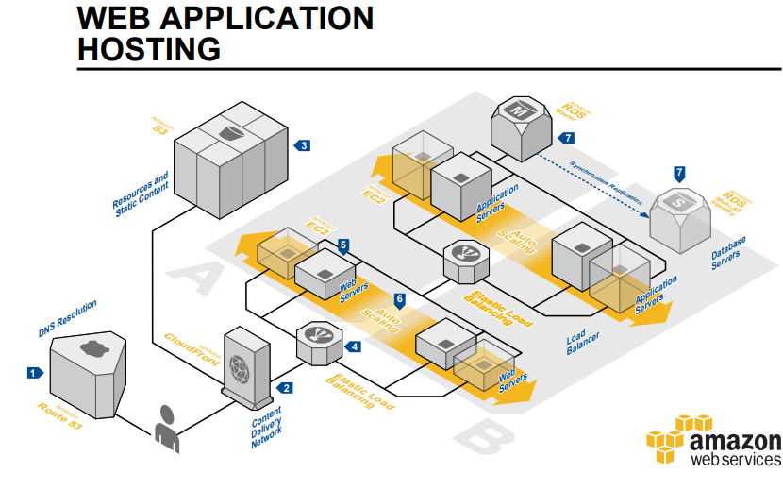
Sample AWS Architectures

Slide 6
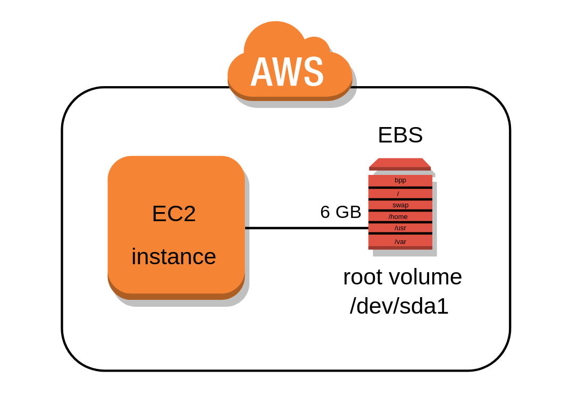
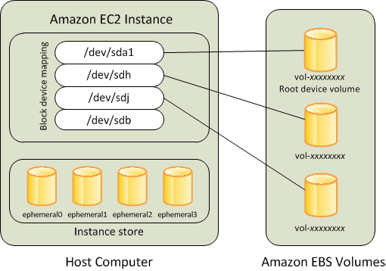
EBS (Elastic Block Store) volumes
Integrated with EC2
Bandwidth varies in 0-14000 Mbit/s
Calculate IOPS (restrict IOPS per volume)
Serves SSD Persistence store (caches, DB)
HDD Persistence (streaming)
Snapshots
Full (copy to S3)
Backup
Recovery
Alarms (IOPS)
Availability zone placement

