Slide 1
Auto-Scaling

Slide 2
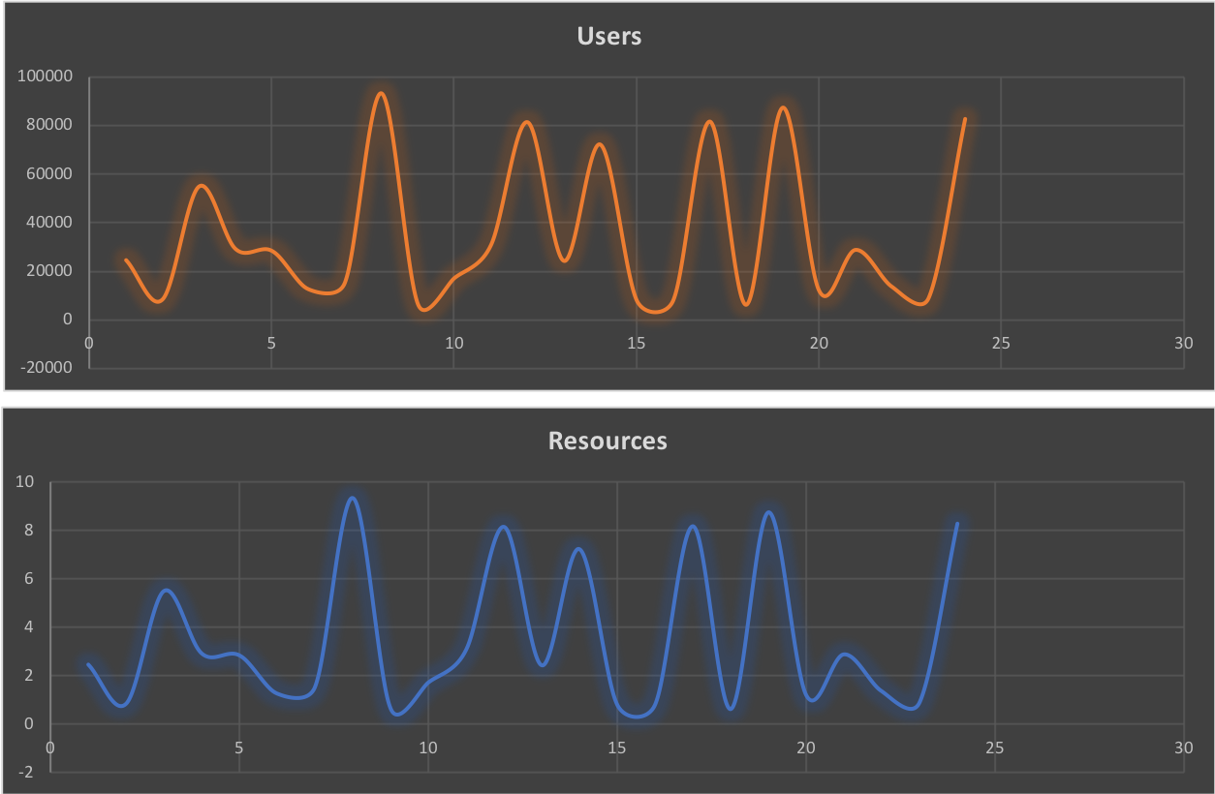
Resource Scaling
AWS EC2 Auto Scaling
AWS Resources Auto Scaling

Slide 3
ELB
Auto scaled
Multi Zone
External/Internal
Pre warm
Session affinity
Sticky session
Health checks and Monitoring
HTTPS protocol + ELB

Slide 4
Auto-scaling Groups
Group of resources (EC2, DB)
Logically single resource
Amazon EC2 Auto Scaling service
ELB
Auto scale Up and Down

Slide 5
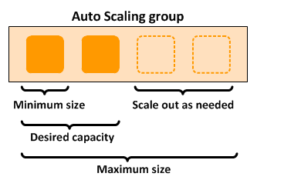
Monitoring Alarms
Launch configuration
AS group
Min/max
Desired capacity
ELB connection
Alarm

