Slide 1
VPC Public and Private Networks

Slide 2



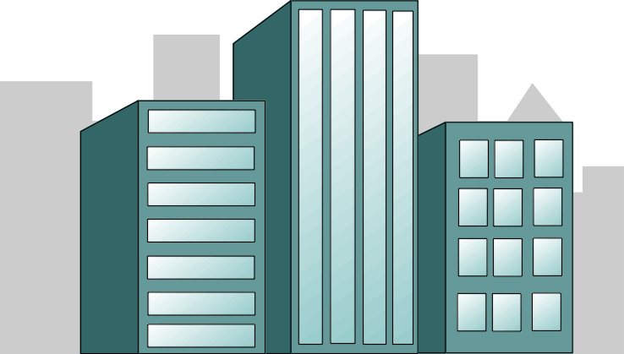
Private vs Public
Private Cloud
Public Cloud

Slide 3
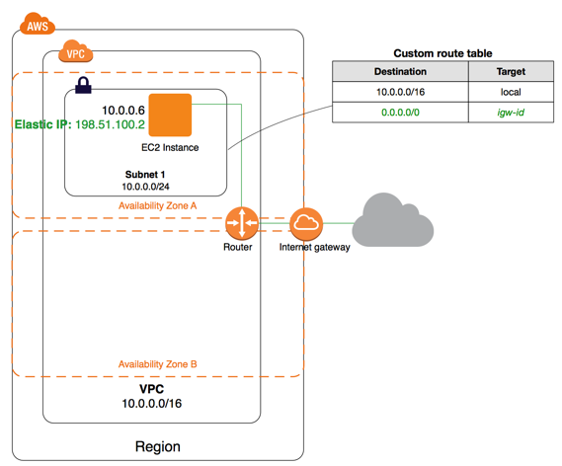
VPC: Public Network
A VPC with a size /24 IPv4
CIDR block (example: 10.0.0.0/24)
This provides 256 public IPv4 addresses.

Slide 4





Public/Private Subnets
instance
Private subnet
Internet gateway
Internet
Elastic IP
instance
instance
Elastic Load
Balancing
Public subnet

Slide 5
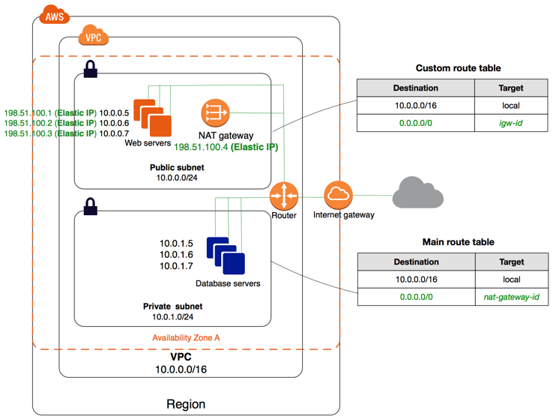
VPC : Add private network
A VPC with a size /16 IPv4
CIDR block (example: 10.0.0.0/16)
This provides 65,536 private IPv4 addresses.

Slide 6
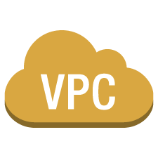


App migration from DC
Simple apps
Multi-tier web applications with lots of components
Environment isolation
Extend your Data Center
Disaster Recovery
Public subnets
Private subnets
VPN to your Data Center
Peer-to-Peer connect to another VPC(s)
Private Link
corporate data center

Slide 7
Routing

Slide 8
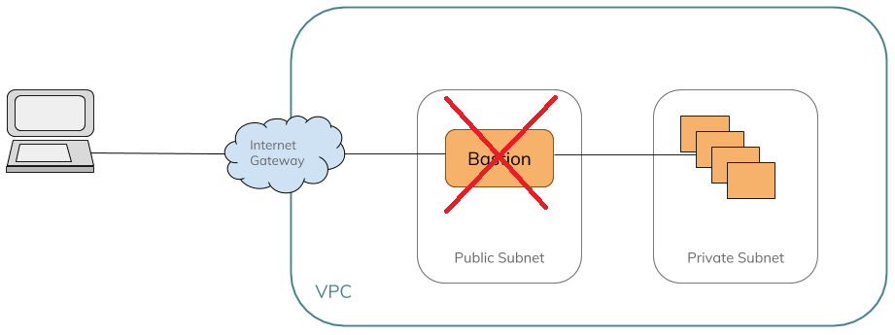
Bastion
Public Network serves as a Bastion
Routing is set between Private and Public network
Blocking EC2 Instance on Bastion isolate all Private subnets

Slide 9
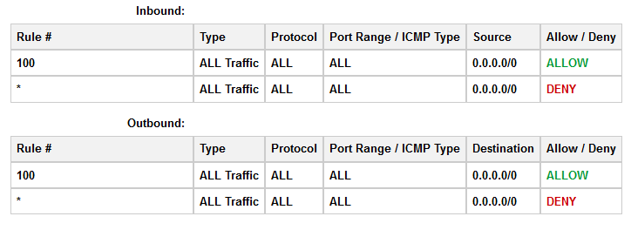
Security
Public/Private subnets - Network ACL controls traffic to subnets
EC2 Instance - Security groups - Inbound and Outbound traffic

