Slide 1
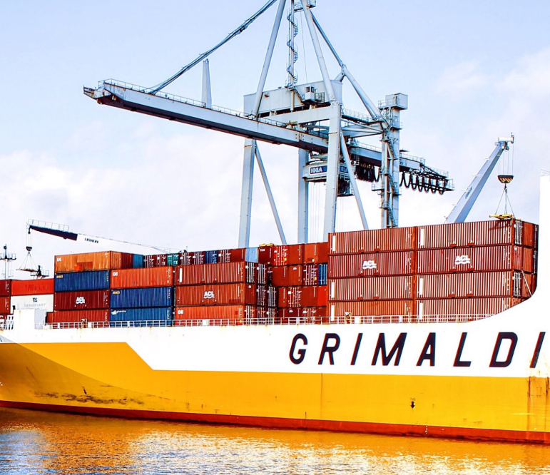
Docker Container

Slide 2
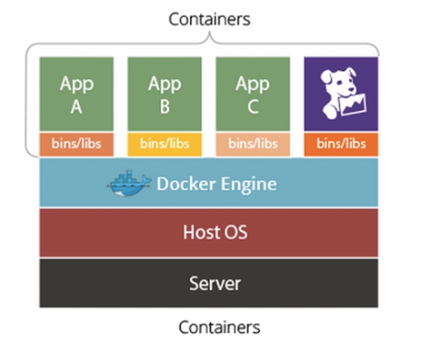
Docker
Docker is composed of six different components namely
Docker Client
Docker Daemon
Docker Images
Docker Registries
Containers
Docker Engine

Slide 3
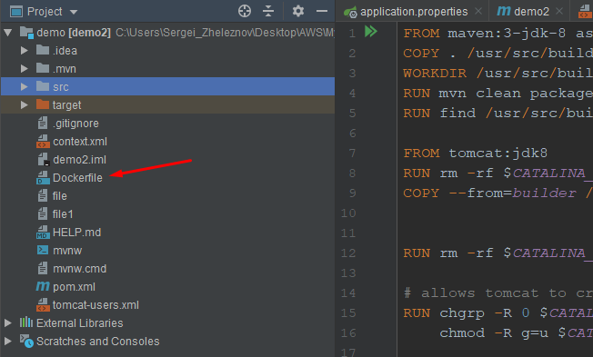
Docker Commands
Add Dockerfile
>docker images
>docker ps
>docker build -f Dockerfile -t app:latest .
>docker run --rm -p 8080:8080 app:latest
>docker start/stop <hash>

Slide 4
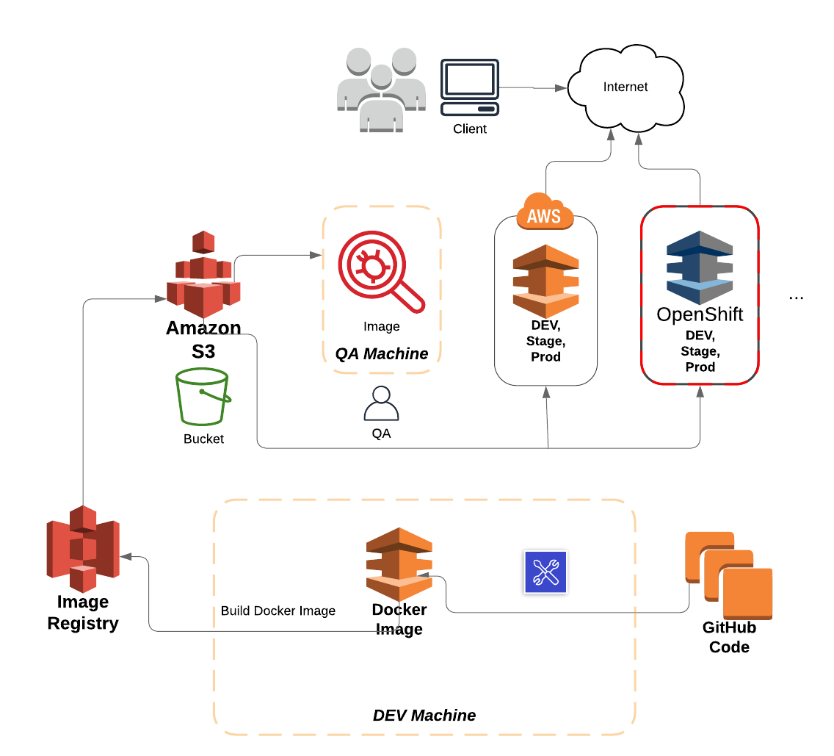
Development in Containers
Docker Image Prepare
Docker Image Registry
Deployment to S3 bucket
QA take over and test Locally
Deploy to OpenShift, AWS
Scale up Containers

Slide 5
Dockerfile
FROM maven:3-jdk-8 as builder
COPY . /usr/src/build
WORKDIR /usr/src/build
RUN mvn clean package -DskipTests -Plocalbuild -f /usr/src/build && mkdir /usr/src/wars/
RUN find /usr/src/build/ -iname 'demo2.war' -exec cp {} /usr/src/wars/ \;
FROM tomcat:jdk8
RUN rm -rf $CATALINA_HOME/webapps/ROOT
COPY --from=builder /usr/src/wars/demo2.war $CATALINA_HOME/webapps/ROOT.war
RUN rm -rf $CATALINA_HOME/conf/Catalina/localhost
USER root
COPY tomcat-users.xml $CATALINA_HOME/conf/
COPY context.xml $CATALINA_HOME/webapps/manager/META-INF/
EXPOSE 8080
CMD ["catalina.sh", "run"]

