Slide 1
Shared Preferences

Slide 2
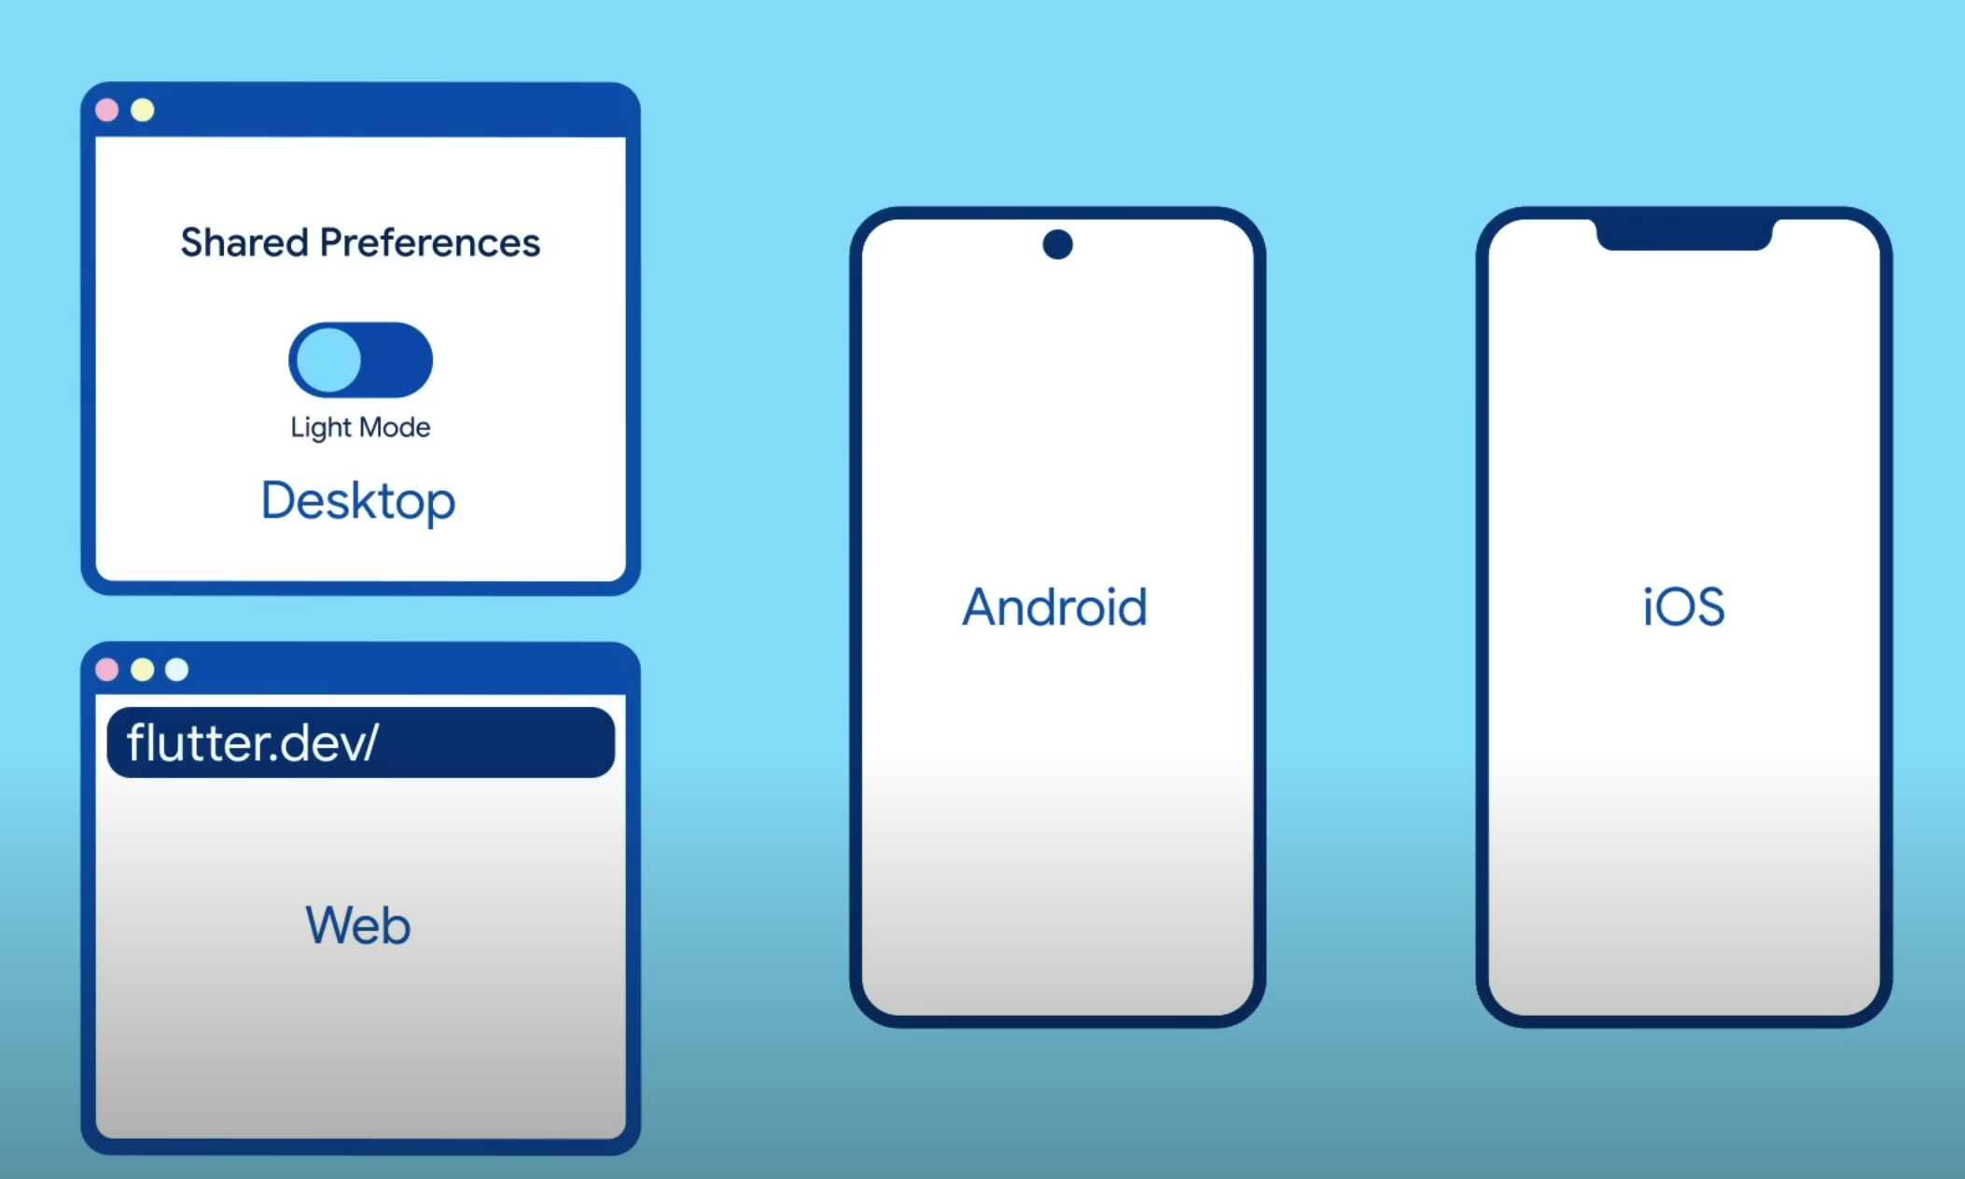
Platforms

Slide 3
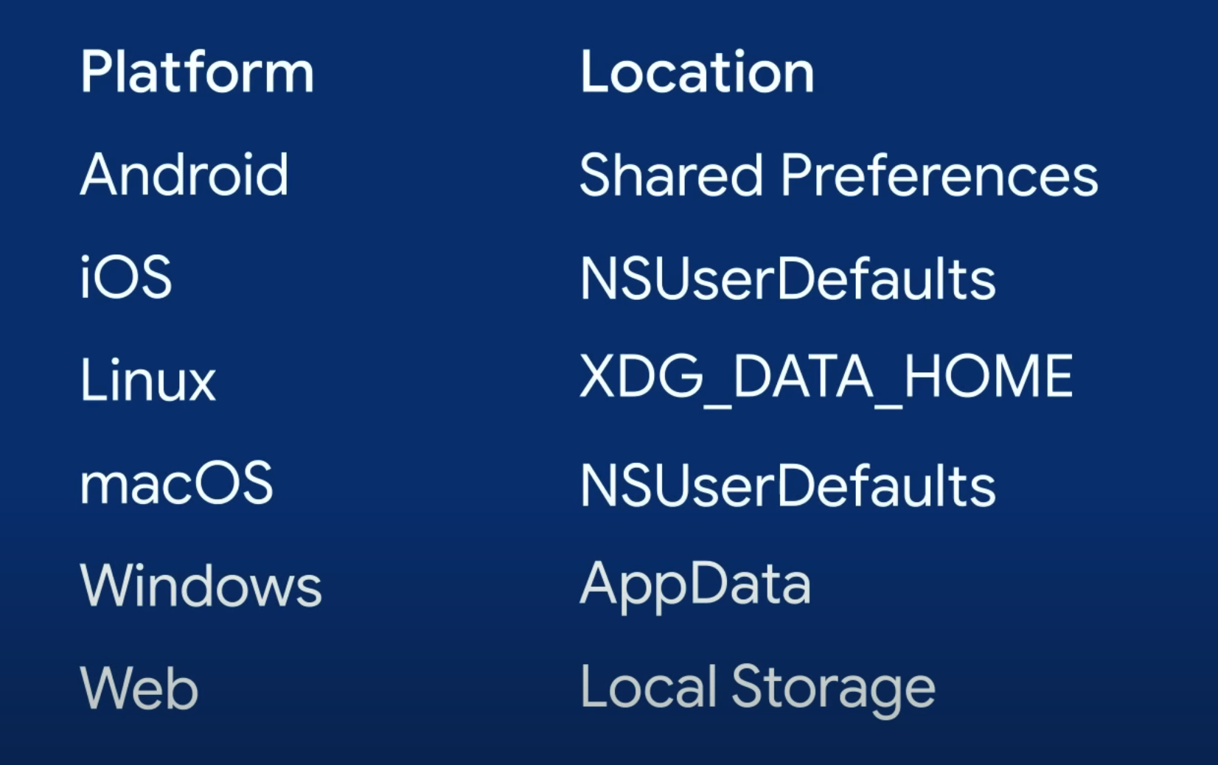
Locations
https://docs.flutter.dev/cookbook/persistence/key-value

Slide 4


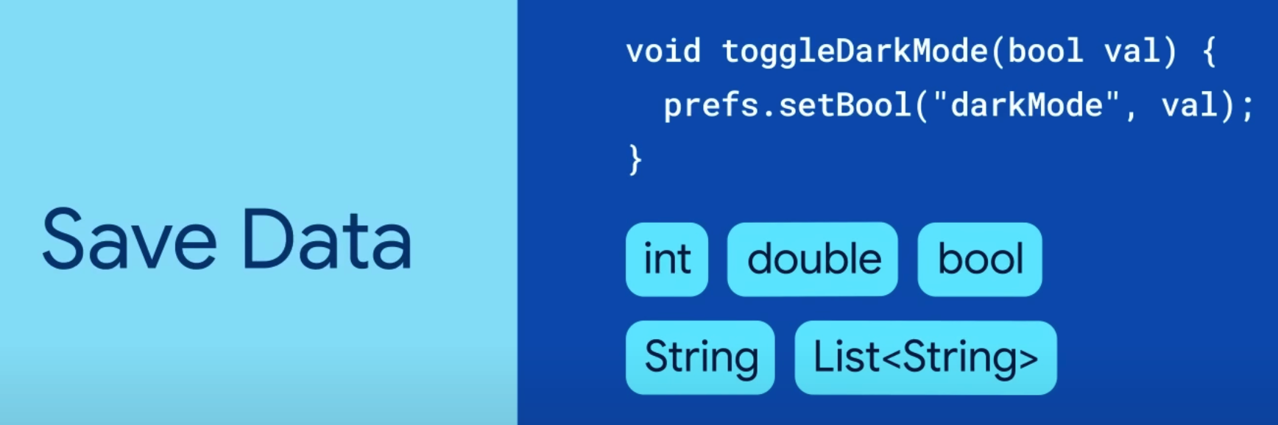
Using
https://docs.flutter.dev/cookbook/persistence/key-value

Slide 5
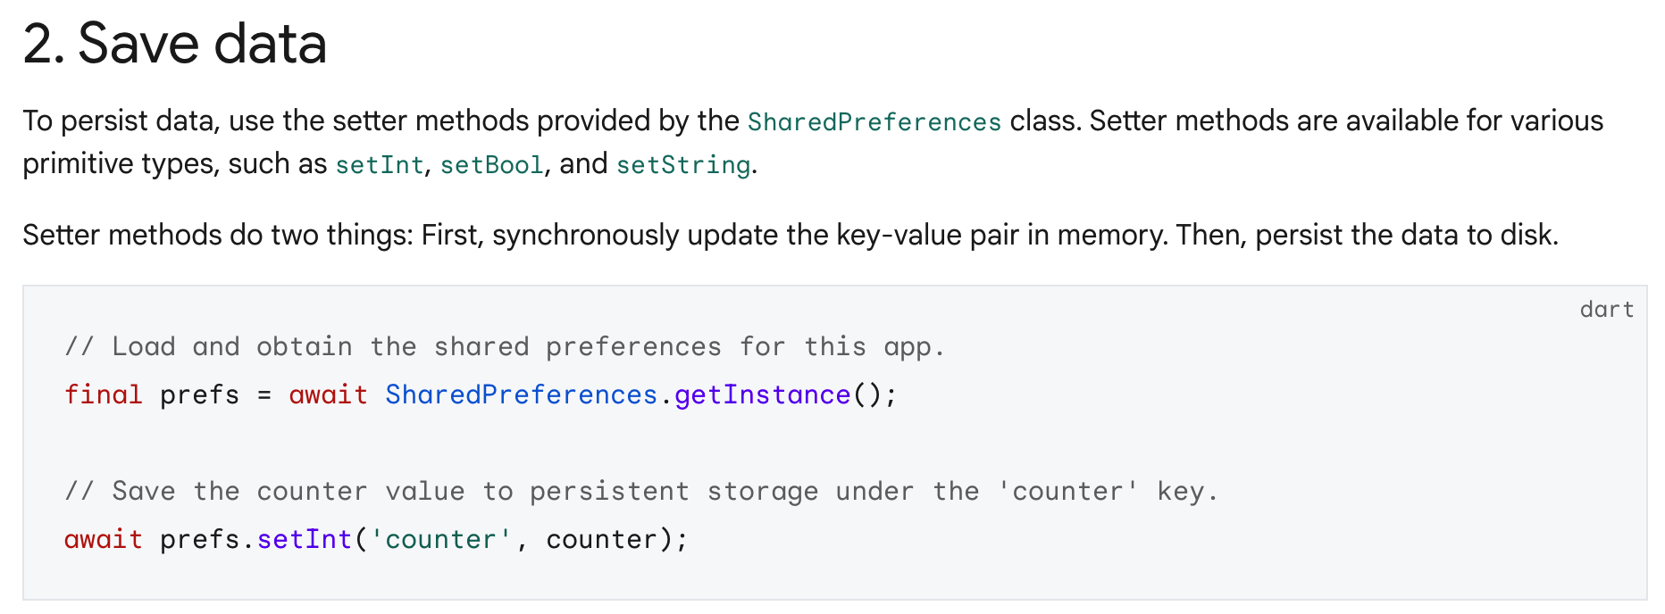
Using
https://docs.flutter.dev/cookbook/persistence/key-value

Slide 6

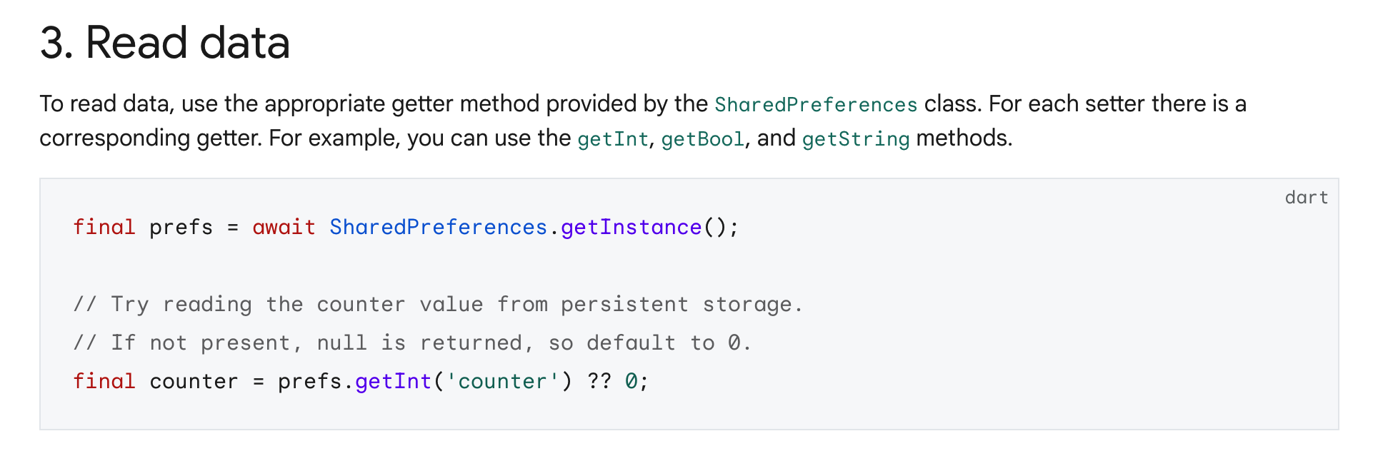
Using

Slide 7
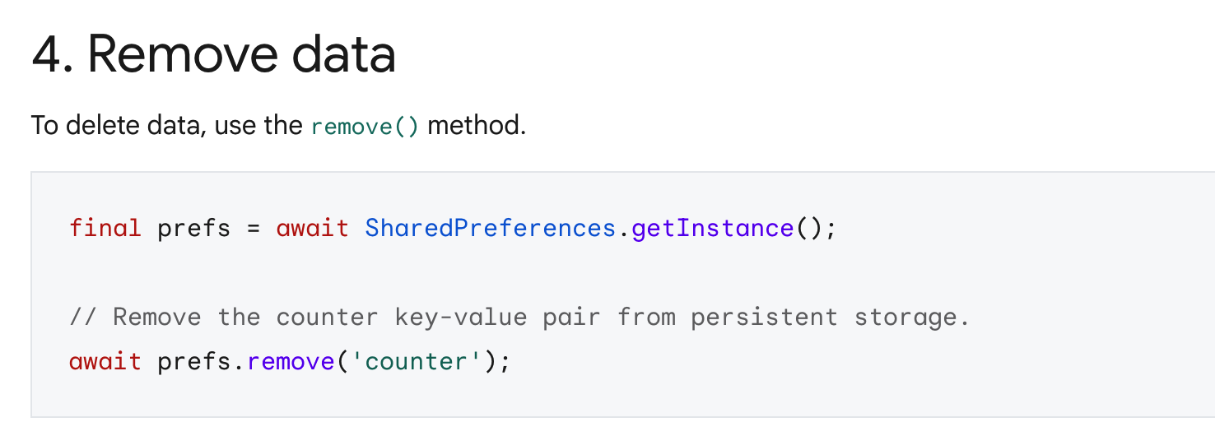
Using

Slide 8
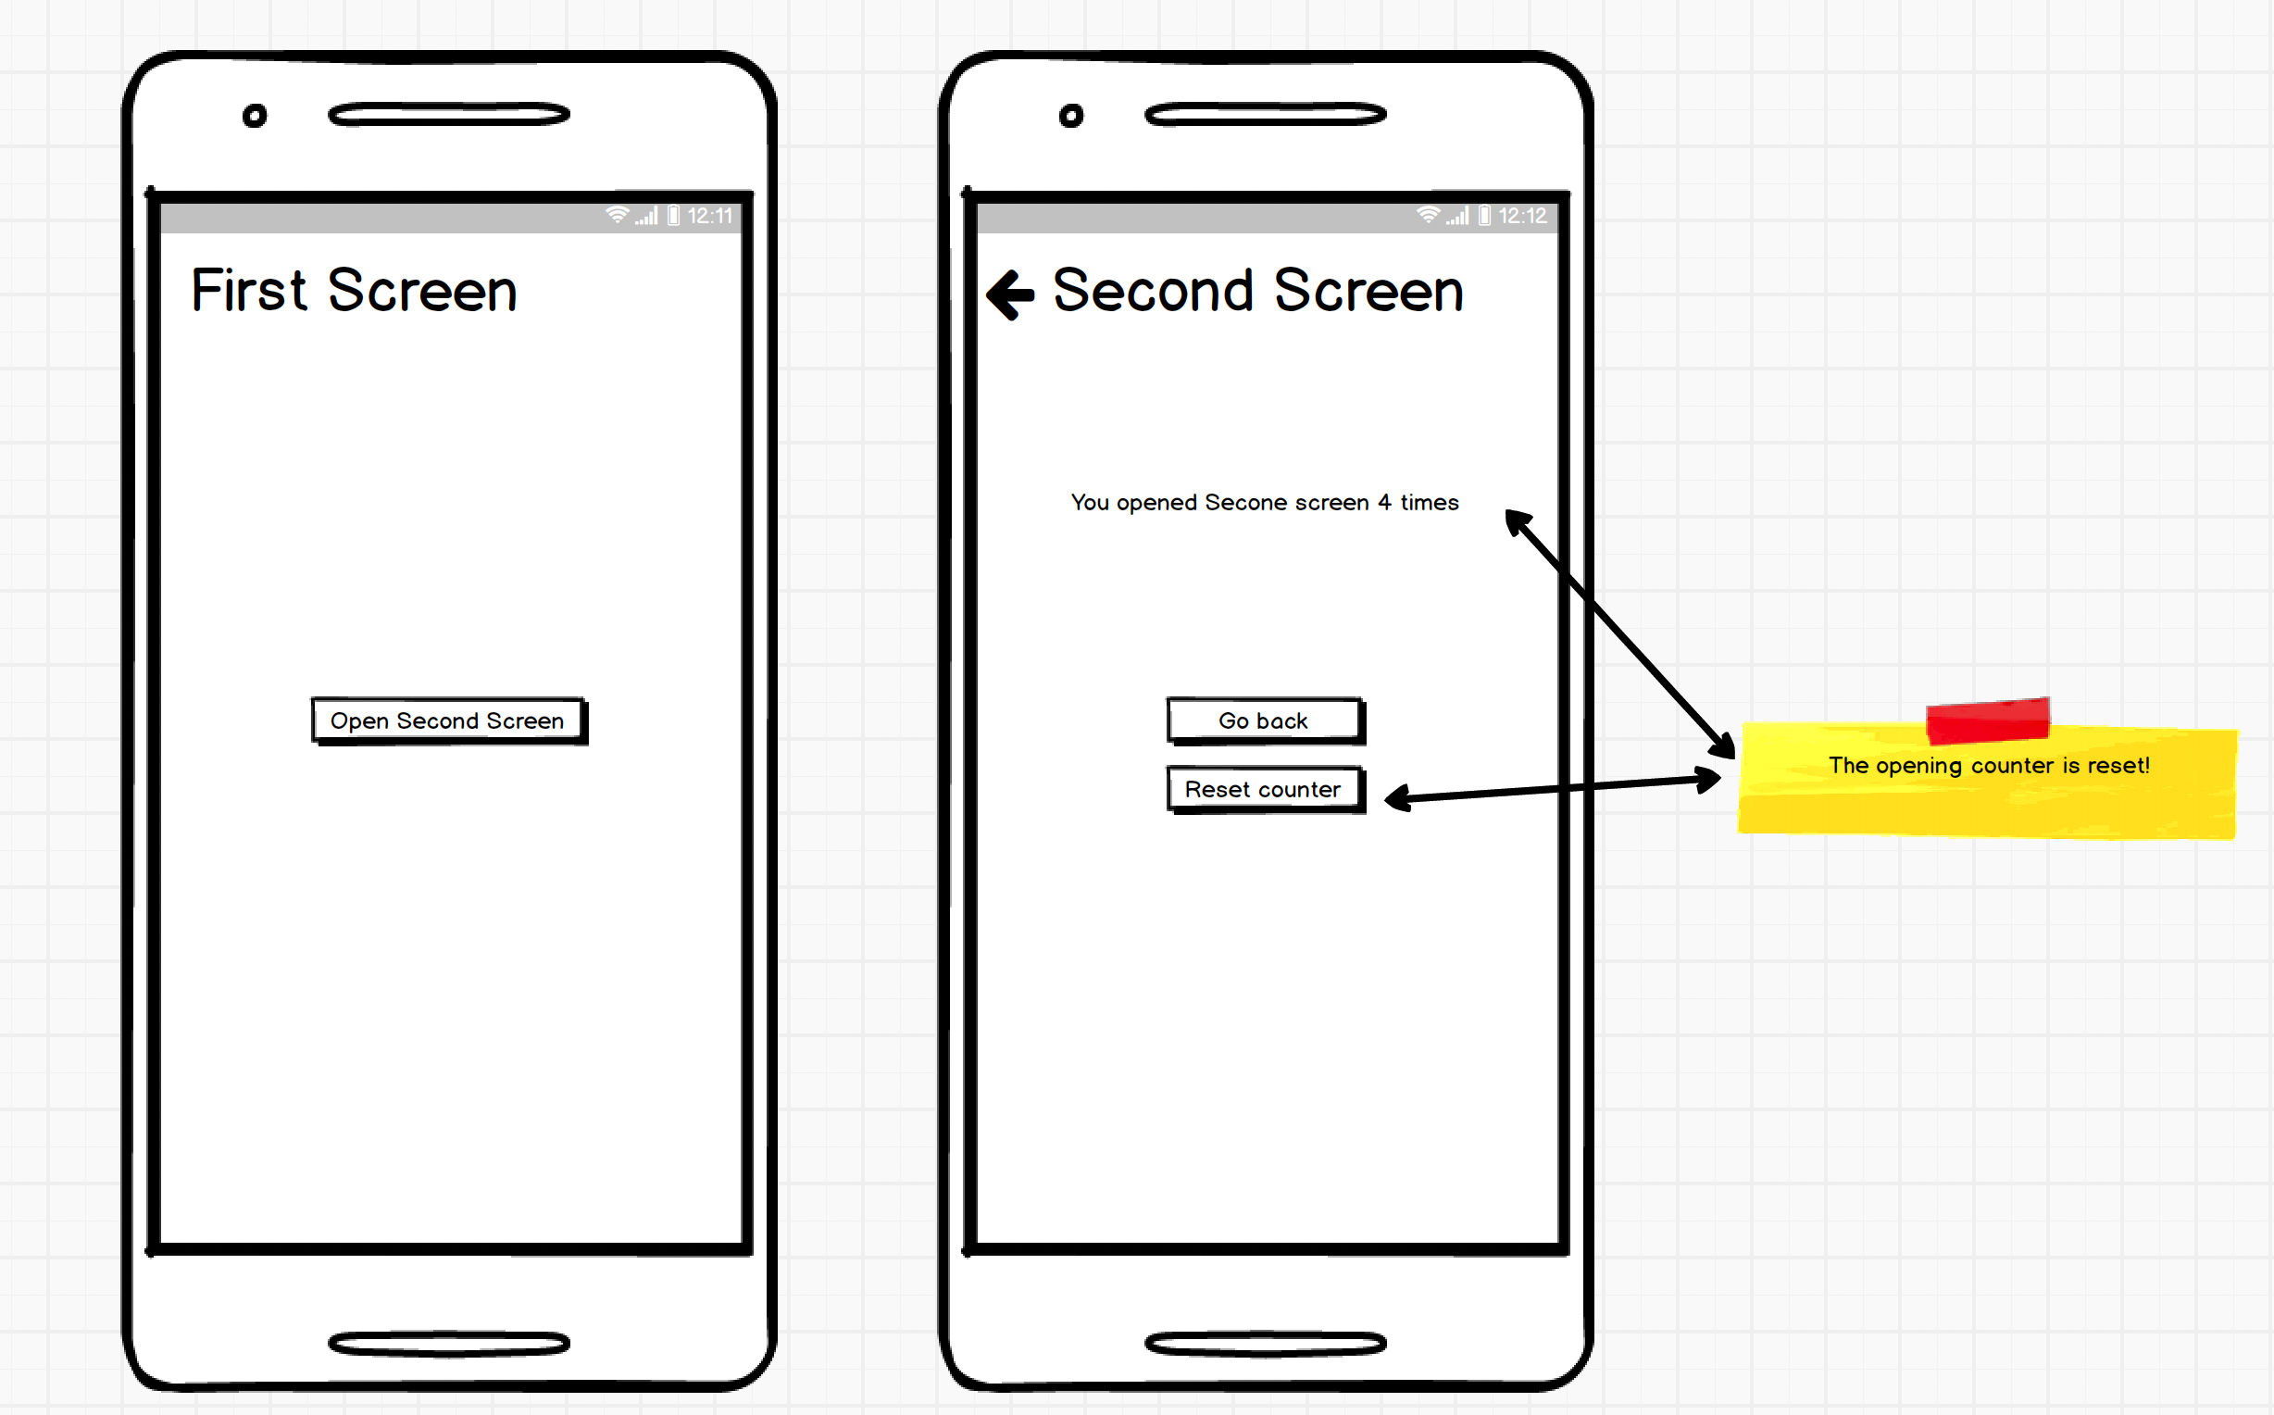
Exercise

