Slide 1
http

Slide 2
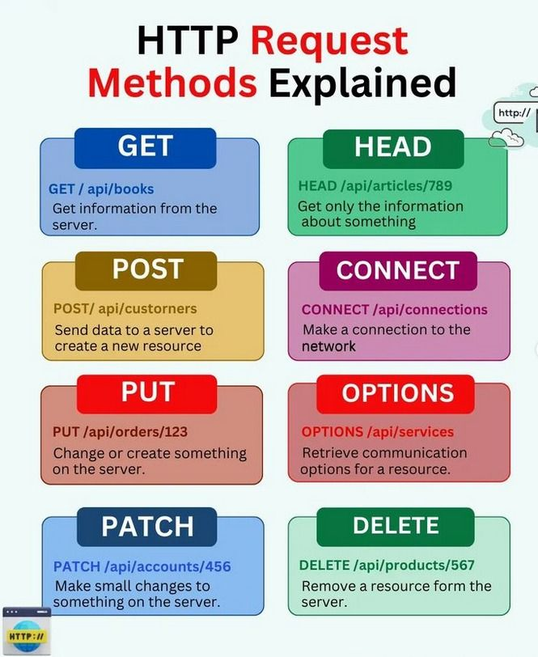
HTTP Request Methods

Slide 3
http package
Add the http package
flutter pub add http
Import the http package
import 'package:http/http.dart' as http;

Slide 4
Client class
Sends an HTTP GET request with the given headers to the given URL
URL.get(Uri url, {Map<String, String>? headers}) → Future<Response>
Sends an HTTP POST request with the given headers and body to the given
URL.post(Uri url, {Map<String, String>? headers, Object? body, Encoding? encoding}) → Future<Response>
Sends an HTTP PUT request with the given headers and body to the given URL.
URL.put(Uri url, {Map<String, String>? headers, Object? body, Encoding? encoding}) → Future<Response>
Sends an HTTP PATCH request with the given headers and body to the given
patch(Uri url, {Map<String, String>? headers, Object? body, Encoding? encoding}) → Future<Response>
Sends an HTTP DELETE request with the given headers to the given
delete(Uri url, {Map<String, String>? headers, Object? body, Encoding? encoding}) → Future<Response>

Slide 5
Examples
GET
http.get(Uri.parse('https://jsonplaceholder.typicode.com/albums/1'));

Slide 6
Examples
POST
http.post(
Uri.parse('https://jsonplaceholder.typicode.com/albums’),
headers: <String, String> {
'Content-Type': 'application/json; charset=UTF-8’,
},
body: jsonEncode(<String, String>{
'title': title,
}),
);

Slide 7
Examples
PUT
http.put(
Uri.parse('https://jsonplaceholder.typicode.com/albums/1’),
headers: <String, String>{
'Content-Type': 'application/json; charset=UTF-8’,
},
body: jsonEncode(<String, String>{
'title': title,
}),
);

Slide 8
Examples
DELETE
http.delete(
Uri.parse('https://jsonplaceholder.typicode.com/albums/$id’),
headers: <String, String>{
'Content-Type': 'application/json; charset=UTF-8’,
},
);

Slide 9
References
https://pub.dev/packages/http
https://pub.dev/documentation/http/latest/http/Client-class.html
https://docs.flutter.dev/cookbook/networking/fetch-data
https://docs.flutter.dev/cookbook/networking/send-data
https://docs.flutter.dev/cookbook/networking/update-data
https://docs.flutter.dev/cookbook/networking/delete-data

Slide 10
Exercises
Create DB and add new table ‘tasks’
NAME | TYPE
id | int, AI
name | varchar(100)
content | text
date | timestamp
created_at | timestamp
updated_at | timestamp
deleted_at | timestamp

Slide 11
Exercises
GET /api/todo/<id>
{
"success": true,
"data":
{
"id": 1,
"name": "TKB 01",
"content": "3 tiet dau mon LT Da nen tang",
"date": "2024-11-10 12:30:00",
"created_at": "2024-11-05 14:00:12",
"updated_at": "2024-11-05 14:00:12",
"deleted_at": null
}
}
{
"success": false,
"message": "Not found task with ID: 100!"
}
Develop APIs

Slide 12
Exercises
GET /api/todo/list
{
"success": true,
"data": [
{
"id": 1,
"name": "TKB 01",
"content": "3 tiet dau mon LT Da nen tang",
"date": "2024-11-10 12:30:00",
"created_at": "2024-11-05 14:00:12",
"updated_at": "2024-11-05 14:00:12",
"deleted_at": null
},
{
"id": 2,
"name": "TKB 02",
"content": "3 tiet cuoi mon LT Da nen tang",
"date": "2024-11-10 15:05:00",
"created_at": "2024-11-05 14:01:12",
"updated_at": "2024-11-05 14:01:12",
"deleted_at": null
}
]
}
Develop APIs

Slide 13
Exercises
Develop APIs
POST /api/todo
{
"success": false,
"message": "Please input task's name!"
}
{
"success": true,
"message": "Create new task successfully!"
}

Slide 14
Exercises
PUT /api/todo/<id>
{
"success": false,
"message": "Not found task with ID: 100!"
}
{
"success": false,
"message": "Please input task's name!"
}
{
"success": true,
"message": "Update task successfully!"
}
Develop APIs

Slide 15
Exercises
Develop APIs
DELETE /api/todo/<id>
{
"success": false,
"message": "Not found task with ID: 100!"
}
{
"success": true,
"message": "Delete task successfully!"
}

Slide 16
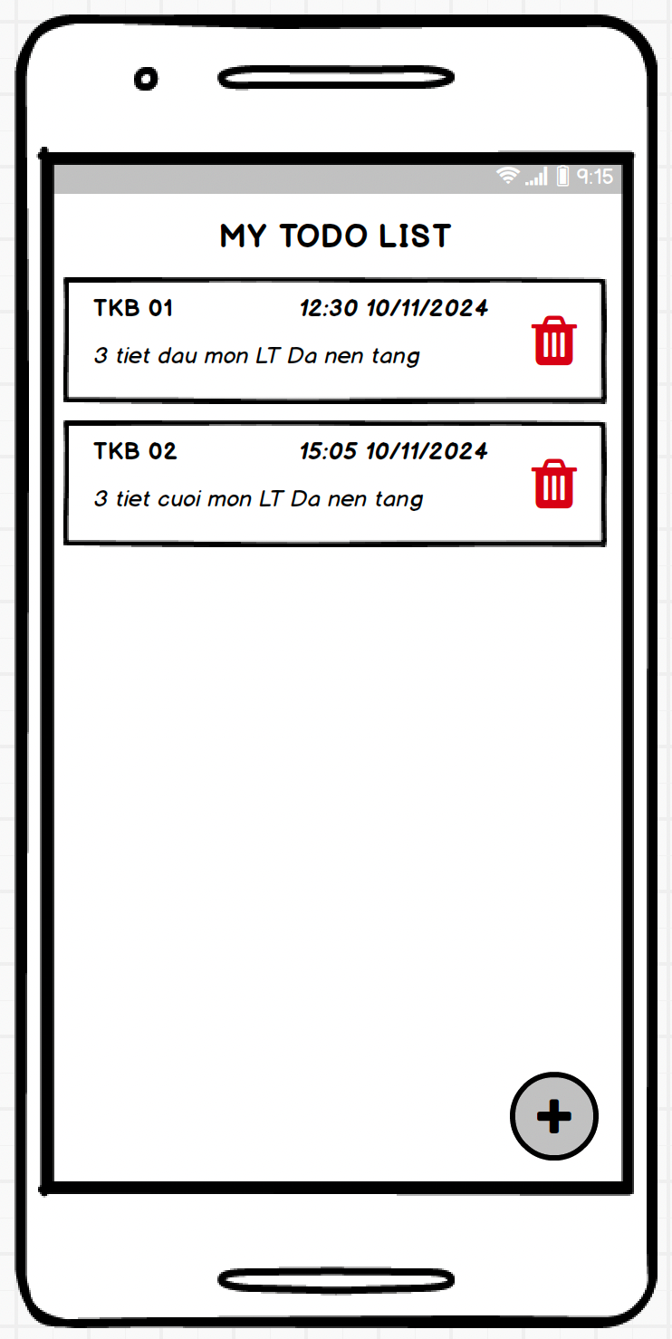
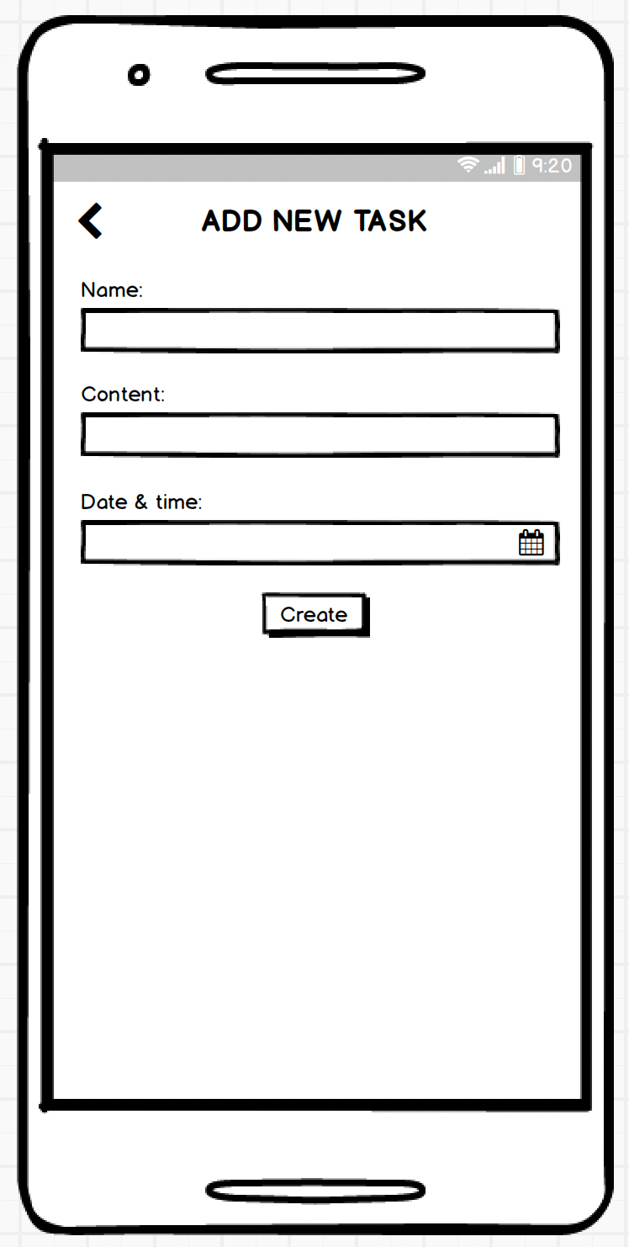
Exercises
Build a ‘TODO LIST’ app

Slide 17
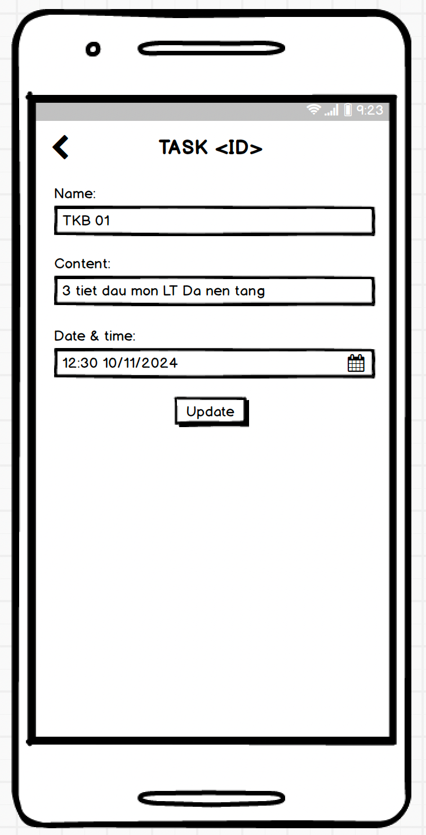
Exercises
Build a ‘TODO LIST’ app

Slide 18
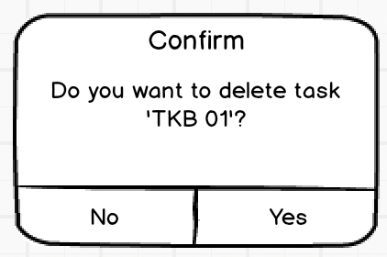
Exercises
Build a ‘TODO LIST’ app

