Slide 1
U.S. Border Inbound Crossing Analysis
Team ABCD: Ziliang Huang, Kaidi Chen, Changying He, Jiawei Guo

Slide 2
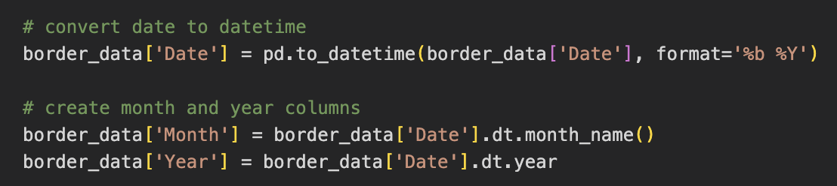
Data Processing
Correct the formatted dates to enable robust time-series analysis and visualisation.
Then extract `Month` and `Year` to create two new columns from `Date` that facilitate easy grouping and summarizing for monthly and yearly trends.

Slide 3
Github Repo: Link

Slide 4
Analytics Tasks
Which port of USA have high traffic border crossings?
Is there any seasonality observed in border crossing types?
Which ports experience the most crossings by date and type?

Slide 5
Analytical Task
Which port of USA have high traffic border crossings?

Slide 6
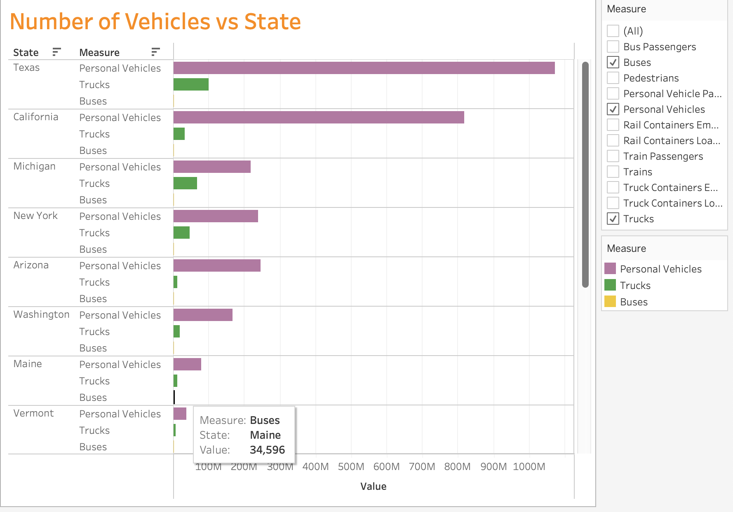
Traffic vs Geographical Location
Process:
Select “Buses”, “Personal Vehicles” and “Trucks” as categories for traffic.
Aggregate the total count for each categories in different states.
Findings:
The majority of Border Crossing activities happen in Texas and California.
Personal Vehicles occupy the majority of the traffic. While buses have little impact on traffic

Slide 7
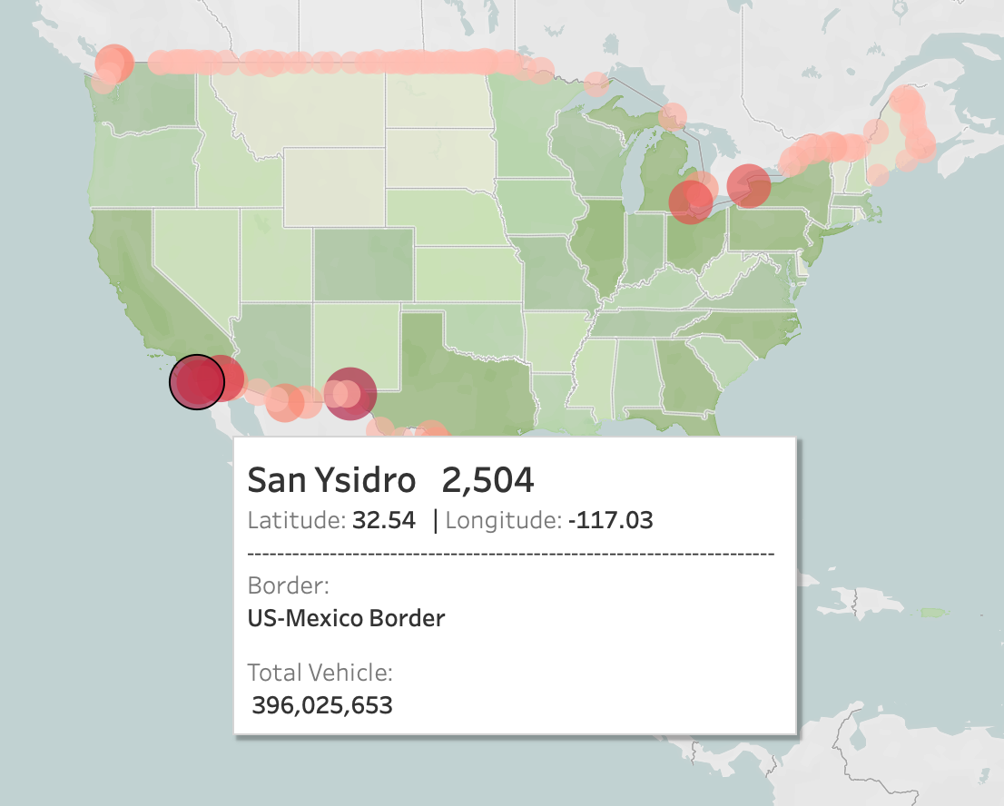
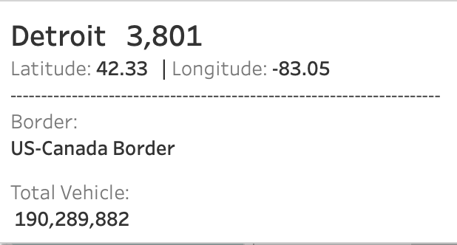
Geographic Display of Border Crossing
Process:
Latitude and Longitude for Map
Integrate built-in population data
Categorize in three popular types
Size and color transition represents the total number of border crossing
Findings:
Most states have a major port that carry most of the ground transportation.
There’s a positive correlation between population and the border crossing
traffic within state.

Slide 8
Analytical Task
Is there any seasonality observed in border crossing types?

Slide 9
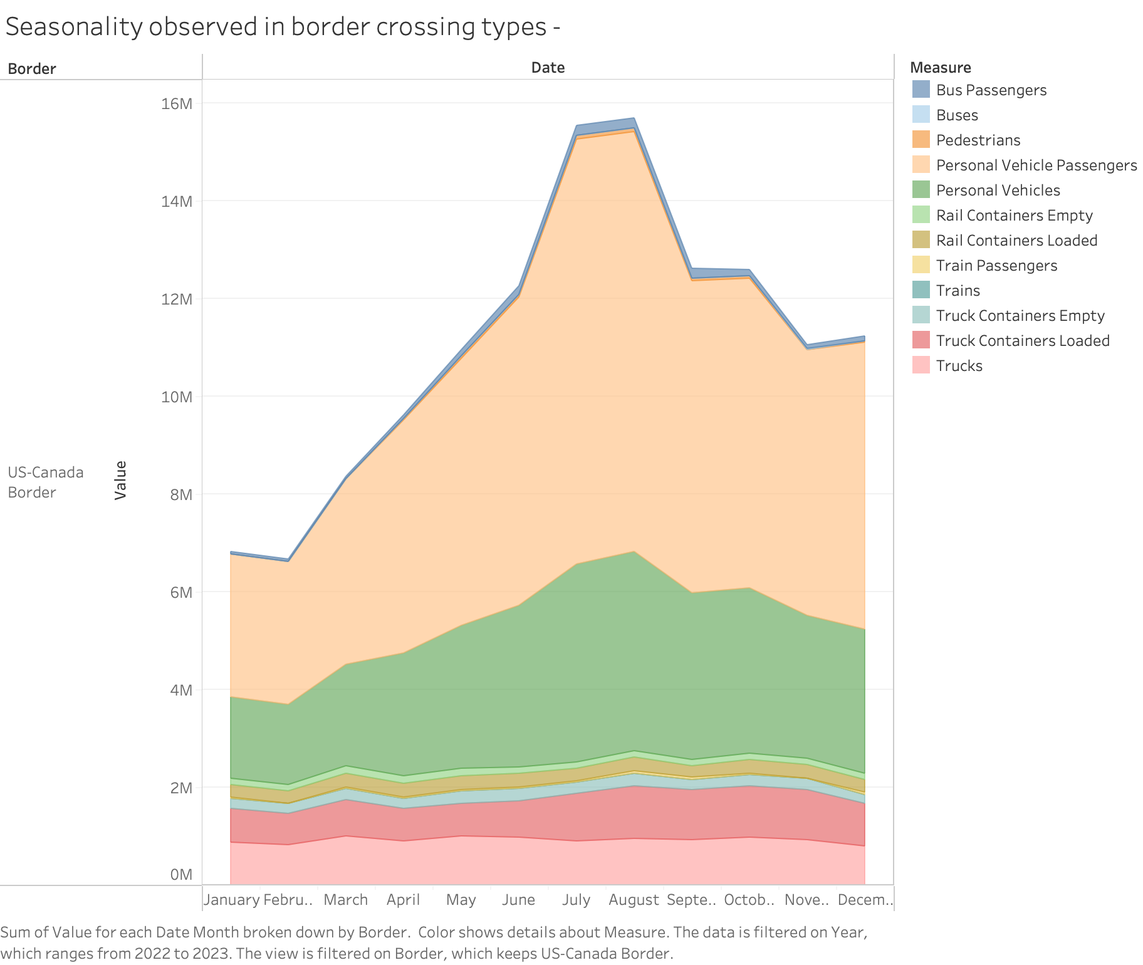
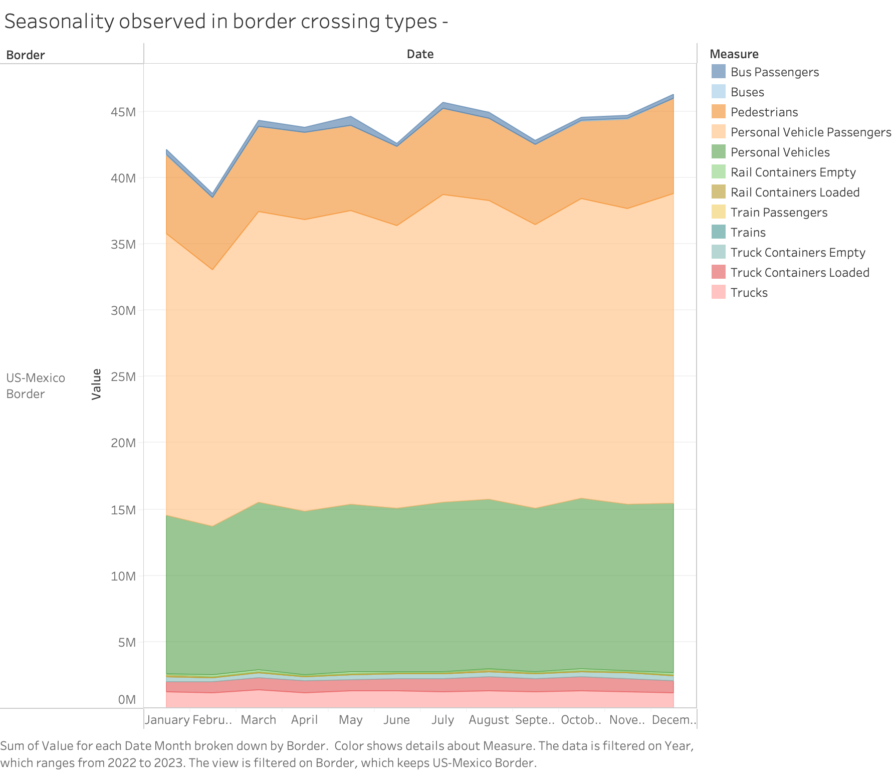
Seasonality observed in border crossing types
Process:
Group the data by month and border types
Plot in area graph to find the correlation
Analysis:
US-Canada border experienced low crossing rate in January to February.
While it experienced more than two times higher crossing rate in July and September.
There’s no obvious trend in the US-Mexico border.

Slide 10
Analytical Task
Which ports experience the most crossings by date and type?

Slide 11
Most Crossings Ports
Process:
Bar race visualization to represent changes in port rankings over the years.
Created a new variable called "Rank" using the Function RANK_UNIQUE(SUM([Value])) to rank the ports based on the volume of crossings.
Analysis:
For the US-Canada border, Buffalo Niagara Falls became the most crossed port for personal vehicles and passengers starting in 2001.
For the US-Mexico border, San Ysidro took over as the top port for the same categories beginning in 2002.

Slide 12
How Can We Help!
Invest in Technology
Seasonal Resource Allocation
Enhanced Security and Efficiency
We can implement some advanced technologies such as automated traffic monitoring systems at major border ports such as Buffalo Niagara Falls and San Ysidro. This will reduce wait times, and improve the overall efficiency of border crossings. For instance, integrating smart sensors and real-time data analytics can optimize the movement of personal vehicles, which dominate the traffic at border crossings.
For the US-Canada border, we should develop a dynamic resource allocation strategy such as increasing staffing levels and resources in July and September. Also, during the low crossing period from January to February, we still need develop back-up staffs and strategies. For the US-Mexico border, even though there is no peak time, we also should prepare enough resources to any unexpected cases.
At key ports like San Ysidro and Buffalo Niagara Falls, we can streamline customs and immigration processes through pre-clearance programs and trusted traveler initiatives, ensuring that legitimate travelers and goods can cross borders swiftly while maintaining high security standards with state-of-the-art scanning and surveillance technologies.

Slide 13
Hope you enjoy it😊

