Slide 1
Workflow Modeling and Process Management
Group 02
MR2

Slide 2

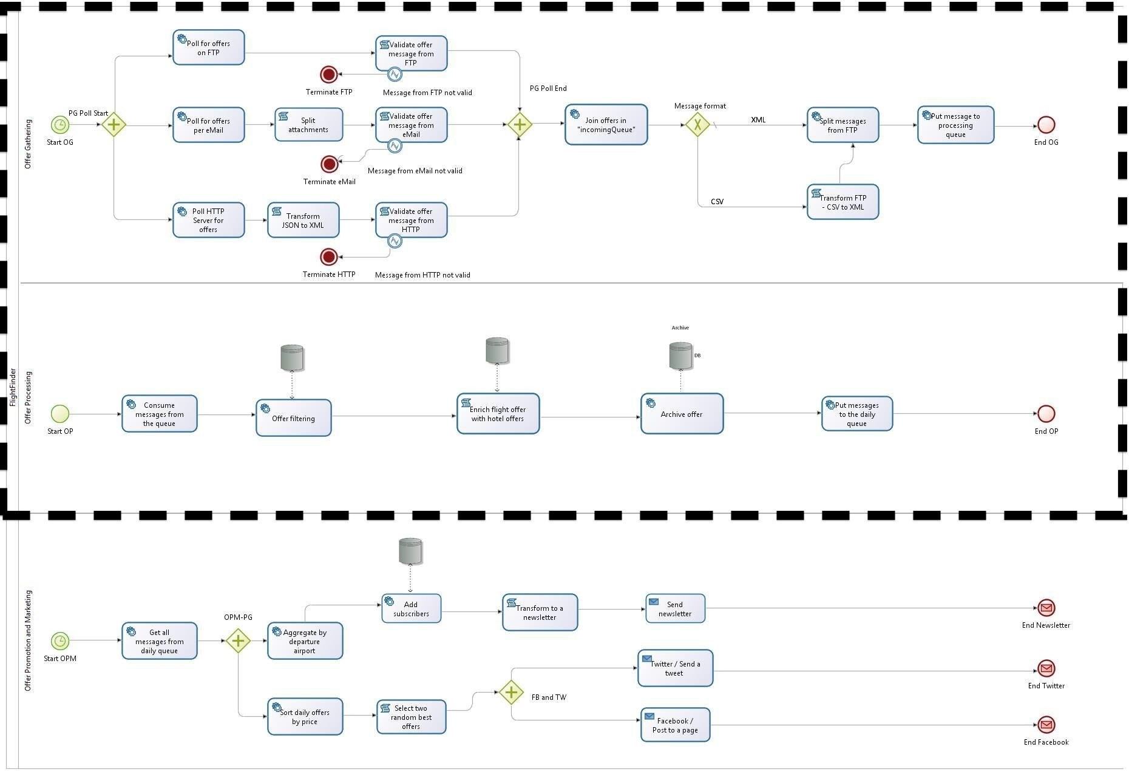
BPMN diagram

Slide 3

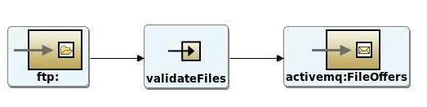


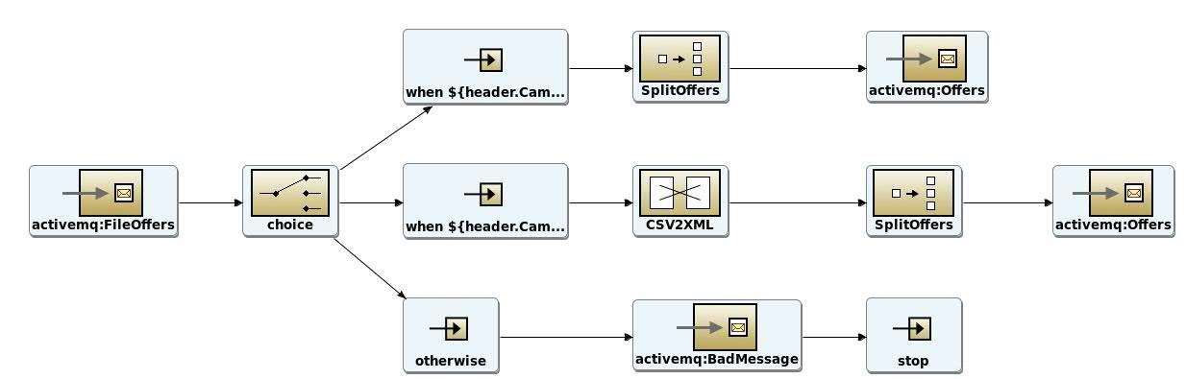
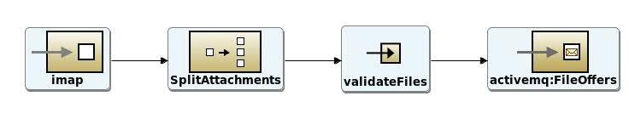

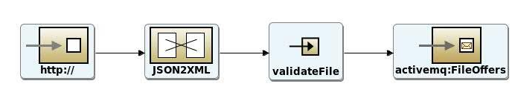
Offer Gathering
Pulling from different sources
ContentBasedRouter

Slide 4



Pulling from different sources
CSV/XML files as messages in “FileOffers” queue

Slide 5
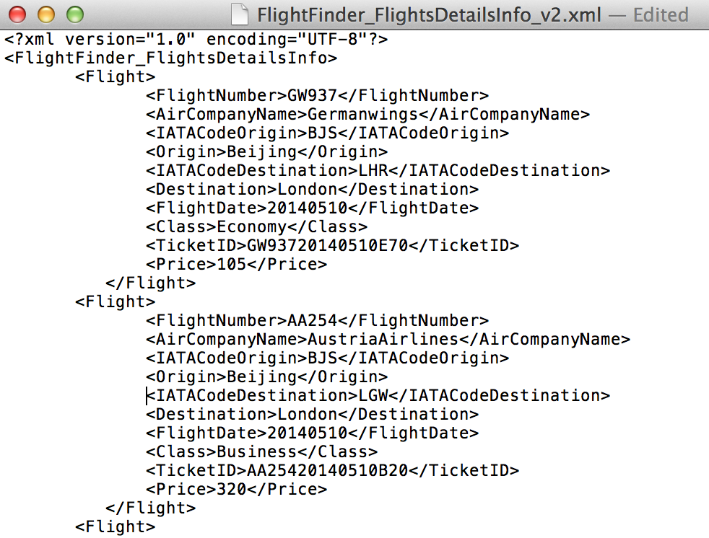
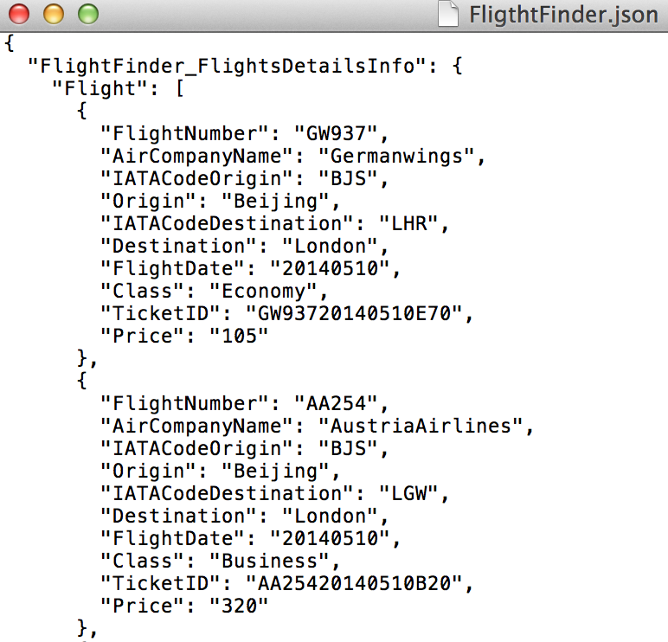
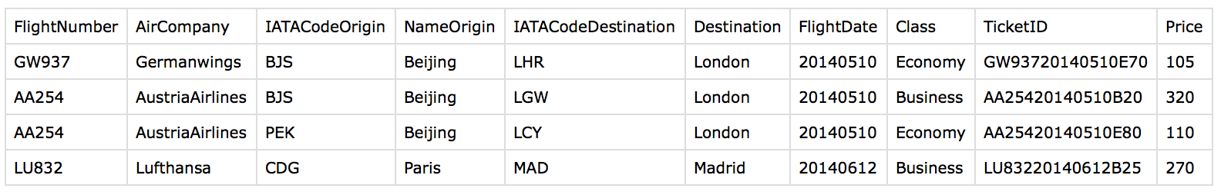
Input files

Slide 6

Content Based Router
CBR routes received file based on its extension
Messages are transformed into XML structure
“Offers” queue contains XML messages only
Non-Supported file formats routed into “BadMessage”

Slide 7

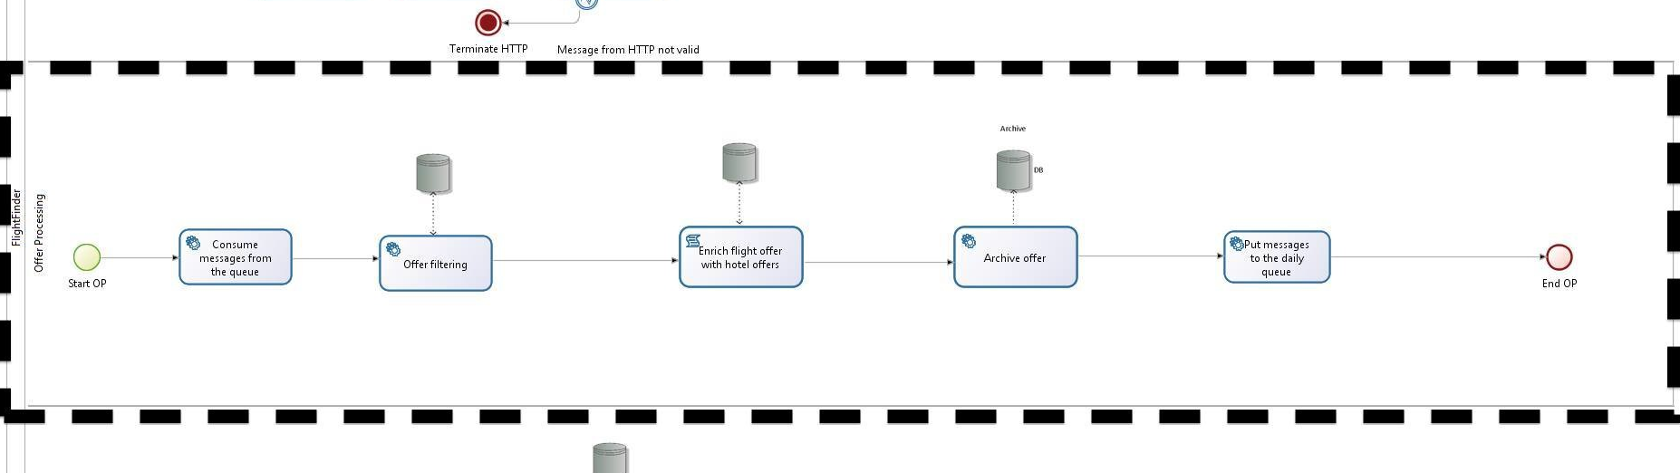

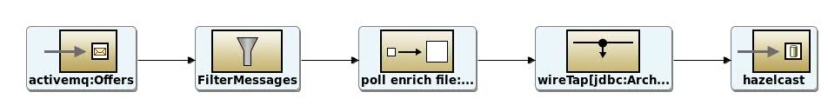
Offer Processing
Filter out Non-European airports
Enrich with hotels from current airport destination
Archive the data to database

Slide 8
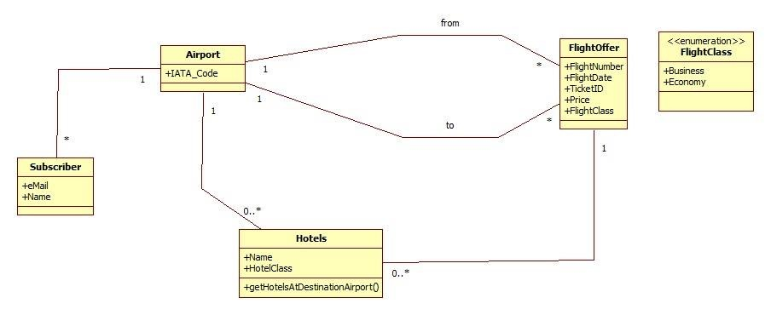
H2 DB - Hibernate

Slide 9
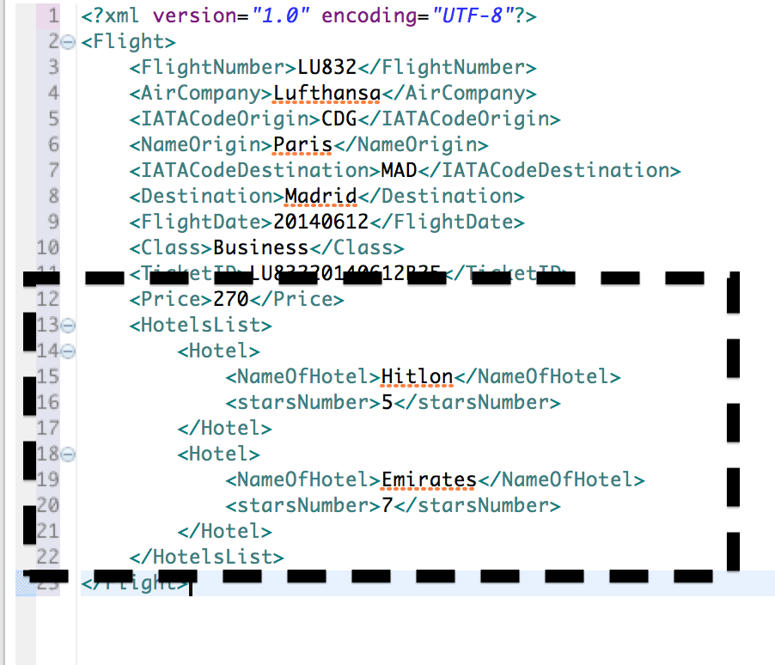
Messages at its final stage…

Slide 10
EIP-Processors-Components
What has been done so far:
Polling Consumer (FTP, HTTP, eMail)
Validator (German special characters)
Message Translator (JSON2XML, CSV2XML)
Message Endpoint (ActiveMQ, Hazelcast)
Splitter (Email Attachments, SplittOffers)
Content Filter (Filter out Non-EU airports)
Content Enricher (enrich with Hotels from DB)
WireTap (store enriched messages)

Slide 11
EIP-Processors-Components
What has to be done:
Message Aggregator (Departure Aggregation)
Message Enricher (SubscriberList)
Message Translator (HTML Template)
Message Endpoints (Facebook, Twitter, Mail)
Message Sort (based on Price)
Message Filter (best2offers)
Multicast

Slide 12

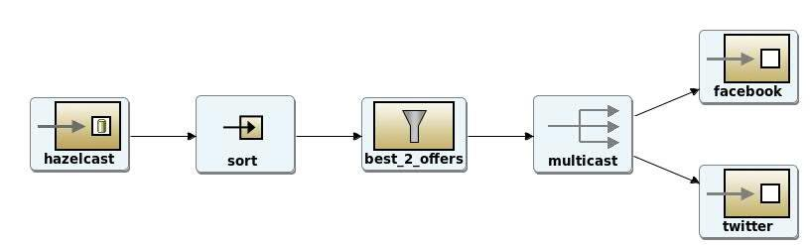

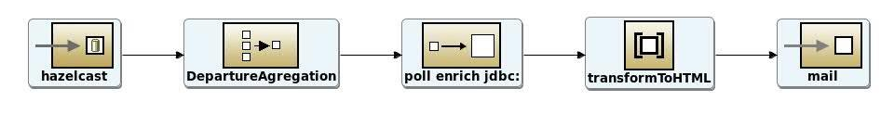
Our Goal until IR2…

Slide 13
Workload diagram

