Slide 1
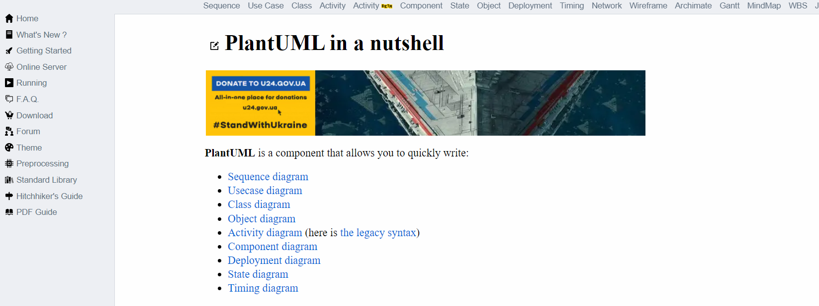
2
1
3

Slide 2
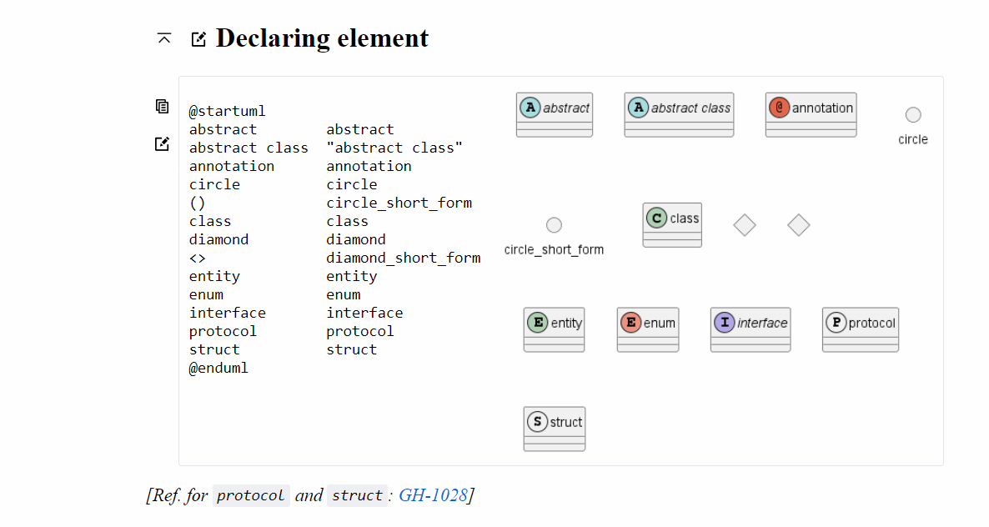
1
Copy to Clipboard
Edit online
2
3

Slide 3
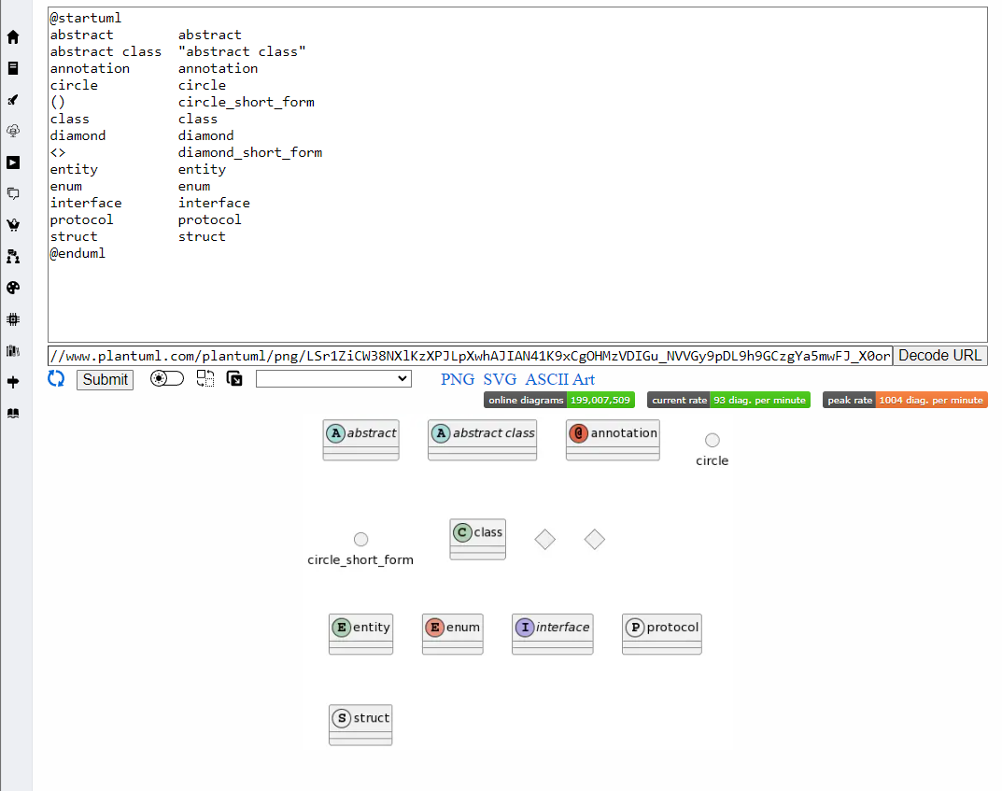
1
3
2

