Slide 1
An ARIMA-LSTM model for predicting Stock Prices
Group 12 presents
Combining statistical and deep learning approaches
Presented by:-
Saket Kumar (241270028)
Pankaj Bhanu (242110607)
Devansh Mishra (241270012)
Aditya Anand (230065)
Tapas Mandal (241080105)

Slide 2
Contents
Introduction
Objectives
Research Methods
Data Source
Empirical Findings
Conclusions
Limitations
References

Slide 3
Introduction
Why Stock Prices Defy Simple Forecasting?
Financial markets are complex adaptive systems shaped by
Market Psychology
Macroeconomic Shocks
Microstructural Noise.
Traditional methods, such as ARIMA, don’t capture the complex patterns of the series.
The Hybrid Advantage
With the combination of the traditional methods and the deep learning methods, we can create a model that forecasts better than either one, without the danger of overfitting.
Real World Impact:-
Many hedge fund management firms employ the hybrid method.

Slide 4
Objectives
To develop different models such as ARIMA, LSTM, and hybrid ARIMA-LSTM.
To compare the results of these models to find the most efficient one in predicting future prices.

Slide 5
Research methods
We have applied these models
ARIMA ( Baseline Model)
LSTM
ARIMA-LSTM ( lag selection with ACF)
ARIMA-LSTM(lag selection with Random Forest)
GJR-GARCH
DeepAR Neural Networks
All these models are used to forecast the future prices of stocks based upon the historical prices.

Slide 6
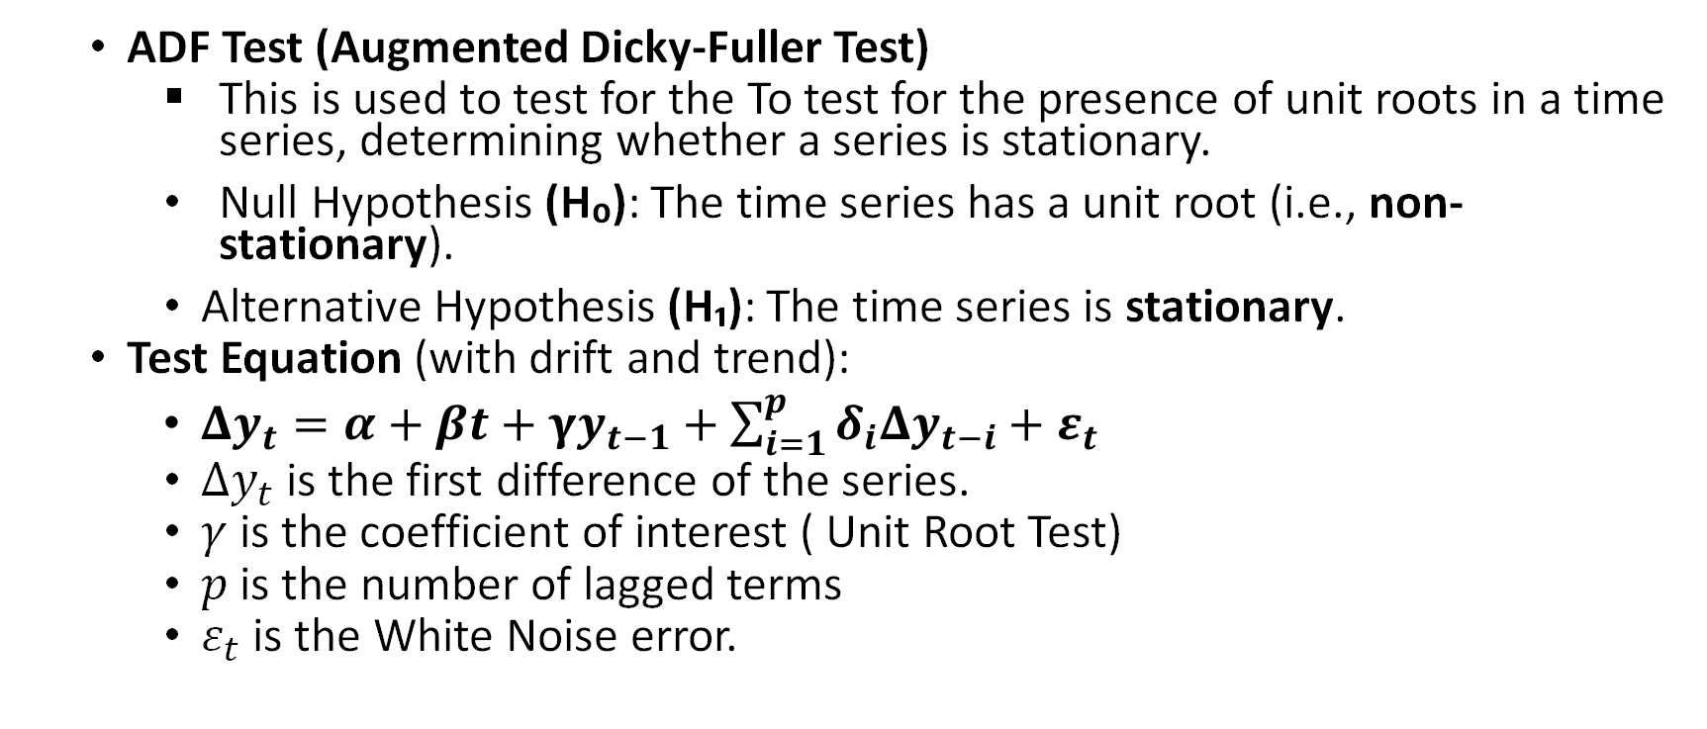
ADF test
ADF Test (Augmented Dicky-Fuller Test)
This is used to test for the To test for the presence of unit roots in a time series, determining whether a series is stationary.
Null Hypothesis (H₀): The time series has a unit root (i.e., non-stationary).
Alternative Hypothesis (H₁): The time series is stationary.
Test Equation (with drift and trend):
$Δy_{t}=α+βt+γy_{t−1}+\sum_{i=1}^{p}{δ_{i}Δy_{t−i}}+ε_{t}$
$Δy_{t}$is the first difference of the series.
$γ$is the coefficient of interest ( Unit Root Test)
$p$ is the number of lagged terms
$ε_{t}$ is the White Noise error.

Slide 7
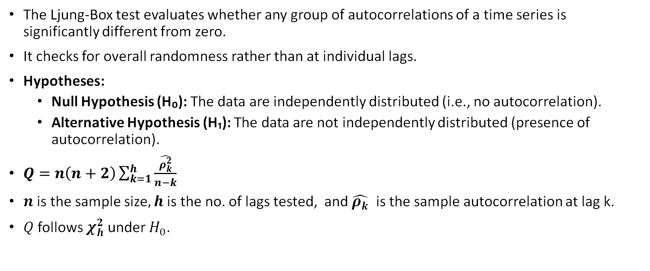
Ljung-Box Test
The Ljung-Box test evaluates whether any group of autocorrelations of a time series is significantly different from zero.
It checks for overall randomness rather than at individual lags.
Hypotheses:
Null Hypothesis (H₀): The data are independently distributed (i.e., no autocorrelation).
Alternative Hypothesis (H₁): The data are not independently distributed (presence of autocorrelation).
$Q=n\left(n+2\right)\sum_{k=1}^{h}{\frac{\hat{ρ_{k}^{2}}}{n−k}}$
$n$ is the sample size$, h$ is the no. of lags tested, and $\hat{ρ_{k}}$ is the sample autocorrelation at lag k.
$Q$follows $χ_{h}^{2}$under $H_{0}$.

Slide 8
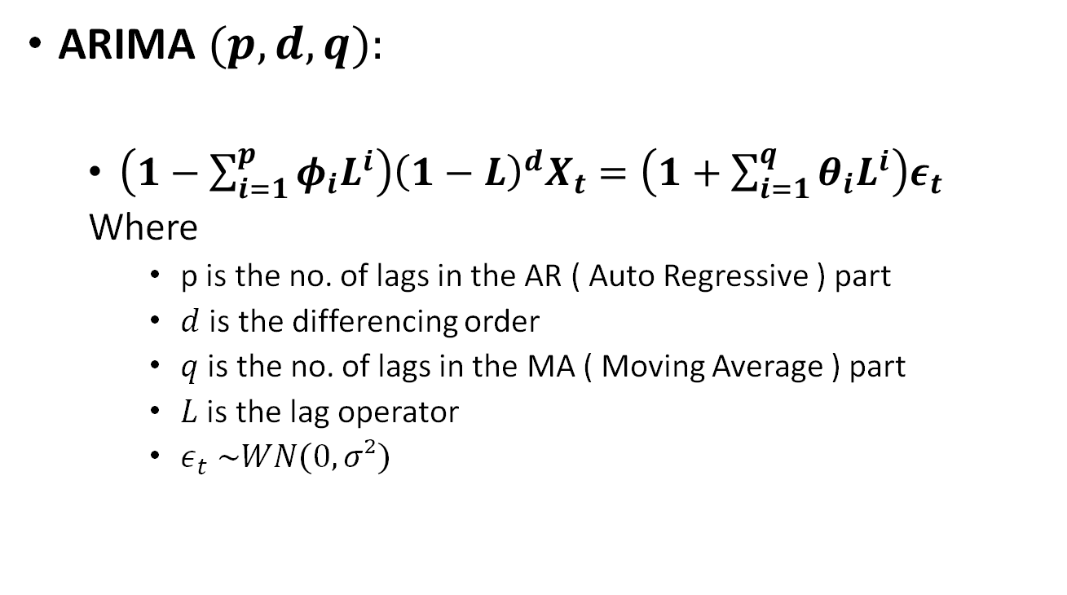
ARIMA model
ARIMA $(p, d, q):$
$\left(1−\sum_{i=1}^{p}{φ_{i}L^{i}}\right){\left(1−L\right)}^{d}X_{t}=\left(1+\sum_{i=1}^{q}{θ_{i}L^{i}}\right)ε_{t}$
Where
p is the no. of lags in the AR ( Auto Regressive ) part
$d$ is the differencing order
$q$ is the no. of lags in the MA ( Moving Average ) part
$L$ is the lag operator
$ε_{t} \sim WN(0,σ²)$

Slide 9
ARIMA-LSTM model
This model is constructed by a combination of ARIMA and LSTM models.
The residuals from the best ARIMA model are used to predict volatility using a deep learning LSTM ( Long-Short Term Memory) model.
The main purpose is to estimate the input lag for the LSTM model to get the best possible prediction of the residuals.
The lags are estimated using the following two methods:
Lag selection using the Autocorrelation function ( ACF).
Lag selection using the Random Forest.
At last, the results from the forecast of the ARIMA model and the residual forecast of the LSTM model are combined to formalize the final forecast of the future stock prices.

Slide 10
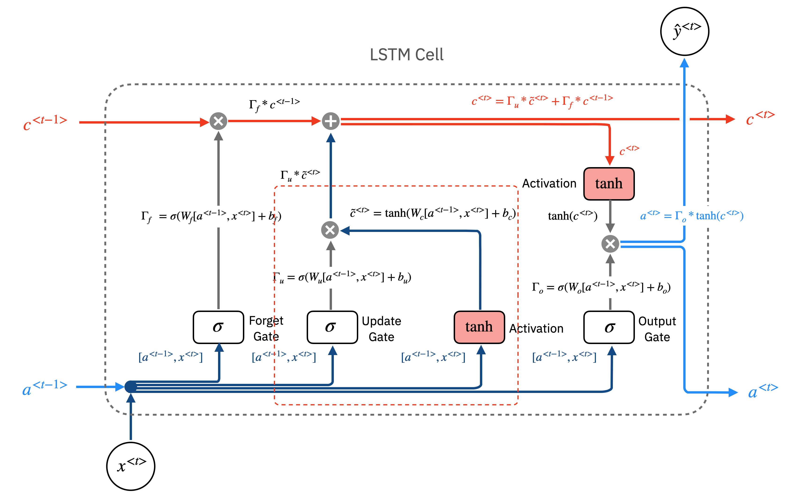
LSTM Architecture
Cell State
Hidden State
Input

Slide 11
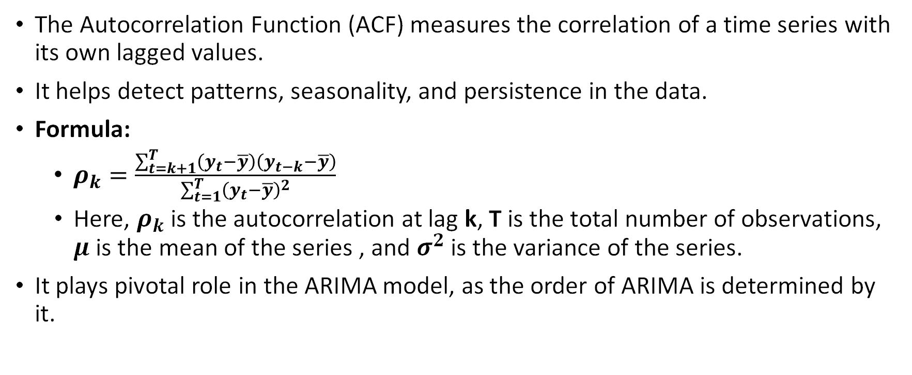
Autocorrelation Function (ACF)
The Autocorrelation Function (ACF) measures the correlation of a time series with its own lagged values.
It helps detect patterns, seasonality, and persistence in the data.
Formula:
$ρ_{k}=\frac{\sum_{t=k+1}^{T}{\left(y_{t}−\overline{y}\right)\left(y_{t−k}−\overline{y}\right)}}{\sum_{t=1}^{T}{{\left(y_{t}−\overline{y}\right)}^{2}}}$
Here, $ρ_{k}$ is the autocorrelation at lag k, T is the total number of observations, $μ$ is the mean of the series , and $σ^{2}$ is the variance of the series.
It plays pivotal role in the ARIMA model, as the order of ARIMA is determined by it.

Slide 12
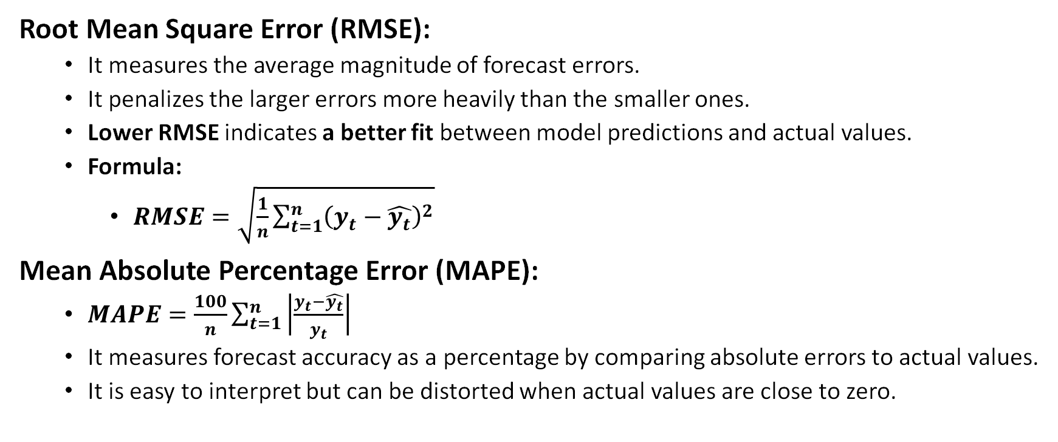
Evaluation Criteria
Root Mean Square Error (RMSE):
It measures the average magnitude of forecast errors.
It penalizes the larger errors more heavily than the smaller ones.
Lower RMSE indicates a better fit between model predictions and actual values.
Formula:
$RMSE=\sqrt{\frac{1}{n}\sum_{t=1}^{n}{{\left(y_{t}−\hat{y_{t}}\right)}^{2}}}$
Mean Absolute Percentage Error (MAPE):
$MAPE=\frac{100}{n}\sum_{t=1}^{n}{\left|\frac{y_{t}−\hat{y_{t}}}{y_{t}}\right|}$
It measures forecast accuracy as a percentage by comparing absolute errors to actual values.
It is easy to interpret but can be distorted when actual values are close to zero.

Slide 13
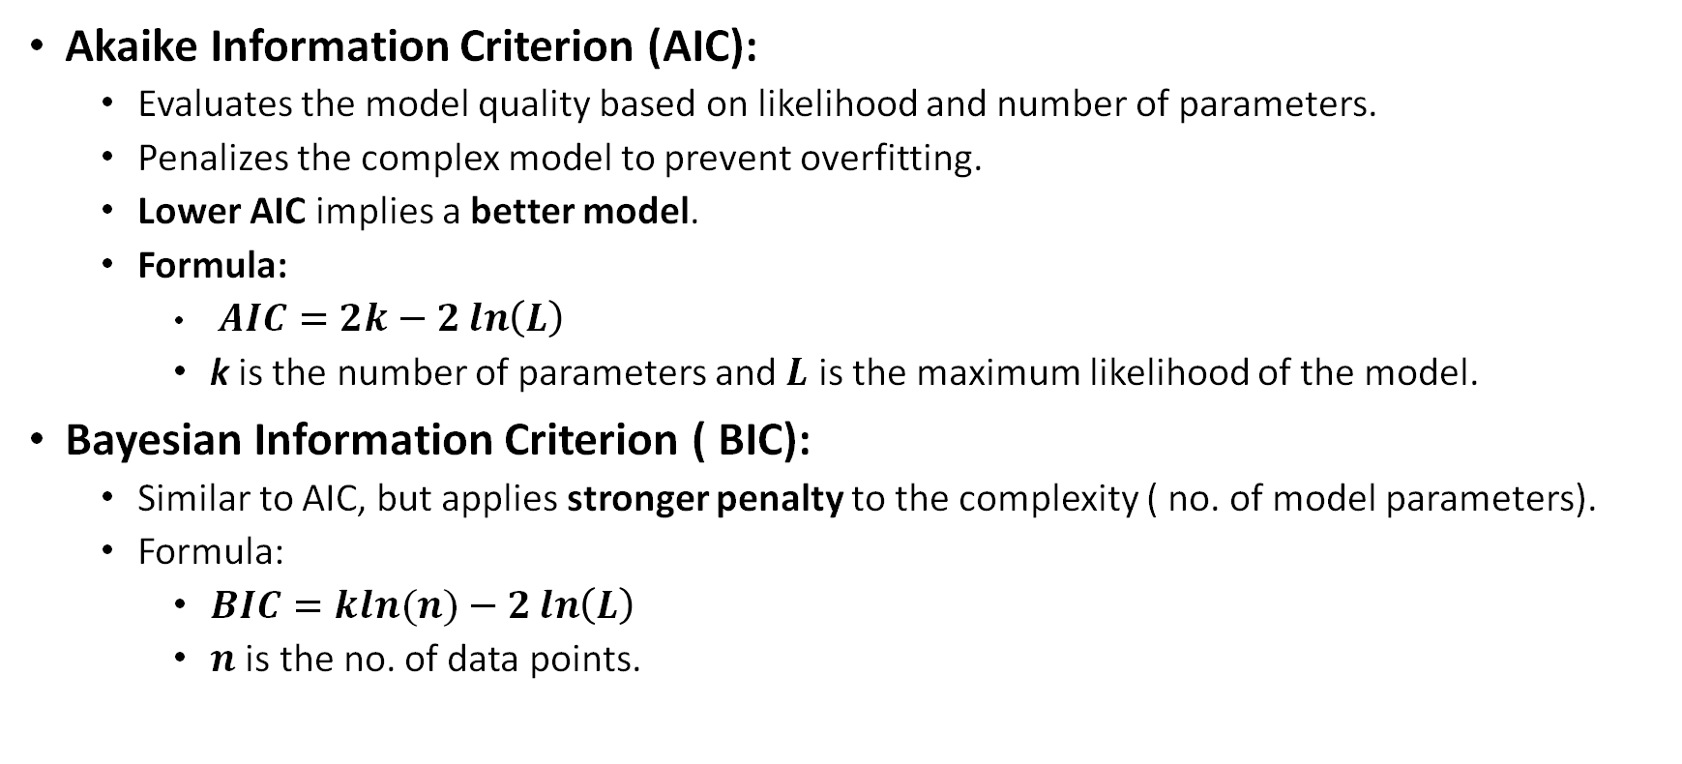
Model Selection Criteria
Akaike Information Criterion (AIC):
Evaluates the model quality based on likelihood and number of parameters.
Penalizes the complex model to prevent overfitting.
Lower AIC implies a better model.
Formula:
$AIC=2k−2\ln\left(L\right)$
k is the number of parameters and $L$ is the maximum likelihood of the model.
Bayesian Information Criterion ( BIC):
Similar to AIC, but applies stronger penalty to the complexity ( no. of model parameters).
Formula:
$BIC=kln(n)−2\ln\left(L\right)$
$n$ is the no. of data points.

Slide 14
Random Forest
Random Forest is an ensemble learning method that builds multiple decision trees and combines their outputs to improve prediction accuracy and reduce overfitting.
Bootstrap Aggregation( Bagging): Each tree is trained on a random subset of data.
Feature Randomness: At each split, only a random subset of features is considered.
Decision Process:
For classification trees, the final decision is taken based on majority voting.
In the case of regression trees, the average result of all the trees is the final answer.
Advantages include being robust to overfitting, handling high-dimensional data well, and the ability to estimate the feature importances.
Limitations include lower interpretability than the single decision tree and being computationally expensive in the case of large datasets.

Slide 15
Data source
The stock price of Microsoft (MSFT), New York Stock Exchange, is obtained using Yahoo Finance.
The timeline of data is from 1st April 2022 to the 31st May, 2025.
We have used the bulk of the data to train the models, and the last 20 data points to test the forecasted values against the real values.
Although the results presented in this presentation only concern the stock-price of Microsoft, a similar analysis can be done with other stocks. Some of which will be presented later.

Slide 16
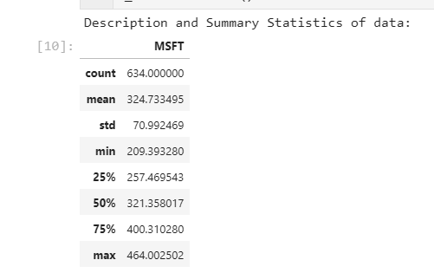
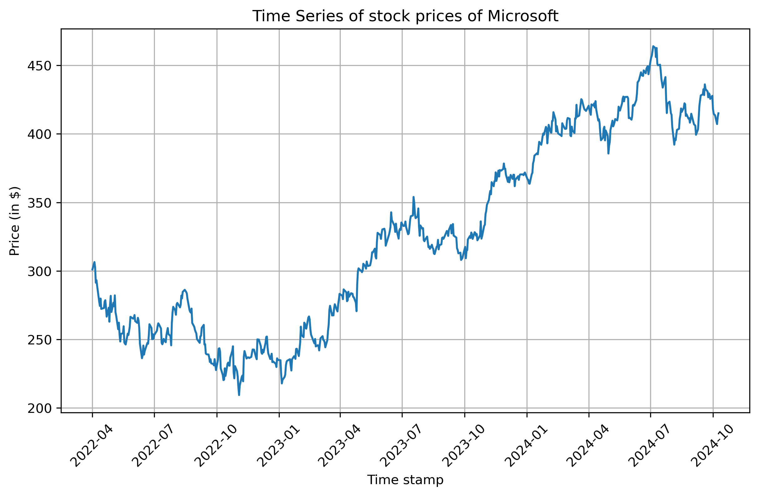
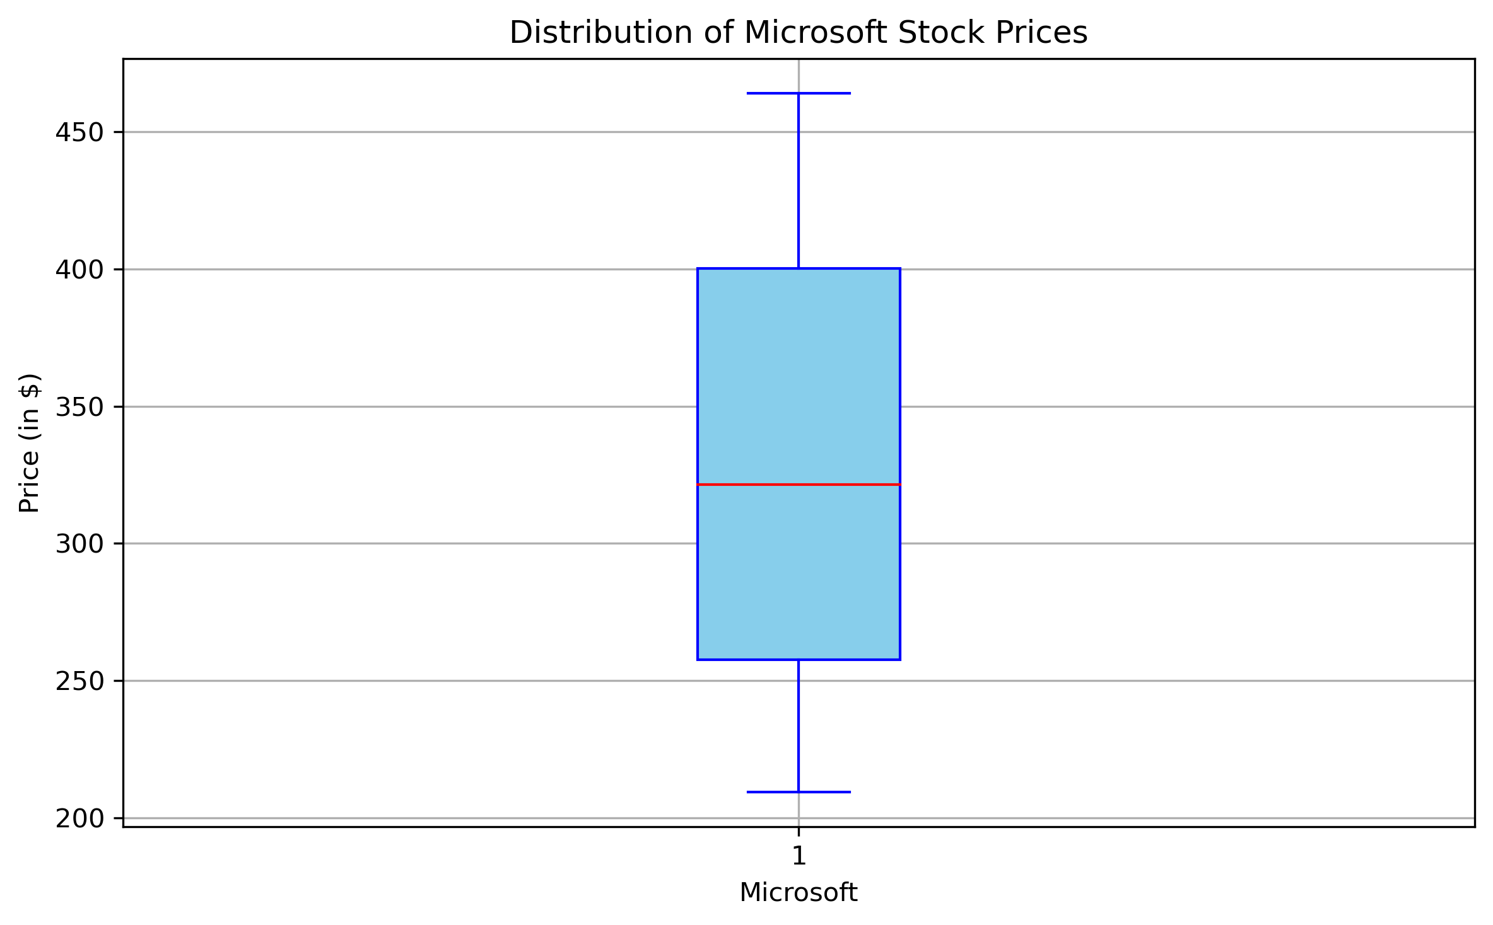
Data Visualization
Summary statistics
Time Series Data
Box-Plot
The chart depicts the upward growth of stock prices, with some patches of downward movement in between.
The box plot shows the lack of any outliers in the data.

Slide 17
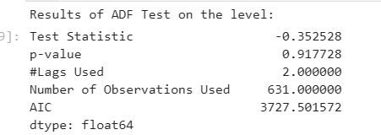
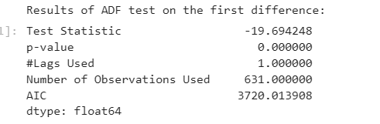
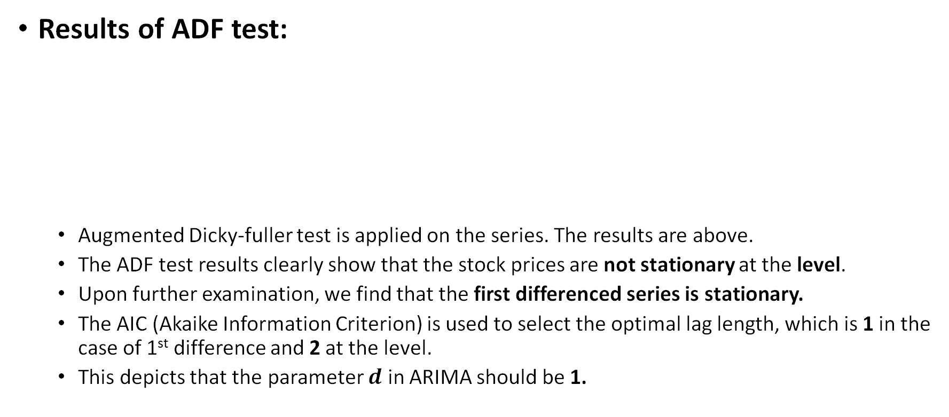
Empirical Results from ARIMA model
Results of ADF test:
Augmented Dicky-fuller test is applied on the series. The results are above.
The ADF test results clearly show that the stock prices are not stationary at the level.
Upon further examination, we find that the first differenced series is stationary.
The AIC (Akaike Information Criterion) is used to select the optimal lag length, which is 1 in the case of 1st difference and 2 at the level.
This depicts that the parameter $d$ in ARIMA should be 1.

Slide 18
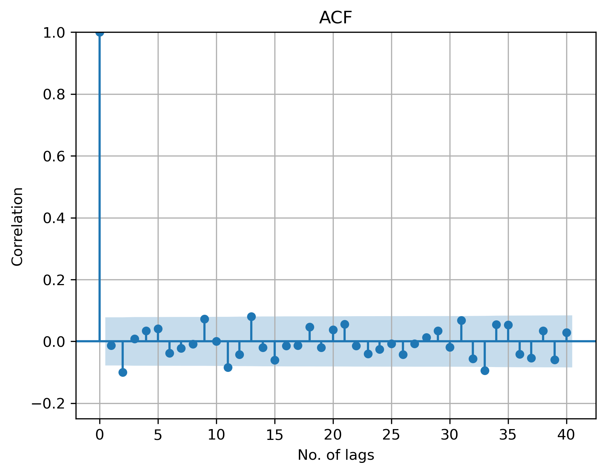
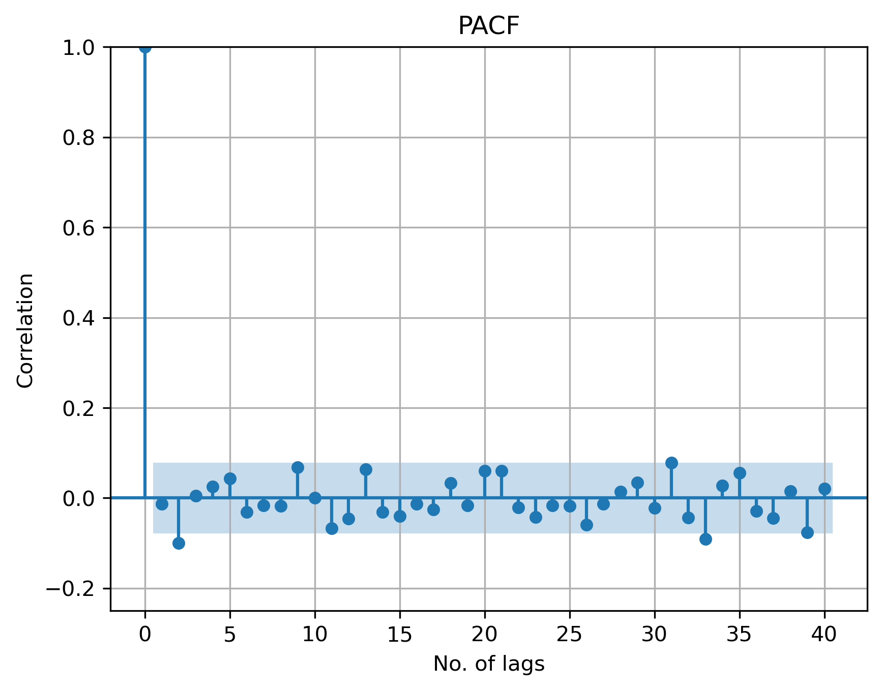
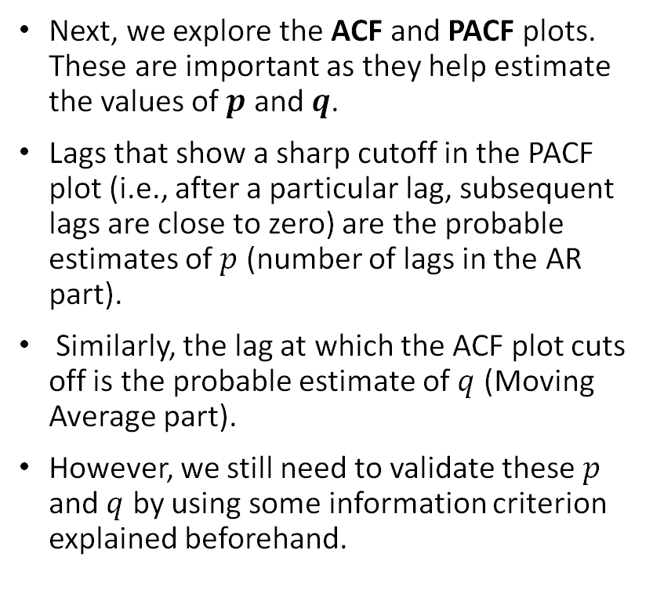
ARIMA model results ( continued)
Next, we explore the ACF and PACF plots. These are important as they help estimate the values of $p$ and $q$.
Lags that show a sharp cutoff in the PACF plot (i.e., after a particular lag, subsequent lags are close to zero) are the probable estimates of $p$ (number of lags in the AR part).
Similarly, the lag at which the ACF plot cuts off is the probable estimate of $q$ (Moving Average part).
However, we still need to validate these $p$ and $q$ by using some information criterion explained beforehand.

Slide 19
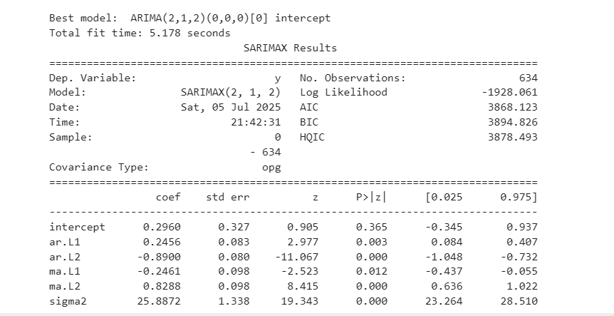
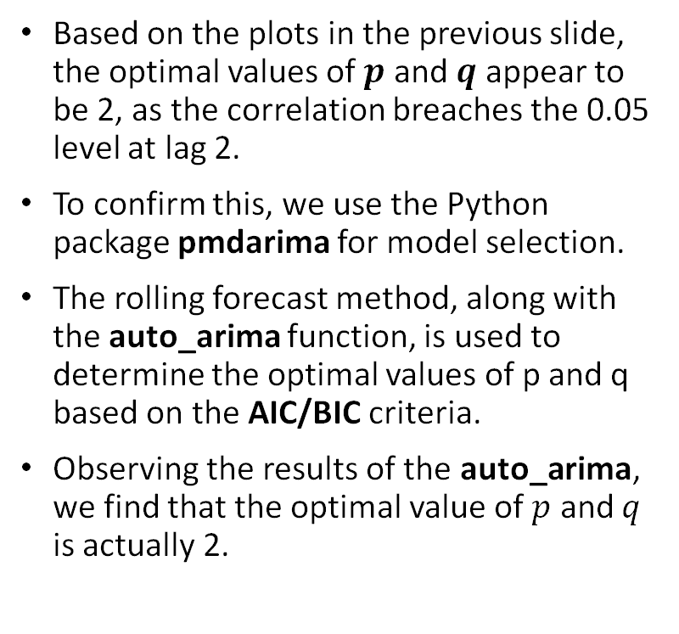
ARIMA results (continued)
Based on the plots in the previous slide, the optimal values of $p$ and $q$ appear to be 2, as the correlation breaches the 0.05 level at lag 2.
To confirm this, we use the Python package pmdarima for model selection.
The rolling forecast method, along with the auto_arima function, is used to determine the optimal values of p and q based on the AIC/BIC criteria.
Observing the results of the auto_arima, we find that the optimal value of $p$ and $q$ is actually 2.

Slide 20
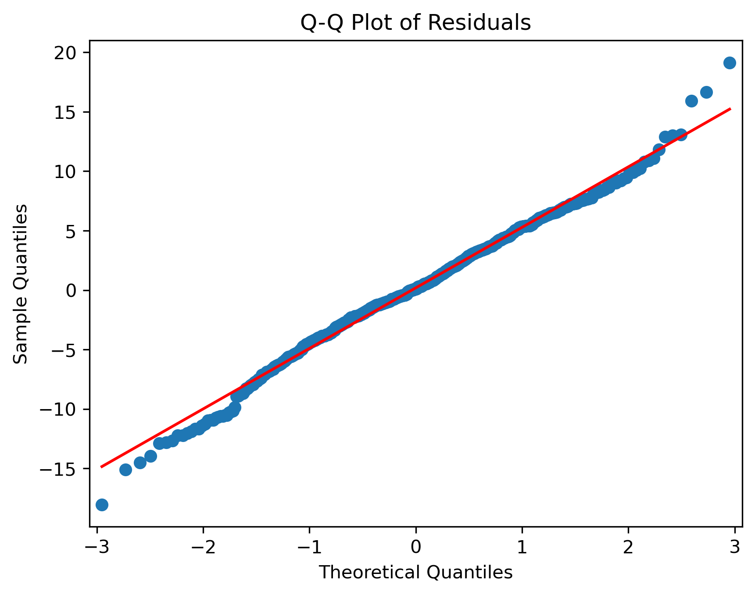
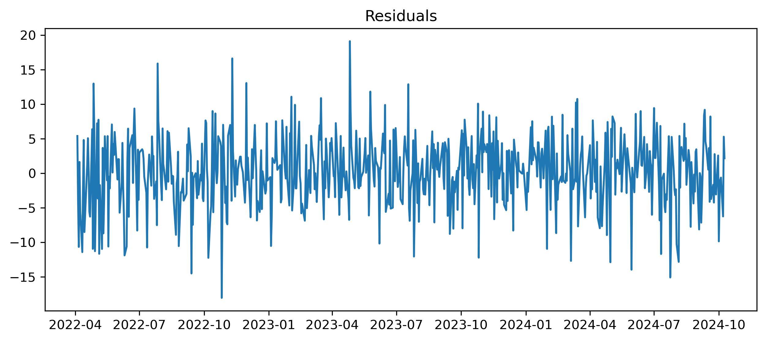
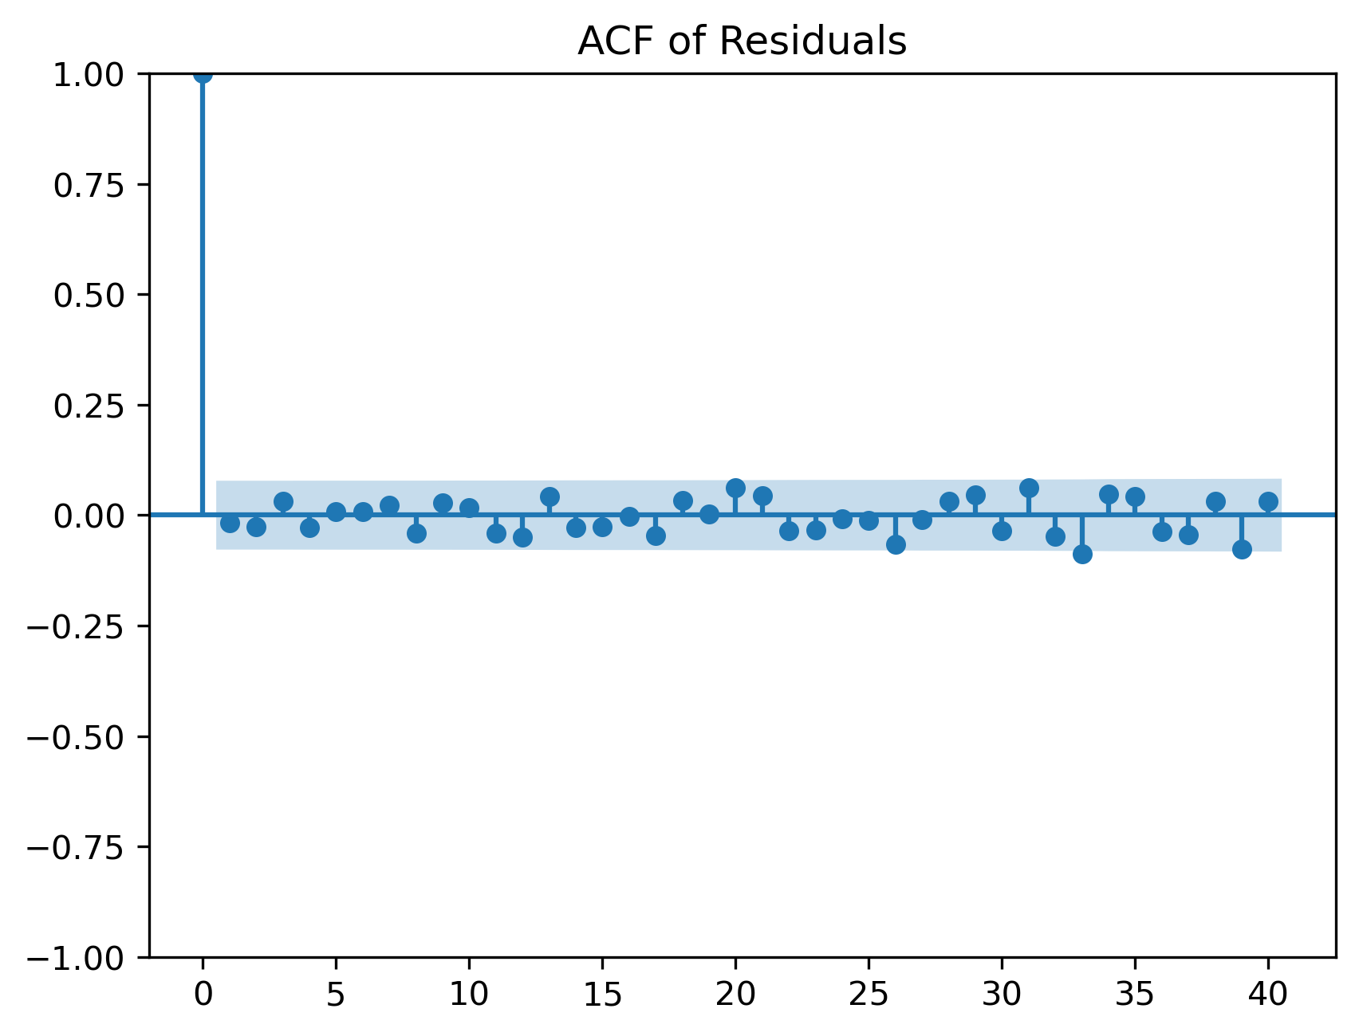
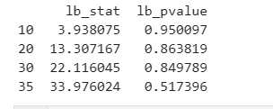
Residual Analysis of ARIMA

Slide 21
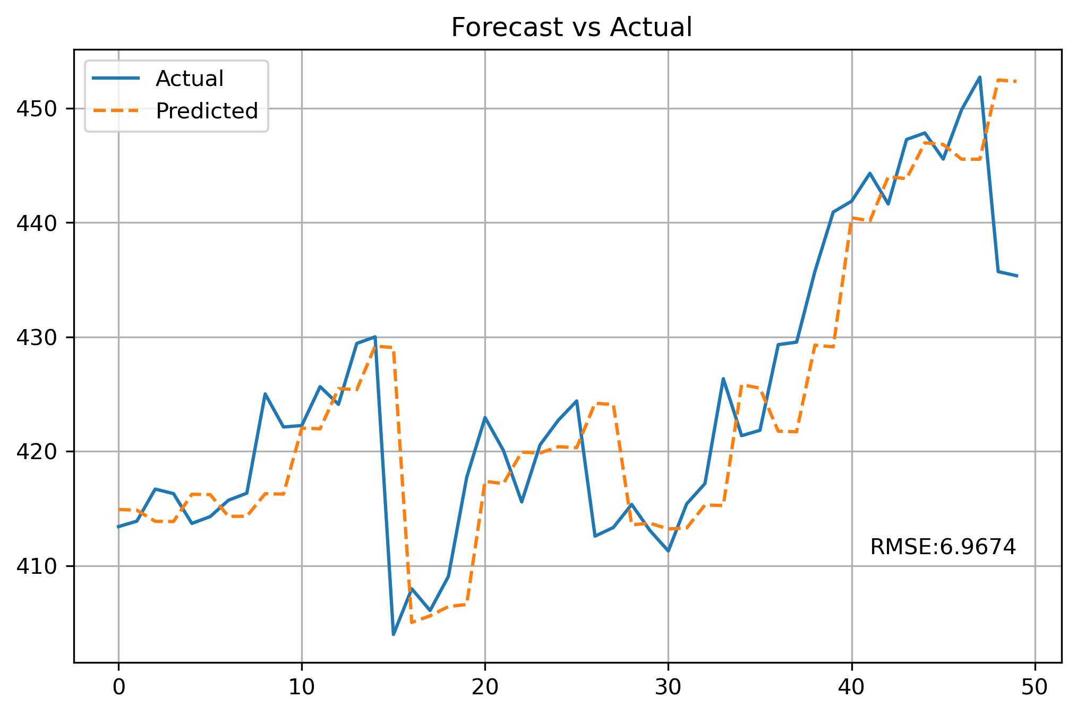
ARIMA-Forecast
Using Walk-forward forecasting, the next 50 values of the best ARIMA model (2,1,2) are predicted.
The RMSE of this ARIMA model is 6.9674.
The models presented later in the slide are expected to beat this score.

Slide 22
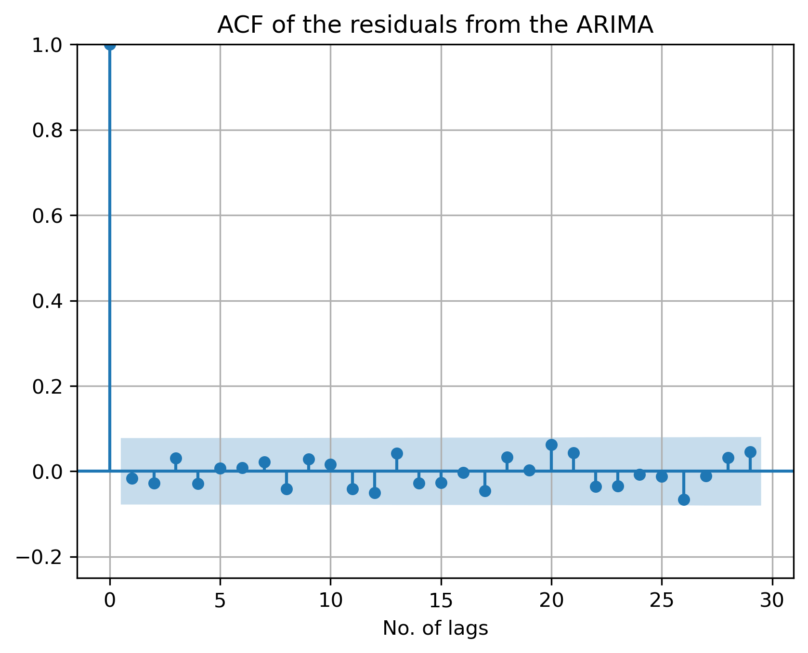
Results from the ARIMA-LSTM Hybrid model
The first and foremost thing to do is to determine the no. of lags which are to be used as the independent variables to forecast the future values of the series in the LSTM model.
This can be done using two methods:-
Using Autocorrelation Function
Using Random Forest
Using the Autocorrelation function, we find that the approximate number of lags is 26.
Using the feature_importance_ feature of random forest, we find that the required number of lags is 13.

Slide 23
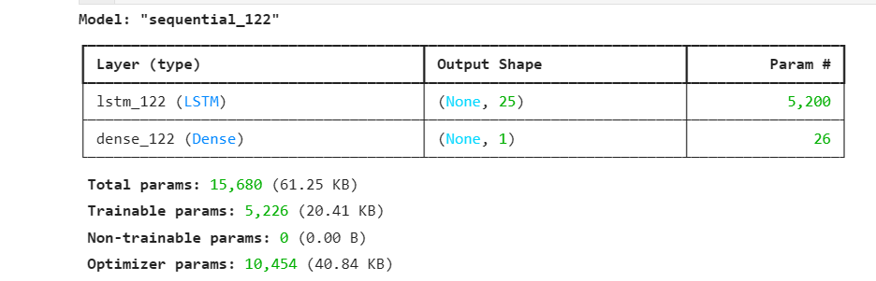
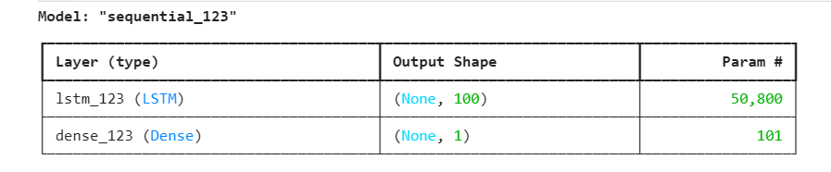
ARIMA-LSTM (continued)
After this, two different LSTM models are applied to the residual, with the input lag being 26 and 13 for ACF lag and Random Forest lag, respectively.
The parameters of both models are estimated using the Hyperparameter tuning. The details of hyperparameters are as follows:-
Units: [25,50,75,100]
Dropout Rate : [0.0,0.2,0.4]
Batch Size: [8,16]
Optimizer: Adam
The best parameter combination
For ACF lag: Units = 25, dropout rate = 0.4, batch size= 8
For Random Forest lag, Units=100, dropout rate=0.4, batch size =8
Optimizer is Adam in both cases, Activation function = Relu
A dense layer is added after LSTM layer.

Slide 24
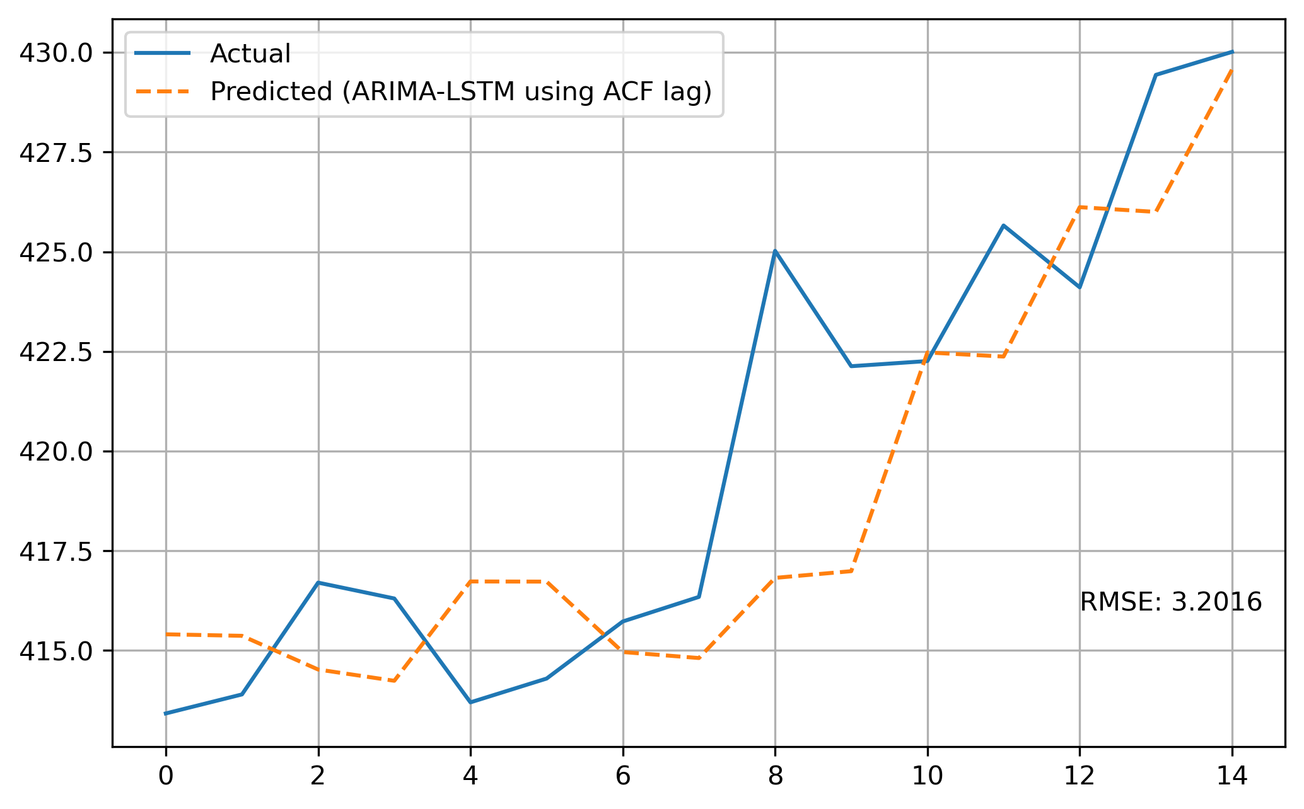

ARIMA-LSTM results
We can see that ARIMA-LSTM with ACF lag selection performed slightly better than Random-Forest lag selection.
However, both performed far better than the ARIMA forecast ( ref. – previous

Slide 25
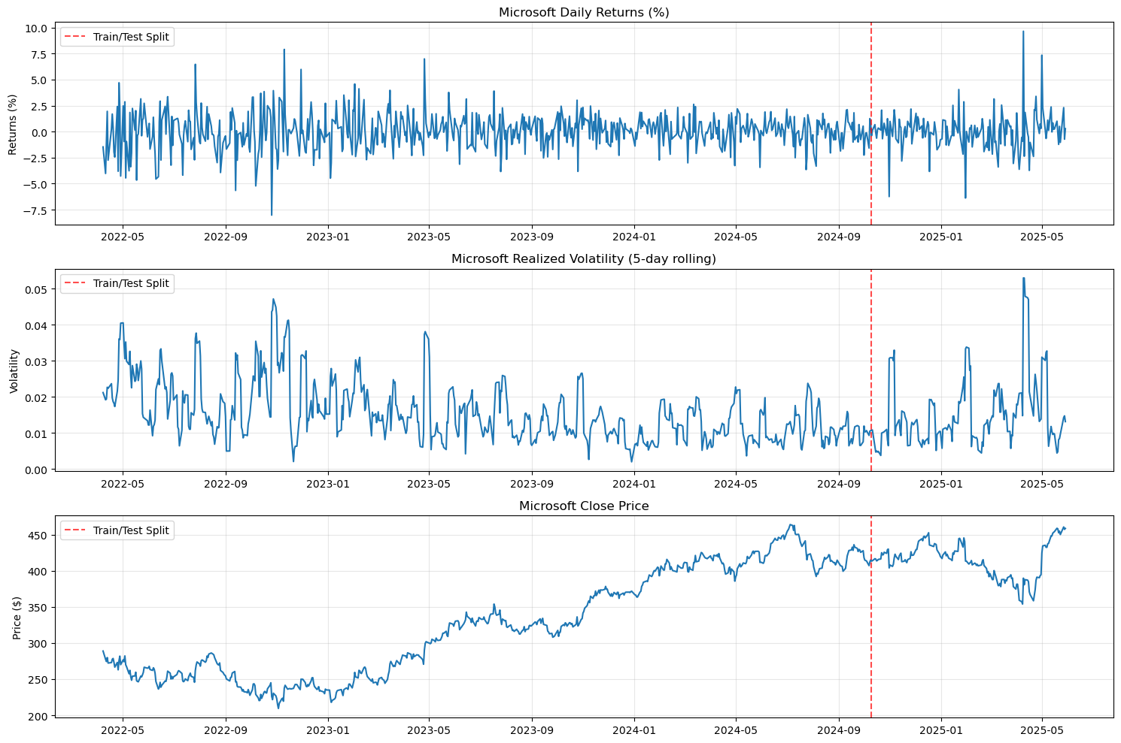
Preliminary Data Analysis

Slide 26
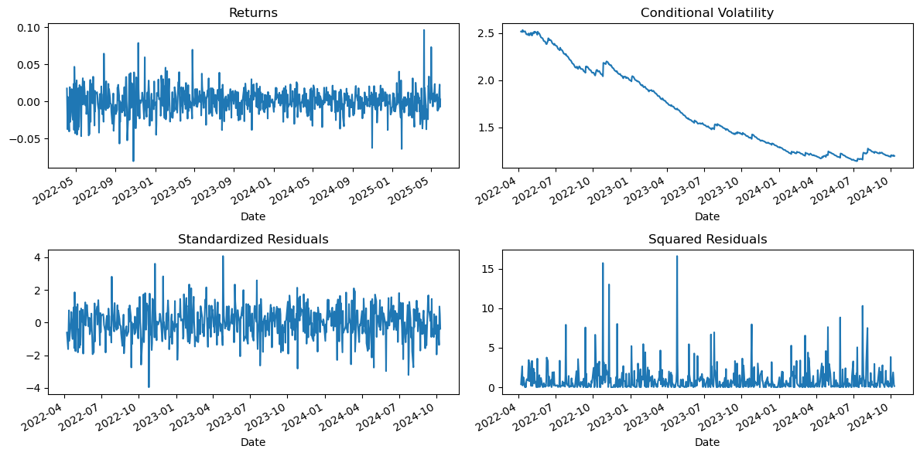
GARCH Residual Analysis

Slide 27
Glosten-Jagannathan-Runkle GARCH (GJR-GARCH)
Captures an asymmetric behavior by allowing the current conditional variance to have a different response to the past positive and negative returns
GJR-GARCH Model Specification:
Return Equation: Rₜ = σₜ * εₜ, where εₜ ~ N(0, 1)
Conditional Variance Equation σₜ² = ω + (α + γ * Iₜ₋₁) * Rₜ₋₁² + β * σₜ₋₁²
ω > 0
α ≥ 0, β ≥ 0, α + γ ≥ 0
Stationarity: α + β + 0.5γ < 1
News Indicator Function Iₜ₋₁ =
0 if Rₜ₋₁ ≥ 0 (good news)
1 if Rₜ₋₁ < 0 (bad news)

Slide 28
Interpretation of γ Parameter
If γ = 0 → standard GARCH model.
Bad and good news have the same impact: α * Rₜ₋₁².
• If γ ≠ 0 → asymmetry in response:
Bad news (Rₜ₋₁ < 0) → impact: α + γ
Good news (Rₜ₋₁ ≥ 0) → impact: α
Hence, if γ > 0, bad news increases variance more than good news.

Slide 29
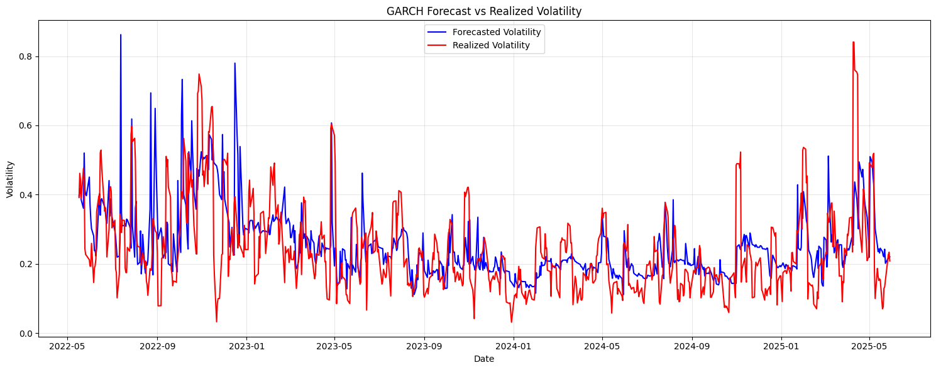
GJR-GARCH Predicted Volatility

Slide 30
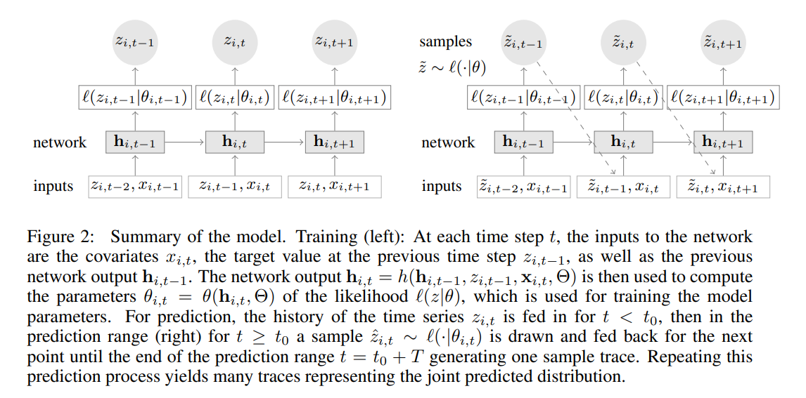
DeepAR: Probabilistic Forecasting with Autoregressive Recurrent Networks – Salinas et Al (Amazon Research)

Slide 31
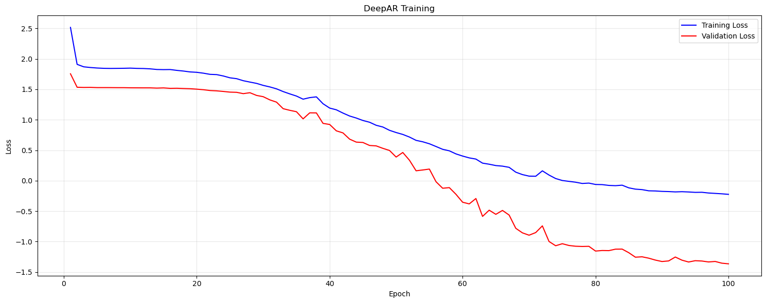
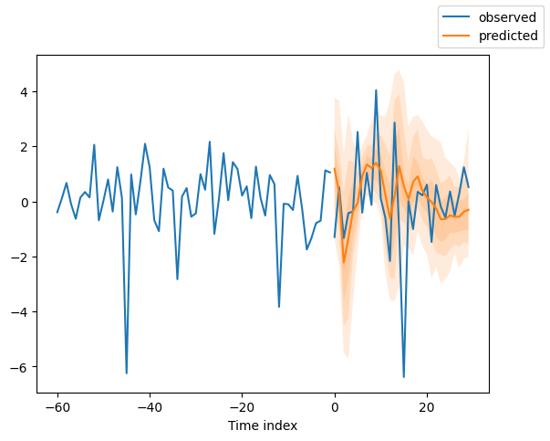
DeepAR Prediction
30 day forecast based on 60 day history from test dataset
Training and Validation Loss

Slide 32
Conclusions

Slide 33
Limitations

Slide 34
Resources
Data source
Code course and also provide on git hub link

Slide 35
References
https://www.sciencedirect.com/science/article/pii/S0169207019301888
https://www.scirp.org/reference/referencespapers?referenceid=2038144

