Slide 1

Final Presentation
Hardware/Software Co-Design with a Lego Car
Group: Poorman‘s Laser
Daniel Collaziol
Juri Kuhn
Josef Stark
Thomas Sennebogen
Viet Tiep Do

Slide 2
Table of Content/ Highlight
Introduction (Initial situation...)
Concept (Architecture, Target, Vision, Features...)
Problem (Hardware, Software...)
Solution (Improvement, Changes...)
Result (Video/Picture...
Experience (what we learned, fun facts...
)
Conclusion

Slide 3
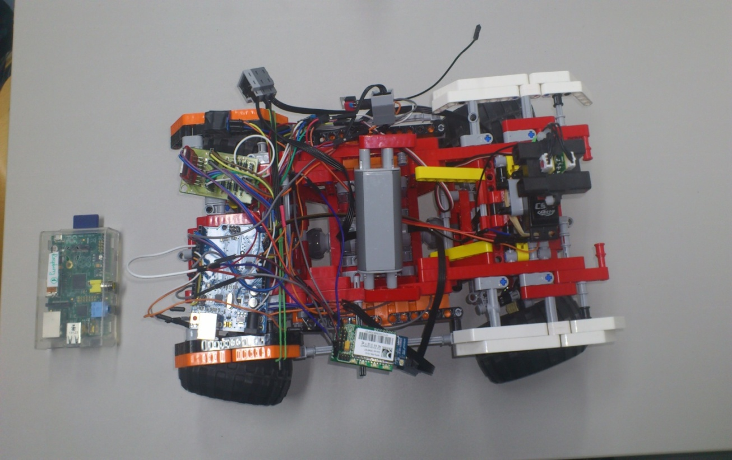
1. Introduction
Initial Components
Car
Arduino Board
Raspberry
Engine
Infrared Sensor
Battery, Cables,H-Bridge..
Wifi-Module(which didnt work...)

Slide 4
2. Concept/Vision/Features...

Slide 5
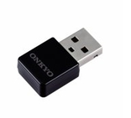
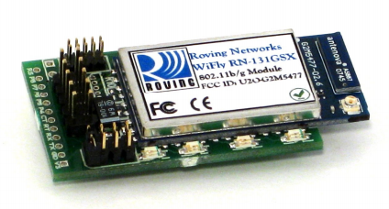
3. Problem
Wifi-Module defects, using a Wlan-Module in combination with Raspberry as subtitution
Sensor‘s accuracy: inconsistent values
Path finding
Wires missing, contact...

Slide 6
4. Solution / Improvement
5 Sensors upfront, 1 back for better obstacles dectection...
Show video how the holder was created
Car remotely controlled using android app, netbook: position given, speed adjustment
Visual signal with LEDs, which indicates three main state: red for obstacles detection,
Green for power connection success and yellow for android app‘s connection success

Slide 7
5. Results
- What lego car able to do... Show videos

Slide 8
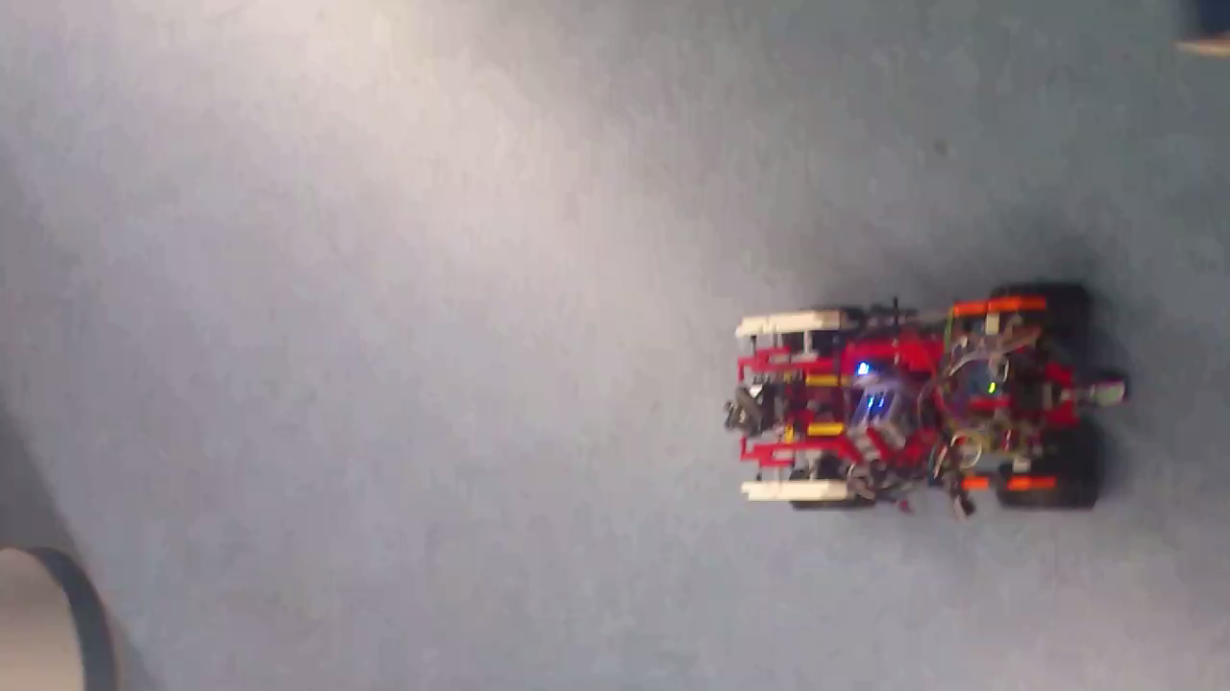
Video/Fotos...

Slide 9
Video/Fotos...

Slide 10
6. Experiences/fun facts
hungry
pizza
women/bitches
facebook

Slide 11
7. Conclusion and potential of development

Slide 12
Additonal Information, documents...

Slide 13
Thank you for your attention!

