Slide 1
KEYLOGGER AND SECURITY
CAPSTONE PROJECT
Presented By:
B.HARITHA - Priyadarshini Engineering College - CSE

Slide 2
OUTLINE
Problem Statement (Should not include solution)
Proposed System/Solution
System Development Approach (Technology Used)
Algorithm & Deployment
Result (Output Image)
Conclusion
Future Scope
References

Slide 3
Problem Statement
The problem statement is that the keyloggers can be detected using antiviruses. Installation of hardware keyloggers is difficult without the knowledge of the owner of the system. The solution to the above existing problem is that we can build a software keyloggers instead of hardware keyloggers.

Slide 4
Proposed Solution
Our proposed system includes-
Building a user-friendly interface which will allow the user to choose between deploying a keylogger and detecting a keylogger in the system of their choice.
Our frontend involves the interface and our backend involves a Python program which will log all the keystrokes and make decisions based on keylogger deployment algorithm.
If the user wishes to detect a keylogger, the backend program will use the keylogger detection algorithm.

Slide 5
System Approach
The System of Keylogger is to sniff out the keystrokes without affecting the working of computer systems. Keylogger consists of hardware tools or software tools or the combination of both in order to capture the data or information which get stored in the log system. The two major flavors of Keyloggers are hardware-based or software-based Keylogger. Hardwarebased Keyloggers can be embedded in the CPU port, or as an unnoticeable plugin between the CPU and the keyboard so that it can interpret all the signal sent from keyboard. But the major problem is the physical presence of cybercriminal is required in order to connect the hardware Keylogger to the system. Unlike hardware-based Keyloggers, software types are easy to introduce and to install on the user’s device without making much effort. That’s the only reason software Keyloggers are much preferable.

Slide 6
Algorithm & Deployment
a. The program will wait for all the system processes to initialize.
b. The keylogger daemon is initialized and the process will be gauged in scale of time.
c. A log file is created for the current session to log all the keystrokes and maintain a record.
d. If no event occurs, keylogger continues listening to the strokes.
e. If an event occurs, the keylogger classifies the type of keystroke that has occurred- special key which are commands or normal text input.
f. If a special key that gives a command has been entered then it is compared with a value in a dictionary and recorded in the log file.
g. If a normal text i.e. anything in the range of ASCII characters has been inputted, the ASCII code is converted to its respective character and this is exported to the log file.
h. The inputs along with their timestamps are recorded in the log file.

Slide 7
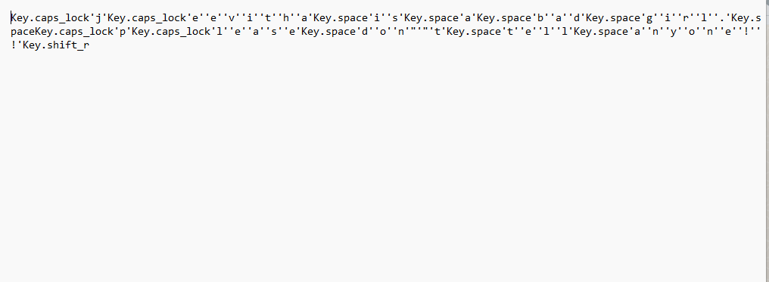
Result

Slide 8
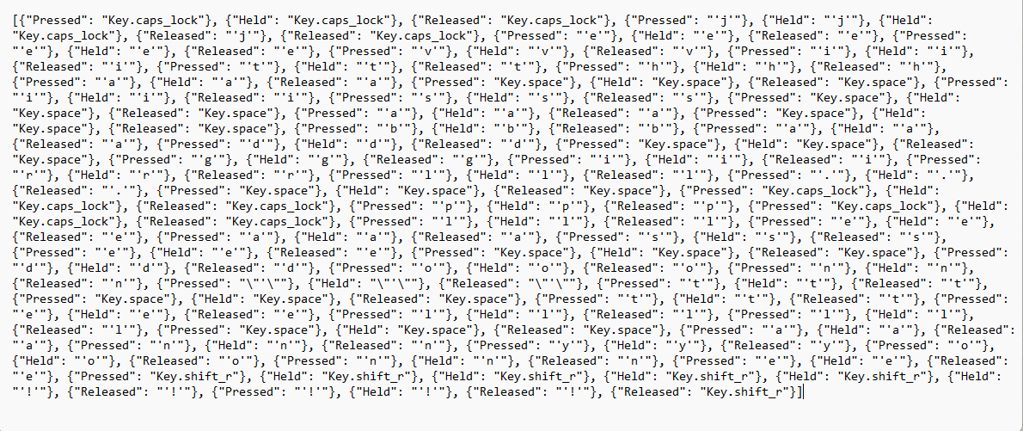
RESULT

Slide 9
Conclusion
We have thus designed a system to deploy and detect a keylogger. This system is not perfect by any stretch and we aim to better it as time goes on. We aim to make this system more user-friendly and interactive. There are multiple ways of capturing keystrokes since all a keylogger needs is to sit between processes and record it and there are multiple ways to detect a keylogger, there is no single, perfect way of detection. We need to be with the times and ahead of a malicious user. And also for searching in RAM will be easier if we use any searching mechanism or string matching program. The goal was to create a method for keylogger detection and make it easier for non-technical person. This proposed method does not need any special technical knowledge. Any regular person will be able to handle it.

Slide 10
Future scope
Privilege escalation mitigations (Running keylogger in non-admin mode to avoid privilege exploitation)
Using UTF-8 Unicode characters instead of ASCII (UTF-8 will provide a higher scope for character detection)
Optimizing heuristic operation of keylogger (Optimizing RAM usage so that the keylogger uses low RAM and becomes difficult to get noticed

Slide 11
References
https://www.linkedin.com/pulse/6-confirmed-signs-key-logger-infections-prevention-computer-arun-kl. https://icssindia.in/blogs/what-is-keylogger/ https://enterprise.comodo.com/computer-keylogger-software.php https://www.geeksforgeeks.org/hardware-keylogger/

Slide 12
THANK YOU

