Slide 1
ONLINE PRODUCT REVIEW ANALYSIS

Slide 2
ONLINE PRODUCT REVIEW ANALYSIS
Online Product Review Analysis is an important application of Data Analytics and Natural Language Processing (NLP) that focuses on studying customer opinions shared on online platforms such as e-commerce websites, social media, and review forums. These reviews reflect customers’ experiences, satisfaction levels, and expectations regarding products or services.
With the rapid growth of online shopping, a huge volume of customer feedback is generated every day. This data is mostly unstructured text, making it difficult to analyze using traditional methods. Online product review analysis helps convert this raw textual data into meaningful insights by using techniques such as sentiment analysis, text mining, and machine learning.

Slide 3
PROBLEM STATEMENT
Online shopping platforms generate a large volume of customer reviews every day. Manually analyzing these reviews is time-consuming and inefficient due to the unstructured nature of textual data. As a result, valuable insights related to customer satisfaction, product quality, and common issues are often overlooked. There is a need for an automated system that can effectively analyze online product reviews using data analytics and sentiment analysis techniques to extract meaningful insights and support better business decision-making.

Slide 4
Objectives
Online Product Review Analysis
To collect and analyze online product reviews from e-commerce platforms
To identify customer sentiment as positive, negative, or neutral
To understand customer satisfaction and preferences
To detect common issues and areas for product improvement
To support better business and marketing decision-making
To measure customer satisfaction levels based on review sentiment and ratings.

Slide 5
To analyze large volumes of review data efficiently using machine learning and NLP methods
To support data-driven decision.
To detect common customer complaints and issues for improving product quality and services.
To improve product recommendations and marketing strategies based on customer opinions
To compare products or brands based on customer feedback and sentiment trends.

Slide 6
Tools Used
Online Product Review Analysis Microsoft Excel Used for initial data cleaning, removing duplicates, sorting reviews, and performing basic statistical analysis .Power BI Used to create interactive dashboards and visualizations such as rating distribution, sentiment trends, and customer feedback insights. Python Used for advanced data processing and sentiment analysis. Libraries like Pandas and numpy are used for data handling, while textblok /NLTK are used for analyzing customer sentiments

Slide 7
Role of Microsoft Excel in the Project
Used to store and organize review data in tabular form
Helps in data cleaning (removing duplicates, handling missing values)
Used for basic data analysis such as sorting and filtering reviews
Helps in analyzing ratings distribution (1–5 stars)
Used to create charts and graphs for visualization
Useful for initial exploration of the dataset

Slide 8
Dataset Description
Online Product Review Analysis The dataset consists of customer reviews collected from online e-commerce platforms It includes product ratings, review text, and review dates Ratings are provided on a scale of 1 to 5 stars Review text contains customer opinions and feedback about the product The dataset is used to perform sentiment analysis and identify customer satisfaction levels

Slide 9
Nature of the Dataset
Data type: Unstructured (review text) and structured (ratings, dates)
File format: CSV (.csv)
Domain: E-commerce
Language: English
Source: Public datasets / e-commerce platforms
Attributes in the Dataset
Review Text: Customer comments about the product
Rating: Star rating given by the customer (1 to 5)
Product Name / Product ID: Product identification
Reviewer ID: Unique user identifier
Review Date: Date of the review

Slide 10
Data Collection
Customer review data is collected from online platforms such as Amazon, Flipkart, or Kaggle datasets. The data includes review text, ratings, and product information.
Data Storage
The collected data is stored in CSV or Excel format for easy access and processing.
Data Cleaning and Preprocessing
Since reviews are unstructured, preprocessing is essential:
Removal of duplicate reviews
Handling missing values
Removing stop words, punctuation, and special characters
Converting text to lowercase
This step improves data quality.

Slide 11
Dashboard Design
Online Product Review Analysis Designed an interactive dashboard using Power BI is played key metrics such as total reviews, average rating, and sentiment distribution Used visualizations like bar charts, pie charts, and line graphs to show rating trends and sentiment analysis Included filters for product category, rating, and review date for better analysis The dashboard provides quick insights into customer satisfaction and product performance

Slide 12
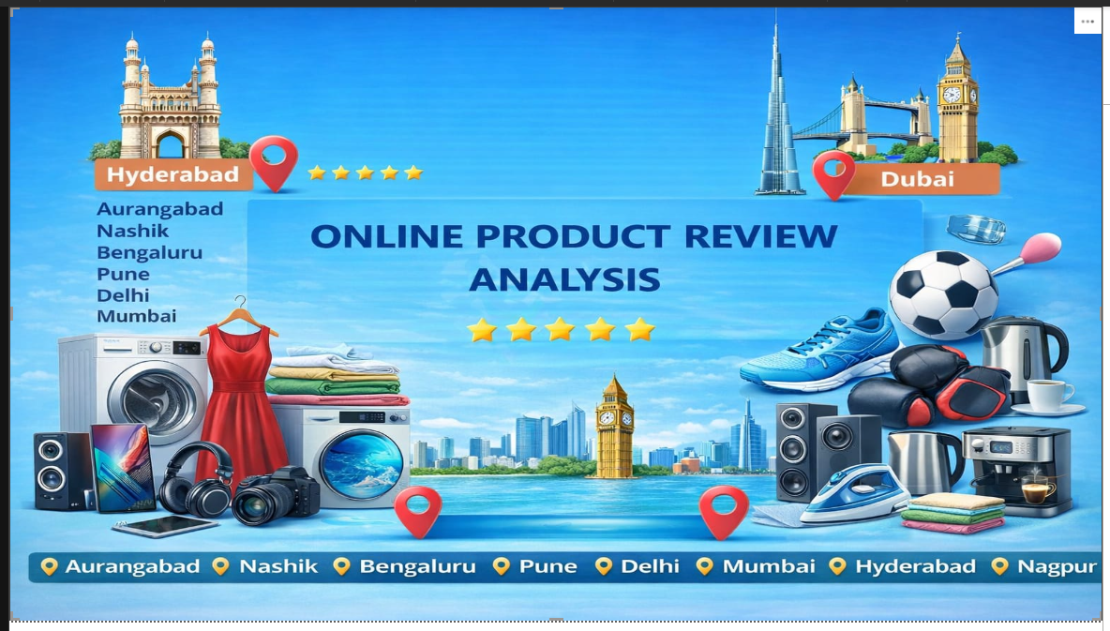
SCREENSHOTS OF DASHBOARD

Slide 13
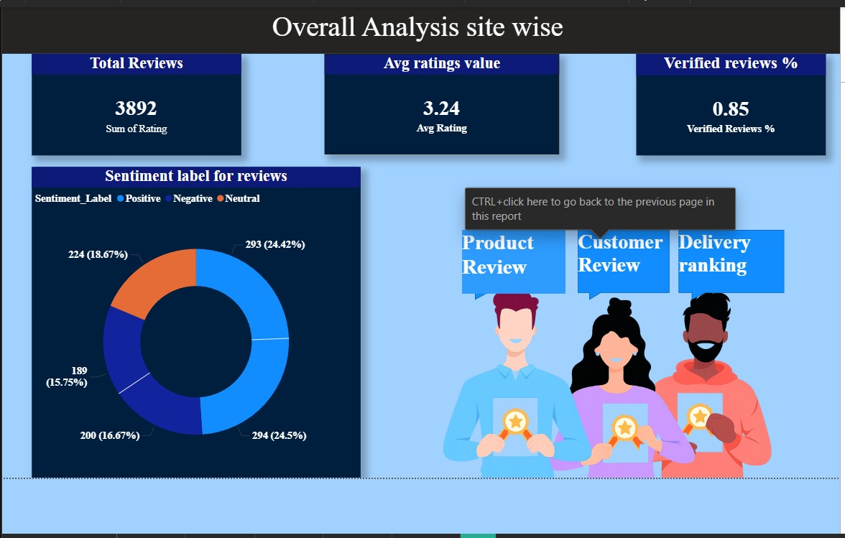

Slide 14
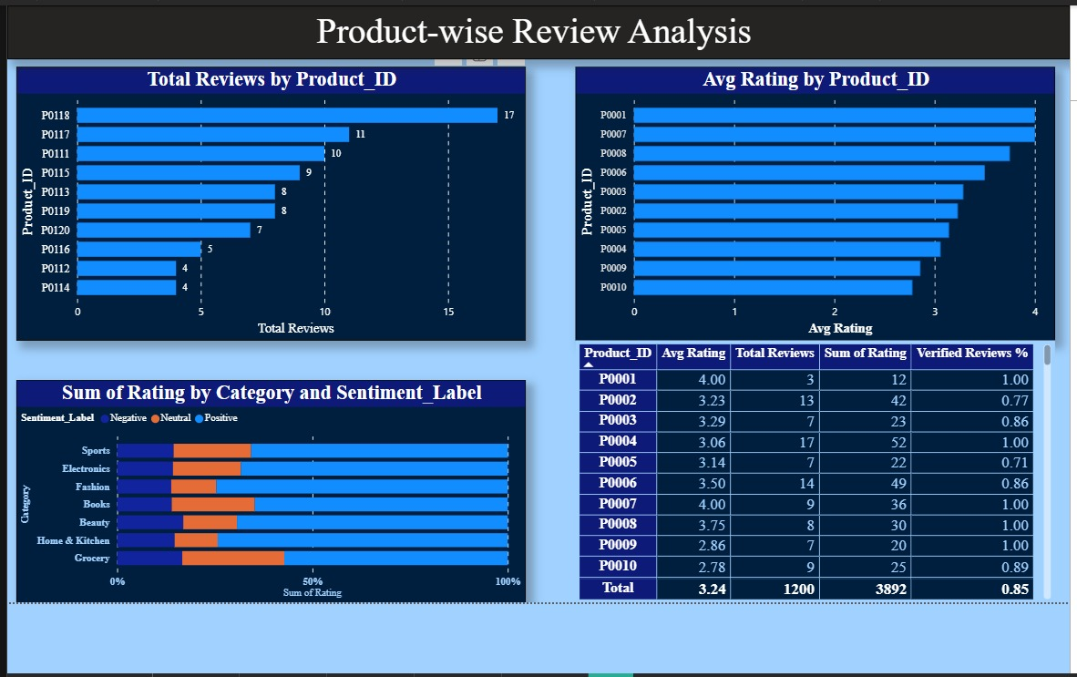

Slide 15
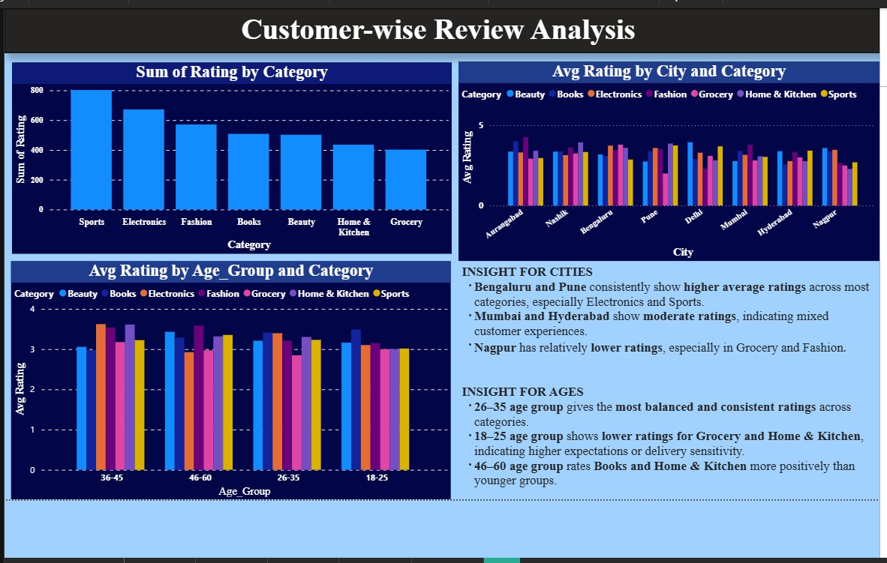

Slide 16
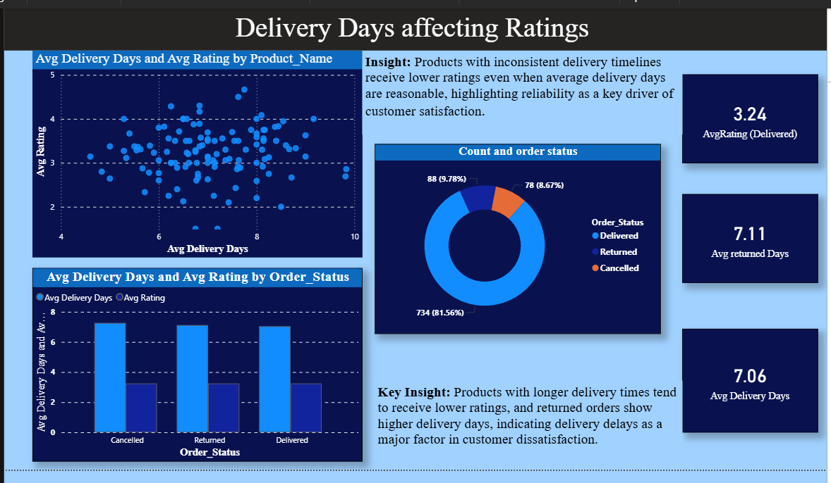
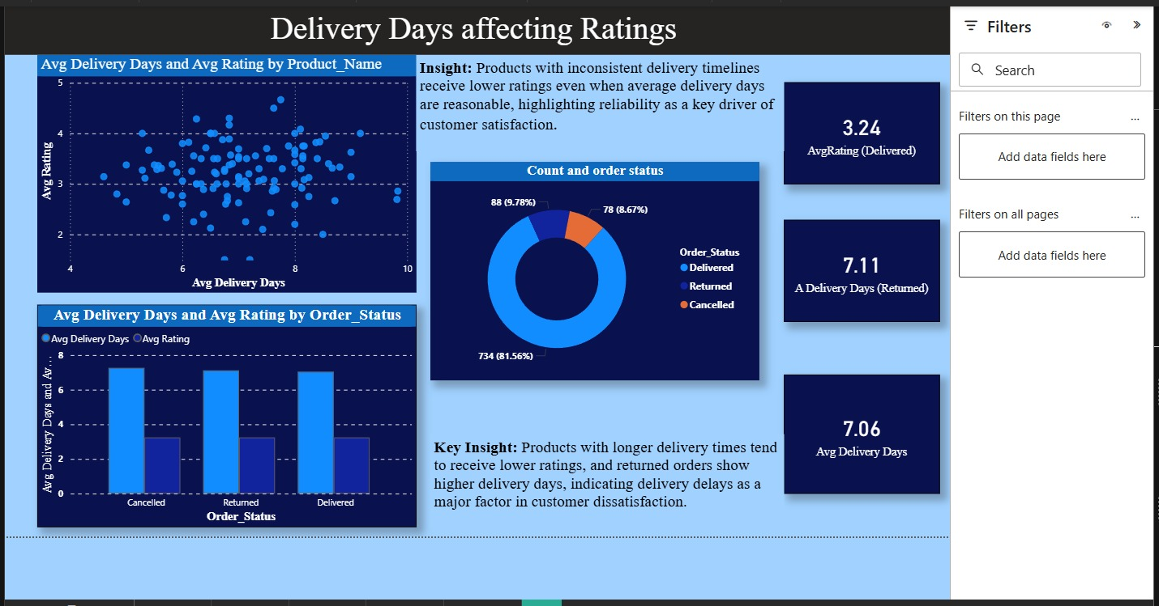

Slide 17
Finding
Online Product Review Analysis Majority of customer reviews are positive, indicating overall customer satisfaction Products with higher ratings generally show positive sentiment in review text Negative reviews mainly highlight issues related to product quality and delivery Sentiment analysis results align closely with customer star ratings The dashboard helps identify key areas for product improvement and customer experience enhancement

Slide 18
INSIGHTS
Majority of customer reviews show positive sentiment, indicating overall customer satisfaction
Products with higher star ratings strongly align with positive review sentiment
Negative reviews mainly highlight issues related to product quality, delivery delays, and packaging
Neutral reviews often suggest scope for feature or service improvement
Sentiment analysis helps identify key customer concerns that are not visible from ratings alone
Products with longer delivery times tend to receive lower ratings, and returned orders show higher delivery days, indicating delivery delays as a major factor in customer dissatisfaction.

Slide 19
References
Kaggle – Online Product Review Datasets Kaggle is an online data science platform that provides free datasets, notebooks, and competitions. It is widely used by students and professionals for data analytics and machine learning projects.
Amazon & Flipkart Customer Review Samples Python Documentation (Pandas, NumPy)
Textblob / NLTK Documentation for Sentiment Analysis Microsoft Power BI Official Documentation

