Slide 1

CCC151
IoT Systems
Product Marketing and Resource Availability

Slide 2


INTRODUCTION
This research aims to delve into designing database architectures that can efficiently store, process, and analyze IoT data, turning it into meaningful insights for businesses and consumers alike. By emphasizing database management, we aim to build a foundation that supports scalable, secure, and efficient IoT integrations.
Abstract
INTRODUCTION
Result
01

Slide 3
SIGNIFICANCE OF THE STUDY
Abstract
Problem
To explore how IoT systems can be integrated into marketing strategies to provide real-time, personalized experiences to consumers, and how these systems can optimize resource availability through efficient database management and back-end implementation. Our interest also stems from the pressing need to bridge the gap between online and offline shopping experiences.
OF THE STUDY
SIGNIFICANCE
Methodology
02

Slide 4


OBJECTIVES
This research aims to develop a website intended for highlighting certain Product Marketing Resource and Availability located in Iligan City, Philippines, which will aim to further promote the best marketing product in the city premises.
OBJECTIVES
03

Slide 5




METHODOLOGY
Market Analysis:
Conduct comprehensive market research to grasp the target audience, competitors, industry trends, and potential opportunities
METHODOLOGY
Resource Distribution Plan:
allocates resources, prioritizing high-impact marketing activities that can be executed efficiently within the available resources, while optimizing effectiveness.
04

Slide 6

METHODOLOGY
Adaptable Execution:
Customer-Centric Engagement:
planning and execution, setting clear goals, and continuously evaluating and adjusting tactics based on performance data and resource availability.
Resource Management Tools:
Implement tools and technologies including project management software, budgeting tools, and analytics platforms for real-time insights into resource utilization and campaign performance.
Encourage proactive engagement with customers to understand their needs and preferences, ensuring personalized interactions that build stronger relationships and enhance customer satisfaction.
05

Slide 7



Continuous Improvement
Purpose and Benefits
Establish processes for monitoring and optimizing resource allocation and marketing performance, regularly tracking key metrics and making data-driven adjustments to maximize ROI.
Clearly define the purpose of the website and articulate the key benefits it offers to users, such as providing valuable information, enhancing engagement, and facilitating easy access to services. Emphasize how the website meets the needs of its target audience and contributes to achieving organizational goals.
Website Convenience
Performance Assessment
Highlight the user-friendly design and intuitive navigation that make the website accessible and convenient for users of all skill levels. Ensure that the website’s layout, features, and functionalities are optimized to enhance the overall user experience..
Establish clear performance metrics and reporting mechanisms to evaluate the effectiveness of marketing initiatives in relation to resource utilization, providing insights for stakeholders and guiding future strategies.
04
05
06

Slide 8
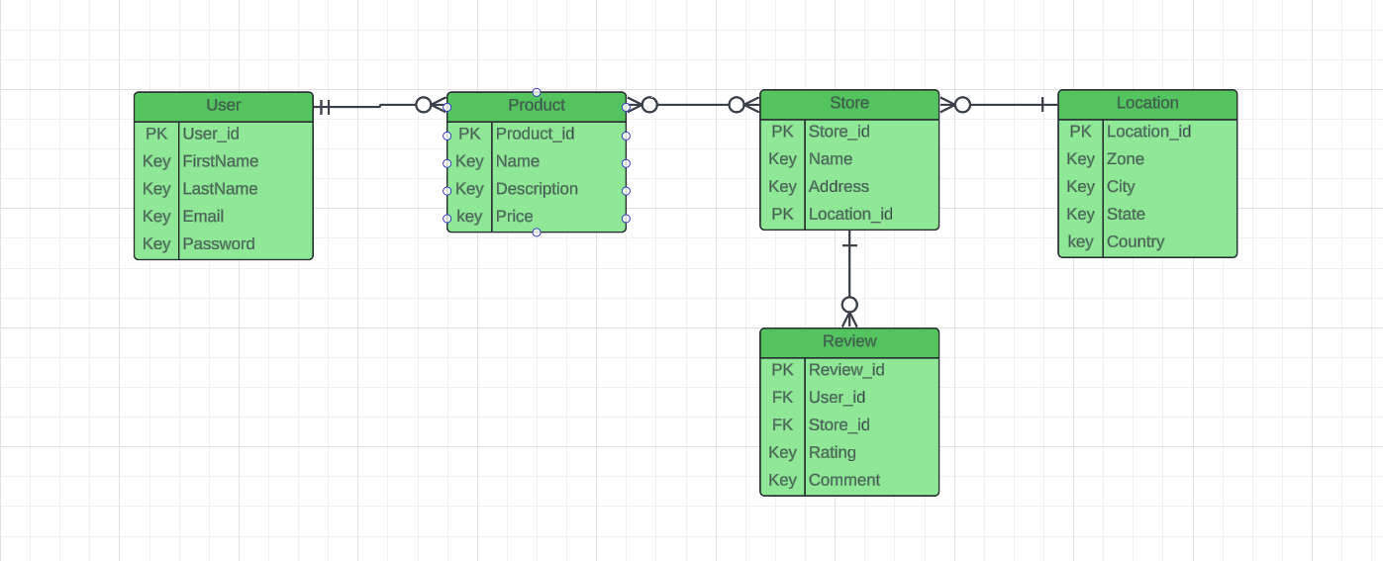
Entity-Relationship diagram

Slide 9

USER BENEFITS
The developers aim to highlight by delivering tangible benefits to users across various segments, the website for Product marketing and Resource Availability in Iligan City can effectively serve as a valuable resource for both consumers and businesses, contributing to the economic growth and developments of the local community.
TARGET AUDIENCE
CONSUMERS
TOURIST AND VISITORS
LOCAL BUSINESS (FROM ILIGAN CITY ITSELF)
07

Slide 10



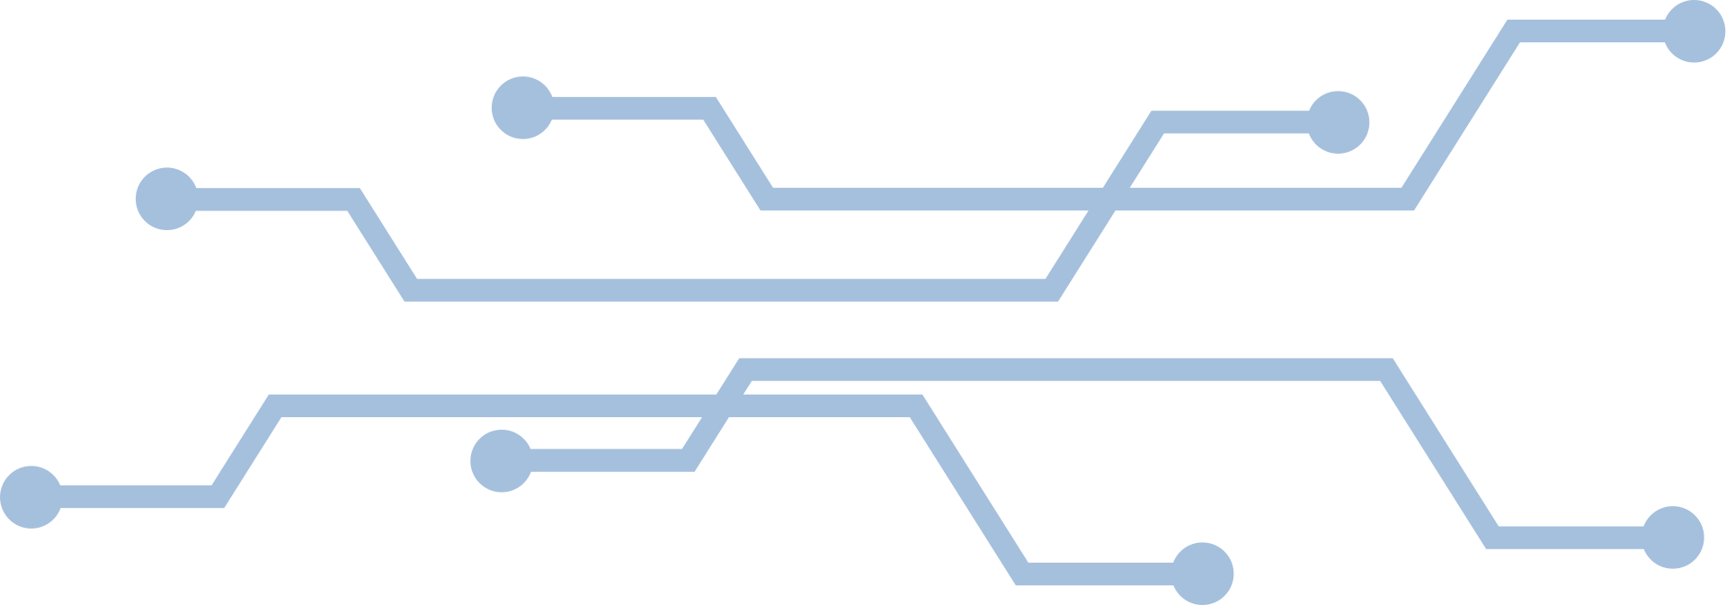
Mindanao State University- Iligan Institute of Technology
The members:
MEMBERS
MEMBERS
MEMBERS
TEAM LEADER
LEE ALFRED S. SIMBAJON

