Slide 1

Basic Details of the Team and Problem Statement
Ministry/Organization Name/Student Innovation:
Ministry of Home Affairs
PS Code:SIH1505
Problem Statement Title:
Device works on fire detection and extinguisher at aerial location of hazardous atmosphere in industries(ALOHA)
Team Name: TEAM SAHA
Team Leader Name:Vineetha
Institute Code (AISHE):
Institute Name:Gayatri Vidya Parishad College Of Engineering For Women
Theme Name: Aurah

Slide 2
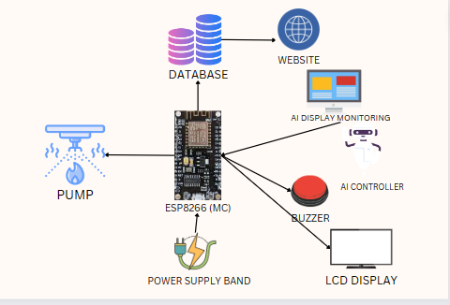
Idea/Approach Details
Process flow chart:
IDEA/SOLUTION:
Implementation of AURAH system specialized for early detection and automatic extinguisher of ALOHA
Advanced detection, image processing, identifies the presence of fire and its location.
Triggers an automatic extinguisher mechanism to suppress the fire effectively.
Capability to work at any temperature, automated extinguisher
precise localization, buzzer indicator, LCD indicator.
Describe your Technology stack here:
AI CONTROLLER-
feature extraction algorithm
AI DISPLAY MONITORING-
tracking algorithm
ESP8266(MC)
Product status:
60% product build completed and further build is on process. Testing and validation process are next to be undergone.

Slide 3
Idea/Approach Details
Describe your Use Cases here
Describe your Dependencies / Show stopper here
Industrial Facilities: AURAH is intentionally created for industrial security, it can reduses the industrial disaster.
Residential Buildings:AURAH provides protection during sleep, it can be life-saving especially for children.
Hospital Facilities: AURAH in hospitals is to protect the lives it is vulnerable to the patients and minimizing property damage
Reduced false alarms: AURAH can differentiate between actual fires and false alarm, it won’t consider activities like cooking or any other disruption.
Coverage of large areas: This system can monitor expansive areas, making them suitable for environments like industrial facilities, warehouses.
Reduce response time: Image processing can rapidly alert emergency services, leading to faster response time.
CHANNELS: Govt, Industries

Slide 4
Team Member Details
Team Leader Name: Vineetha D
Branch : Btech Stream :CSE Year :III
Team Member 1 Name: Kavya A
Branch : Btech Stream :CSE Year :III
Team Member 2 Name: Harini K
Branch : Btech Stream :CSE Year :III
Team Member 3 Name: Akshaya K
Branch :Btech Stream :CSE Year :III
Team Member 4 Name: Komali V
Branch :Btech Stream :CSE Year :III
Team Member 5 Name: Parvathi v
Branch :Btech Stream :CSE Year :III
Team Mentor 1 Name: Mr.S.Sumhasa
Category :Academic Expertise : AI Domain Experience (in years): 14

