Slide 1

examples
.NET

Slide 2
R1 | R2 | Diff
300 | 3 | 297
209 | 29 | 180
30 | 3 | 27

Slide 3

















Slide 4












































Slide 5















User Interface
Business Layer
Models Library
Customer
Product
Store
Viewmodel(a special model used for users viewing)
Repository Layer
MapperClass
ADO.NET
Q
R
Azure Db

Slide 6
Select * from Stores
Left join inventory on stores.storeId = inventory.storeId
Left join products on inventory.productid = Products.productid
EX……
select * from _Members
Left join _Families on Family = FamilyId
Left join _Origins on Origin = OriginId
where FamilyId = 13;

Slide 7

















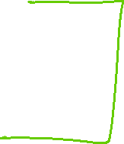







Slide 8
Checkin Model-Driven App
Manager Table
Approves the Checkin
Employee (CSR) Table
Creates a Checkin
1-N relationship
1-N relationship
1-N relationship
Checkin Table

Slide 9
Security in Dynamics365 make yellow and blue screens to overlay to create the green
You can create custom security Roles
Customer Service Rep II Role
Can edit customer info.
Customer Service Rep I Role
Can view customer form but can’t edit
User 1
You can create forms and assign security Roles to them.
You can create security Roles and assign them to individual fields.

Slide 10




Access Levels explanation
Organization
Business Unit
User (Self)

Slide 11
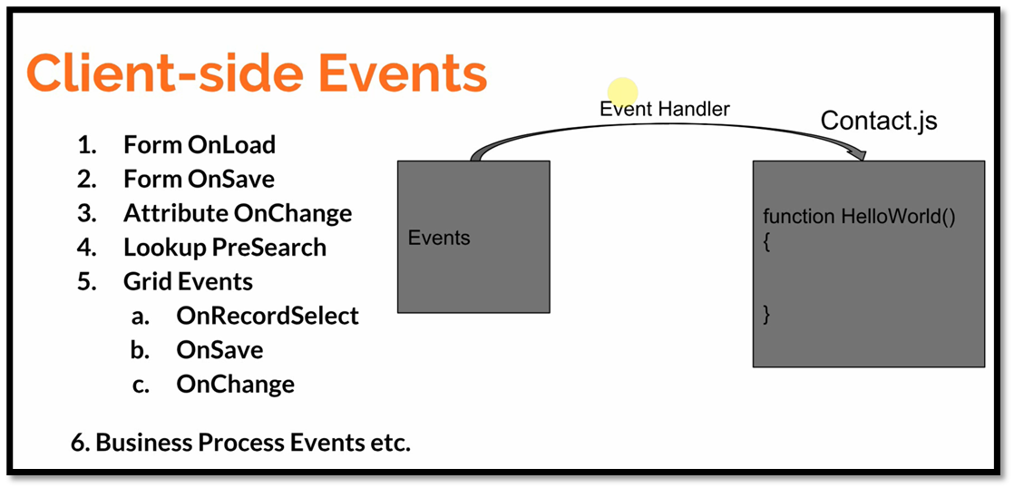

Slide 12
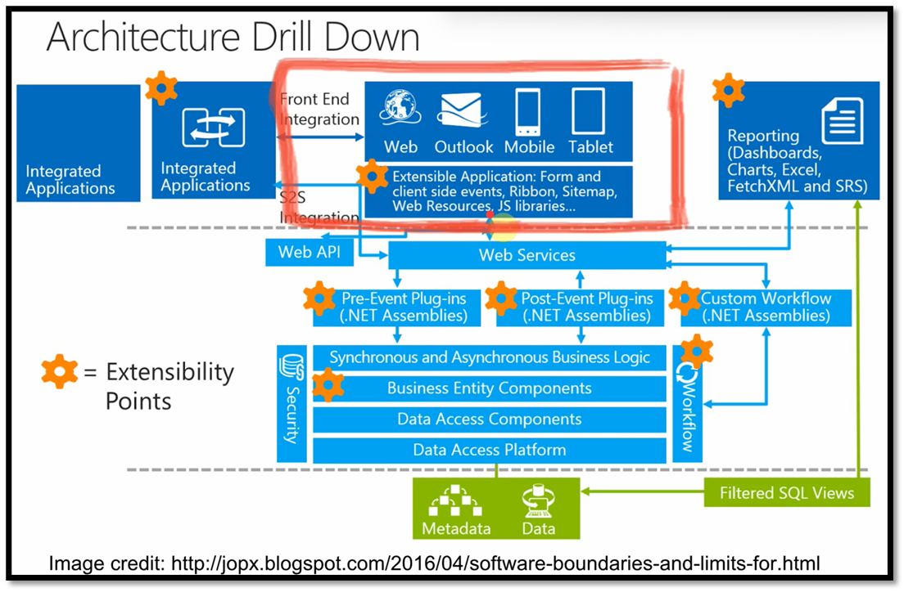
Plugins ->

Slide 13
